Slide 1
Crawler4j Introduction
Version: 3.5
Reporter: John
Date:

Slide 2
Crawler4j 3.5
Crawler4j is an open source Java crawler which provides a simple interface for crawling the Web. You can setup a multi-threaded web crawler in 5 minutes!
Original Source code can be retrieved via Git: git clone https://code.google.com/p/crawler4j/
I have enhanced part of it and upload to Github: https://github.com/johnklee/sd2014.git
Support <script src=‘…’></script> tag.
Read “tld-names.txt” outside the jar space.

Slide 3
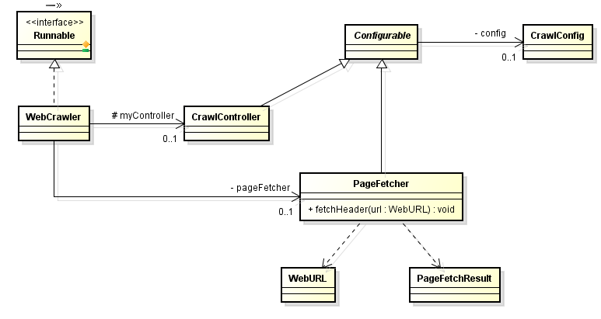
Hello Word’s Sample Usage
This class hold crawling configuration:
setCrawlStorageFolder(String): Crawling Storage Folder.
setPolitenessDelay(int): Make sure that we don't send more than 1 request per setting
setMaxPagesToFetch(int): Set the maximum number of pages to crawl.
setMaxDepthOfCrawling(int): Maximum depth of crawling
More
In the beginning, let’s check the class diagram of what we will use later:
User provide crawling URLs here via API:addSeed()
User can decide how many working threads while start crawling via API: start() or API: startNonBlocking()
More
This class use Apache HttpClient library to crawl pages; use Apache Tika library to parse HTML page for outgoing link.
The crawling result will be stored in PageFetchResult class .
The max size of page to download is 1M bytes and it can be configured via attribute maxDownloadSize of CrawlConfig.
More
java.lang.Runnable
This class is used to store crawling.
When storing URL in this class, it will parsed the URL:
domain
subDomain
Path
Anchor text
The crawling depth can be known here.
More
User can define crawling behavior via overwriting below two APIs:
shouldVisit(WebURL url): Crawling or not.
visit(Page page): The Crawling result is stored in page object.
CrawlController will be responsible in initializing this class and run it as thread. The thread number can be configured.
The crawling behavior is dedicated to class PageFetcher.

Slide 4
Hello Word’s Sample Usage
Now is time to know how to use crawler4j. Actually, it is quite simple. Just only 4 steps is needed:
Define your own Crawler: Extends the WebCrawler and overwrite below two API:
shouldVisit(WebURL url): You can decide whether to crawler the given url or just abandon it by return false. One example is you can define regular expression to filter the file extension such as .js, .css or .mp3 etc.
visit(Page page): When this callback is called, the crawling result is stored in page variable. You can use API:getParseData() to known the page is HTML file (HtmlParseData), text file (TextParseData) or a binary file (BinaryParseData).
Initialize CrawlController:
Initialize CrawlConfig: Decide your crawling behavior
Initialize RobotstxtConfig/RobotstxtServer: It will read robots.txt to be a polite crawler.
Initialize PageFetcher: Delegate the crawling work to it.
Put URLs into controller via API:addSeed(…)
Start the controller via API:start(…)
Decide how many threads to open as working threads
Decide your own Crawler implementation.

Slide 5
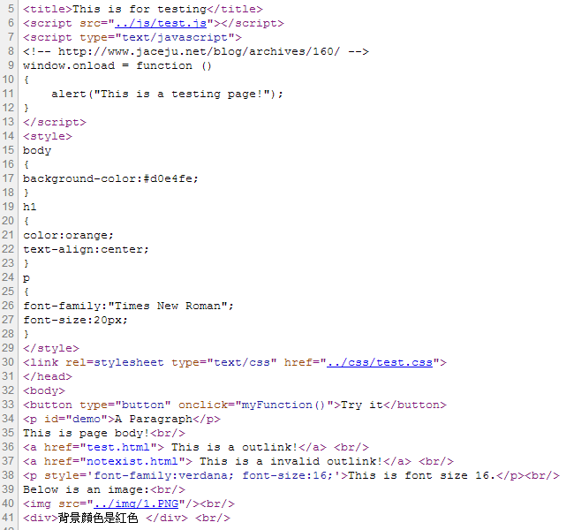
Hello Word’s Sample Usage
javascript
We need a testing page for sample code: (http://localhost/FF/crawlme/index.html)
css
HTML page elements
Valid/Invalid outlink
image file

Slide 6
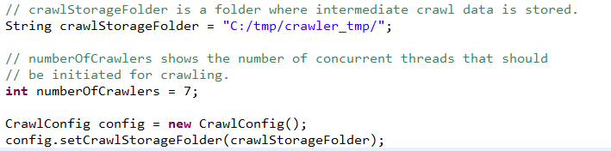
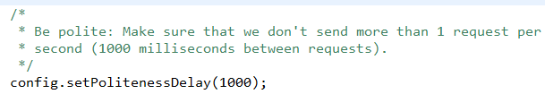
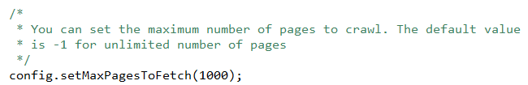
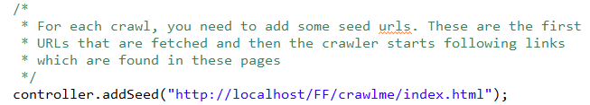
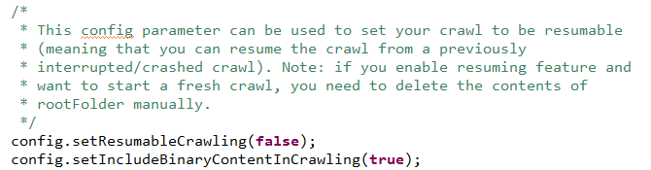
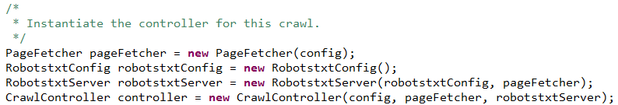

Hello Word’s Sample Usage
Below is the sample code:
Step1. MyCrawler.java (Only display crawling information)
Step2. Initialize CrawlController
Step3. Give your crawling URL(s)
Step4. Start crawling:

Slide 7
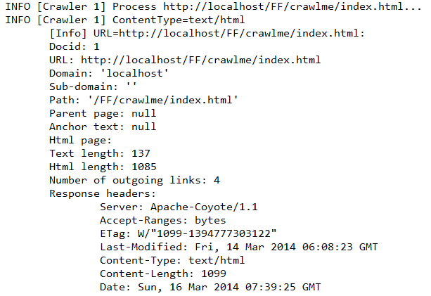
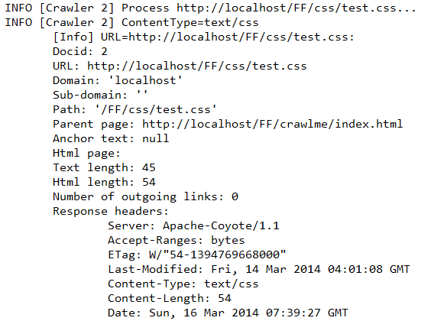
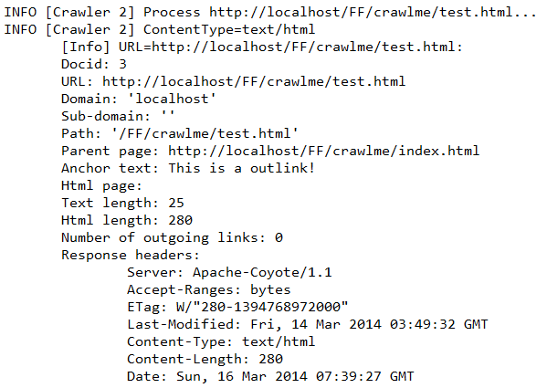
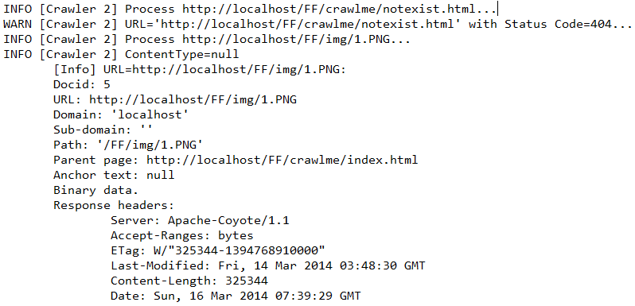
Hello Word’s Sample Usage
Below is the console output

Slide 8
Next Week To Do
Add JUnit Test Cases to make sure the enhancement/original functionalities work.
Buildup a PoC UI to visualize the crawling result.
Add more cases for downloading different file type/mime type.

