Slide 1
Crawler4j Introduction
Version: 3.5
Reporter: John
Date:

Slide 2
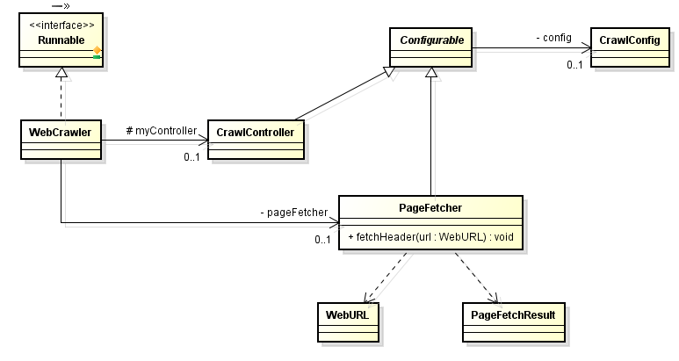
Hello Word’s Sample Usage
In the beginning, let’s check class diagram of what we will use later:
java.lang.Runnable
This class hold crawling configuration:
setCrawlStorageFolder(String): Crawling Storage Folder.
setPolitenessDelay(int): Make sure that we don't send more than 1 request per setting
setMaxPagesToFetch(int): Set the maximum number of pages to crawl.
setMaxDepthOfCrawling(int): Maximum depth of crawling
More
User can define crawling behavior via overwriting below two APIs:
shouldVisit(WebURL url): Crawling or not.
visit(Page page): The Crawling result is stored in page object.
CrawlController will be responsible in initializing this class and run it as thread. The thread number can be configured.
The crawling behavior is dedicated to class PageFetcher.

