Slide 1

Crawling Module (SiTree Design)
SiTree requirement & design
示範 SiTree 類別的使用
Unit Test
Known Issues & Enhancement plan

Slide 2
SiTree Requirement
Functional Requirement:
CrawlController can start to crawl pages. User can decide how many threads used in the crawling process and CrawlController has default setting for it.
Application can use SiTree to retrieve crawling pages from CrawlController and traverse the result in tree structure via DFS/BFS algorithms.
CrawlController notifies SiTree on each crawling result and SiTree can know the crawling result is success or fail.
CrawlController will update SiTree with Tuple information in real time. The SiTree can use first element of this Tuple to know whether the crawling of specific URL is success or not; second element of Tuple as crawling result.
More than one observers can be registered in CrawlController by user and removed as required.
Non Functional Requirement:
CrawlController can crawl pages unsynchronized.
CrawlController can decide to drop specific file type during crawling.
SiTree can output crawling result into file system.

Slide 3
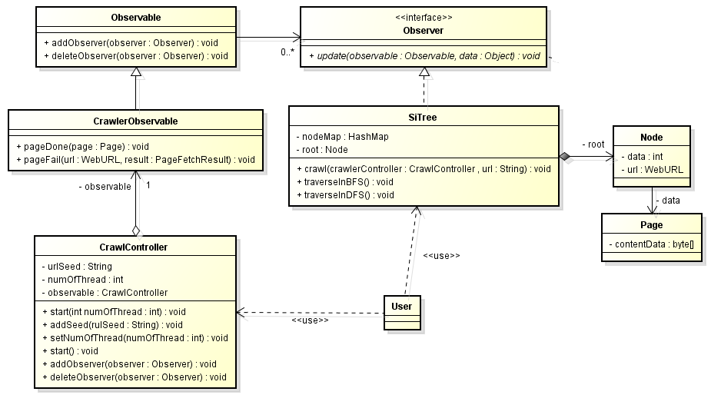
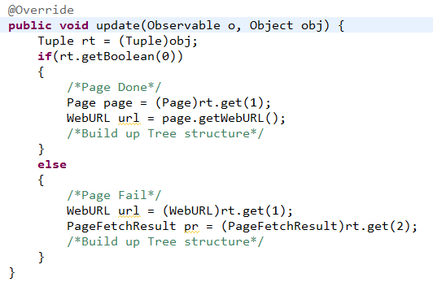
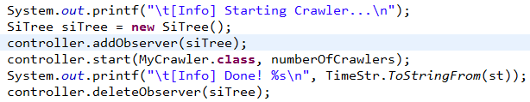
SiTree Initial Design

Slide 4
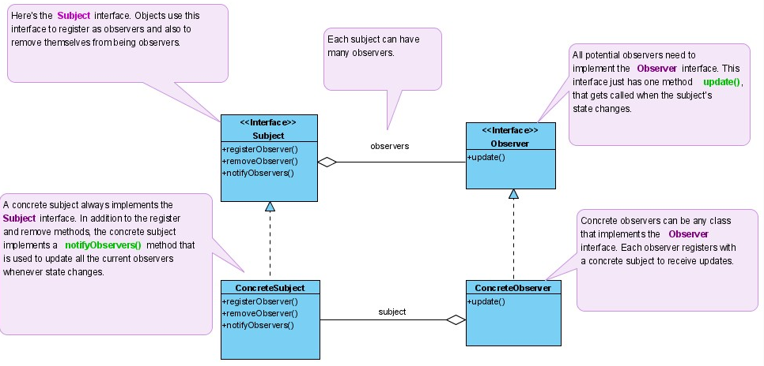
SiTree Usage (1)
According to TDD, test cases are user cases equally. We will follow unit test case to understand the design and usage of SiTree.
So far, we have only one test case for SiTree which test the basic API designs. The requirement of SiTree requires Crawler4j to crawling the page and stored them into tree structure.
For flexibility concern, I adopt Observer pattern for customized purpose.
CrawlController
SiTree

Slide 5

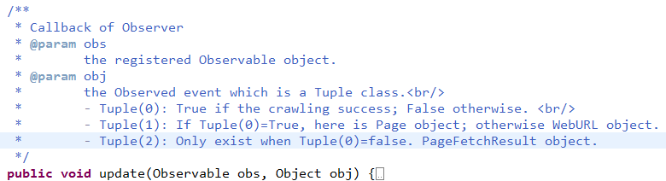
SiTree Usage (2)
The CrawlController is treated as an subject (Observable) and you can implement your own Observer and register in CrawlController to receive notification.
SiTree is an concrete class of Observer. So you can register in CrawlController object as controller. For example:
If you want to stop listening to , you can use API:deleteObserver():
If you want to implement your own Observer, you have to override:

Slide 6
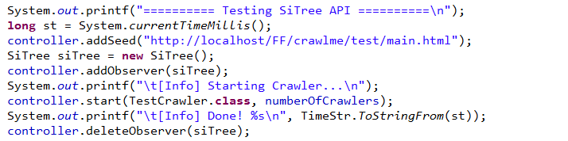
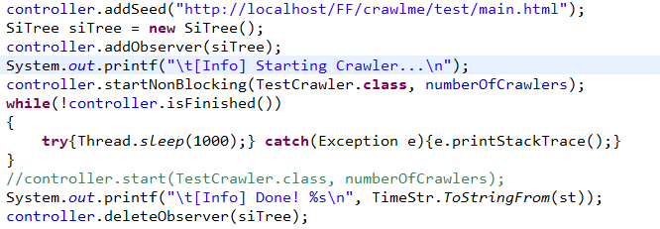
SiTree Usage (3)
So let’s see our first UnitTest class unitest.FAST :
Block mode from case testSiTree01():
Non-Block mode from case testSiTree02():

Slide 7
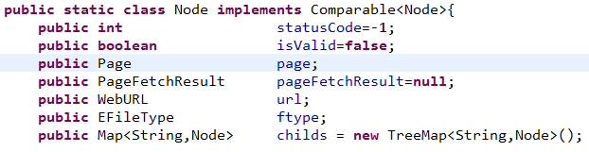
SiTree Usage (4)
So all the crawling result is stored in SiTree. Then how to retrieve out the crawling result? The intuitional way is via attribute root of SiTree object. root is instance of class Node with below attributes:
root is a tree structure which keeps the relationship of crawling path. Current design, it is one way from parent to child.
Another way to retrieve crawling result is from attribute nodeMap of SiTree object. The key of it is URL string; value of it is corresponding Node object.
The SiTree also support DFS/BFS algorithm to traverse root tree structure.
If you want to free memory resource in SiTree object, call close().
Finally, if you want to dump memory into file-system, call outputTo(File dir). The parameter dir is the output folder.

Slide 8
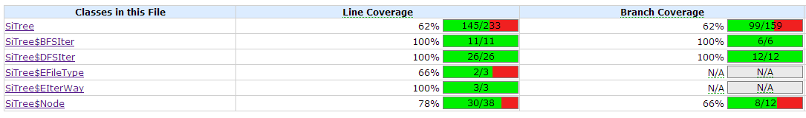
SiTree UnitTest
I use JUnit 4.8 Eclipse plugin to do unit testing. For installation and evaluation, can refer to this “JUnit - Plug with Eclipse”.
In order to generate testing report, I install another Eclipse plugin “eCobertura” which can help me to calculate the coverage of lines/branches.
So far, I open two kinds of testing cases:
FAST - Functional Acceptance Simple Test (7)
FET – Force Error Test (1)
The testing report:
The part outside of coverage could be:
Except catch: Such as network interruption/Open file fail.
Error handling: Dead code maybe – Unreachable error handling.

Slide 9
Known Issue & Enhancement plan
The Crawler4j doesn’t support <object data…"> tag
The Crawler4j doesn’t handle redirection perfectly.
The performance of Crawler4j isn’t good and can be enhanced.
More test cases can be added to ensure quality. (Ex. Volume Test/Stress Test)
Well documentation. (Ex. FAQ, Readme)

