Slide 1
Smart Pebble
By Thomas Li and John Koh

Slide 2
Context and Background
We want to find a smart and efficient way to monitor soil conditions
Including temperature, humidity, soil acidity and nitrate content
The ideal device should be small in size and easy to maintain
Wirelessly transmit data to the cloud
We are going to build a smart pebble

Slide 3
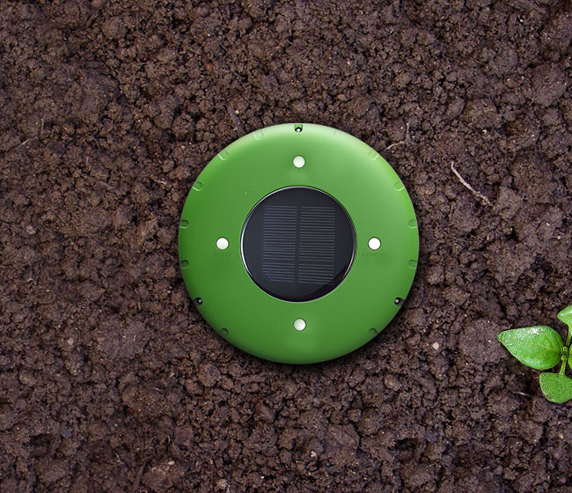
Product Features
Solar panels
Waterproof
ABS plastic
pH/moisture/
element sensors

Slide 4
IoT Tech Stack
Security
Connected via WLAN with WPA2 security
Generates an internal OTP to connect to central server
Product Cloud
App platform that supports iOS, Android.
Pebble gets localized weather info via the server.
Connectivity
REST API’s with a client-server configuration keeps the Pebble modular and disposable
Users retrieve processed data from the server
Product
Array of sensors capture the environment around it
Onboard embedded software written in easily maintainable Python
Analytics
Crowdsourced anonymous data allow servers to tweak their algorithms autonomously.

Slide 5
Key Enabler:
Current soil monitoring products on market are bulky and not accurate
Reinforcement learning system augments the sensor values to reduce errors
Solar panels remove the need to recharge unlike competitors

Slide 6
Key Barrier:
Frequently dead batteries will be troublesome for this product
Solar panels might underperform in shaded areas
Components must be power-saver

Slide 7
Summary of Benefits
Small in size, easy to deploy
Multiple environmental settings, e.g. gardens, botanic zoos, etc
More accurate data
Real-time monitor

