Slide 1
Smart Pebble
By Thomas Li and John Koh

Slide 2
Context and Background
The agriculture industry needs a smart and efficient way to identify soil conditions, in order to facilitate production or make modification
Temperature, humidity, soil acidity, and nitrate content to be monitored
The ideal device should be small in size and easy to maintain
Wirelessly transmit data to the cloud
Data analysis leading to solutions
We are going to build the SmartPebble
Notes:
Thomas

Slide 3
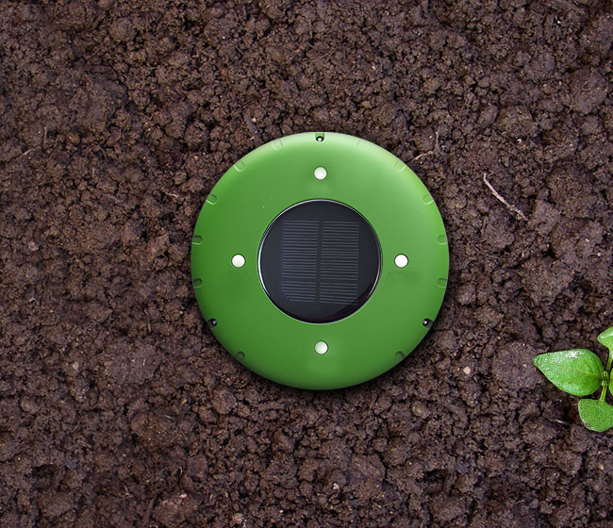
Product Features
Waterproof
ABS plastic
Solar panels
pH/moisture/
element sensors
Notes:
john

Slide 4
IoT Tech Stack
Security
Connected via WLAN with WPA2 security
Product Cloud
App platform that supports iOS, Android.
Pebble gets localized weather info via the server.
Connectivity
REST API’s with a client-server configuration keeps the Pebble modular and disposable
Users retrieve processed data from the server
Product
Array of sensors capture the environment around it
Onboard embedded software written in easily maintainable Python
Analytics
Crowdsourced anonymous data allow servers to tweak their algorithms autonomously.
Generates an internal OTP to connect to central server
Notes:
john

Slide 5
Key Enabler
Current soil monitoring products on market are large in size and complicated
Maintenance is thus hard
SmartPebble is simple and easy to install
Solar panels and power supply design dismiss the need for battery recharge
Reinforcement learning system augments the sensor values to reduce errors
Notes:
john

Slide 6
Key Barrier
Frequently dead batteries will be troublesome for this product
Solar panels might underperform in shaded areas
Components must be power-saving
Notes:
thomas

Slide 7
Summary of Benefits
Small in size, easy to deploy
Various environmental settings, e.g. gardens, botanic zoos, etc
Higher data accuracy
Real-time monitor
Notes:
john

