Slide 1
Smart Pebble
By Thomas Li and John Koh

Slide 2
Context and Background
We want to find a smart and efficient way to monitor soil conditions
Including temperature, humidity, soil acidity and nitrate content
The ideal device should be small in size and easy to maintain
Wireless transmit data to the cloud
We are going to build a smart pebble

Slide 3
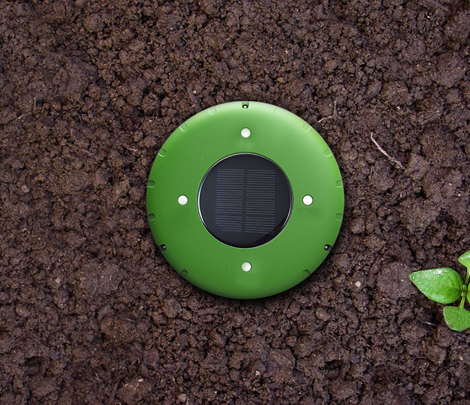
Product Features
Solar panels
Waterproof
ABS plastic
pH/moisture/
element sensors

Slide 4
IoT Tech Stack
Security
Connected via LE Bluetooth with security
Generates OTP to connect to central server
Product Cloud
App platform that supports iOS, Android.

Slide 5
Key Enabler:

Slide 6
Key Barrier:
Frequently dead batteries will be troublesome for this product
Solar panels might underperform in shaded areas
Components must be power-saver

Slide 7
Summary of Benefits
Small in size, easy to deploy
Multiple environmental settings, e.g. gardens, botanic zoos, etc
More accurate data
Real-time monitor

