Slide 1
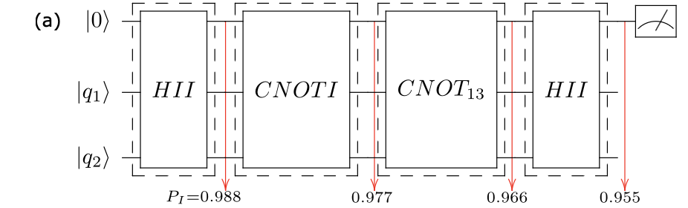
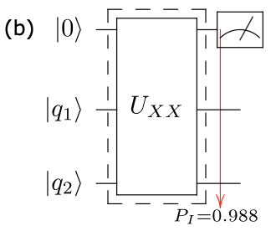
U_XX gate synthesis using qutip_qoc GOAT analytical pulse optimisation

Slide 2
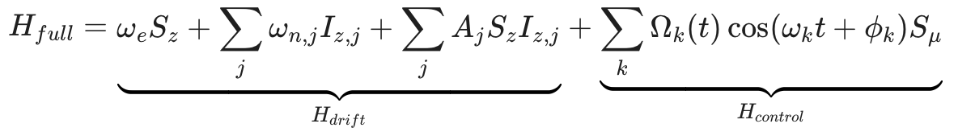
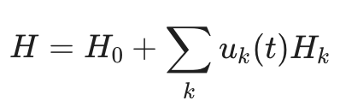
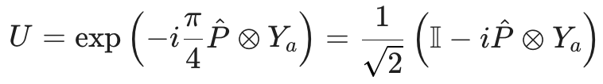
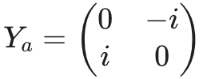
Target U_XX & Hamiltonian
Full physical Hamiltonian:
Ising-like/effective Hamiltonian:
Target Unitary:

Slide 3
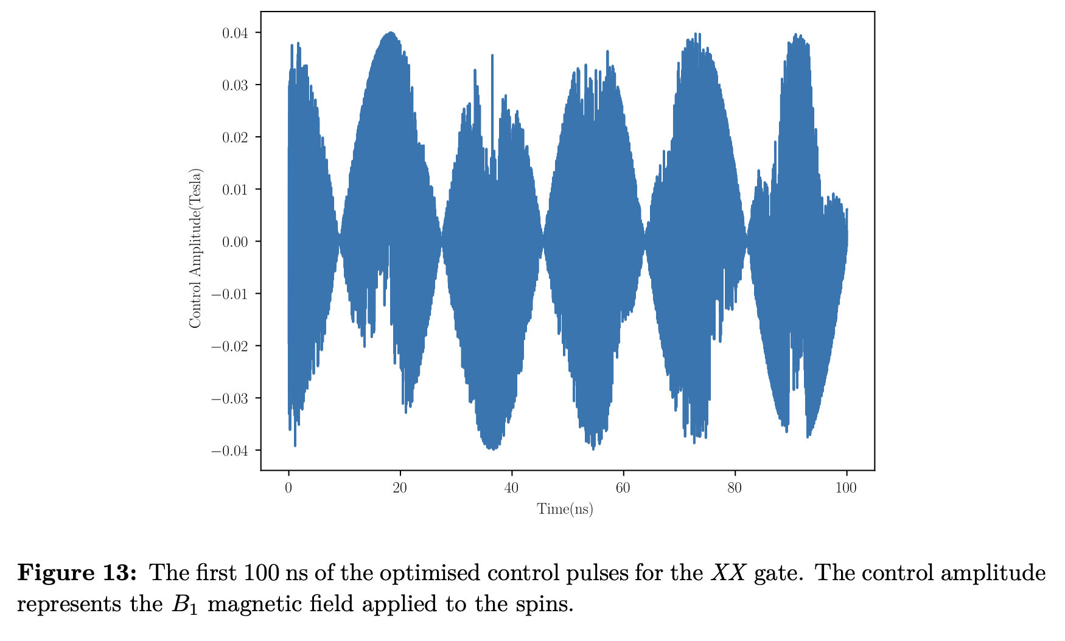
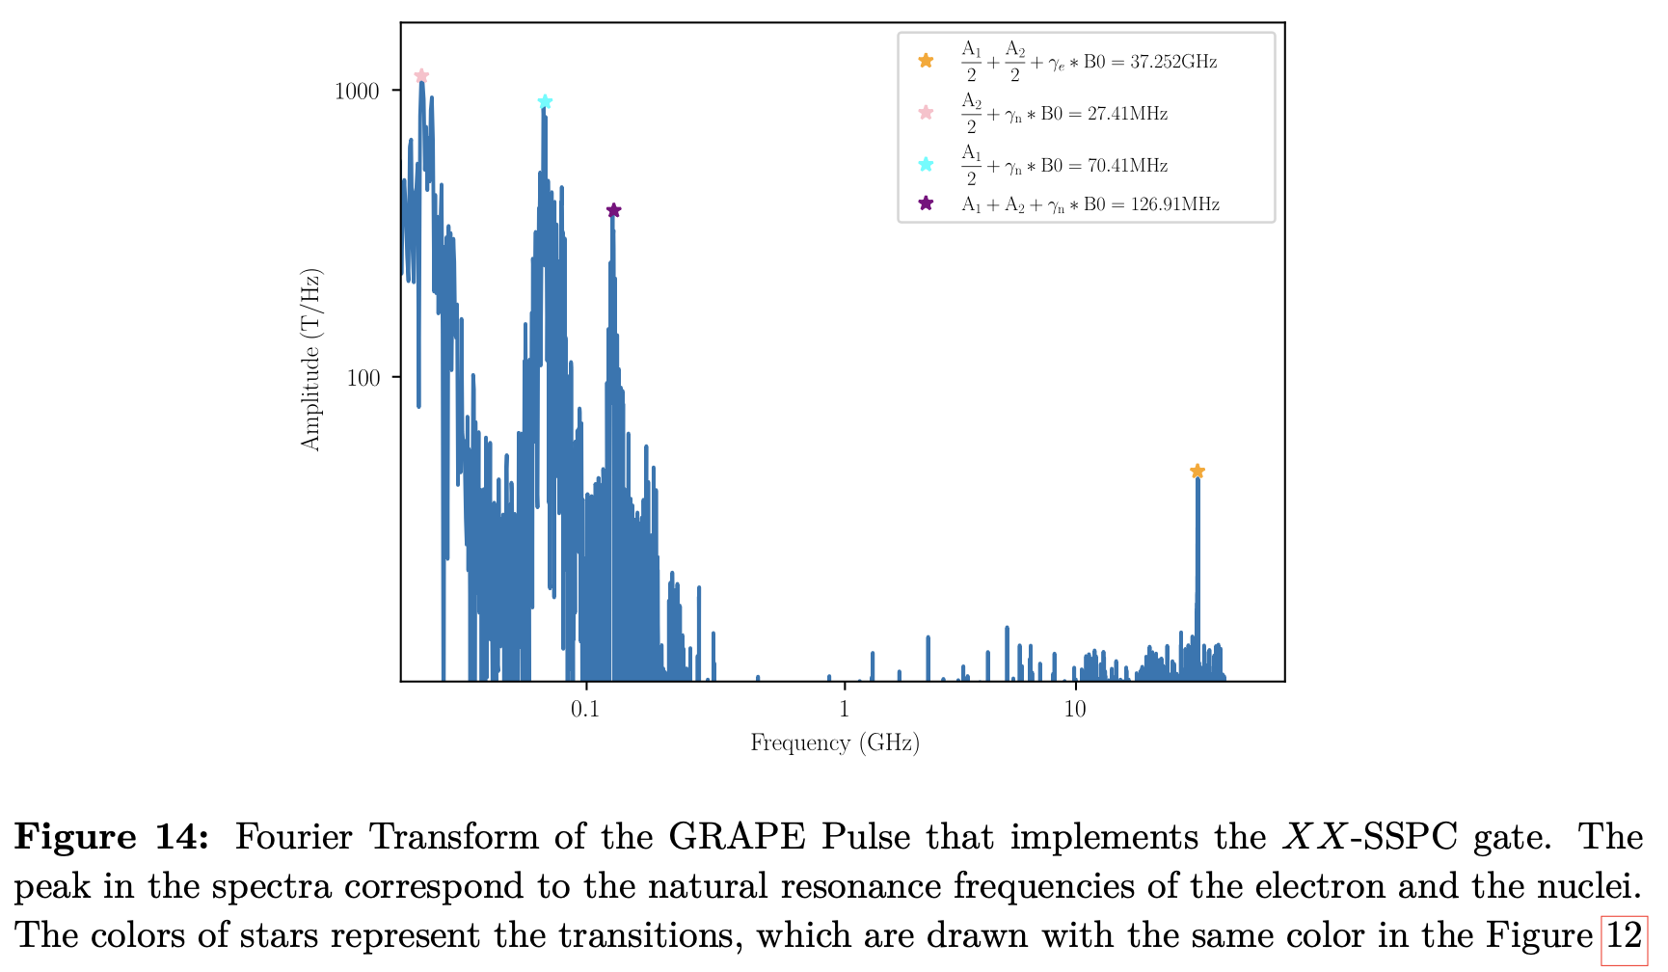
Paper: GRAPE state-to-state-transfer
GRAPE parameterizes control as many piecewise constant time slots
=> enough flexibility to fit complex signal
Paper used 400k timeslices with 10 ps resolution
- frequency spectrum up to ~50 GHz
- peaks at electron and nucleus resonance frequencies
to drive transitions (e.g., Lamor frequency at ~27 GHz)

Slide 4
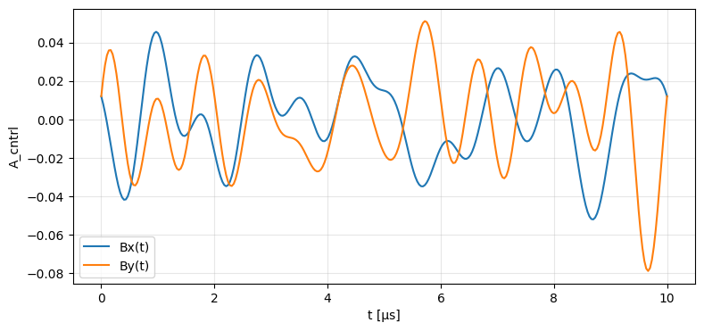
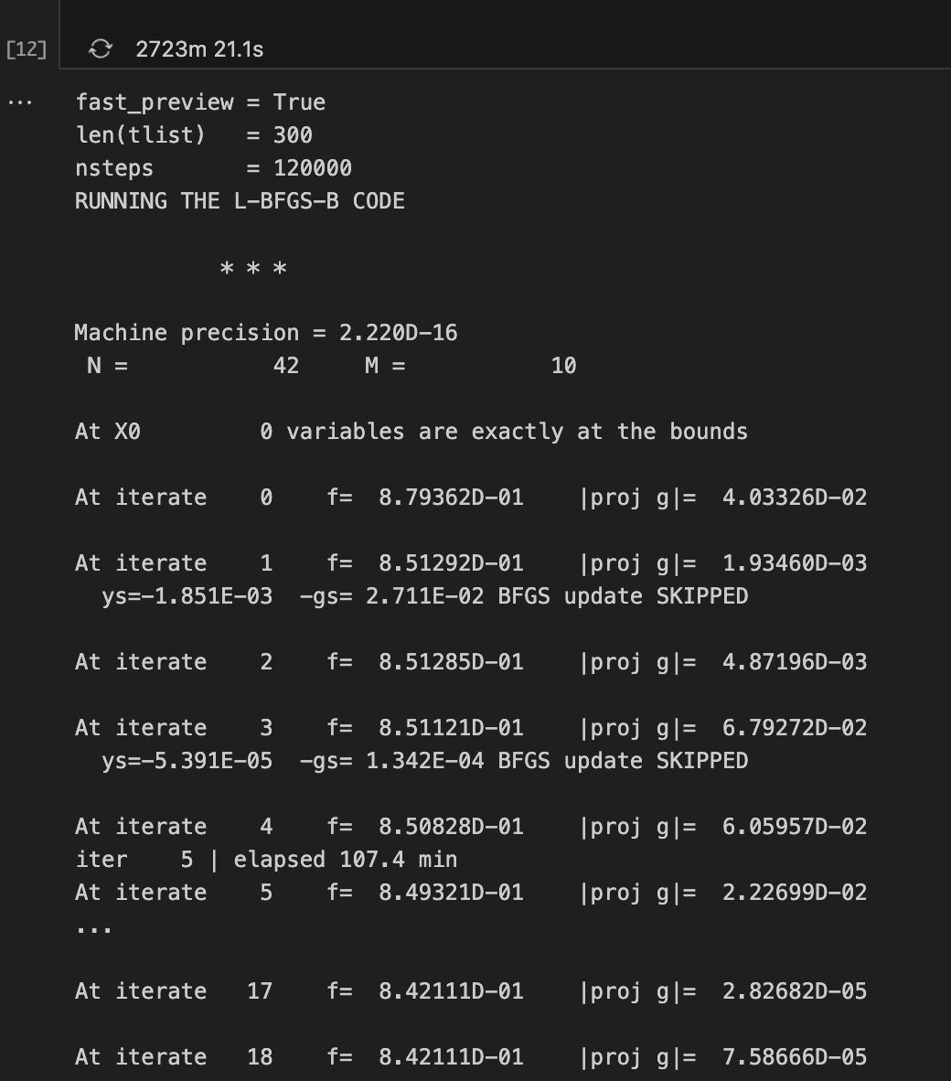

(non-feasible) GOAT Runs
SMALLER PARAMETER RUN:
Nsteps=20k, T=4µs, K=384, n_ts=1600, Amax=40
=> infidelity of ~0.5
=> takes envelope shape
TO MATCH PAPER RESOLUTION:
10ps resolution would correspond to K ~ 10^5
=> model too large, runtime / memory error:
(MemoryError: Unable to allocate 931. TiB for an array with shape
(8000009, 8000009) and data type complex128)
=> carrier-informed GOAT

Slide 5
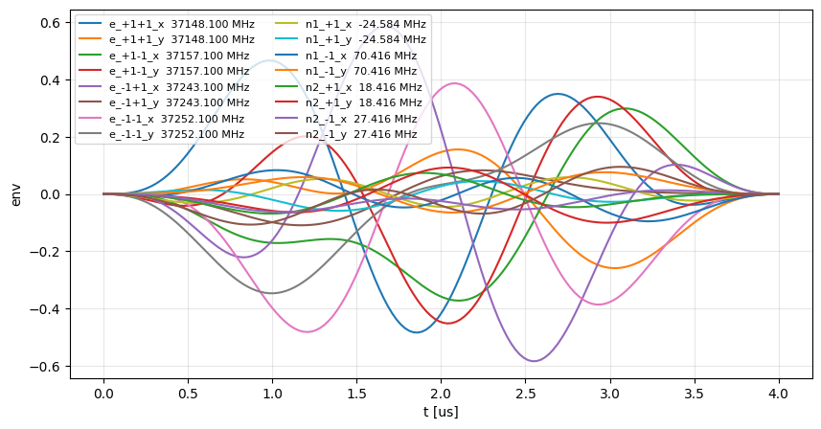
Carrier-informed GOAT runs
Carrier informed model ran for ~40h
No fidelity increase (~0.5)

Slide 6



Rotating frame ising Hamiltonian + 2 independent controls per particle
Hamiltonian:
Controls: σ_x, σ_y per particle

Slide 7
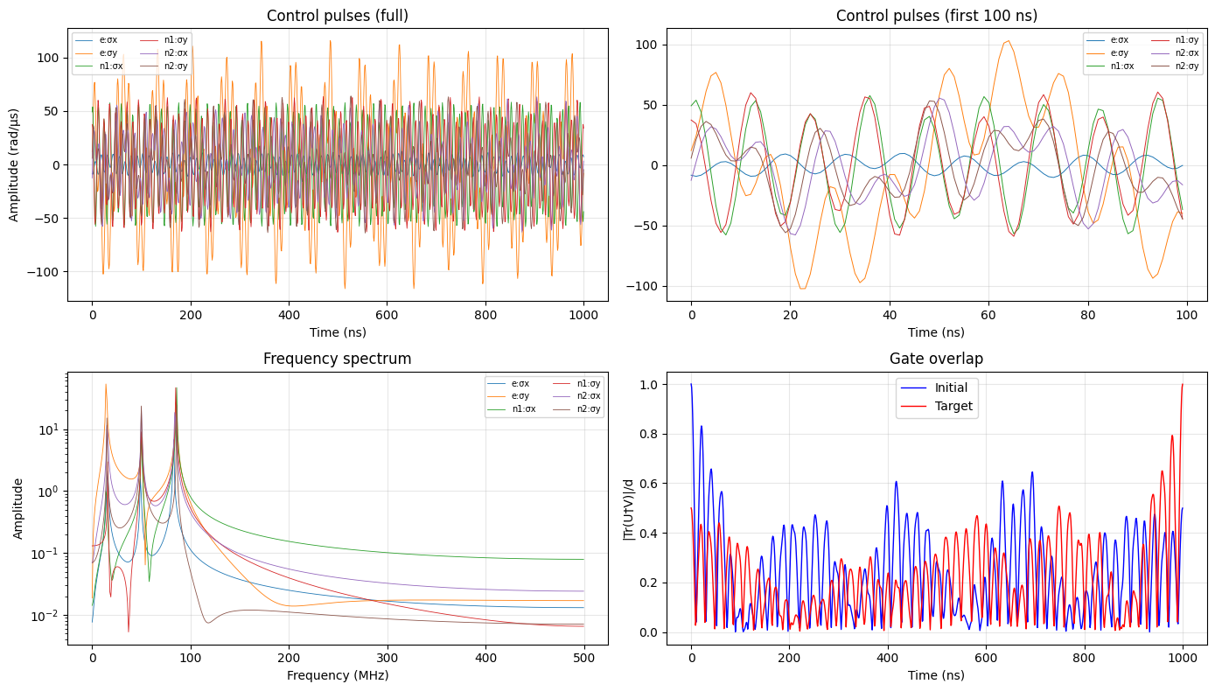
U_ZZ
Fidelity:
0.999107
Time:
42 min
# params:
54

Slide 8
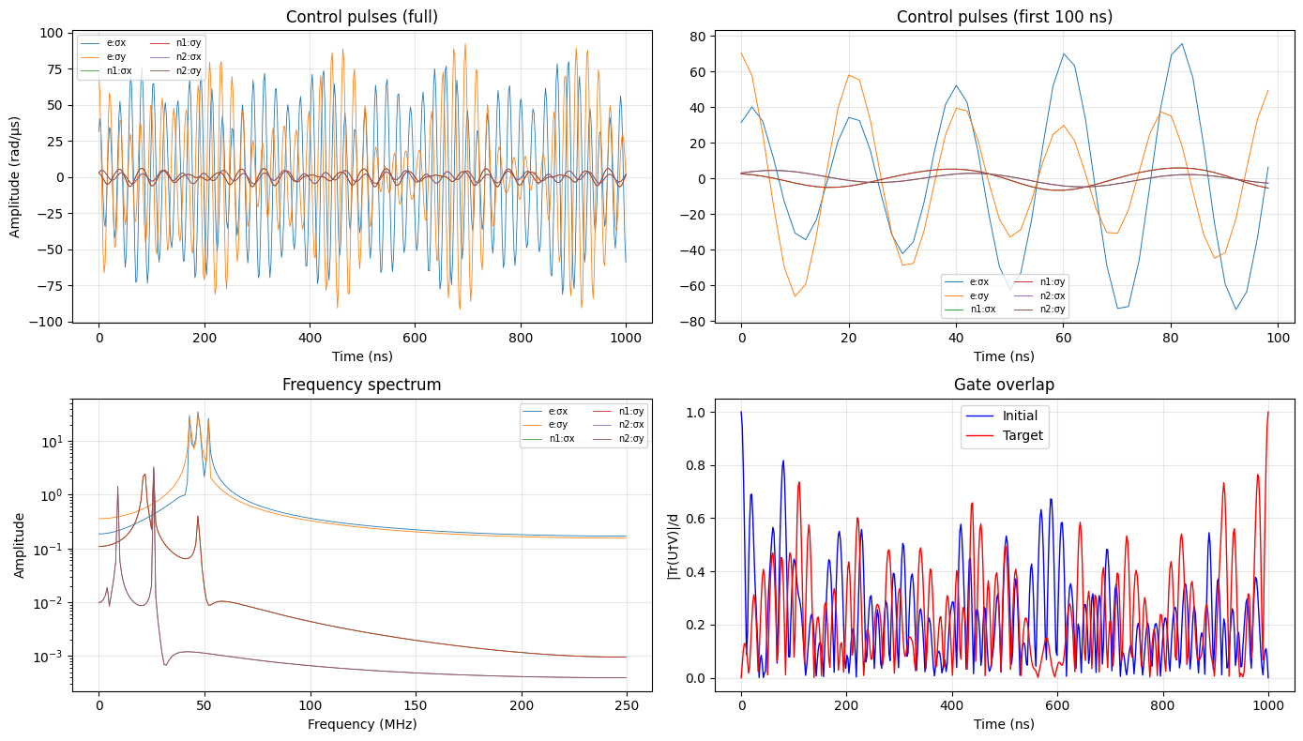
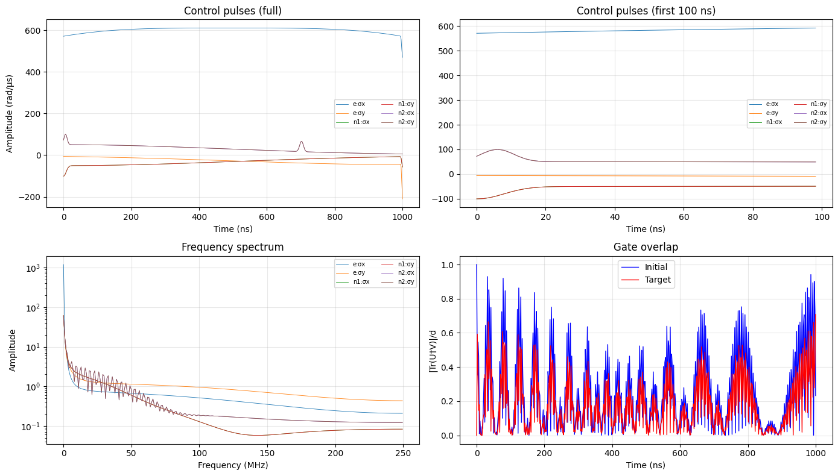
Hadamard (electron)
Fidelity:
0.7141/0.9991
Time:
11/14 min
# params: 54

Slide 9
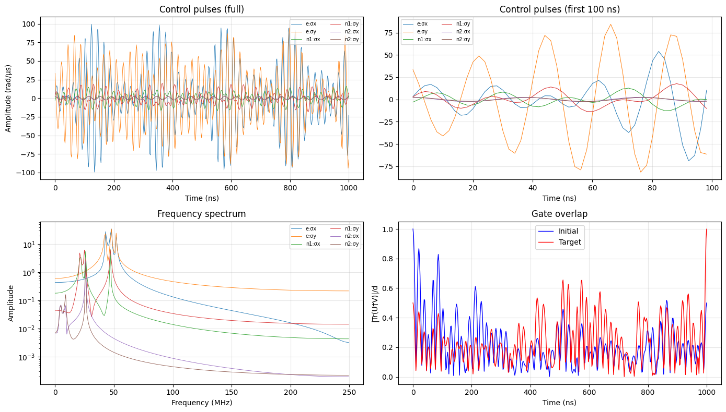
CNOT(1=>2) x I
Fidelity:
0.99894
Time:
78 min
# params:
54

Slide 10
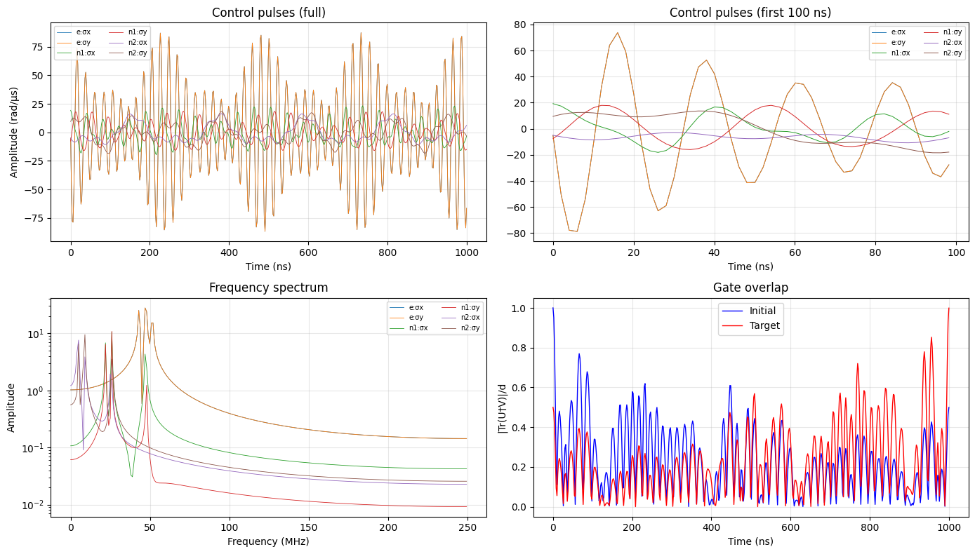
CNOT(1=>2) x CNOT(1=>3)
Fidelity:
0.9990
Time:
18 min
# params:
54

Slide 11
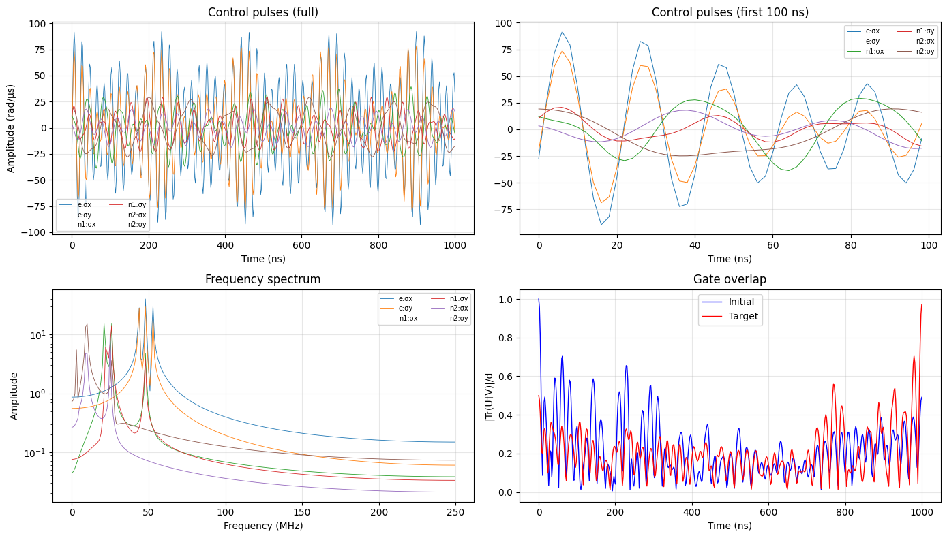
U_XX
Fidelity:
0.97223
(0.96 with
time opt.)
Time:
98 min
(1d with
time opt.)
# params:
54
(T_opt=2µs)

Slide 12
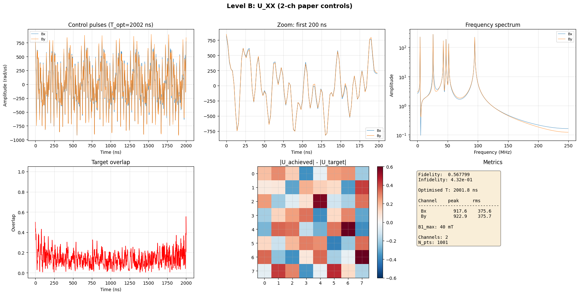
Level b Hamiltonian, 2 controls (B_x, B_y) total
fid: 0.57
CPU time: 23 min
T_opt = 2µs
N_freq = 6

Slide 13
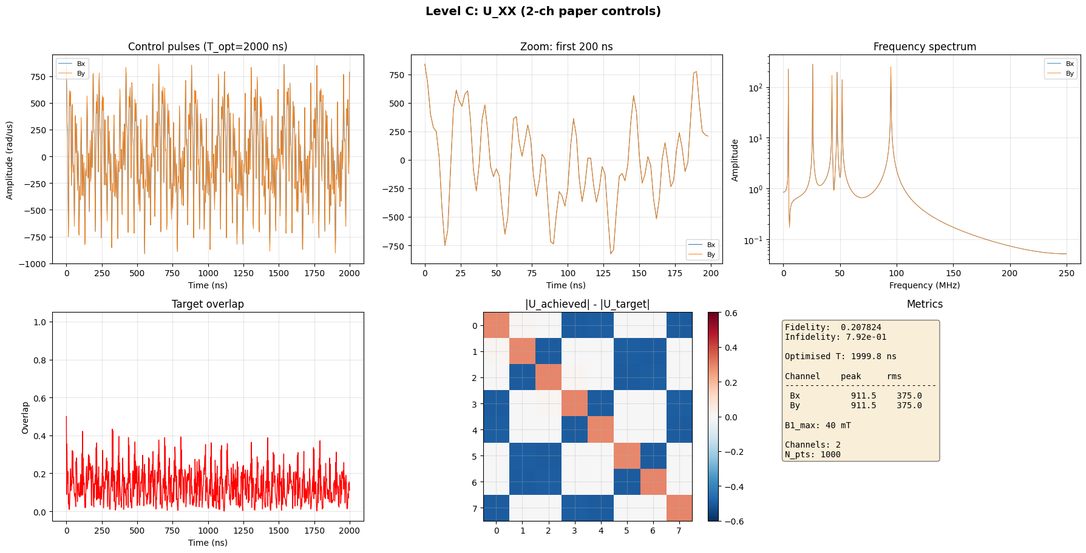
Level C Hamiltonian, 2 controls (B_x, B_y) total
fid: 0.208
CPU time: 565 min
T_opt = 2µs
N_freq = 6

Slide 14
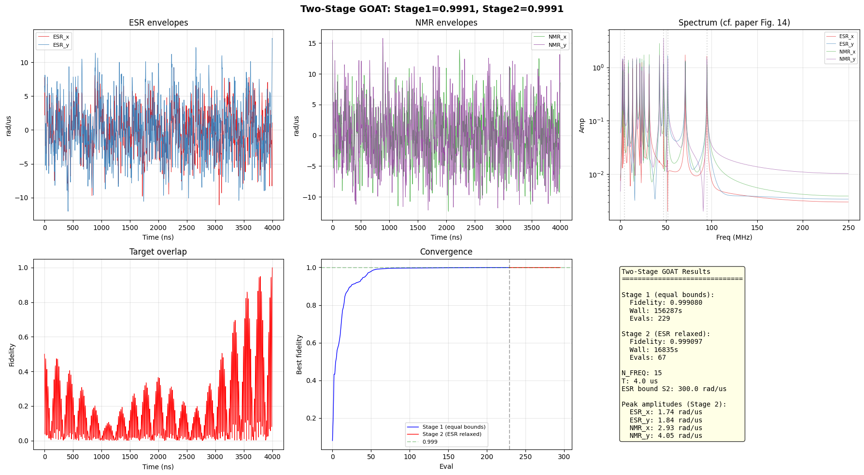
Two stage warm start

