Slide 1
Enhanced Apple Pay Experience
UX Mockup for Enterprise and High-Value Clients

Slide 2
Overview
This presentation showcases a UX mockup for Apple Pay tailored for enterprise clients and high-value users, focusing on:
- Enterprise Dashboard for multi-account management
- Recurring Payments Hub for subscription insights
- Cross-Border Payments with transparent FX rates

Slide 3
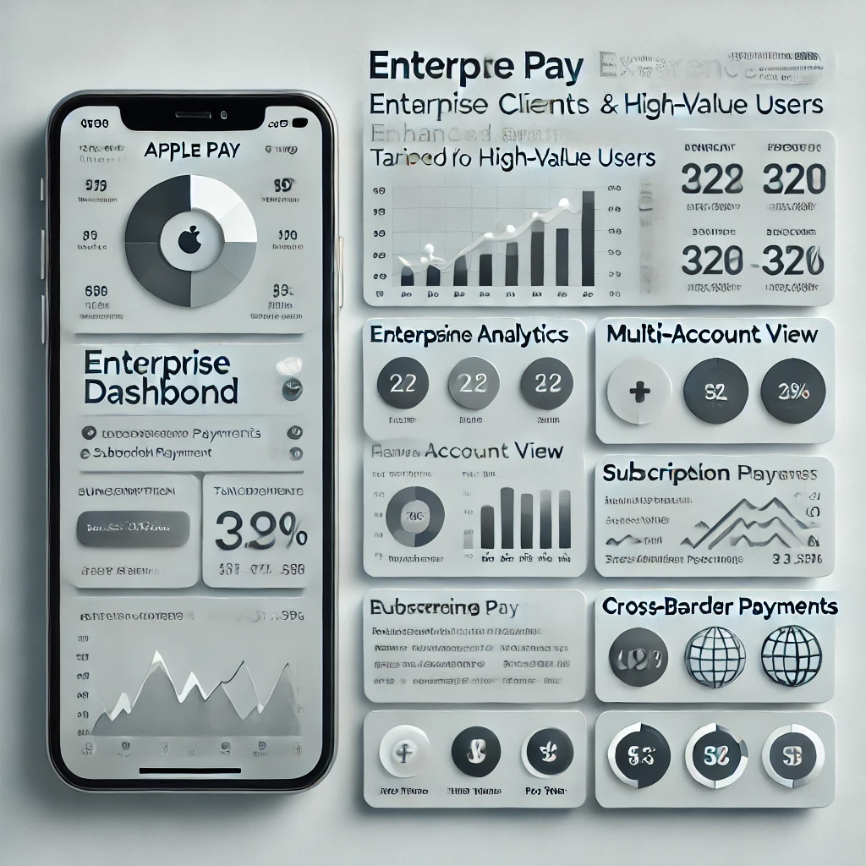
Enhanced Apple Pay Mockup

Slide 4
Key Features
- **Enterprise Dashboard**: Track transactions, balances, and spending trends
- **Recurring Payments Hub**: Manage subscriptions with detailed insights
- **Cross-Border Payments**: Real-time FX rates and transparent fee breakdowns

Slide 5
Next Steps
This mockup highlights opportunities for Apple Pay to enhance its value for enterprise clients. Potential implementation steps include:
- Incorporating client feedback for feature prioritization
- Building prototypes for usability testing
- Collaborating with business stakeholders for deployment

