Slide 1
Understanding and Preventing OWASP Top 10 Security Issues
John Kuefler

Slide 2

About Me
John Kuefler
Director of Technology, LimeLight Marketing
Content Author, Pluralsight
CIS Instructor, Pittsburg State University
Email: john.kuefler@limelightmarketing.com
Twitter: @john_kuefler91
GitHub: https://github.com/johnkuefler/OwaspDemo

Slide 3

What is the OWASP Top 10?
OWASP
“Open Web Application Security Project”
An unbiased source of information on security best practices and standards
Lots of great information
OWASP Top 10
A curated list of the top 10 biggest security threats web apps face
Available as a PDF
Updated every few years - new edition coming soon

Slide 4

Disclaimer:
ONLY USE THIS KNOWLEDGE FOR GOOD!

Slide 5

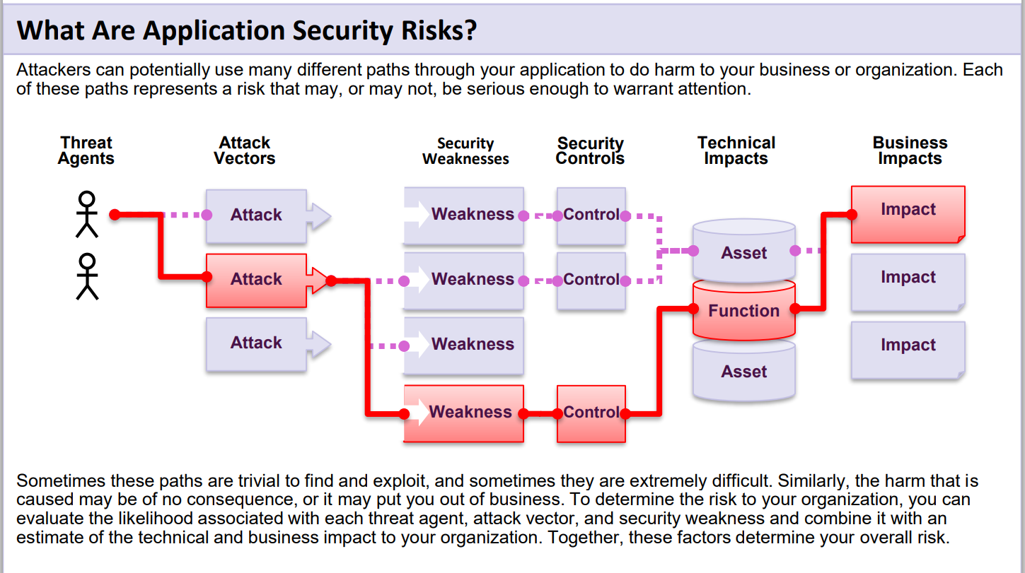
Notes:
There is no 100% security. All we can do is control risk and mitigate to the highest degree possible that is reasonable.

Slide 6
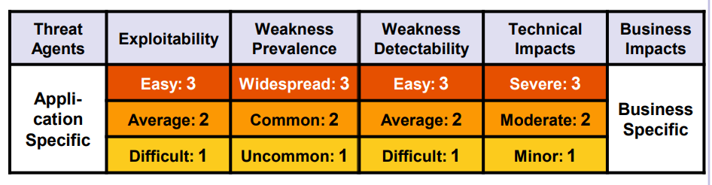
Risk assessment methodology

Slide 7
OWASP Top 10 Security Risks - 2017
Injection
Broken Authentication
Sensitive Data Exposure
XML External Entities (XXE)
Broken Access Control
Security Misconfiguration
Cross-Site Scripting (XSS)
Insecure Deserialization
Using Components with Known Vulnerabilities
Insufficient Logging & Monitoring

Slide 8
The Common theme to all of these?
People
Process
Tools

Slide 9
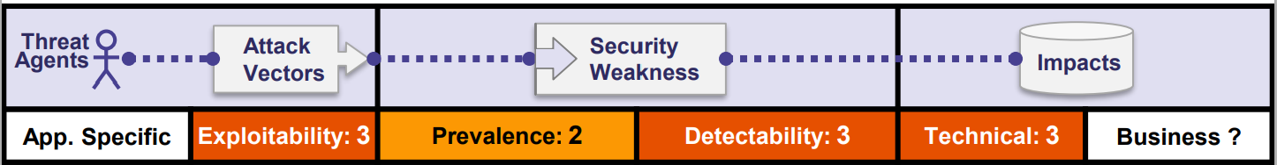
1. Injection
Injection flaws, such as SQL, NoSQL, OS, and LDAP injection, occur when untrusted data is sent to an interpreter as part of a command or query. The attacker’s hostile data can trick the interpreter into executing unintended commands or accessing data without proper authorization.

Slide 10
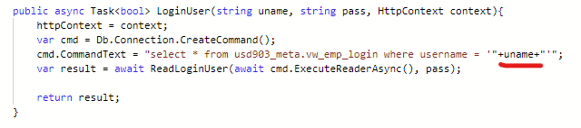
“Nobody ever does this”
Example from a real codebase of a large organization

Slide 11
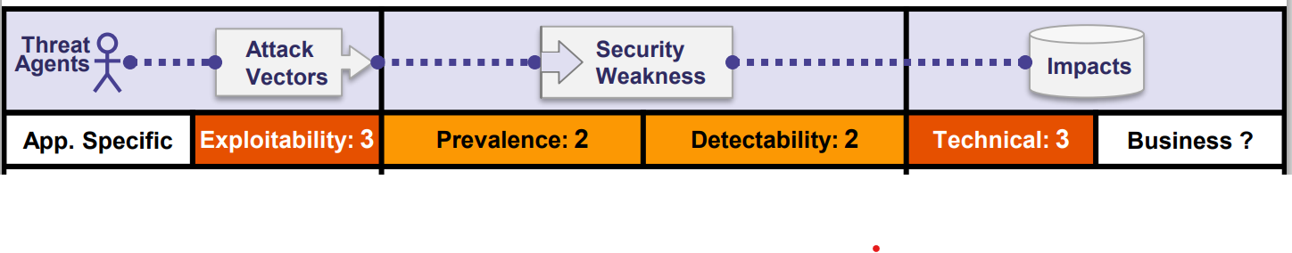
2. Broken Authentication
Application functions related to authentication and session management are often implemented incorrectly, allowing attackers to compromise passwords, keys, or session tokens, or to exploit other implementation flaws to assume other users’ identities temporarily or permanently.

Slide 12
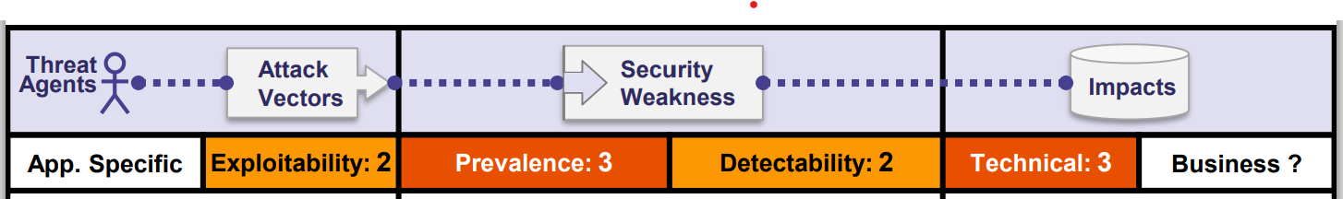
3. Sensitive Data Exposure
Many web applications and APIs do not properly protect sensitive data, such as financial, healthcare, and PII. Attackers may steal or modify such weakly protected data to conduct credit card fraud, identity theft, or other crimes. Sensitive data may be compromised without extra protection, such as encryption at rest or in transit, and requires special precautions when exchanged with the browser.

Slide 13
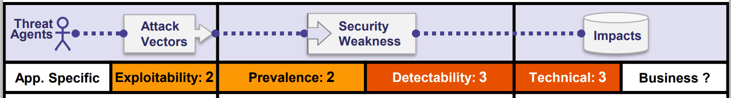
4. XML External Entities (XXE)
Many older or poorly configured XML processors evaluate external entity references within XML documents. External entities can be used to disclose internal files using the file URI handler, internal file shares, internal port scanning, remote code execution, and denial of service attacks.

Slide 14
Specific examples
Billion laughs attack: https://en.wikipedia.org/wiki/Billion_laughs_attack
Remote file execution:
<!DOCTYPE foo [ <!ENTITY xxe SYSTEM "file://C:/etc/passwd"> ]>
<product id="1">
<description>&xxe;</description>
</product>

Slide 15
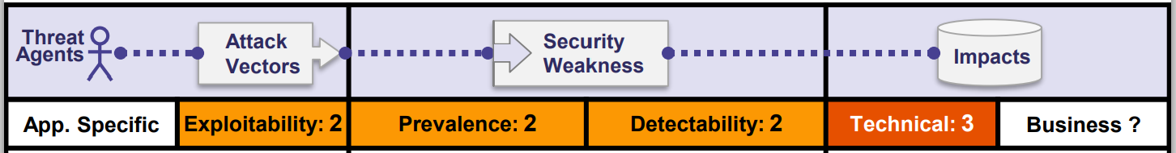
5. Broken Access Control
Restrictions on what authenticated users are allowed to do are often not properly enforced. Attackers can exploit these flaws to access unauthorized functionality and/or data, such as access other users' accounts, view sensitive files, modify other users’ data, change access rights, etc.

Slide 16
Broken Access Control tips
Deny by default
Conduct routine audits
This (in my opinion) is the hardest one

Slide 17
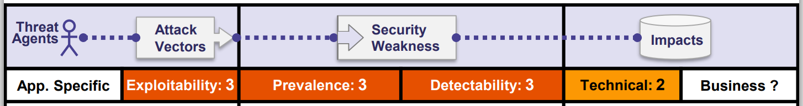
6. Security Misconfiguration
Security misconfiguration is the most commonly seen issue. This is commonly a result of insecure default configurations, incomplete or ad hoc configurations, open cloud storage, misconfigured HTTP headers, and verbose error messages containing sensitive information. Not only must all operating systems, frameworks, libraries, and applications be securely configured, but they must be patched and upgraded in a timely fashion.

Slide 18
Security Configuration: Headers
Add the Strict-Transport-Security Header
By using HSTS, you can force that all communication is done using HTTPS.
Add the X-Content-Type-Options Header
The X-Content-Type-Options can be set to no-sniff to prevent content sniffing.
Add the Referrer Policy Header
This allows us to restrict the amount of information being passed on to other sites when referring to other sites.

Slide 19
Security Configuration: Headers
Add the X-XSS-Protection Header
The HTTP X-XSS-Protection response header is a feature of Internet Explorer, Chrome and Safari that stops pages from loading when they detect reflected cross-site scripting (XSS) attacks.
Add the X-Frame-Options Header
You can use the X-frame-options Header to block iframes and prevent click jacking attacks.
Add the Content-Security-Policy Header
A content security policy dictates where what types of styling and config can be loaded from.
Optionally add the Permissions-Policy Header
Specifies which browser APIs (e.g. camera, geolocation, etc.) can be used on your site

Slide 20
Perform a scan of security headers
Tools like https://securityheaders.com/ make it easy
Example #1: Scan results for amazon.com (securityheaders.com)
Example #2: Scan results for https://owasp.demo.dev-squared.com/ (securityheaders.com)

Slide 21
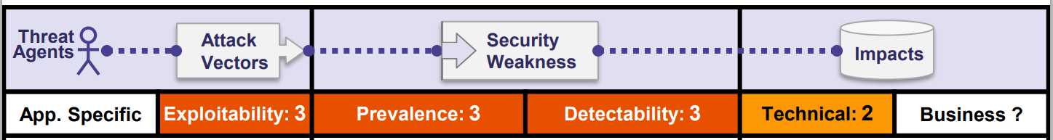
7. Cross-Site Scripting XSS
XSS flaws occur whenever an application includes untrusted data in a new web page without proper validation or escaping, or updates an existing web page with user-supplied data using a browser API that can create HTML or JavaScript. XSS allows attackers to execute scripts in the victim’s browser which can hijack user sessions, deface web sites, or redirect the user to malicious sites.

Slide 22
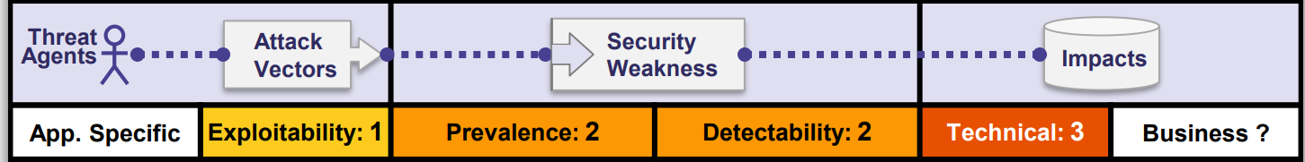
8. Insecure Deserialization
Insecure deserialization often leads to remote code execution. Even if deserialization flaws do not result in remote code execution, they can be used to perform attacks, including replay attacks, injection attacks, and privilege escalation attacks

Slide 23
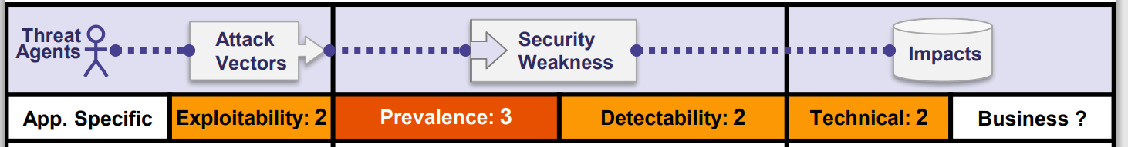
9. Using Components with Known Vulnerabilities
Components, such as libraries, frameworks, and other software modules, run with the same privileges as the application. If a vulnerable component is exploited, such an attack can facilitate serious data loss or server takeover. Applications and APIs using components with known vulnerabilities may undermine application defenses and enable various attacks and impacts.

Slide 24
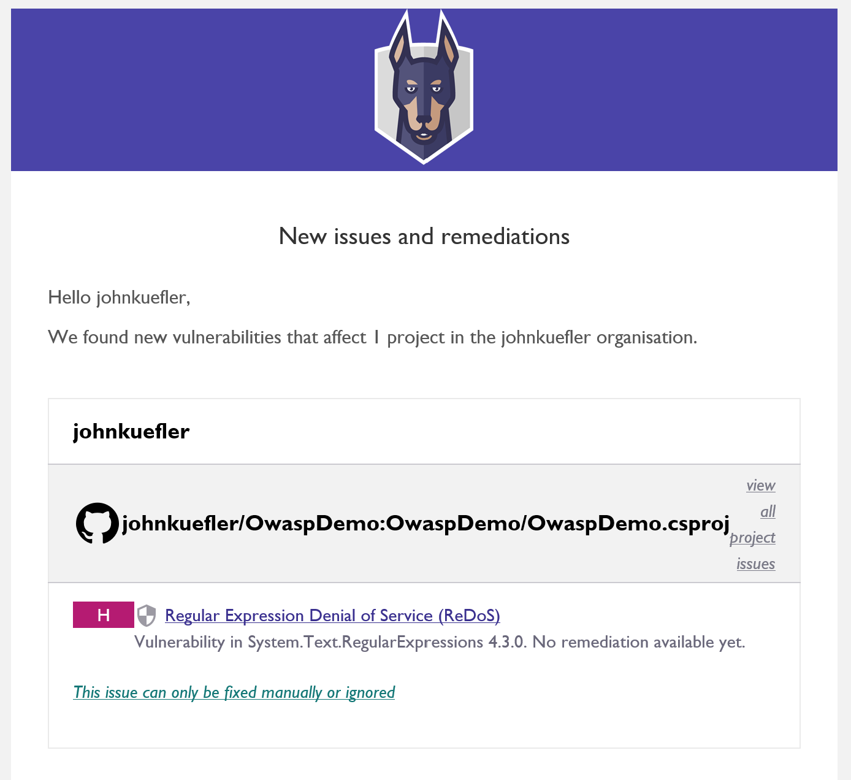
Snyk is one tool we can use to detect 3rd party component vulnerabilities.
Let’s look at it on this repository

Slide 25
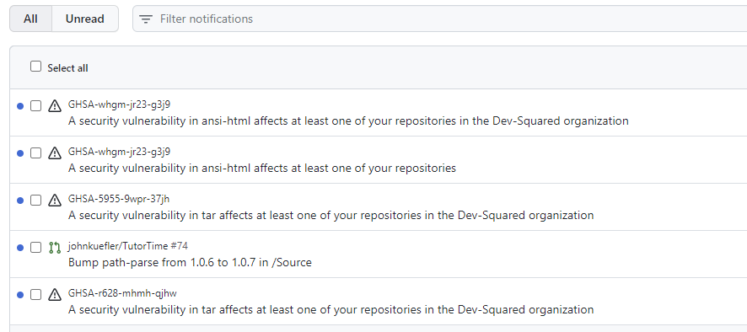
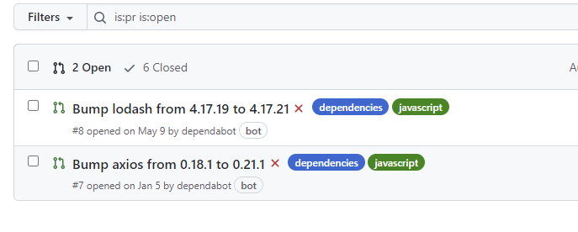
Github also has this built in!

Slide 26
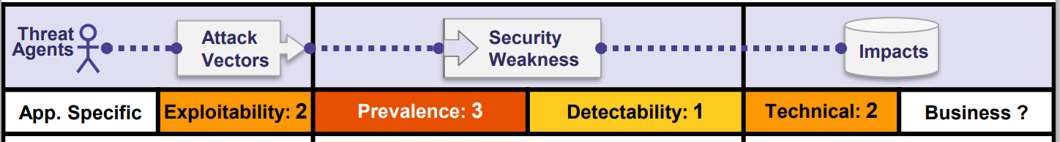
10. Insufficient Logging & Monitoring
Insufficient logging and monitoring, coupled with missing or ineffective integration with incident response, allows attackers to further attack systems, maintain persistence, pivot to more systems, and tamper, extract, or destroy data. Most breach studies show time to detect a breach is over 200 days, typically detected by external parties rather than internal processes or monitoring.

Slide 27
What Can We Do?
Read the OWASP Top 10!
Create a culture of security - implement code review, audit regularly
Evaluate vendors carefully, include security contract annex: https://www.owasp.org/index.php/OWASP_Secure_Software_Contract_Annex
Incorporate OWASP Top 10 into project management
Use automated testing/static code analysis
Example: Static Analysis: SonarQube
Example: Live Analysis: Zap

Slide 28
Tools
Static code analysis
Codacy
SonarQube
Dynamic analysis
OWASP Zap
Library security
Snyk
Github

Slide 29
Questions?

