Slide 1
Register Harbor Self-Signed Cert on Windows Docker Client

Slide 2
Connect to harbor using Docker Desktop on Windows
1. Obtain the Harbor Registry's CA Certificate:
Log in to your Harbor registry's web interface.
Navigate to the Administration -> Configuration -> Registry Root Certificate section.
Download the certificate, typically named ca.crt.
2. Import the Certificate into the Windows Certificate Store:
Docker Desktop for Windows leverages the Windows Certificate Store for managing trusted Certificate Authorities (CAs). Therefore, the recommended way to get your Docker client to trust the Harbor registry's certificate is to import the CA certificate into your Windows system's trusted root store.
Copy the downloaded ca.crt file to your Windows machine.
Using Microsoft Management Console - MMC)
Open the Microsoft Management Console ( mmc.exe ).
Go to File -> Add/Remove Snap-in. [ see following ]
Select Certificates -> Add >.
Choose Computer account -> Next -> Local computer -> Finish.
Expand Certificates (Local Computer) -> Trusted Root Certification Authorities -> Certificates.
Right-click Certificates and select All Tasks -> Import….
Follow the prompts to import your ca.crt certificate, ensuring you place it in the Trusted Root Certification Authorities store.
3. If necessary, restart the windows system
4 Now you should be able to connect to your Harbor registry using the docker login command, specifying the registry's IP address or FQDN.
docker login harbor_registry_address
Notes:
Method 1 (using the Windows Certificate Import Wizard):
Right-click the ca.crt file and select Install Certificate.
Follow the prompts in the wizard to install the certificate, ensuring you choose to place it in the Trusted Root Certification Authorities store.
Method 2 (using Microsoft Management Console - MMC):
Open the Microsoft Management Console ( mmc.exe ).
Go to File -> Add/Remove Snap-in.
Select Certificates -> Add >.
Choose Computer account -> Next -> Local computer -> Finish.
Expand Certificates (Local Computer) -> Trusted Root Certification Authorities -> Certificates.
Right-click Certificates and select All Tasks -> Import….
Follow the prompts to import your ca.crt certificate, ensuring you place it in the Trusted Root Certification Authorities store.

Slide 3
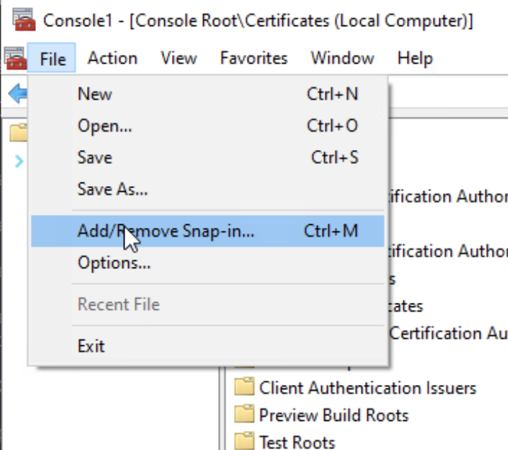

Slide 4
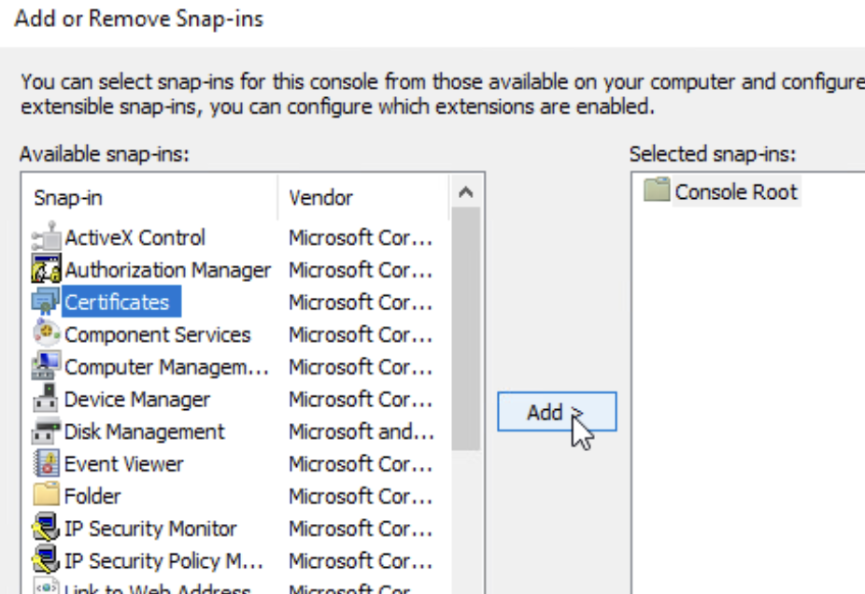

Slide 5
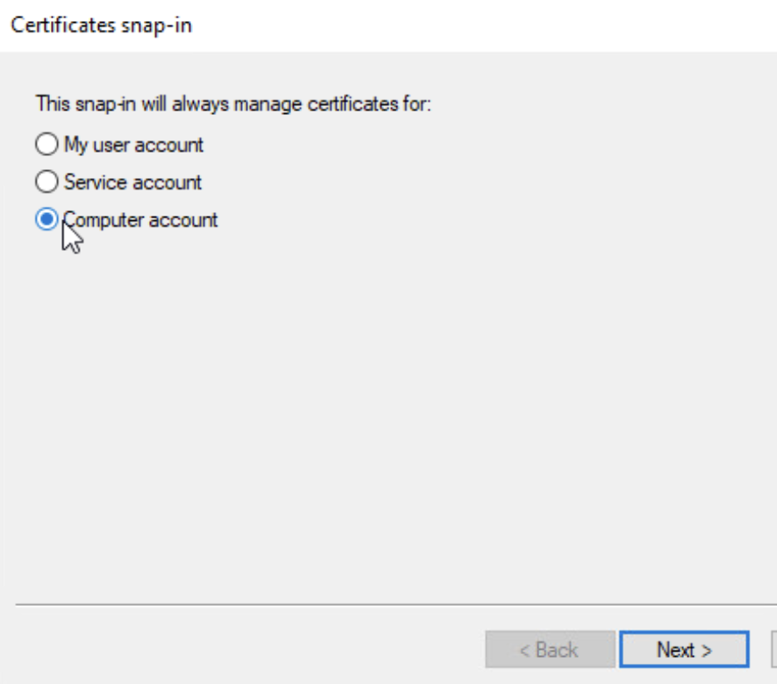

Slide 6
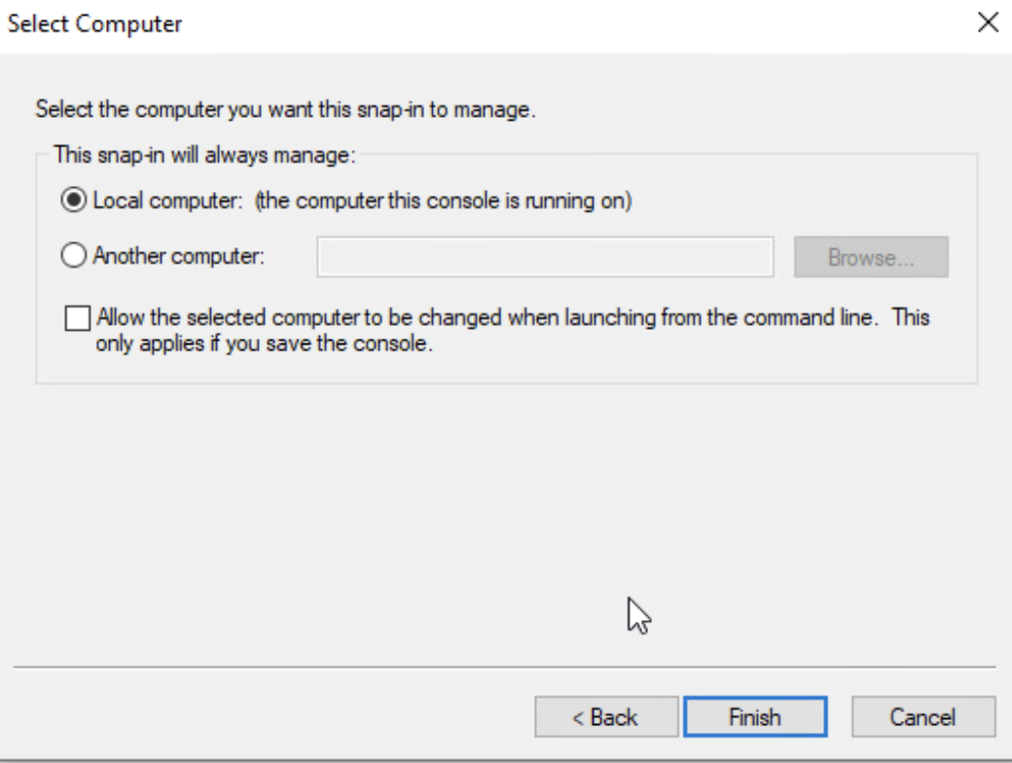

Slide 7
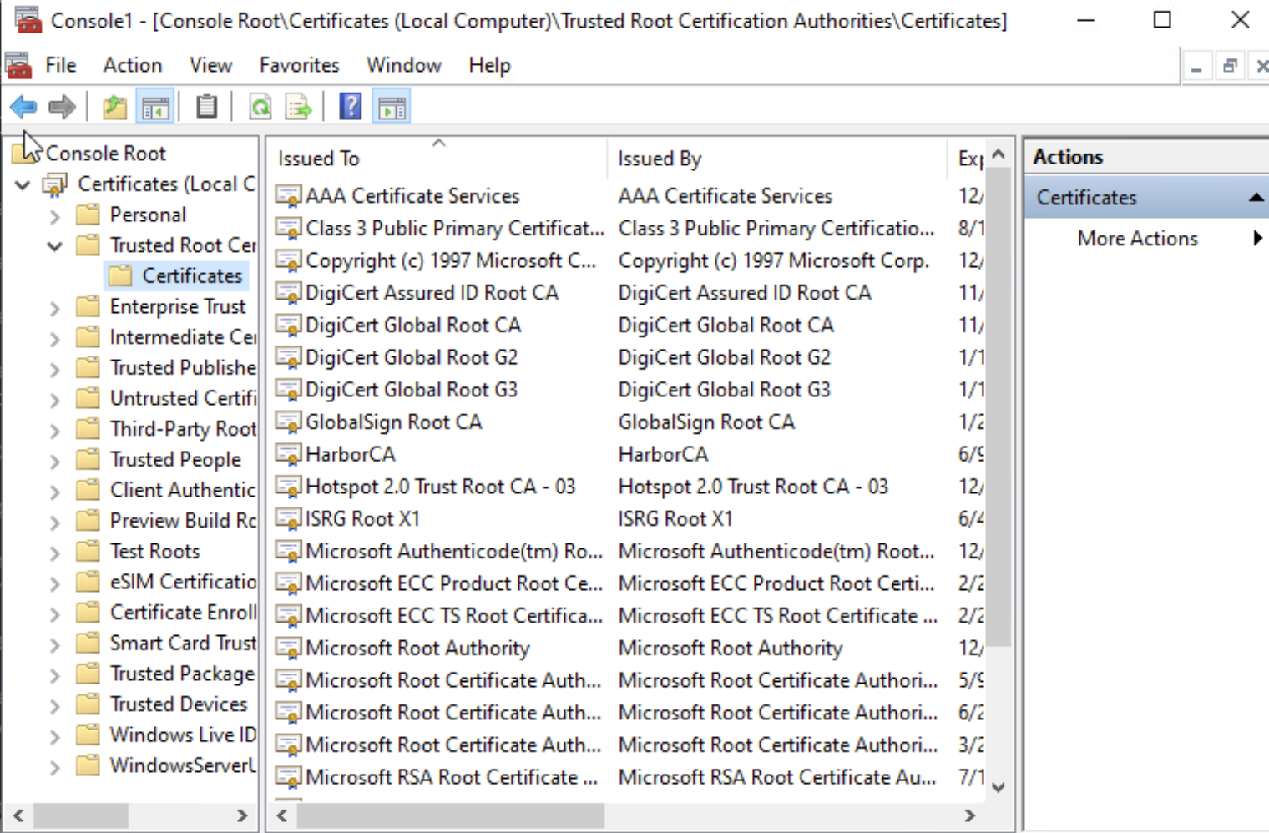

Slide 8
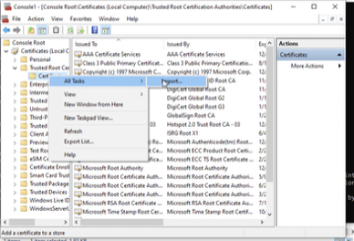

Slide 9
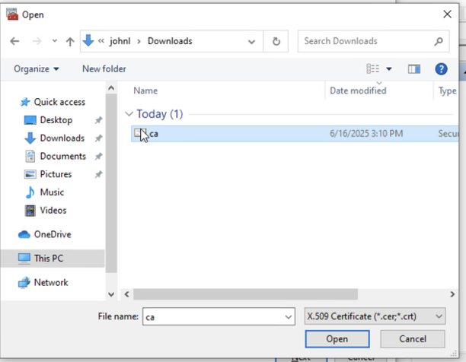

Slide 10
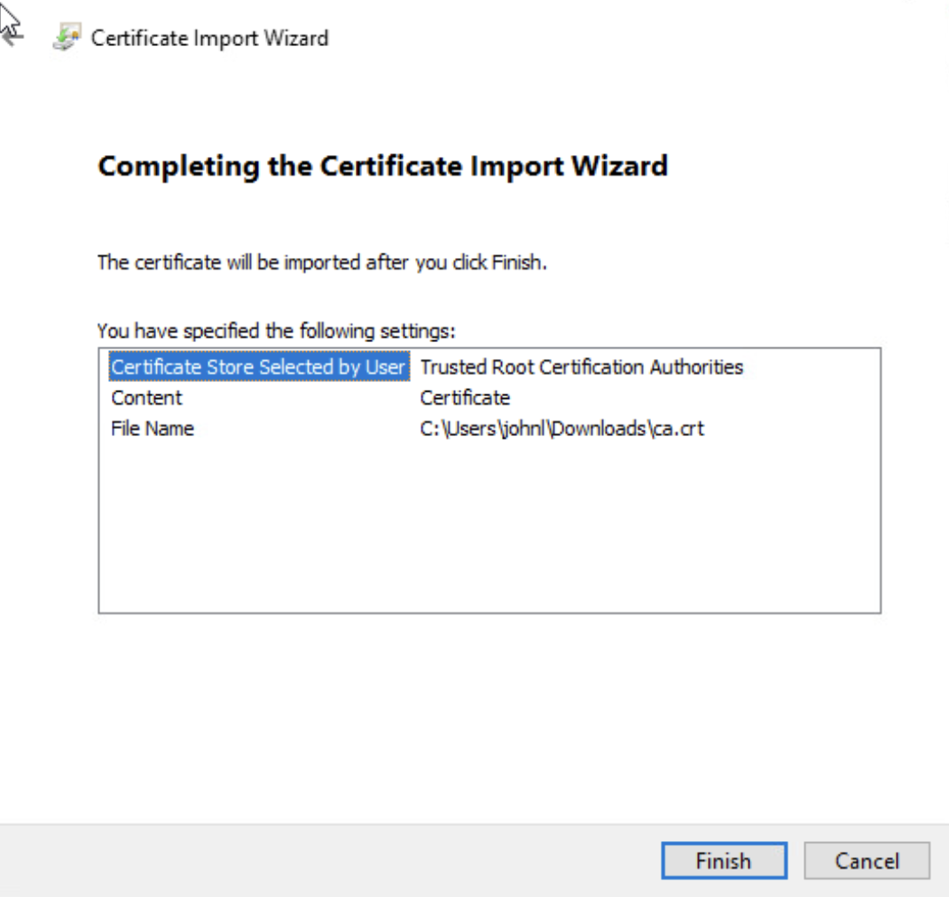

Slide 11
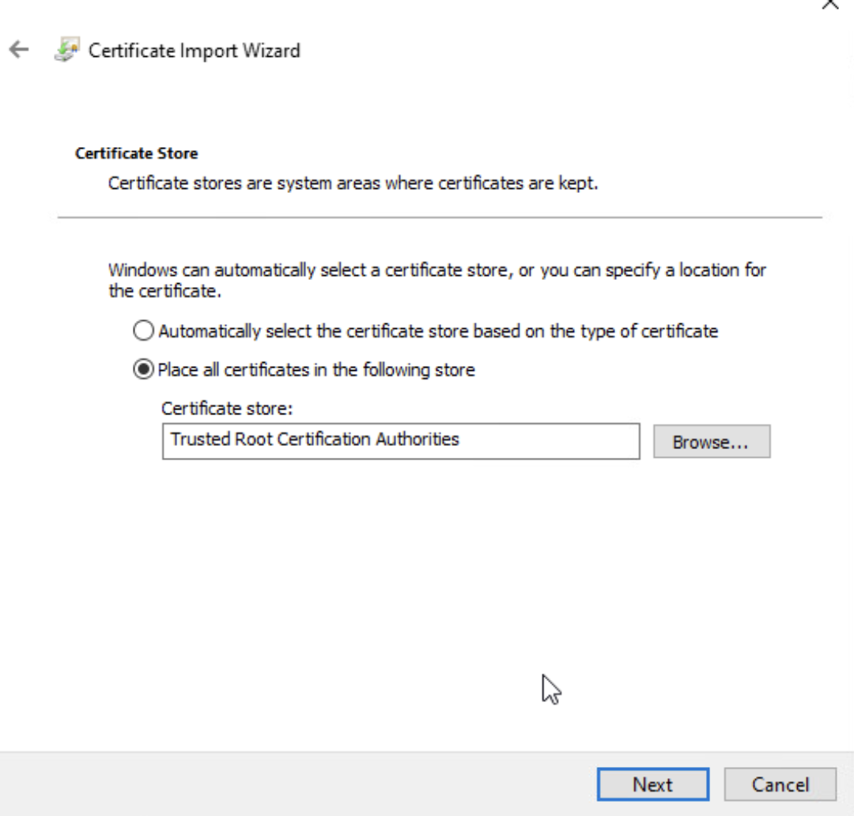

Slide 12


