Slide 1


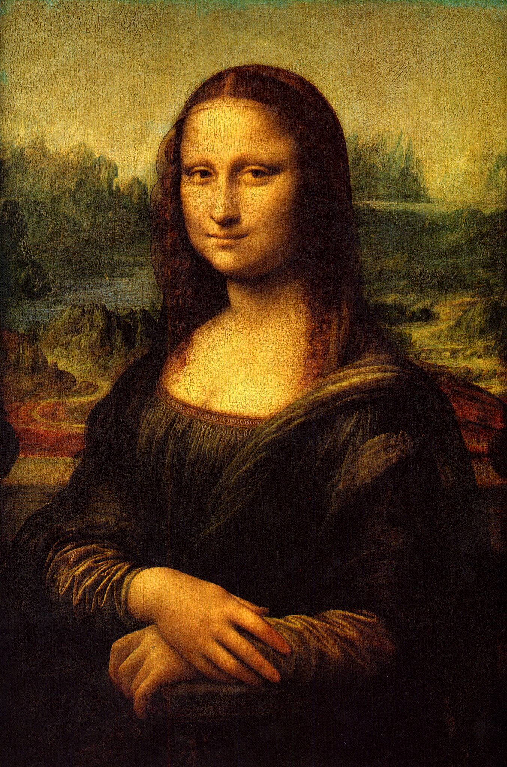









Target image
Canvas
Textures

Slide 2

Average RBG color in region
Target image
Canvas

