Slide 1

TRAVELMATE CAPSTONE
Meet the capstone team
CORTES, ROVIC
GULBE, JOHNMARK
JUMAO-AS JOHNLEE
Notes:
Good day. We are presenting TravelMate, our capstone system. The names shown here follow the archived manuscript, so the team should confirm the final roster and spelling before submission. In this short presentation, we will introduce the project, its intended users, the problem it addresses, and its main features.

Slide 2
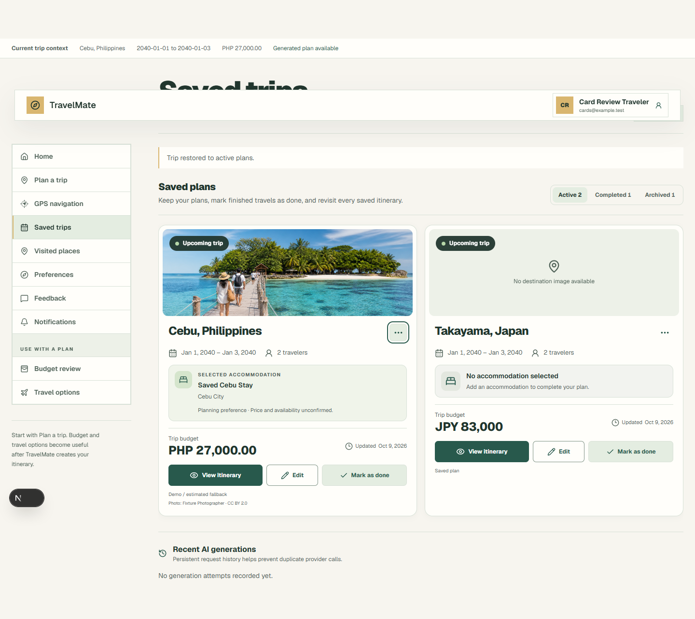
CAPSTONE TITLE
TravelMate
AI-Powered Travel Planning and Itinerary Management System
TravelMate turns a destination, dates, travelers, budget, and preferences into a structured itinerary.
The system keeps the daily plan, cost estimates, weather context, saved trips, maps, and visited-place records in one workflow.
TravelMate Capstone
02
Notes:
Our capstone title is TravelMate: AI-Assisted Travel Planning and Itinerary Management System. A traveler supplies the trip boundaries such as destination, dates, group size, budget, and preferences. TravelMate creates a structured daily plan and keeps related information together, including estimated costs, conditions, maps, saved trips, and visited places.

Slide 3
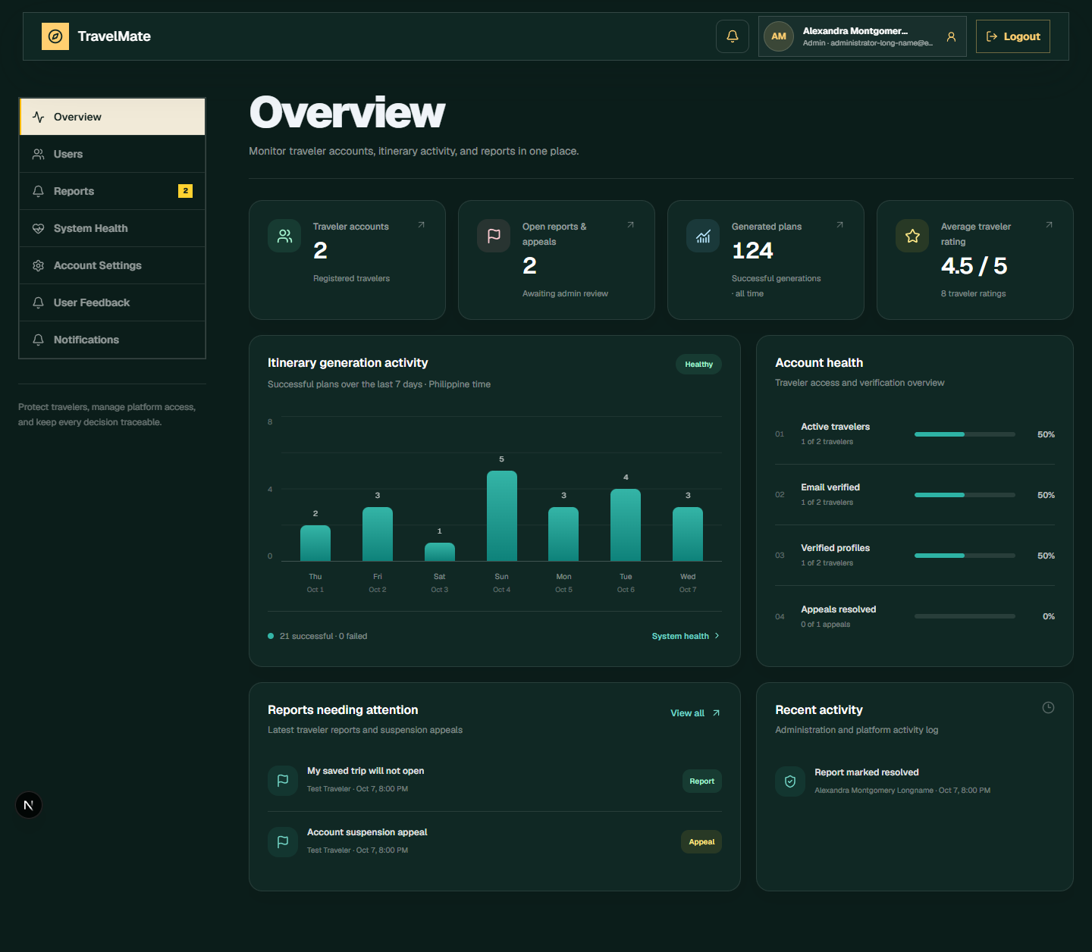
CLIENT AND STAKEHOLDERS
Project ownership and users
No external client is identified in the project records.
Academic stakeholders
Capstone team, adviser, panel, and institution. Final names and approval details remain for confirmation.
Primary users
Travelers create and manage plans. Administrators manage accounts, feedback, reports, and moderation.
TravelMate Capstone
03
Notes:
The current records do not identify an external client, so we should not invent one. This is an academic capstone project whose stakeholders include the project team, adviser, panel, and institution. Its operational users are travelers, who create and manage trips, and administrators, who manage accounts, feedback, reports, and moderation.

Slide 4
PROBLEM AND SOLUTION
Travel planning without a connected system
MANUAL PROCESS
TRAVELMATE PROCESS
1 Search different sites for destinations, weather, places, routes, and accommodation.
2 Build the daily schedule and estimate the budget by hand.
3 Copy details into notes or spreadsheets, then repeat the work when plans change.
1 Validates the destination and trip details.
2 Generates a day plan from available place data and the configured AI provider.
3 Recalculates budget context, saves the trip, supports editing, and connects activities to maps.
Result: one reviewable itinerary instead of disconnected research and repeated manual calculations.
TravelMate Capstone
04
Notes:
Without TravelMate, a traveler must search several websites, assemble a schedule, estimate costs, and update separate notes whenever the plan changes. TravelMate connects those steps. It validates the trip details, generates a structured plan using available place data and an AI provider, recalculates cost context, saves the itinerary, and links activities to maps. The traveler still reviews the result and confirms real prices and availability.

Slide 5
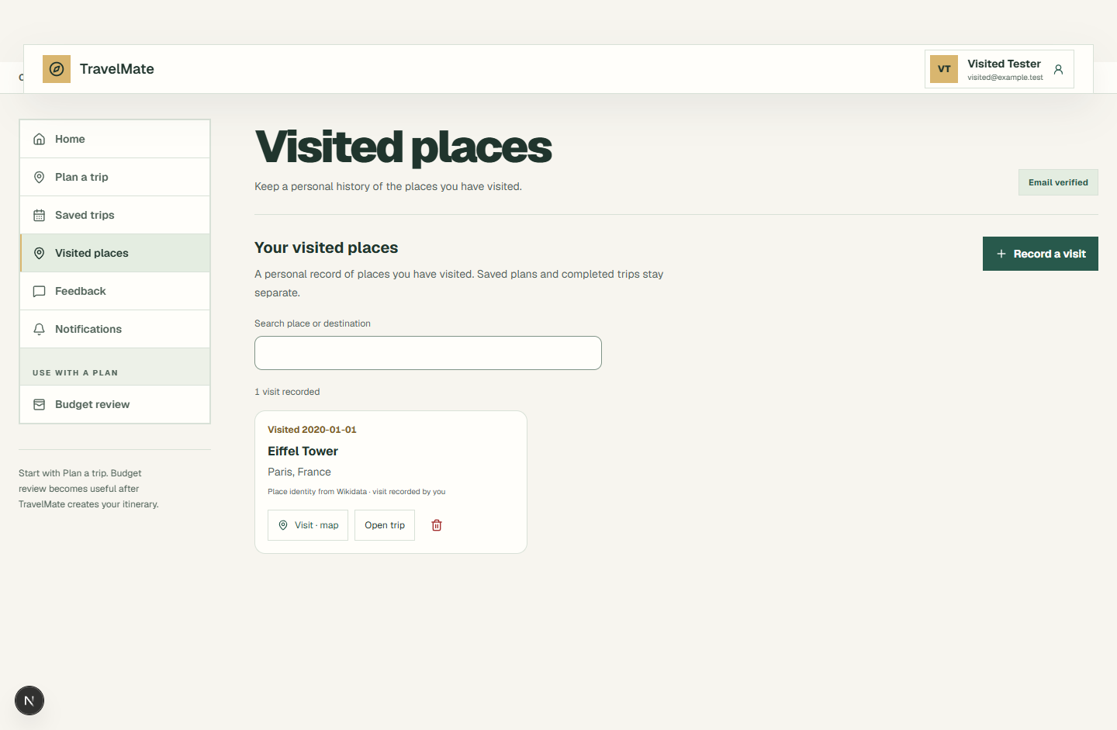
PROJECT FEATURES AND FUNCTIONS
Users and system capabilities
FOR TRAVELERS
Plan trips from 1 to 31 days
Generate culture and interest-based activities
Review deterministic budget estimates
Edit, save, reopen, and complete trips
View route previews and record visited places
FOR ADMINISTRATORS
Manage traveler accounts and status
Review feedback, reports, and moderation work
Monitor important system notifications
Secure sign-in, AI itinerary generation, weather context, accommodation suggestions, saved-trip history, maps, and visit records.
TravelMate Capstone
05
Notes:
Travelers can plan trips from one to thirty-one days, receive activities based on culture and interests, review budget estimates, edit and save trips, view route previews, mark trips complete, and keep visited-place records. Administrators support the platform by managing accounts, feedback, reports, and moderation. The underlying functions include secure sign-in, AI-assisted generation, weather context, accommodation suggestions, saved-trip history, and maps.

