Slide 1
Loan Defaulters
Predicting loan defaulters using machine learning
Oluwasola Oluwaseun
231229

Slide 2
Project Overview
Objective : develop a predictive model to classify loan applicants as defaulters (1) or non-defaulters (0)
Scope:
Clean and preprocess the data.
Handle missing values and imbalanced classes.
Train and evaluate models.
Analyze results and highlight feature importance by age groups.

Slide 3
Exploratory Data analysis
Source: Loan default Database
Shape of Data: 148670 rows and 35 columns
Key Features:
Age, Interest rate, Loan Amount, credit type, etc.
Target Variable: “Status” (Defaulter = 1, Non-Defaulter = 0)
Challenges:
Missing values in key features.
Imbalanced dataset (Class 0 > Class 1).
Multicollinearity among dependent features

Slide 4
Exploratory Data Analysis
Step 1: Inspect all variables
Drop redundant variables [ID, year, @]
justification: Variables has no relevance in predicting defaulters.
Step 2: Separating Variables (Categorical &Quantitative)
Check for multicollinearity among quantitative variables .
Check for cardinality level and value count in each Categorical values.
Reason: Preserves data distribution and ensures no bias.
Step 3: Handling missing values among features
Could not drop missing values because when I did it had all the minority class completely wipe out from our dataset which will be useless for our model.

Slide 5
Data Preprocessing
Step 1: Removing Nuisance Variables
Using a threshold of 95% for feature imbalance in categorical features
Dropped features with excessive Imbalance above threshold.
Justification: Model is unlikely to differentiate between defaulters and non.
Step 2: Handling Missing Values
Numerical Features: Imputed with median values.
Categorical Features: Imputed with the constant “missing.”
Reason: Preserves data distribution and ensures no bias.
Step 3: Scaling and Encoding
Standardized numerical features using StandardScaler.
Ordinal encoded categorical features.

Slide 6
Handling class Imbalance
Techniques Used:
Baseline Model: Trained on the imbalanced dataset.
Oversampling: Used SMOTE to balance minority and majority classes.
Justification: SMOTE helps balance the class distribution by generating synthetic examples of the minority class, ensuring the model gets enough data to learn patterns from both classes effectively.
Results:
Improved recall for defaulters after applying SMOTE.
Trade-off observed in precision and overall accuracy.

Slide 7
Model
Models Evaluated:
Logistic Regression
Random Forest Classifier
Training Pipeline:
Preprocessing applied using ColumnTransformer.
Models trained with cross-validation to ensure robustness.
Evaluation Metrics:
Accuracy, Precision, Recall, F1-Score, ROC-AUC

Slide 8
Result Logistic Regression
Before Oversampling:
High accuracy but poor recall for defaulters (Class 1).
Precision: 95%, Recall: 46% for Class 1.
After Oversampling:
Balanced recall and precision for both classes.
Precision: 63%, Recall: 65% for Class 1.
Conclusion: Oversampling improved minority class detection.

Slide 9
Result Random Forest
Before Oversampling:
High accuracy but poor recall for defaulters (Class 1).
Precision: 100%, Recall: 33% for Class 1.
This may be due to overfitting
After Oversampling:
Balanced recall and precision for both classes.
Precision: 100%, Recall: 43% for Class 1.
Conclusion: Oversampling moderately improved recall for minority class detection.

Slide 10
Feature Importance by Age group
Segregation by Age:
Grouped applicants by age ranges.
Re-trained models for each age group.
Key Observations:
Different age groups showed almost the same feature importance.
Example: Credit type and Employment Status was major feature across all group age.

Slide 11
Challenges and limitations
Challenges Faced:
Handling significant missing data without introducing bias.
Trade-off between precision and recall in oversampling.
Limitations:
Synthetic data from SMOTE may introduce noise.
Group-based analysis didn’t show any significant result.

Slide 12
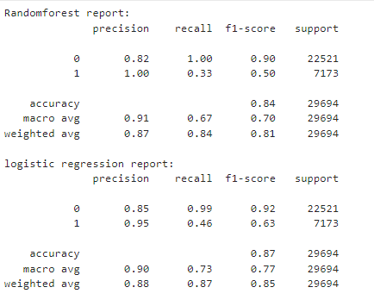
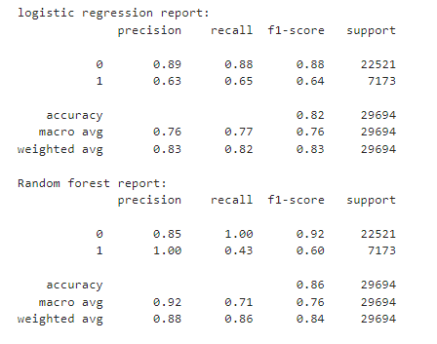
Model Report
Before Oversampling
After Oversampling

Slide 13
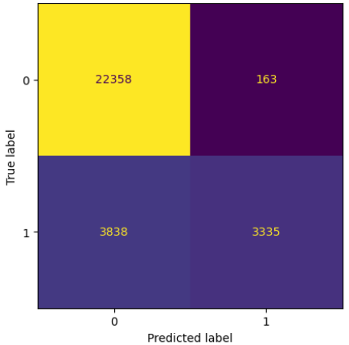
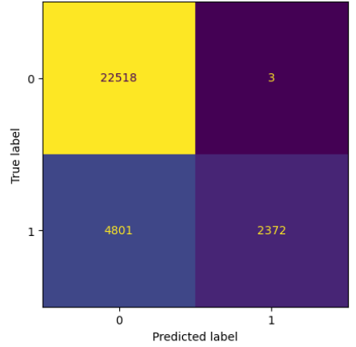
Confusion Matrix before oversampling
Logistic Regression
Random Forest

Slide 14
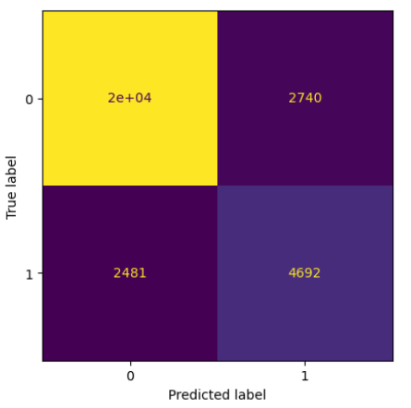
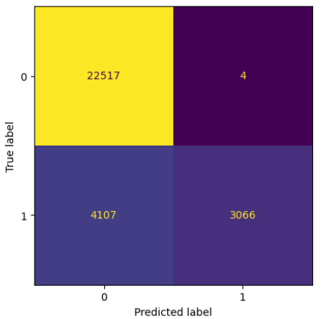
Confusion Matrix after oversampling
Logistic Regression
Random Forest

Slide 15
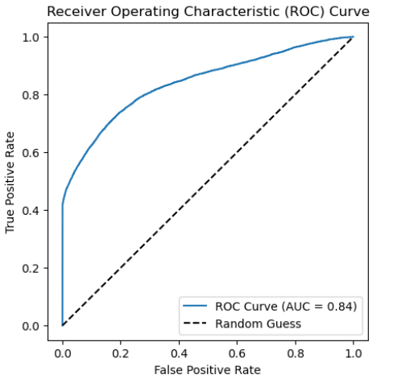
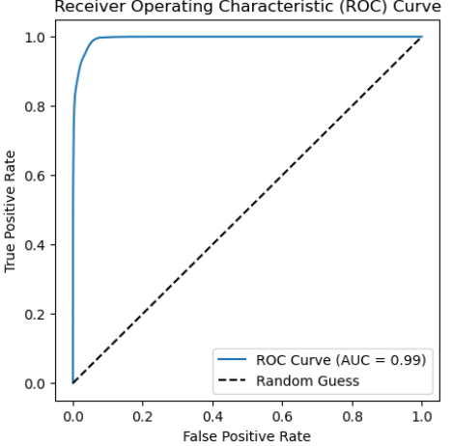
ROC CURVE
Logistic Regression
Random Forest

Slide 16
Key terms Explanation
Accuracy: tells how well the model performs overall. However, it can be misleading for imbalanced datasets because it doesn’t account for class distribution.
Precision: when the model predicts a defaulter, it is often correct
Recall(sensitivity): how well the model correctly identifies most of the defaulters.
F1 score: gives a single measure of a model's performance on the defaulters.
Oversampling(smote):creates new synthetic data points for the minority class(defaulters) without discarding any data from the majority class(non defaulter), preserving the dataset's richness and diversity

Slide 17
Model Interpretation
Non Defaulters (Majority Class):
Both models perform well in terms of precision, recall, and F1-score.
Random forest achieves better recall (1.00) for non defaulters, but at the cost of worse performance on defaulters.
Defaulters (Minority Class):
Logistic regression has a better balance between precision and recall for defaulters , leading to a better F1-score.
Random forest shows high precision but poor recall, meaning it predicts very few instances of class 1.
Accuracy:
Random forest has slightly higher accuracy overall, but this is mainly due to its performance on non defaulters.

Slide 18
Conclusion and Recommendation
Conclusion:
Logistic Regression with SMOTE effectively balanced precision and recall.
Random forest is really struggling in terms of recall even after oversampling
Age-specific models revealed no specific feature importance across groups.
Recommendations:
If Identifying defaulters is our goal, logistic regression is preferable because it has a better F1-score for defaulters.
If over accuracy and non defaulter performance more critical, Random forest may be a better choice

