Slide 1
Enterprise Modeling
Modeling the Enterprise with UML
and
Sparx Enterprise Architect
Prepared by JFL
November 8, 2026

Slide 2
Objectives
Enterprise Modeling is a two hour tutorial designed to:
  Provide participants with an introduction to fundamental modeling concepts
  Establish a common vocabulary for discussing enterprise modeling
  Describe a standardized UML template for enterprise architecture
  Familiarize participants with Sparx Enterprise Architect modeling tool
Assumptions
  Participants should recognize some graphical notations such as flow charts entity-relationship diagrams, or data flow diagrams
Notes:
This tutorial is designed to:
Provide an introduction to fundamental modeling and architecture concepts
Establish a common vocabulary for discussing modeling artifacts and activities
Describe a UML template for application modeling and
Demonstrate how this template can be used in Sparx Enterprise Architecture to model an example application
This is not a UML tutorial and participants should be
familiar with object-oriented concepts and
understand base UML constructs such as class and sequence diagrams.
A brief UML notation guide has been provided for those that are unfamiliar with the UML notation.

Slide 3
Overview
Organization
  Architecture and Modeling
  Enterprise Model Set
  Sparx Enterprise Architect
Format
  Interactive
  Questions
Notes:
The tutorial is organized into 3 sections:
The first section will present some of the underlying concepts for describing architectures, who uses these descriptions, and for what purpose
The second section focuses on the Application Model Set, the most detailed kind of architecture description, and describes the kinds of models its contains.
The final section provides an introduction to the Sparx Enterprise Architect UML modeling tool and demonstrates some key features using an example application model set

Slide 4
Architecture and Modeling

Slide 5
Architecture and Modeling Contents
In this section
  Underlying Architecture Concepts
  Architecture Stakeholders
  Architecture Descriptions
  Communication and Alignment
  Model Sets
Points to think about
  How does modeling support documenting a system’s architecture?
  How do stakeholders at different levels effectively communicate?
  Is stakeholder miscommunication a concern?

Slide 6




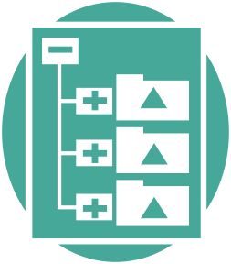


Underlying Architecture Concepts
Architecture and Modeling Maturity
Standardized Conceptual Building Blocks
IEEE-1471
System
has a ▶
System
Architecture
1
1
1
fulfills needs of
▼
1
▲
documents
1..*
1..*
◄communicates
architecture to
Stakeholder
Architecture
Description
1..*
1..*
Model Set
Architecture
Document
Architecture
Summary
Notes:
The field of architecture and modeling is starting to reach a significant level of maturity.
We are starting to see conceptual building blocks for architecture and modeling being defined and becoming standardized.
A leading standard in this area is the IEEE Recommended Practice on Architecture Description or IEEE-1471. This slide shows a some of the concepts from IEEE-1471.
Systems are the main focus of architecture and modeling efforts. The kinds of systems we are most interested in are software intensive applications.
The purpose of a system is to fulfill the needs of one or more stakeholders. Stakeholder needs drive the requirements and objectives that shape a system.
A system has a system architecture. A system architecture is the fundamental organization of a system.
An architecture description is an artifact that documents a system architecture and communicates that architecture in a way the system’s stakeholders can understand. While there can be many kinds of architecture descriptions, our architecture development methods focus on three:
Model Sets (the architecture description used in detailed modeling)
Architecture Documents (like the AAD used in our RUP projects and Architecture Review Process), and
Architecture Summaries (that communicate application architecture to high level stakeholders)

Slide 7



Architecture Stakeholders
Stakeholders
Persons, groups, or entities having interest in a system
Provide the primary motivation
Three levels of Stakeholder Roles
Detail-Oriented
Stakeholders
Tactic-Oriented
Stakeholders
Strategy-Oriented Stakeholders
Create and understand detailed elements
Analysts, Developers, Testers
Architects, Project Leads
Broad but tactical view
Customers, Project Managers, Architects, Project Leads
High-level, strategic view
Senior-level Managers (Sponsors), Strategy Developers, Architecture Governance Bodies
Important Customers

Slide 8
Architecture Descriptions
Artifact
Documents a System Architecture for Stakeholders
System Architecture addresses Stakeholder Concerns
Three levels of description
Architecture
Description
Model Set
Architecture Document
Architecture Summary
Set of Models
Visualize, specify, construct, and document
Highest degree of detail
Produced and consumed by Detail-Oriented Stakeholders
Set of Views
Architecturally significant elements, relationships, and collaborations
Provides rationale for architectural decisions
Consumed by Tactic-Oriented Stakeholders
Presentation Deck
Summarization of Architecture Document
Captures the most important items
Consumed by Strategy-Oriented Stakeholders

Slide 9
Communication and Alignment
Strategy-Oriented Stakeholders
Architecture Summary
high-level summary
Tactic-Oriented Stakeholders
Architecture Document
significant elements
Detail-Oriented Stakeholders
Model Set
Establishes common vocabulary for System development
Defines and documents the system architectures important to the American Funds enterprise
Reduces the impedance mismatch between different levels abstraction
Establishes conceptual alignment between each level of abstraction through links between Architecture Descriptions
Promotes communication between Stakeholder levels
Provides the appropriate information to each Stakeholder level

Slide 10





Model Sets
Stakeholder
Model Set
Holistic View of System Architecture
1..*
is addressed to
contains
1
◄supports
1..*
Viewpoint
Model
has
Diagram
*
1
1..*
*
1..*
has
has
1..*
1..*
visualizes
Element
relates
Relationship
2
1
*
1..*
visualizes
Notes:
A model set
contains a collection of models. Each model is an abstraction of an aspect of a system architecture
A model supports a specific viewpoint that focuses on issues and concerns
addressed to one or more kinds of stakeholders.
A model contains sets of
Elements and
Relationships
And a model may have zero or more diagrams.
Diagrams provide a visualization of various elements, their relationships, and their collaborations.
Collectively, all of the models in the model set provide a holistic view of the system architecture.

Slide 11
Enterprise Model Set

Slide 12
Enterprise Model Set Contents
In this section
  Overview of Enterprise Model Set
  Details about each model
Points to think about
  How can multiple aspects of an enterprise architecture be visualized?
  What is the importance of connections between models?
  What models are most relevant to your work?

Slide 13
Enterprise Model Set
Enterprise
Model Set
Business
Environment
Model
Business
Motivation
Model
Business
Use-Case
Model
Business
Analysis
Model
Business
Design
Model
Business
Deployment
Model
Business Environment Model
  Customers, Suppliers, Investors, Sponsors, Regulators, Competitors
  Business Services, Business Inputs, Business Outputs
Business Motivation Model
  Goals and Objectives
  Strategies and Tactics
  Policies, Decisions, and Rules
Business Use-Case Model
  Business Actors and Business Use-Cases
Business Analysis Model
  Business Processes
  Business Boundaries, Business Workers, and Business Entities
Business Design Model
  Refinement of Business Analysis Model
  Business Systems, Organizational Units, Business Roles, and Application Systems
Business Deployment Model
  Business Localities and Communication Networks
  Technology Platforms

Slide 14
Business Environment Model
Environment Viewpoint
  Focuses on environment in which the business exists
  Analyzes business environment participants such as customers, suppliers, and regulators
Purpose
  Describes the participants in the business environment, their requirements demanded of the business, and their relationships with the business
Stakeholders
  Producers
    Business Analyst
    Enterprise Architect
  Consumers
    Business Manager
    Strategic Initiative Manager
    Enterprise Architect
    Architecture Reviewer
UML Diagrams
  Class Diagram
UML Elements
  Actors
    «Customer»
    «Supplier»
    «SponsorInvestor»
    «Regulator»
    «Competitor»
  Classes
    «BusinessRequirement»
    «BusinessInput»
    «BusinessOutput»
  «BusinessService» Interface
  «MarketSegment» Package
UML Relationships
  Association
  Dependencies
    «BusinessFlow»
    «supports»
  Generalization
  Realization

Slide 15

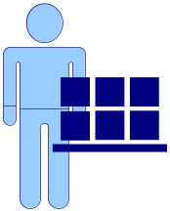
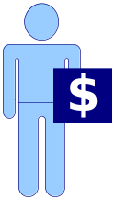


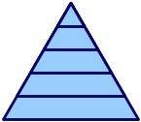


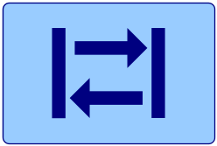
Business Environment Elements
Customer | A customer of the business.
Supplier | A supplier that provides some type of resource to the business.
SponsorInvestor | A group or individual that has the authority to sponsor funding of the business or invests money in the business.
Regulator | A government or industry group that has the authority to regulate the operations of the business.
Competitor | Another business that competes in the same market segments as the business.
BusinessRequirement | A need or want that Customers, Suppliers, SponserInvestors, and Regulators require the business addresses in some manner.
BusinessInput | A physical or informational artifact that is produced by Customers, Suppliers, etc and input to the business through a BusinessService.
BusinessOutput | A physical or informational artifact that is output from the business through a BusinessService and consumed by Customers, Suppliers, etc.
BusinessService | A high level service provided by the business to Customers, Suppliers, etc expressed in terms of operations, inputs and outputs.
MarketSegment | A collection of related Customers, BusinessRequirements, and Competitors that represents a segment of the overall market in which the business operates.

Slide 16
Business Environment Diagrams
Business
«BusinessFlow»
«BusinessFlow»
Customer
BusinessService
BusinessService
Supplier
«BusinessFlow»
«BusinessFlow»
Regulator
BusinessService
Sponsor-Investor

Slide 17
Business Environment Diagrams
Inputs:
Outputs:
BusinessInput
BusinessInput
BusinessOutput
«BusinessFlow»
Customer
BusinessService
«requires»
«supports»
BusinessRequirement

Slide 18
Business Environment Diagrams
MarketSegment A
Analysis of how effective
Competitor supports
Customer A’s
BusinessRequirements.
«requires»
«supports»
BusinessRequirement
Competitor
Customer A
MarketSegment B
Analysis of how effective
Competitor supports
Customer B’s
BusinessRequirements.
«requires»
«supports»
BusinessRequirement
Competitor
Customer B

Slide 19
Business Motivation Model
Business Planning Viewpoint
  Focuses on the ends ands means of business planning
  Courses of action, desired results, directives
Purpose
  Defines the business plan of the enterprise
Stakeholders
  Producers
    Application Architect
    Developer
  Consumers
    Project Manager
    Business System Analyst
    Developer
    Tester
UML Diagrams
  Class Diagram
UML Elements
  Classes
    «Goal»
    «Objective»
    «Strategy»
    «Tactic»
    «Policy»
    «Rule»
    «Decision»
UML Relationships
  Dependency
  «supports» Dependency

Slide 20

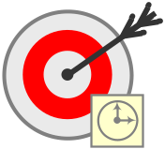





Business Motivation Elements
Goal | A statement about a state or condition of the business to be brought about or sustained through appropriate means.
Objective | A statement of an attainable, time-targeted, and measurable target that the business seeks to meet in order to achieve its goals.
Strategy | A course of action that is an element of a plan devised through the science and art of business leadership exercised to ensure the most advantageous conditions
Tactic | A course of action that is a device or expedient to be employed as part of a strategy
Policy | A course of action that guides and usually determines present and future decisions
Rule | A statement that defines or constrains some aspect of the business. It is intended to assert business structure or to control or influence the behavior of the business
Decision | The act or process of deciding; determination, as of a question, by making a judgment

Slide 21
Business Motivation Diagram
«supports»
«supports»
«governs»
desiredResult: Goal
program: Strategy
principle: Policy
«guides»
«supports»
«guides»
timeboxedResult: Objective
project: Tactic
choice: Decision
detailedConditions: Rule

Slide 22
Business Use-Case Model
Functional Viewpoint
  Focuses on what an enterprise does
  Functional elements and primary interactions
Purpose
  Provides a model of the enterprise’s intended functions and environment
  Describes interactions between the enterprise and external business actors
  Makes up part of the enterprise’s behavioral requirements
Stakeholders
  Producers
    Business Analyst
    Enterprise Architect
  Consumers
    Customer
    User
    Architecture Reviewer
    Developer
    Tester
UML Diagrams
  Use-Case Diagram
  Interaction Overview Diagram
  Activity Diagram
UML Elements
  Business Actor
  Business Use-Case
  Activity
  Action
  Object
  Decision/Merge
UML Relationships
  Association
  «include» Dependency
  «extend» Dependency
  Generalization
  Control Flow
  Object Flow

Slide 23

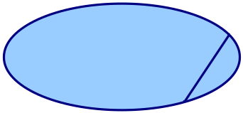
Business Use-Case Elements
BusinessActor | A person or system outside of a business that interacts with one or more business use-cases. A BusinessActor is a refinement of one or more business environment participants such as Customers, Suppliers, Regulators, etc defined in the Business Environment Model.
BusinessUseCase | A description of a business’s behavior in terms of its interactions with BusinessActors and events that exist in the business environment. A collection of BusinessUseCases form the realization of a BusinessService. Each BusinessUseCase should support one or more Goals defined in the Business Motivation Model.

Slide 24
Business Use-Case Diagrams
Business Environment
Customer
BusinessService
«refines»
Related Use-Cases
BusinessActor
BusinessUseCase
BusinessUseCase
«supports»
«supports»
«supports»
Business Motivation
goalX: Goal
goalY: Goal
goalZ: Goal

Slide 25
Business Use-Case Diagrams
Business Boundary
BusinessActor
BusinessUseCase
GeneralUseCase
GeneralActor
SpecificUseCaseA
SpecificUseCaseB
SpecificActor

Slide 26
Business Use-Case Diagrams
swimlane: BusinessActor
swimlane: Business
Begin Use Case
Action
Action
Decision?
[choice A]
Action
Action
[choice B]
End Use Case

Slide 27
Business Analysis Model
Analysis Viewpoint
  Focuses on how an enterprise performs its functions at a high level
  Abstract representation of structure and behavior
Purpose
  Describes business processes at a high level of abstraction
  Identifies business analysis classes and their collaborations
Stakeholders
  Producers
    Enterprise Architect
    Business Analyst
  Consumers
    Business Process Owner
    Architecture Reviewer
    Application Architect
    Business System Analyst
UML Diagrams
  Class Diagram (Analysis Level)
  Interaction Overview Diagram
  Sequence Diagram
  Communication Diagram
UML Elements
  «BusinessProcess» Collaboration
  Business Analysis Classes
    «BusinessBoundary» Class
    «BusinessWorker» Class
    «BusinessEntity» Class
    «BusinessEvent» Class
  Instance
  Lifeline
  Combined Fragment
UML Relationships
  Dependency
  Association
    Aggregation
    Composition
  Generalization
  Realization

Slide 28
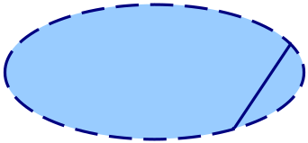




Business Analysis Elements
BusinessProcess | A collection of related, structured activities or tasks that produce a specific service or product, usually for one or more BusinessActors. A BusinessProcess may be a realization (implementation) of a BusinessUseCase. Each BusinessProcess should support one or more Goals or Objectives.
BusinessBoundary | A business element that acts as an interface between a BusinessActor and a business.
BusinessWorker | A business element that embodies a set of behaviors, skills, and responsibilities that are applied to executing the activities of a business process.
BusinessEntity | A business element that is an informational or physical item that is input to or output from a business process, or is used in the internal activities of a business process.
BusinessEvent | An event that has significance to a business and may trigger one or more business process activities.

Slide 29
Business Analysis Diagrams
Business Use-Case
BusinessUseCase
BusinessProcess
BusinessProcess
«supports»
«supports»
«supports»
Business Motivation
goalX: Goal
goalY: Goal
goalZ: Goal

Slide 30
Business Analysis Diagrams
BusinessEntity
BusinessEvent
BusinessBoundary
BusinessWorker
BusinessWorker
BusinessActor
BusinessEntity
BusinessWorker

Slide 31
Business Analysis Diagrams
aggregation
aggregation
GeneralEntity
SharedEntity
WholeEntity
generalization
composition
association
SpecificEntity
SpecificEntity
BusinessEntity
BusinessEntity
PartEntity

Slide 32
Business Analysis Diagrams
:BusinessActor
:BusinessBoundary
:BusinessEvent
:BusinessWorker
initiateProcess()
performAction(input)
«create»
:BusinessEntity
setAttribute(value)
getAttribute()
value
notfiy(event)
«destroy»
output
output

Slide 33
Business Design Model
Design Viewpoint
  Focuses on how an enterprise performs functions at a detailed level
  Concrete representations of structure and behavior
Purpose
  Refines the Analysis Model elements
  Introduces specific details that illustrate how the enterprise implements business processes in terms of people and application systems
Stakeholders
  Producers
    Application Architect
    Developer
  Consumers
    Architecture Reviewer
    Developer
    Tester
UML Diagrams
  Class Diagram (Design Level)
  Component Diagram
  Sequence Diagram
  Communication Diagram
UML Elements
  Collaboration (Design Level)
  Component
  Interface
  Class
  Instance
  Lifeline
  Combined Fragment
UML Relationships
  Dependency
  Association
    Aggregation
    Composition
  Generalization
  Realization

Slide 34


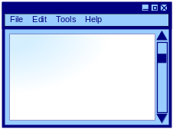


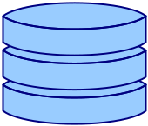





Business Design Elements
BusinessAutomation | A realization (implementation) of a BusinessWorker that is a software system or mechanical device that executes the activities of a business process.
ApplicationSystem | A kind of BusinessAutomation that is a software application, often composed of several types of components.
UserInterfaceClient | A component of an ApplicationSystem that provides a user interface for accessing the functions and data of the application. If the UserInterfaceClient is used by BusinessActors, then it is a realization of a BusinessBoundary defined in the Business Analysis Model.
BatchClient | A component of an ApplicationSystem that provides batched processing—usually in the form of scripted jobs.
BusinessServer | A component of an ApplicationSystem that provides the primary business logic and services of the application. BusinessServers are usually connected to UserInterfaceClients and/or BatchClients. BusinessServers are realizations of BusinessWorkers defined in the Business Analysis Model.
Database | A component of an ApplicationSystem that stores and manages the data of an application. Databases and their connected BusinessServers are often realizations of BusinessEntities defined in the Business Analysis Model.
BusinessRole | A role defined in the business and performed by a person or group that executes the activities of a business process. A BusinessRole can realize a BusinessBoundary or BusinessWorker defined in the Business Analysis Model.
OrganizationalUnit | A part of the organizational structure of the business which includes: divisions, departments, groups, workgroups, committees, forums, and other organizational forms. OrganizationalUnits are usually structured as hierarchies or networks. OrganizationalUnits can sometimes perform BusinessRoles.
Employee | A person employed in the business and a member of one or more OrganizationalUnits. Employees perform one or more BusinessRoles.
BusinessEnsemble | A realization of a BusinessWorker that is a combination of an Employee performing a BusinessRole in conjunction with some kind of BusinessAutomation such as an ApplicationSystem.

Slide 35
Business Design Diagrams
Business Analysis
BusinessBoundary
BusinessWorker
BusinessEntity
BusinessActor
«ApplicationSystem»
Application
BusinessRole
Interface/API/Protocol
Interface/API/Protocol
UserInterfaceClient
BusinessServer
Database

Slide 36
Business Design Diagrams
«OrganizationalUnit»
Committee
guides ▶
«OrganizationalUnit»
Department
contains
«OrganizationalUnit»
Team
«OrganizationalUnit»
Team
«OrganizationalUnit»
Team
«performs»
ABC
«performs»
BusinessRole
BusinessRole
DEF
GHI
JKL
MNO

Slide 37
Business Deployment Model
Deployment Viewpoint
  Focuses on the environment into which an application is deployed
  Hardware and network requirements, technology compatibility, and other physical constraints
Purpose
  Describes the packaging of Components into Artifacts
  Maps Artifacts onto Nodes that represent execution environments
Stakeholders
  Producers
    Application Technology Partner
    Developer
  Consumers
    System Administrator
    Architecture Reviewer
    Developer
    Tester
UML Diagrams
  Deployment Diagram
UML Elements
  Artifact
  Component
  Node
UML Relationships
  Dependency
  «manifest» Dependency
  Association
  Generalization
  Nesting

Slide 38








Business Deployment Elements
BusinessLocality | A physical location and facilities of the business such as campus site or office building.
CommunicationNetwork | A data and voice network that connects BusinessLocalities and enables communication between computer systems.
Client | A client computer system such as a desktop or laptop computer.
Server | A server computer system.
Mainframe | A mainframe computer system.
Storage | A storage device such as a disk drive or a network attached storage unit.
Printer | A networked printer.
Scanner | A networked scanner.

Slide 39
Business Deployment Diagrams
«CommunicationNetwork»
PhoneNetwork
«communicates»
«BusinessLocality»
Site
«CommunicationNetwork»
IntegratedNetwork
«communicates»
«BusinessLocality»
Building
«communicates»
«CommunicationNetwork»
ComputerNetwork
«BusinessLocality»
DataCenter
«Client»
PC
«communicates»
«Server»
Server
«Mainframe»
Mainframe
«communicates»
«Storage»
NAS
«communicates»
«communicates»

Slide 40
Business Deployment Diagrams
«Client»
PC
«Server»
ApplicationServer
«Server»
DatabaseServer
Interface/API/Protocol
Interface/API/Protocol
UserInterfaceClient
BusinessServer
Database
«communicates»
«communicates»
«communicates»
«CommunicationNetwork»
ComputerNetwork

Slide 41
Sparx Enterprise Architect

Slide 42
Sparx Enterprise Architect Contents
In this section
  Introduce the Enterprise Architect UML modeling tool
  Demonstrate Enterprise Architect
Points to think about
  How can all aspects of an enterprise architecture be visualized
  What is the importance of connections between models
  What models are most relevant to your work

Slide 43
Introduction
Sparx Enterprise Architect (Sparx EA)
Key Features
  UML 2 Modeling
  Source Code/Model Generation
    Generate UML Models from Source Code
    Generate Source Code from UML Models
  Document Generation
    HTML
    Rich Text
  Eclipse Integration
Current AFTG Standard UML Modeling Tool
  Preferred tool for Application Modeling
  Exploring suitability for Enterprise Modeling

Slide 44
Sparx EA Demonstration
Show the basic layout of the tool
Present the enterprise model set template
  Example Enterprise: American Funds Architecture Program
Demonstrate some common tasks
  Add an actor and use-case to the use-case model
  Modify an analysis class diagram in the analysis model
  Modify a sequence diagram in the analysis model
Demonstrate some useful features
  Generate UML models from source code
  Generate HTML documentation from enterprise model set
  Generate Rich Text documentation from use-case model
Begin Demonstration

Slide 45
Wrap Up

Slide 46
Feedback
What did you like about the tutorial?
What could be done differently to improve the tutorial?
What elements of the tutorial are puzzling or unclear?
Please email feedback to JFL@capgroup.com

Slide 47

OOAD Knowledge Network Recruiting
Interested in having further discussions about
  Object-Oriented Analysis and Design
  Modeling Techniques
  Application Architecture Best Practices
  Design Patterns
Contribute to AFTG’s Object-Oriented Modeling Practices
  Provide feedback on how we use UML in application development
  Influence what OOAD tools become part of AFTG’s portfolio
  Discover and document new design patterns
Join the OOAD Knowledge Network
  A new knowledge network that is being formed
  OOAD Knowledge Network Web Site
    http://phx1vapp206:14000/knowledgenetworks/ooad/default.aspx
  Send email to JFL@capgroup.com

Slide 48
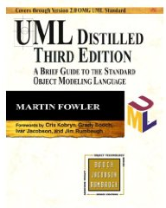
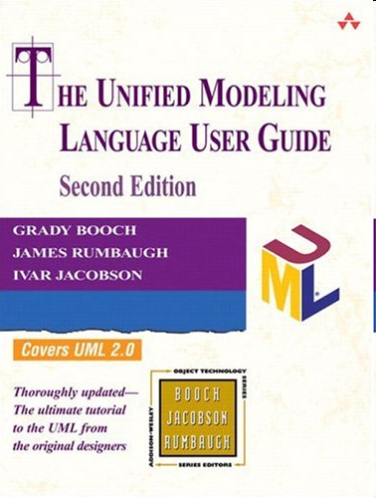
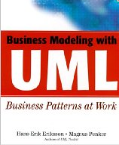
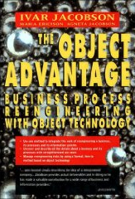

Additional Information
Books
  http://www.amazon.com/UML-Distilled-Standard-Addison-Wesley-Technology/dp/0321193687
  http://www.amazon.com/Unified-Modeling-Language-Addison-Wesley-Technology/dp/0321267974
  http://www.amazon.com/Business-Modeling-UML-Patterns-Work/dp/0471295515
  http://www.amazon.com/Object-Advantage-Business-Reengineering-Technology/dp/0201422891
  http://www.amazon.com/Use-Cases-Patterns-Blueprints-Software/dp/0131451340

Slide 49
Additional Information
Web Sites
  http://domaindrivendesign.org/
  http://www.booch.com/architecture/
  http://www.martinfowler.com/
  http://www.hillside.net/
Conferences
  http://www.oopsla.org
  http://hillside.net/conferences/plop.htm
White Papers, Articles, and Presentations
  Architecture Concepts
    http://phx1vapp206:14000/knowledgenetworks/aaf/Shared%20Documents/Architecture%20Method/AdaptiveEnterpriseArchitecture.doc
    http://phx1vapp206:14000/knowledgenetworks/aaf/Shared%20Documents/Architecture%20Method/SoftwareArchitecture.ppt
  IEEE 1471
    http://phx1vapp206:14000/knowledgenetworks/aaf/Shared%20Documents/Architecture%20Method/1471-2000.pdf
    http://en.wikipedia.org/wiki/IEEE_1471

Slide 50
Appendix

Slide 51
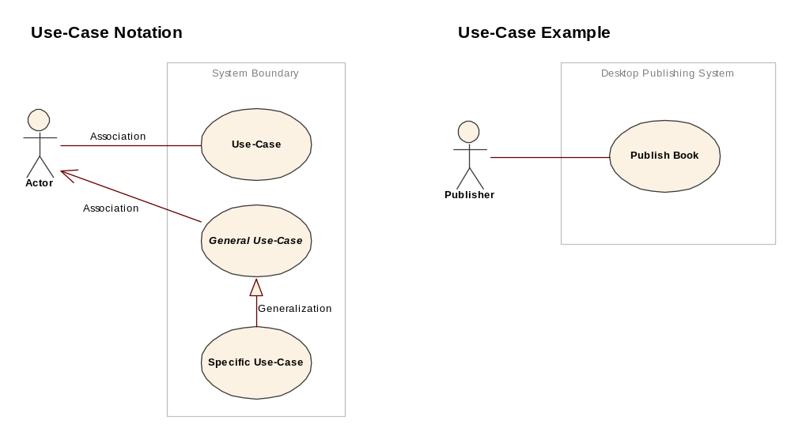
UML Notation Guide: Use-Cases

Slide 52
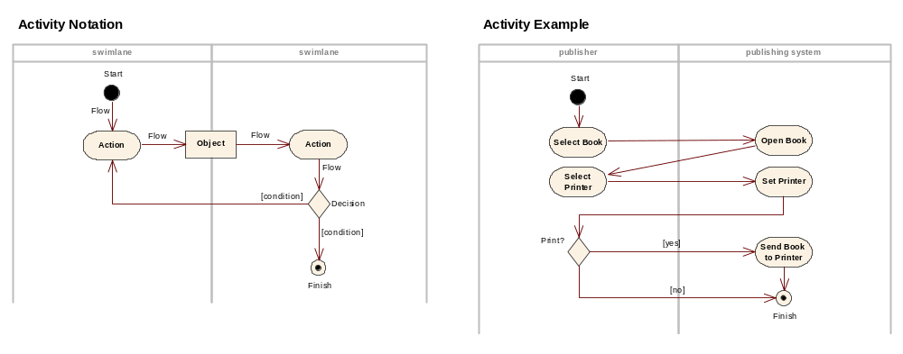
UML Notation Guide: Activities

Slide 53
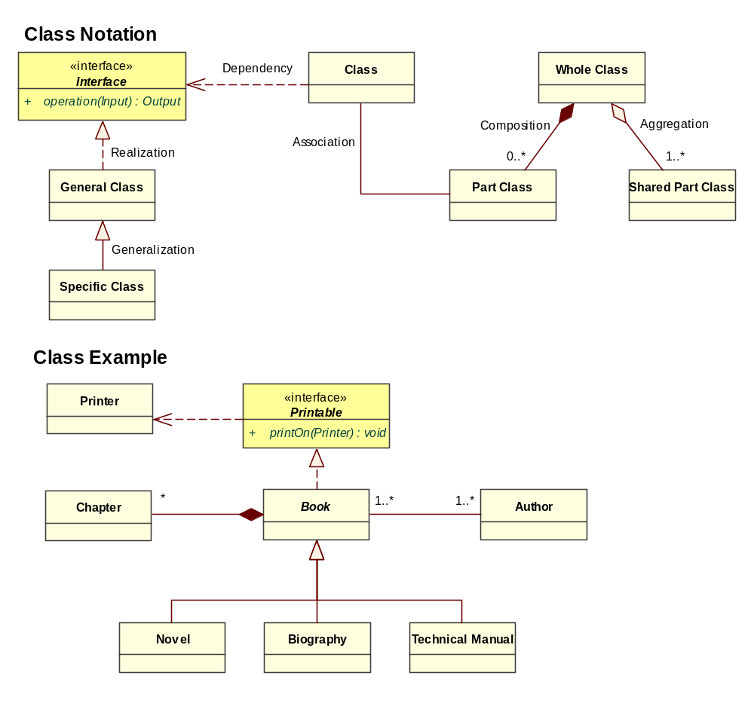
UML Notation Guide: Classes

Slide 54
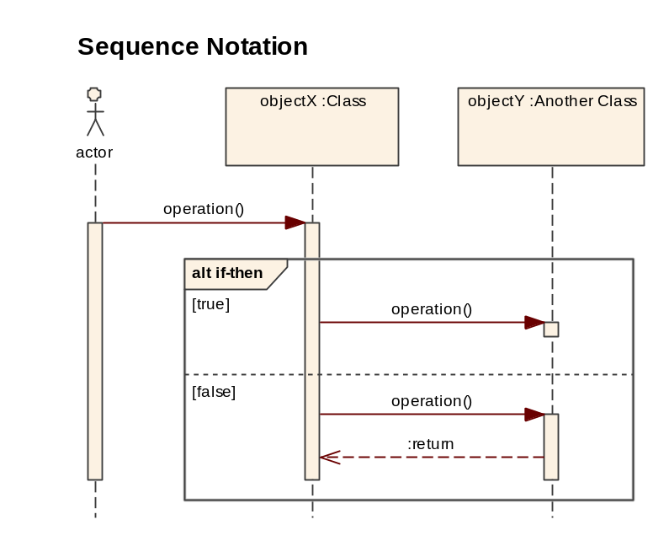
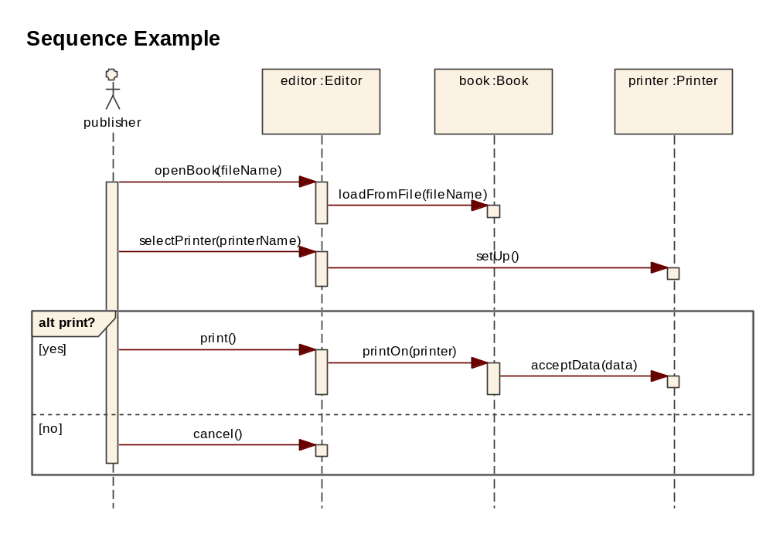
UML Notation Guide: Sequences

Slide 55
Sparx EA Installation
Download the Enterprise Architect setup program
  http://www.sparxsystems.com.au/securedownloads/easetupfull.exe
  You will need the following user ID and password:
    User ID: ea0608
    Password: theyra15
Run the setup program
Set up a license key:
  map \\Snovapp046\keystore to a drive
  start EA
  Add Key → Shared Key
  Select drive and sskeys.dat
  Click EA Corporate Edition
After this setup you will be able to run Enterprise Architect without further setup

