Slide 1


















HM11 C41AB/C43AB/C46AB
I2C dumper user guide
2026/08/24

Slide 2
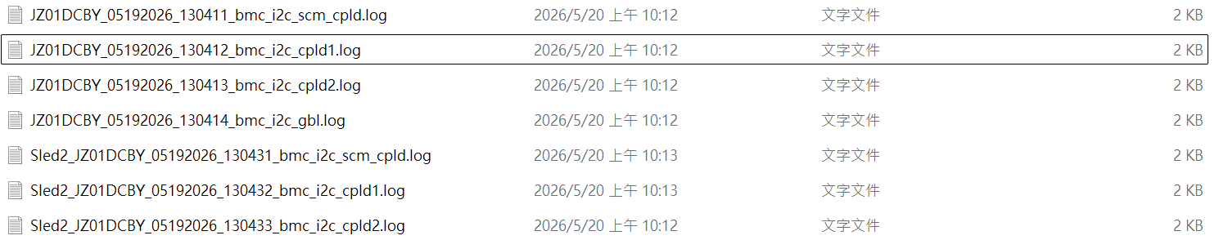
Preparation the input file ( Two ways - One )
Execute the corresponding BMC command to obtain the I2C dump log.
i2cdump -y -f 15 0x60 (DC-SCM)
i2cdump -y -f 6 0x30 (Global FPGA)
i2cdump -y -f 5 0x30 (HPM FPGA1)
i2cdump -y -f 5 0x31 (HPM FPGA2)
Save the output as a text file (log file).
Rename the files using the following naming convention:
SLEDy_xxx_scm_cpld
SLEDy_xxx_cpld1
SLEDy_xxx_cpld2
SLEDy_xxx_glb
Note : xxx can be any user-defined prefix.
SLEDy indicates the sled number, where y = 1, 2, 3, or 4.
The order is flexible. As long as the filename contains the corresponding keywords (such as SLEDy, scm_cpld, cpld1, cpld2, or glb), the parser can identify the file correctly.

Slide 3
Preparation the input file ( Two ways - Two )
Execute the corresponding BMC command to obtain the I2C dump log.
i2cdump -y -f 15 0x60 (DC-SCM)
i2cdump -y -f 6 0x30 (Global FPGA)
i2cdump -y -f 5 0x30 (HPM FPGA1)
i2cdump -y -f 5 0x31 (HPM FPGA2)
Save the all output as a same text file (log file).
And the content format should also be adjusted and organized by SLED, as shown below

Slide 4
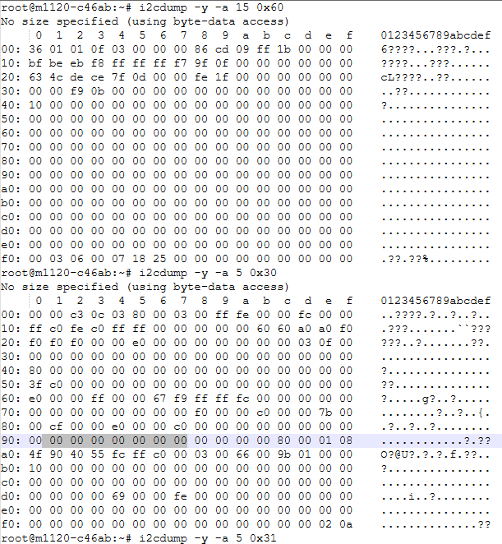
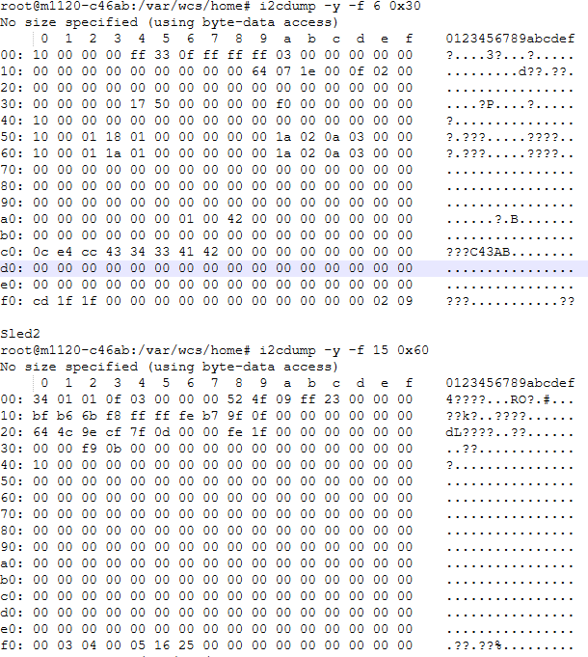
The command
I2C dump content
Grouped by SLED (e.g., SLED1, SLED2, SLED3, SLED4)

Slide 5
Sample file
Two ways - One
Two ways - Two

Slide 6
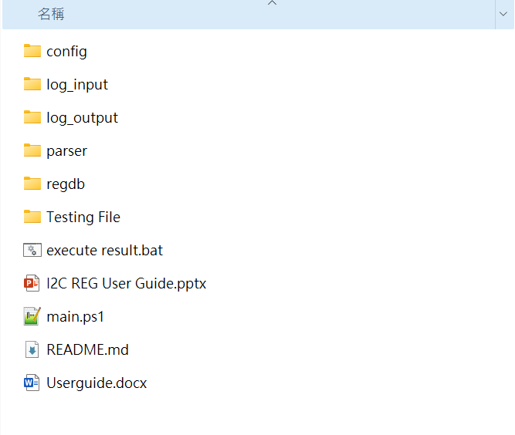
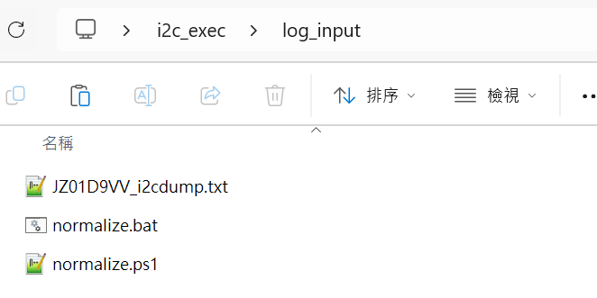
Put the log / txt file into the log_input file
Two output file formats will be generated. 1. Select either output file. 2. Copy the selected file into the log_input directory.

Slide 7
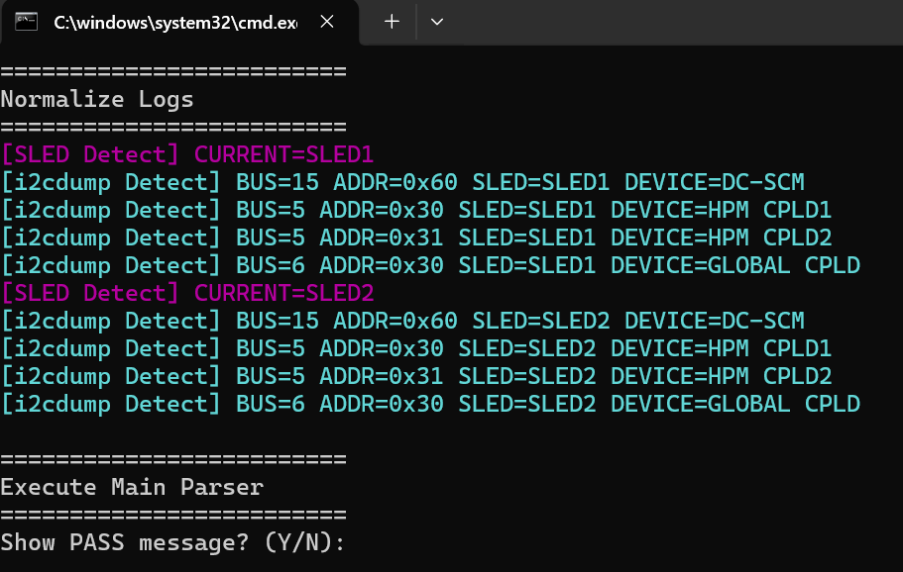
Click the execute result.bat
1. Click the execute result.bat

Slide 8
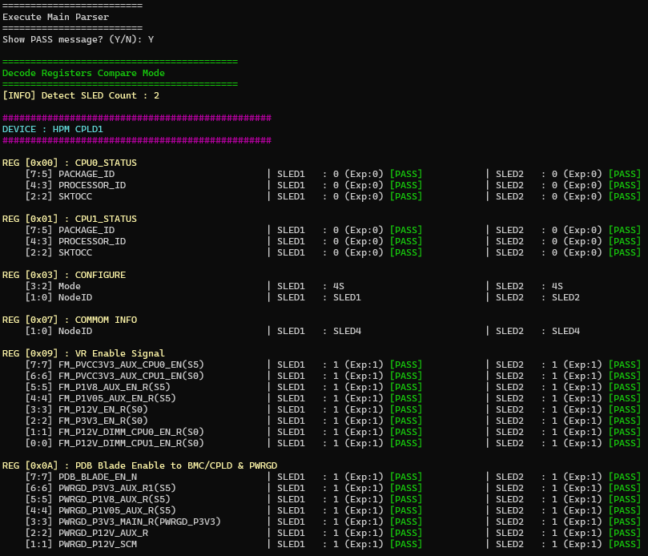
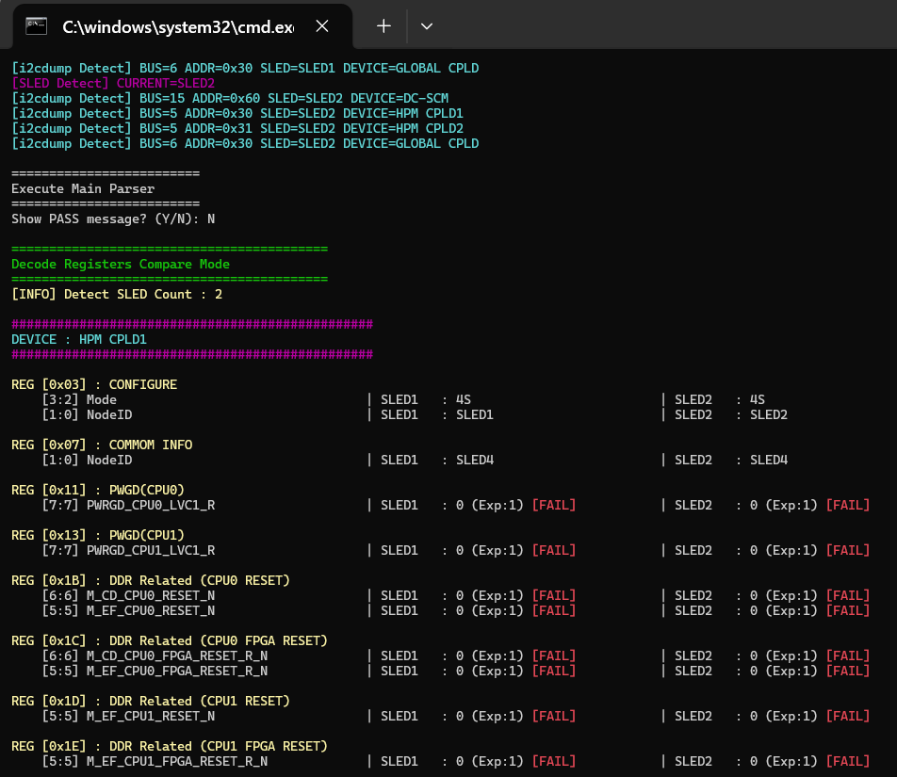
Enable or disable the PASS log output (based on your requirements)

Slide 9
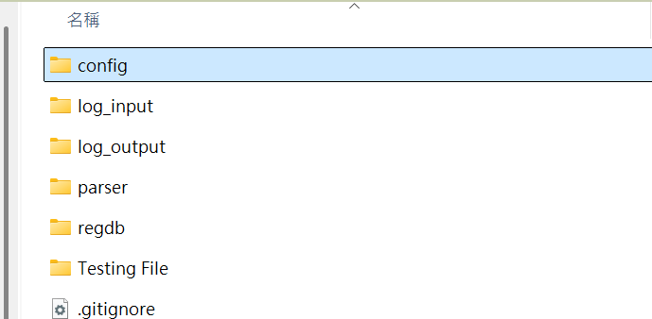

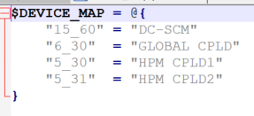
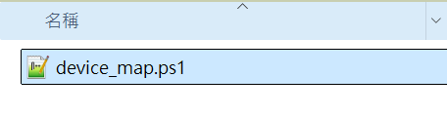
Update the Code for Another Project
Update the I2C command by BMC For Ex : HM12 HPM CPLD vs HM11 HPM CPLD

Slide 10
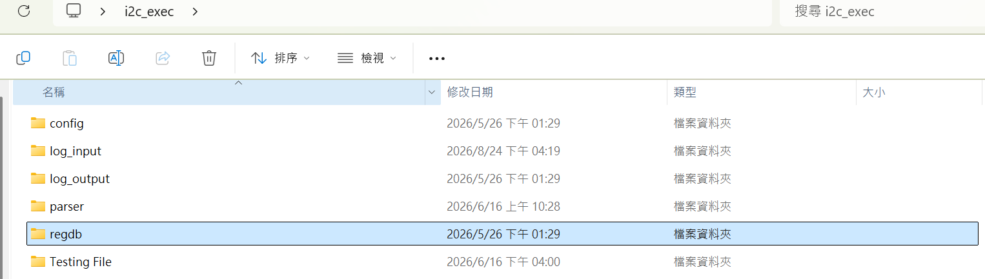
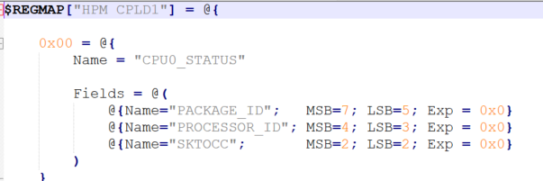
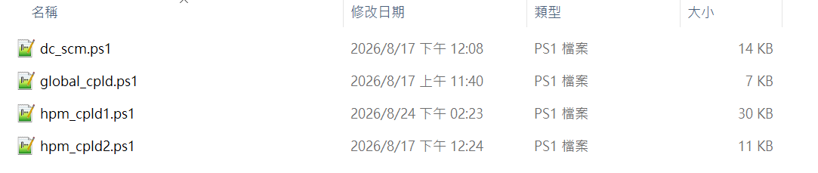

Update the Code for Another Project
Update register dB for Project define

