Slide 1
Airbnb new York data visualization
A short brief demo of the power of Python for data visualization by John Liu

Slide 2
Introduction
Python is an excellent language for data analytics due to its large community and ease of use
The dataset was grabbed from Kaggle; a popular machine learning competition website that also offers free datasets for data analytics and machine learning
Link: https://www.kaggle.com/dgomonov/new-york-city-airbnb-open-data/kernels
Matplotlib was the library used to produce the graphs
This entire project was done over several hours; much of which went into learning Matplotlib and data manipulation skills in Python, something that will make producing my next project much better!

Slide 3
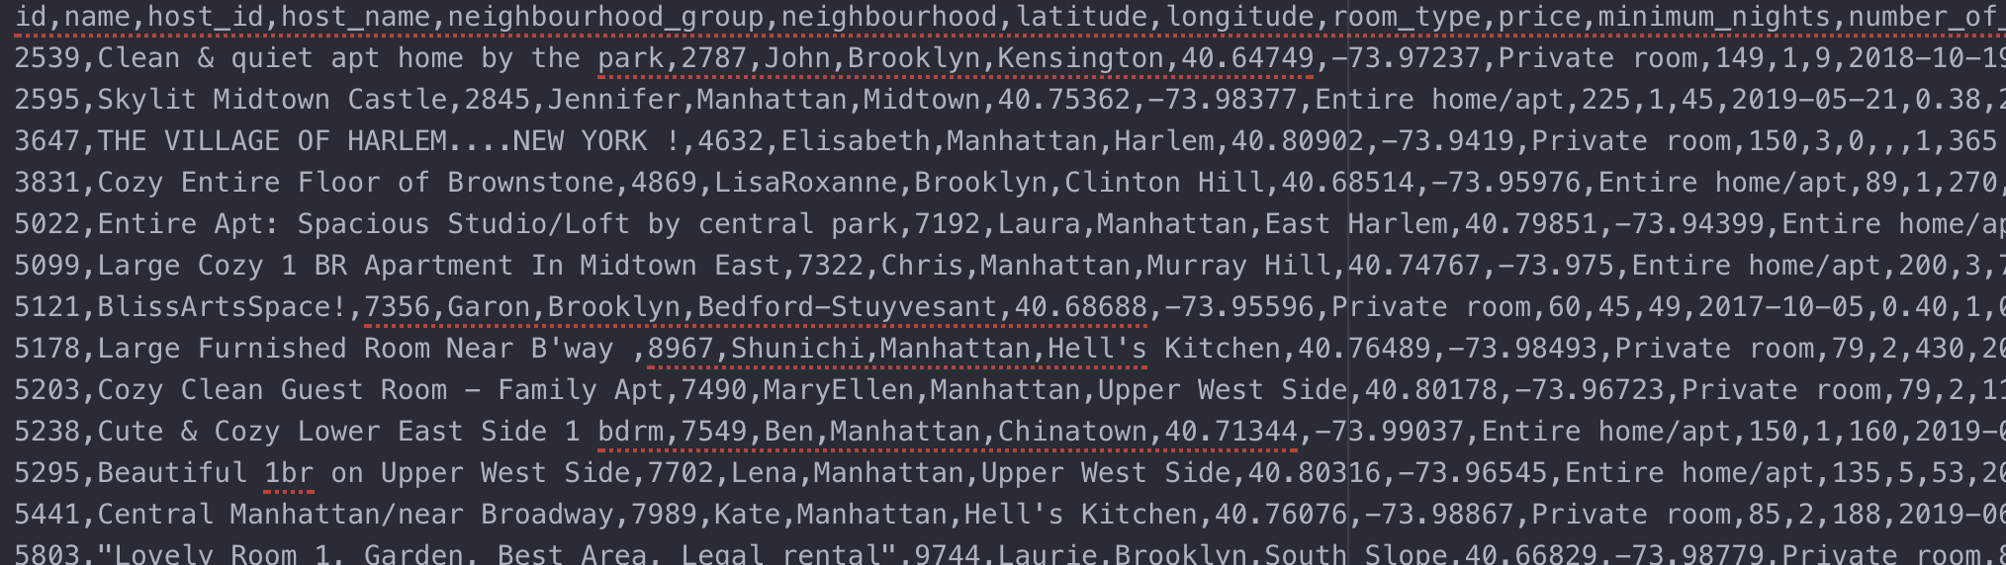
Data Extraction
The dataset from Kaggle is a large CSV file; its contents look like this
We can use Pythons CSV module to parse this

Slide 4
Data Visualization
After parsing and processing the data; we can begin data visualization!
The Matplotlib lib is very easy to use and robust in terms of functionality
A few lines of code allow us to generate the following image on the next slide

Slide 5
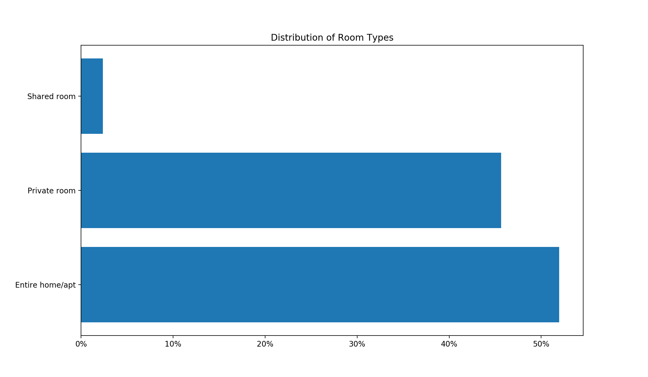

Slide 6
What can we observe?
Most people are renting a whole home or buying a private room; with slightly more people opting for the whole home
Very few people have rented a shared room
We can infer that people much rather would have complete privacy

Slide 7
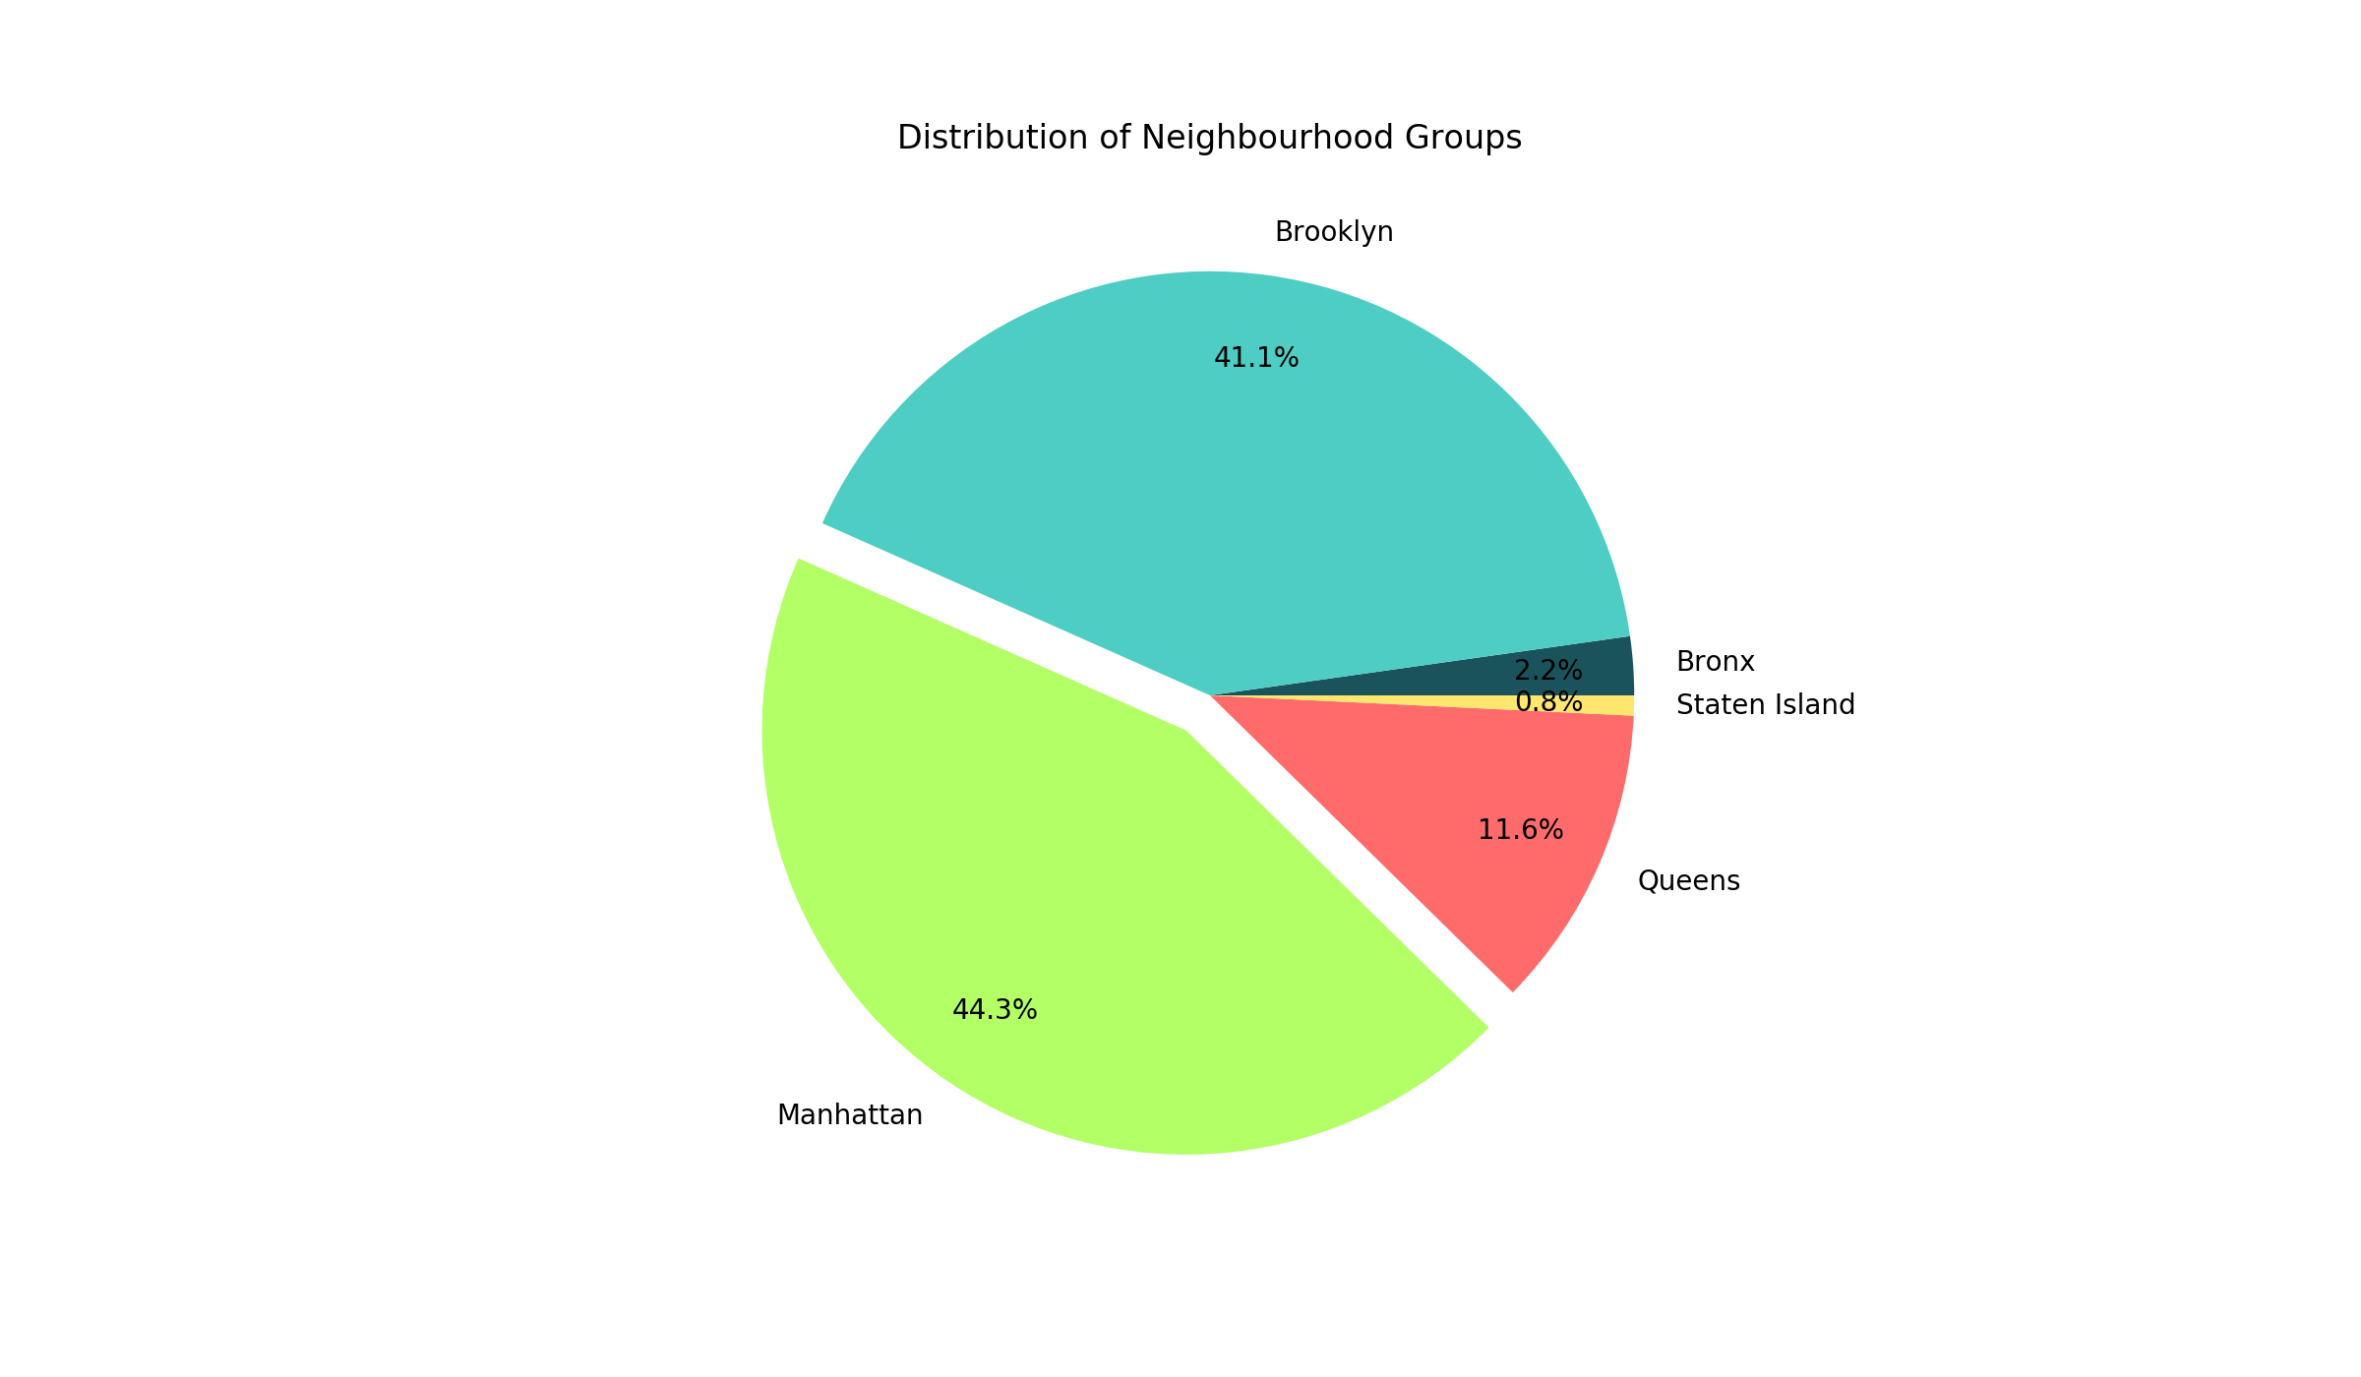

Slide 8
What can we observe?
Over 85% of Airbnb customers in New York lived in either Brooklyn or Manhattan
Few people lived in Queens and even fewer people lived in the Bronx or Staten Island
We can infer that people want to live closely to the most popular destinations of New York; the Statue of Liberty, Times Square, etc.

Slide 9
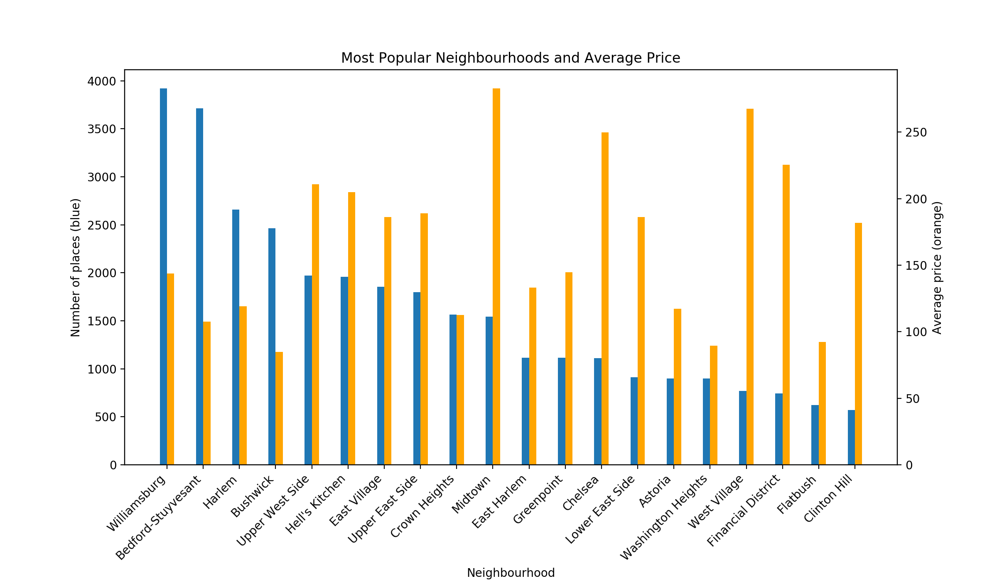
Note that I show only the top 20 most popular neighbourhoods

Slide 10
What can we observe?
Of the top four most popular neighbourhoods to rent in; three belong to Brooklyn, the other Manhattan
The top four also have price averages on the lower end of the range
Many of the other neighbourhoods have much higher price averages per night, for the savvier spenders
Generally the Manhattan neighbourhoods cost much more (which makes sense since Manhattan is all the most notable attractions of New York lie)

Slide 11
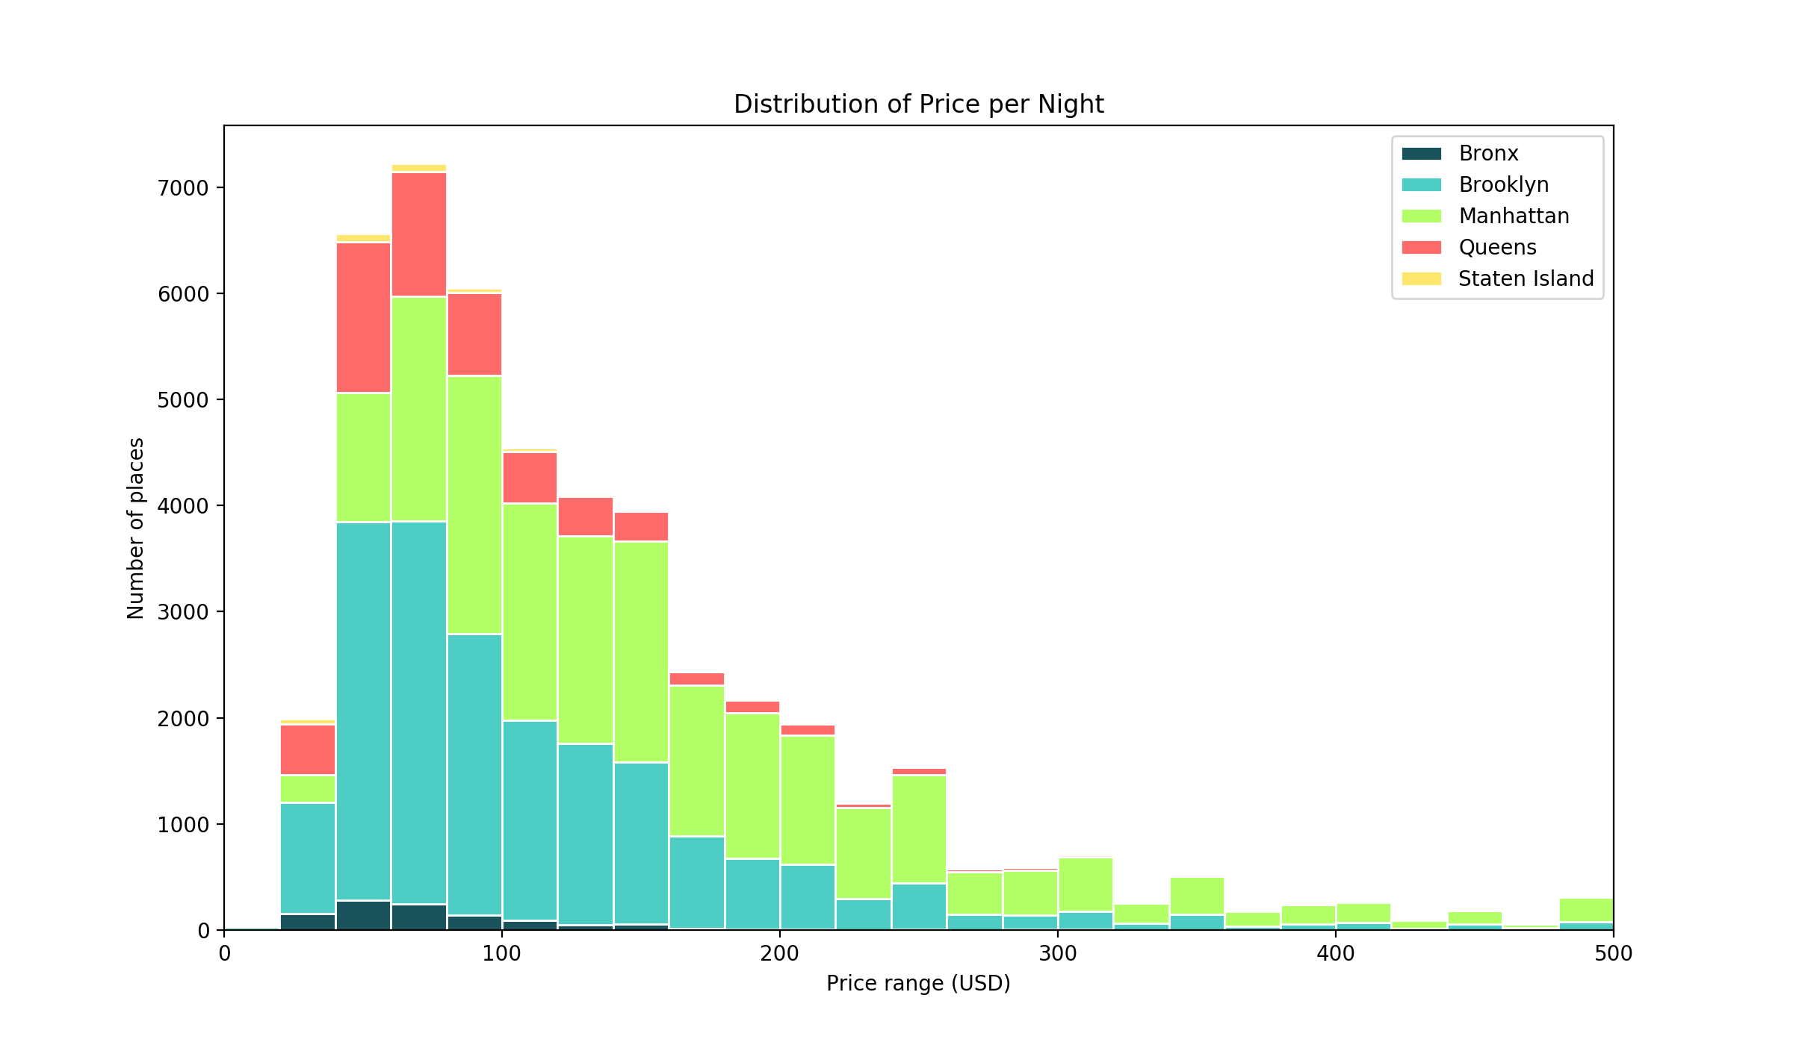
Note that I only show a price range of up to $500 USD. There are very few places that charge more than this.

Slide 12
What can we observe?
Like the previous graph about neighbourhoods; Manhattan is a lot more costly to rent per night than Brooklyn
Brooklyn has a lot more places for 40 and 60 USD per night than any where else by quite a bit
Past 140 USD, Manhattan starts to have a lot more places that cost more than anywhere else

Slide 13
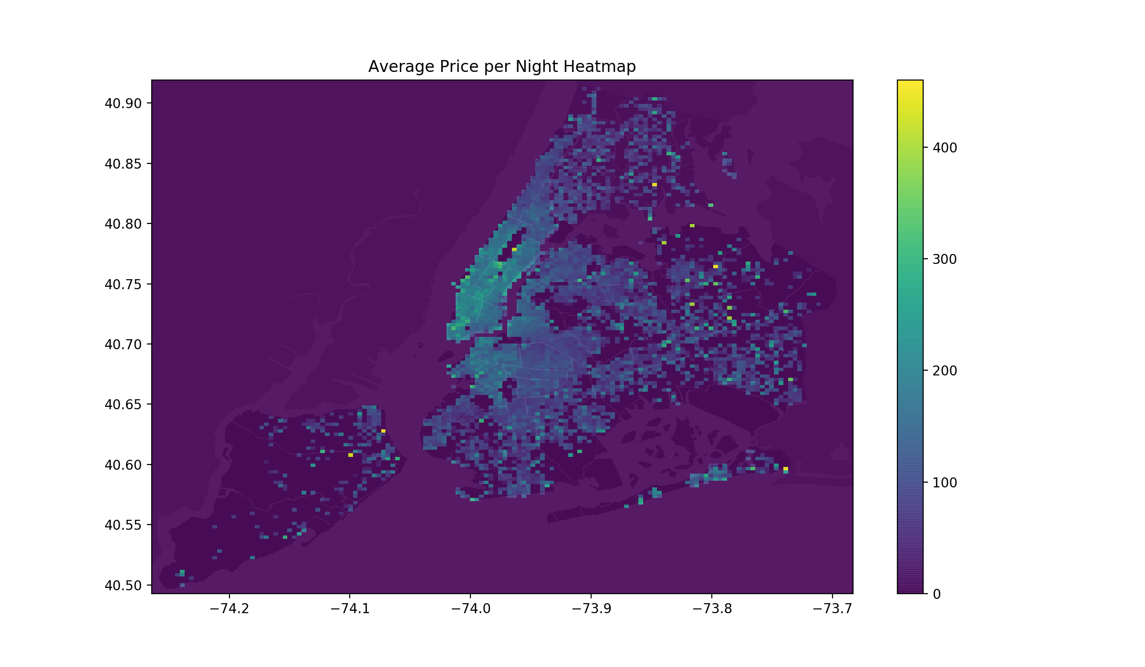

Slide 14
What can we observe?
As we can see from the heatmap, the closer we are to the downtown core of Manhattan, the more expensive the Airbnb rentals get
There are a few areas on the outskirts of New York that are quite costly; these could be due to some important landmark or some attraction
Very people want to go to Staten Island

Slide 15
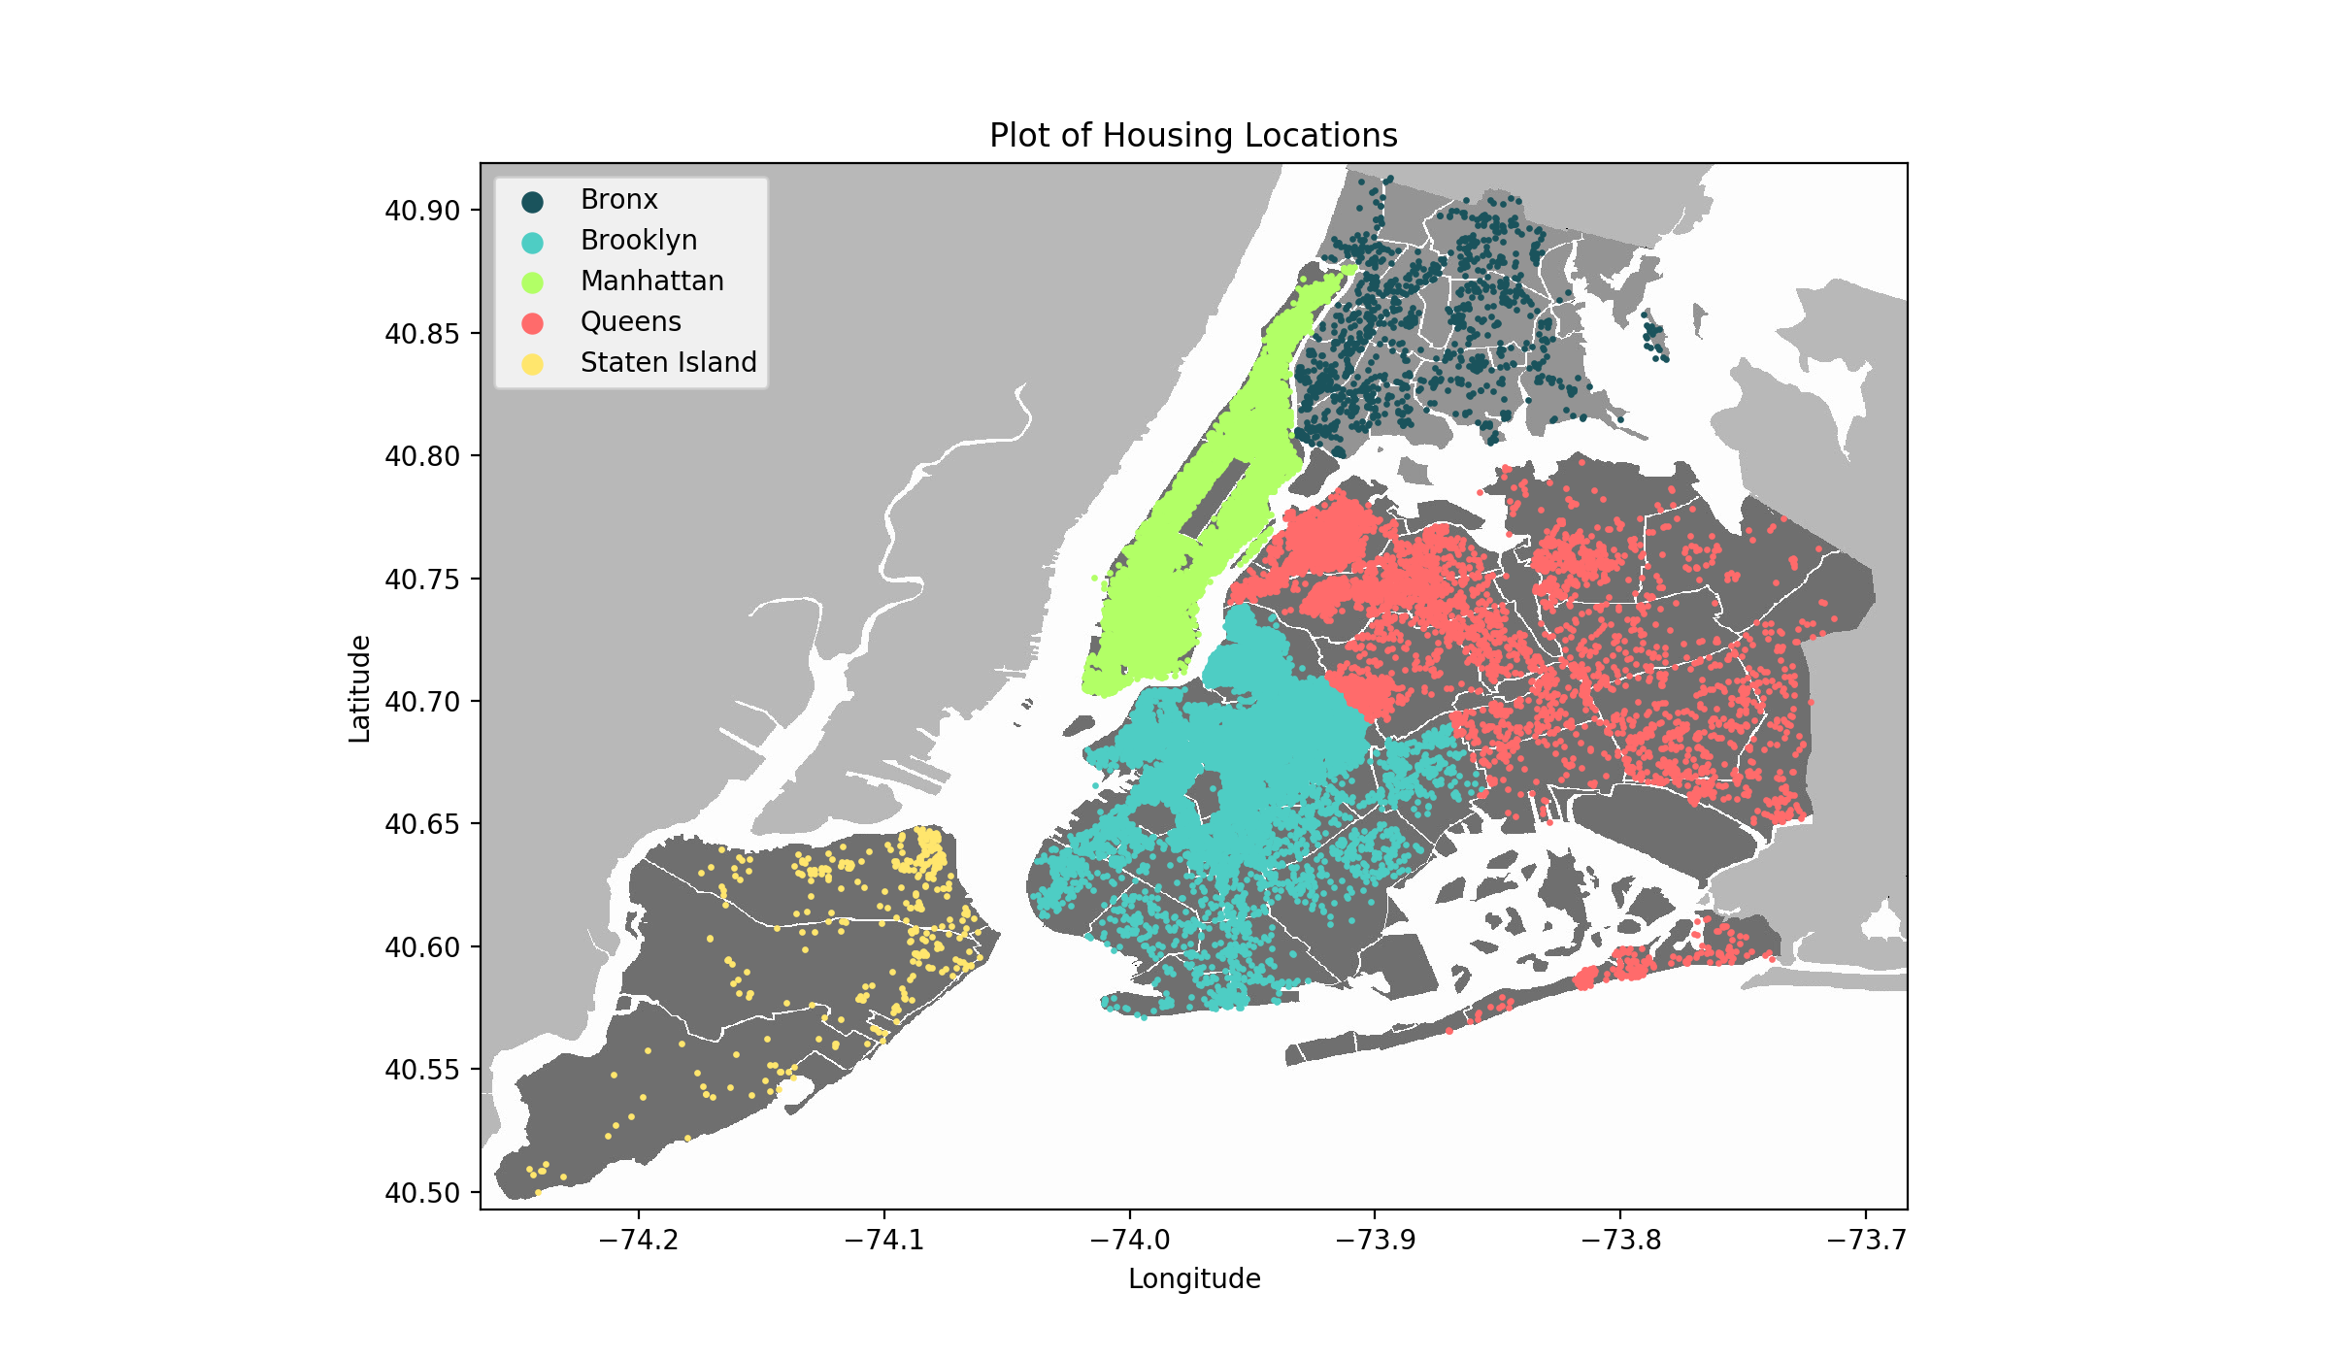

Slide 16
What can we observe?
The entirety of Manhattan is densely filled with Airbnb rentals
Upper and central Brooklyn is just as packed
The Bronx and Staten Island are very sparse; few people want to live in these Boroughs

Slide 17
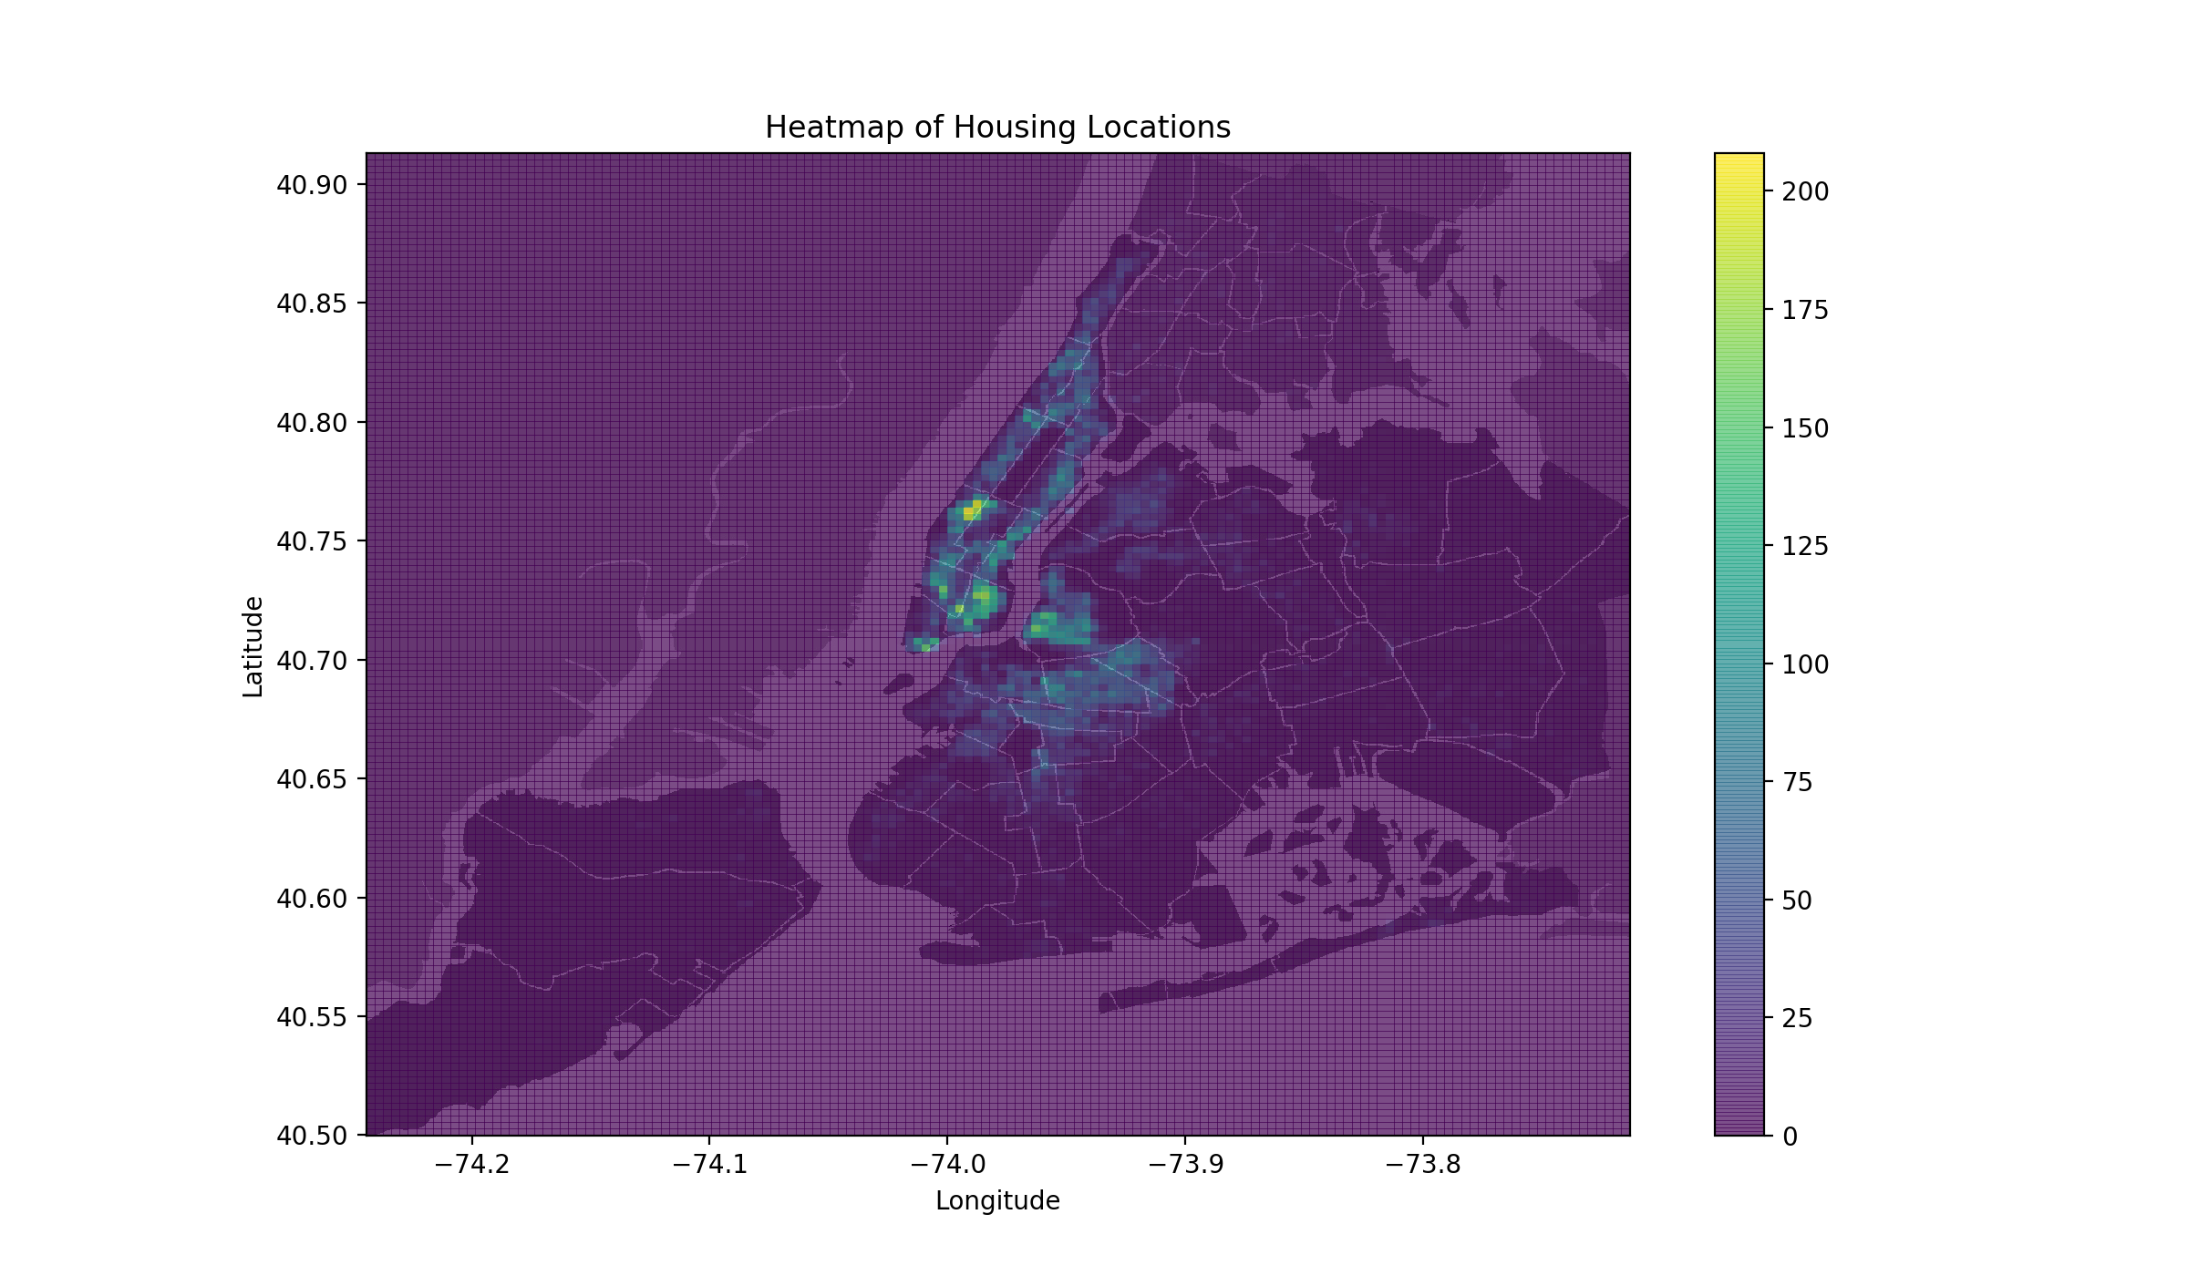

Slide 18
What can we observe?
Within Manhattan, the most popular spots are in the neighbourhoods of the Upper West Side and East Village; these are actually the 5th and 7th most popular neighbourhoods to stay in (as can be seen in the earlier graph)
We can see that that Williamsburgs is also quite densely populated; it was the most popular neighbourhood to stay in (same earlier graph)

Slide 19
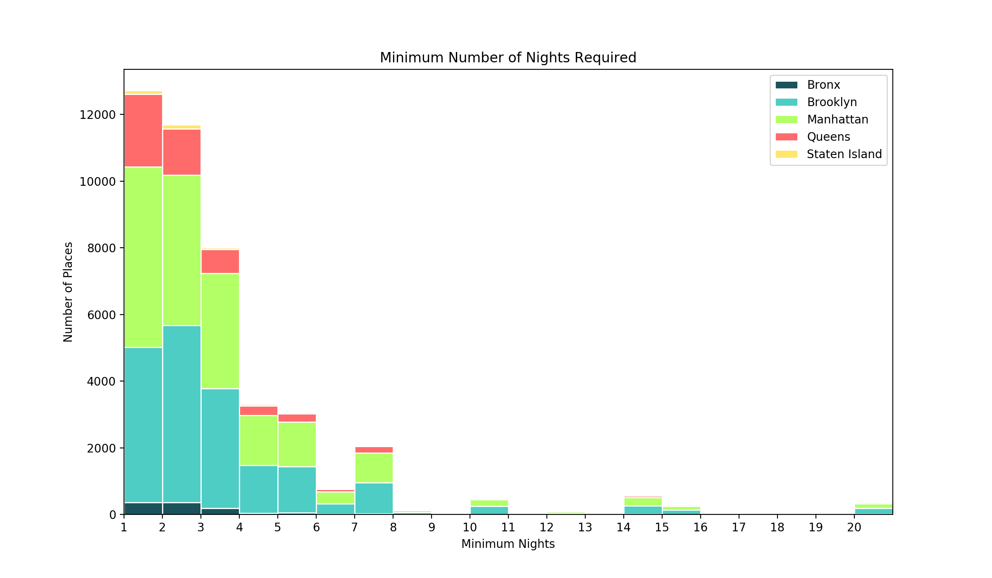

Slide 20
What can we observe?
Majority of places require you to stay at least one, two, or three nights
Some people ask for you to stay more than 4 or 5 nights

Slide 21
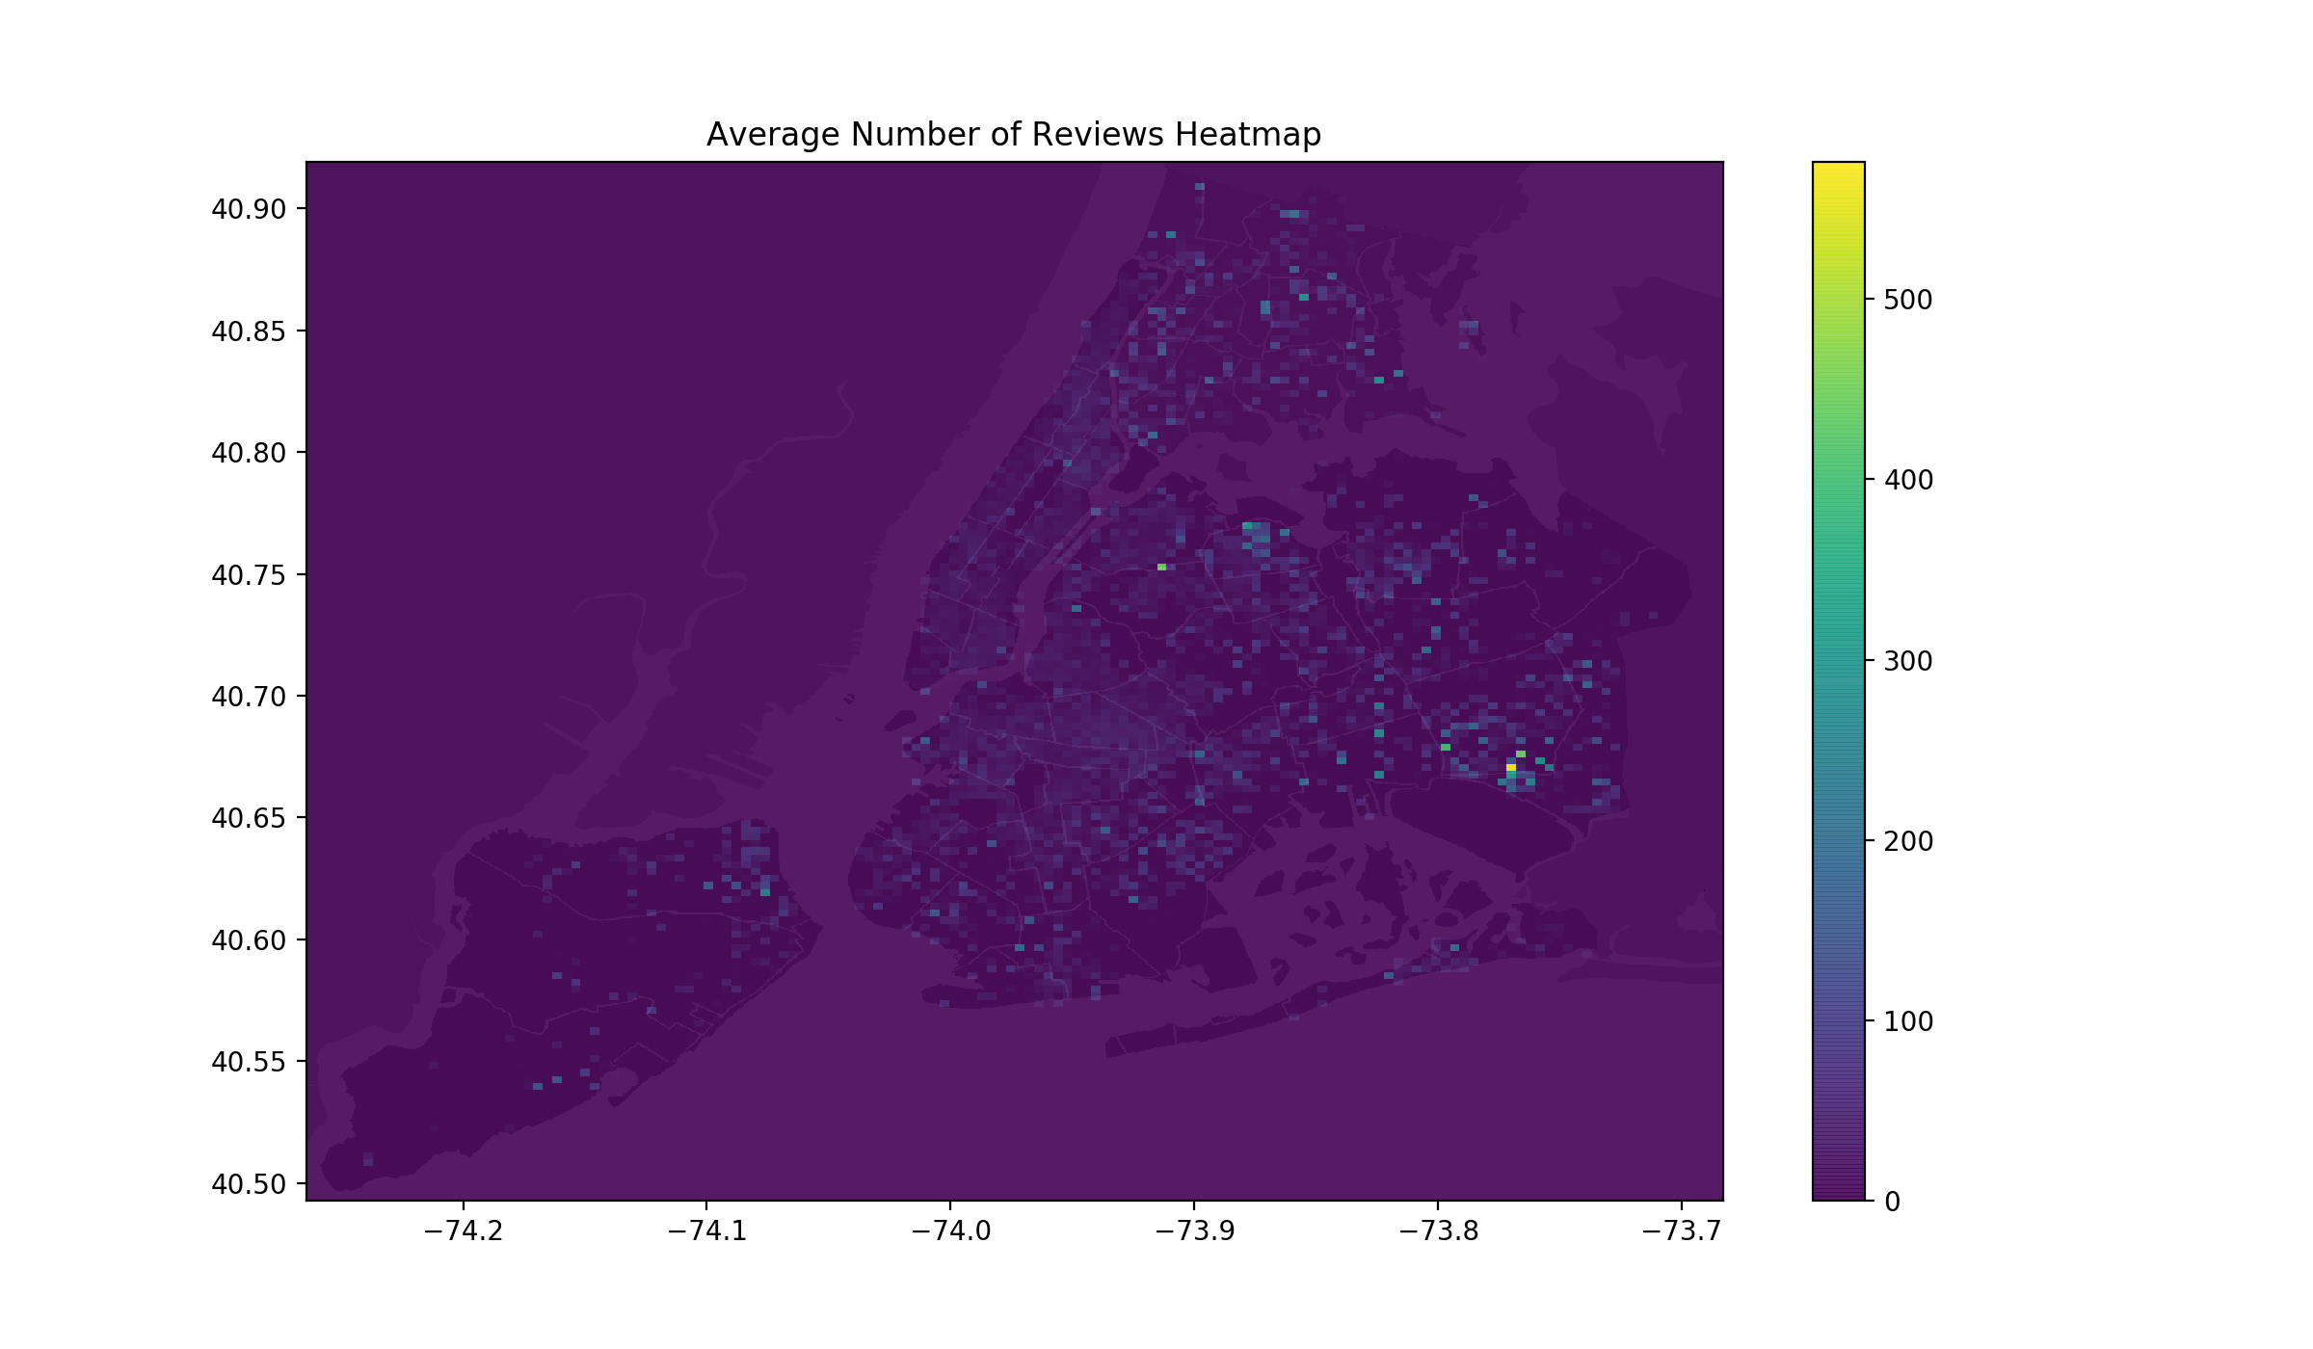

Slide 22
What can we observe?
While Manhattan and Brooklyn may be densely populated; very people give reviews to their Airbnb rentals
For some strange reason, a very large number of reviews have been given to a small spot on the east side of Queens

Slide 23
Conclusion
A question that you might ask is could we use machine learning here?
Ask, are there any possible correlations between any of the points of data given?
If the answer is no; then there really isn’t a use for machine learning here.
Although this dataset provides lots of insight into how Airbnb pricing and popularity in New York is like; there isn’t any place to apply machine learning
Perhaps if the dataset was much larger and provided information about the dates of when rentals were posted; we could forecast future pricing of Airbnbs in New York
However we were able to do some basic data visualization and draw various conclusions and inference from the data.
Thanks for reading!

