Slide 1
MVP
Break Song

Slide 2
MVC
Model 用於封裝與應用程式的業務邏輯相關的資料以及對資料的處理方法
View 能夠實現資料有目的的顯示
Controller 起到不同層面間的組織作用，用於控制應用程式的流程。它處理事件並作出回應。「事件」包括用戶的行為和資料 Model 上的改變。

Slide 3
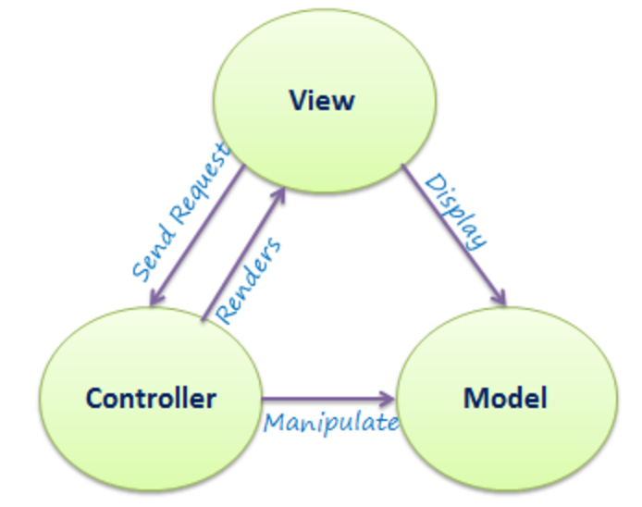
MVC

Slide 4
MVP based on MVC
MVP 是從經典的模式MVC演變而來，它們的基本思想有相通的地方：
Controller/Presenter 負責邏輯的處理
Model 提供數據
View 負責顯示
MVP與MVC有著一個重大的區別：
在MVP中View並不直接使用Model，它們之間的溝通是通過Presenter (MVC中的Controller)來進行的，所有的交互都發生在Presenter內部，而在MVC中View會從直接Model中讀取數據而不是通過Controller

Slide 5
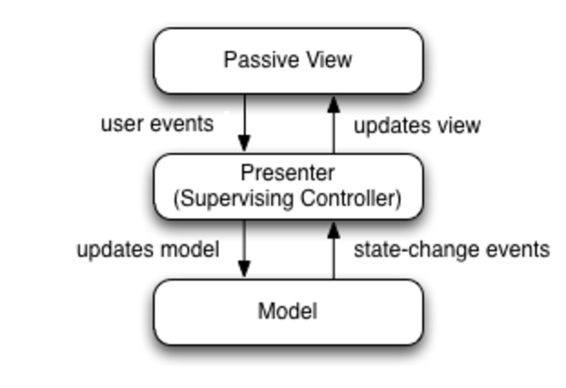
MVP

Slide 6
MVP
(Model) The model is an interface defining the data to be displayed or otherwise acted upon in the user interface.
(View) The view is a passive interface that displays data (the model) and routes user commands (events) to the presenter to act upon that data.
(Presenter) The presenter acts upon the model and the view. It retrieves data from repositories (the model), and formats it for display in the view.

Slide 7
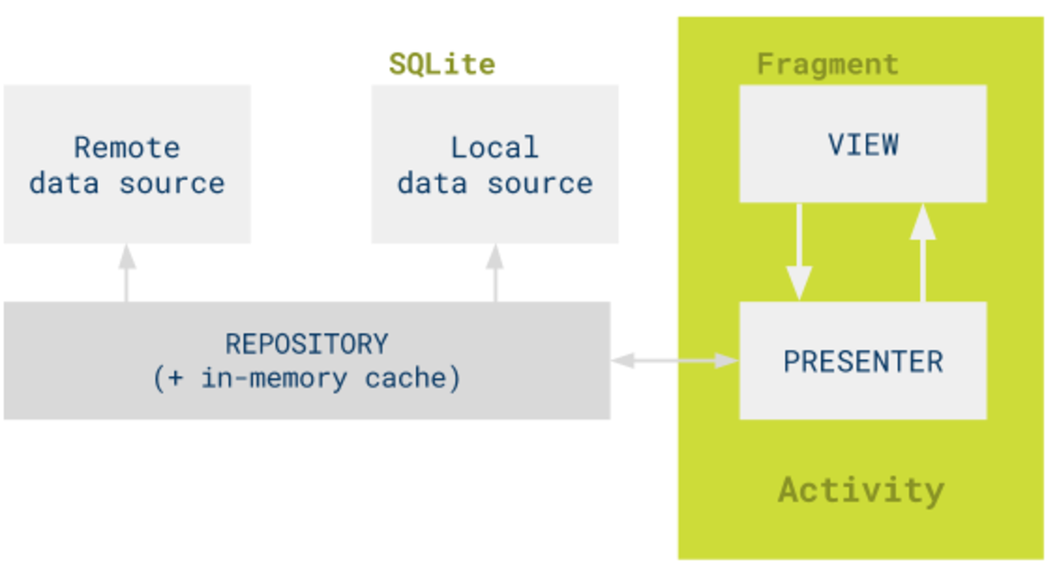
Google TODO-MVP Example

Slide 8
VP Implementation
Break Song

Slide 9
View (Interface View)
MyPresenter class
public interface Contract {
interface IMyView extends BaseView<Presenter> {
void showTasks(List<Task> tasks);
void showAddTask();
void showTaskDetailsUi(String taskId);
void showTaskMarkedComplete();
boolean isActive();
}
Contract
IMyView Class
IMyPresenter class

Slide 10
Interface Presenter
interface Presenter extends BasePresenter {
void result(int requestCode, int resultCode);
void loadTasks(boolean forceUpdate);
void addNewTask();
void openTaskDetails(@NonNull Task requestedTask);
void completeTask(@NonNull Task completedTask);
}
}

Slide 11
Presenter (Constructor put Model and View)
public class TasksPresenter implements TasksContract.Presenter {
private final TasksRepository mTasksRepository;
private final TasksContract.View mTasksView;
private TasksFilterType mCurrentFiltering = TasksFilterType.ALL_TASKS;
private boolean mFirstLoad = true;
public TasksPresenter(@NonNull TasksRepository tasksRepository, @NonNull TasksContract.View tasksView) {
mTasksRepository = checkNotNull(tasksRepository, "tasksRepository cannot be null");
mTasksView = checkNotNull(tasksView, "tasksView cannot be null!");
mTasksView.setPresenter(this);
}

Slide 12
Simple-Flow (Activity/Fragment)
Act/Frag implements IMyView
myPresenter= new MyPresenter(this)
Note:In this case “this” equal to MyView
Override IMyView methods
Note: IMyView’s method depend on MyPresenter trigger IMyView method callback
@Override
public void viewInfoRequestSuccess(String data){
//do something………..
}
Use myPresenter to involve business logic and call IMyView’s method
Example:
myPresenter.AddTask
myPresenter.PerformRequest(data)

Slide 13
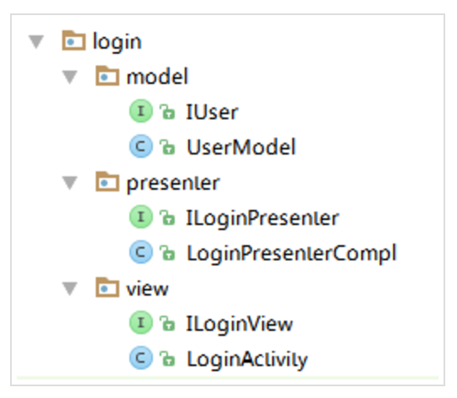
Example

