Slide 1
Chapter 5
Break Song

Slide 2
Create new Activity
Androidmanifest
<application
android:allowBackup="true"
android:icon="@mipmap/ic_launcher"
android:label="@string/app_name"
android:theme="@style/AppTheme" >
<activity
android:name=".QuizActivity"
android:label="@string/app_name" >
<intent-filter>
<action android:name="android.intent.action.MAIN" />
<category android:name="android.intent.category.LAUNCHER" />
</intent-filter>
</activity>
<activity android:name=".CheatActivity">
</activity>
</application>
Note: android:name="com.bignerdranch.android.geoquiz.CheatActivity"

Slide 3
Create new Activity
XML
</LinearLayout>
<Button
android:id="@+id/cheat_button"
android:layout_width="wrap_content"
android:layout_height="wrap_content"
android:text="@string/cheat_button"/>
<Button
android:id="@+id/next_button"
android:layout_width="wrap_content"
android:layout_height="wrap_content"
android:text="@string/next_button"
android:drawableRight="@drawable/arrow_right"
android:drawablePadding="4dp"/>
</LinearLayout>

Slide 4
Create new Activity
Java
public class QuizActivity extends AppCompatActivity {
...
private Button mNextButton;
private Button mCheatButton;
...
@Override
protected void onCreate(Bundle savedInstanceState) {
...
mCheatButton = (Button)findViewById(R.id.cheat_button);
mCheatButton.setOnClickListener(new View.OnClickListener() {
@Override
public void onClick(View v) {
// Start CheatActivity
}
});
if (savedInstanceState != null) {
mCurrentIndex = savedInstanceState.getInt(KEY_INDEX, 0);
}
updateQuestion();
}
...
}

Slide 5
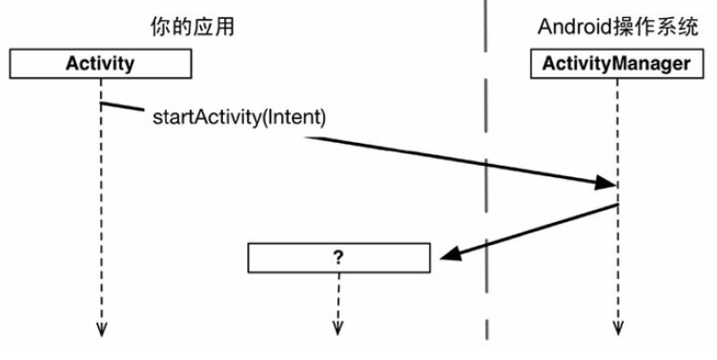
Start Activity B from A
startActivity(Intent)
mCheatButton.setOnClickListener(new View.OnClickListener() {
@Override
public void onClick(View v) {
// Start CheatActivity
Intent i = new Intent(QuizActivity.this, CheatActivity.class);
startActivity(i);
}
});
...

Slide 6
Replace Fragment B from A
@Override public void onClick(View v) {
NextFragment nextFrag= new NextFragment();
this.getFragmentManager().beginTransaction()
.replace(R.id.Layout_container, nextFrag,TAG_FRAGMENT)
.addToBackStack(null)
.commit();
}

Slide 7
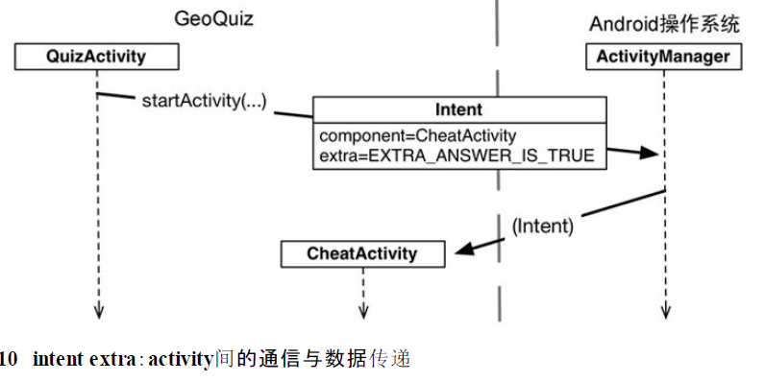
Bypass value to Activity B from A
Intent.putExtra（...）方法形式多變。
不變的是，它總是有兩個參數。一個參數是固定
for String類型的鍵，另一個參數值可以是多種數據類型。
該方法返回intent自身，因此，需要時可進行鍊式調用。
@Override
protected void onCreate(Bundle savedInstanceState) {
super.onCreate(savedInstanceState);
setContentView(R.layout.activity_cheat);
mAnswerIsTrue = getIntent().getBooleanExtra(EXTRA_ANSWER_IS_TRUE, false);
}

Slide 8
Bypass value from Activity B to A
A 父
@Override
public void onClick(View v) {
boolean answerIsTrue = mQuestionBank[mCurrentIndex].isAnswerTrue();
Intent i = CheatActivity.newIntent(QuizActivity.this, answerIsTrue);
startActivityForResult(i, REQUEST_CODE_CHEAT);
}
});
B 子
private void setAnswerShownResult(boolean isAnswerShown) {
Intent data = new Intent();
data.putExtra(EXTRA_ANSWER_SHOWN, isAnswerShown);
setResult(RESULT_OK, data);
}

Slide 9
Bypass value from Activity B to A
A 父
@Override
protected void onActivityResult(int requestCode, int resultCode, Intent data) {
super.onActivityResult(requestCode, resultCode, data);
switch(requestCode){
case REQUEST_CODE_CHEAT:
Toast.makeText(this, data.getExtras().getString("B"), 0).show();
}
}
requestCode:是對應startActivityForResult的第二個參數，判斷是由哪個Activity回傳資料
上一頁是用REQUEST_CODE_CHEAT
這邊用swtich去判斷他是不是REQUEST_CODE_CHEAT
是的話就用Toast.makeText去製造一個訊息Bar把他顯示出來
resultCode: 對應B code的setResult()的第一個參數，其值是上面設的RESULT_OK，在此我們還用不到
data: 對應B code的setResult()的第二個參數(如果有設的話)，有就是B回傳的資料，可以用data.getExtras()把資料取出來

Slide 10
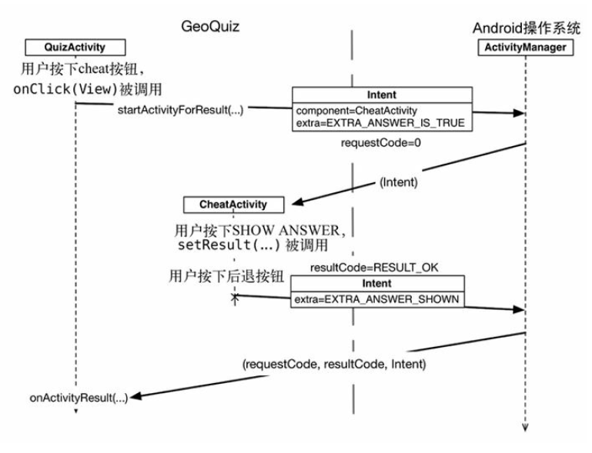
Bypass value from Activity B to A

