Slide 1
Theme
Break Song
Notes:
http://www.vogella.com/tutorials/AndroidCustomViews/article.html
http://stackoverflow.com/questions/1103027/how-to-change-an-application-icon-programmatically-in-android/15249542#15249542

Slide 2
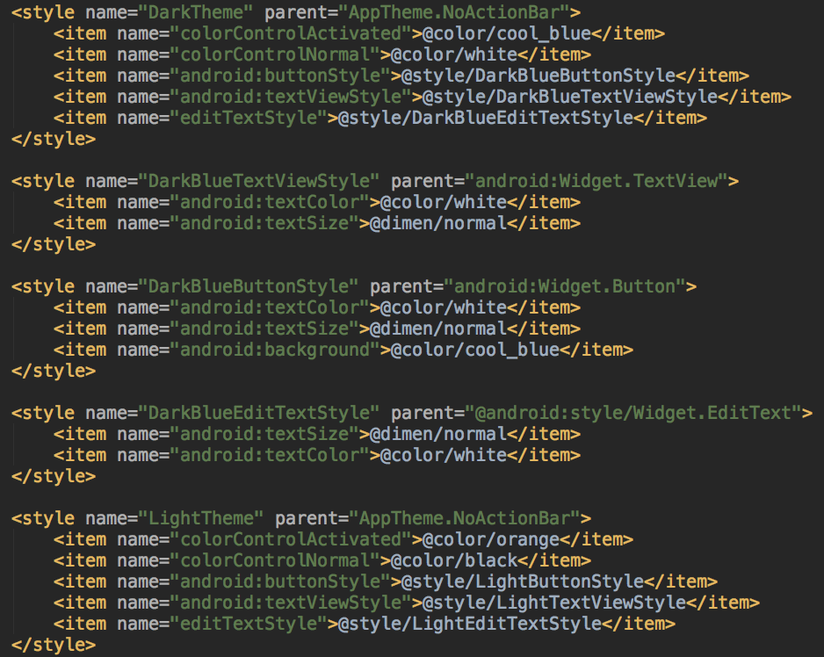

Define Theme Style XML
Define Theme style in style.xml
1.Dark Theme
2.Light Theme
XML file

Slide 3
Define Theme Class
ThemeUtils
1. Initial Theme 2. Change Theme 3. Get Theme Title
ThemeStyle
1. Initial view’s color / size / background / padding / margin
ThemeIcon
1. Initial view’s icon (Depend on UI designer provide png file)

Slide 4
ThemeUtils - BaseActivity
Theme Initial
onActivityCreateSetTheme (Theme initial)
changeToTheme (Restart Activity)
getThemeTitle (明亮主題/深色主題)

Slide 5
ThemeStyle - BaseActivity
首頁
1.Common Background (root view)
2.Common Toolbar style
3.Common divider line style
首頁

Slide 6
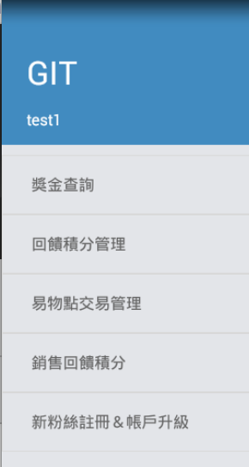
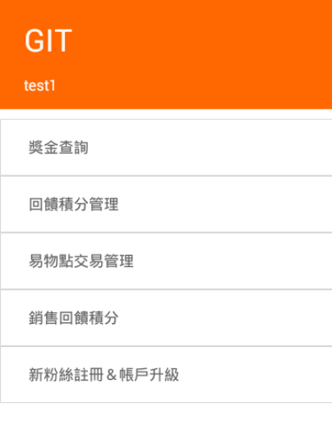


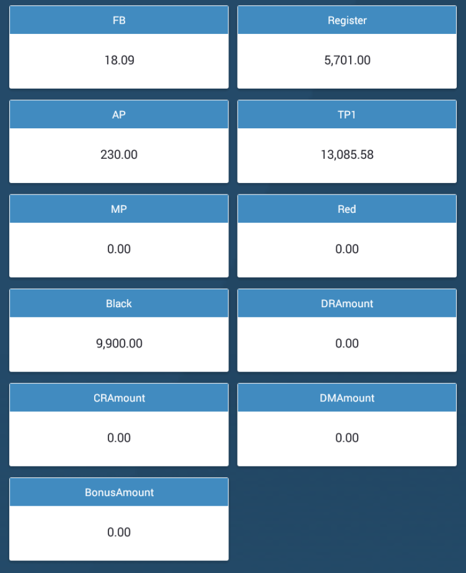
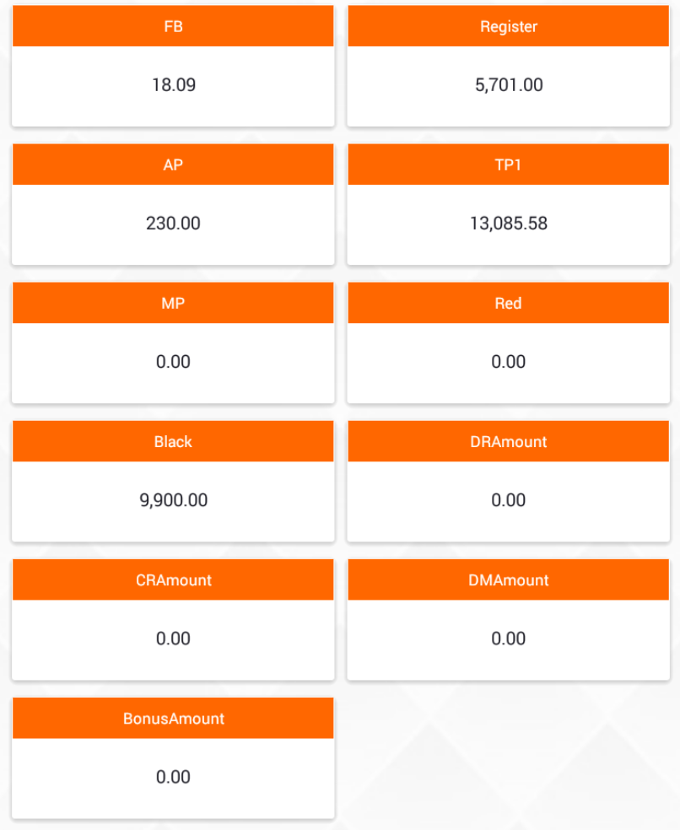
ThemeStyle - Custom Views
NavigationView
Custom NavigationView
TextView
Custom TextView
Tag
FlexbotLayout
ThemeStyle

Slide 7





ThemeIcon - Custom Views
TextView
Custom TextView
ImageView
Custom ImageView
Tag
Tab
ThemeIcon

Slide 8
Q & A

Slide 9
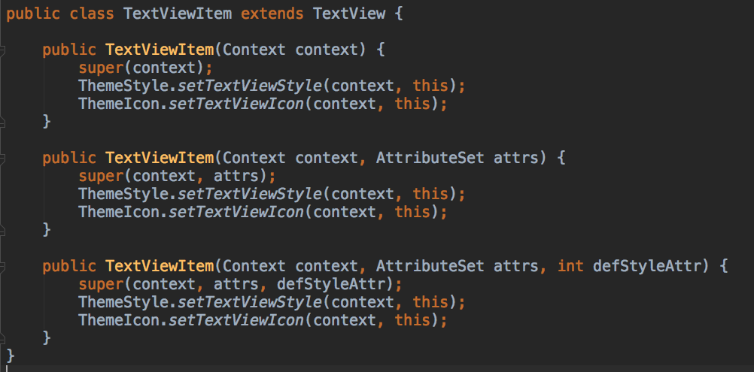
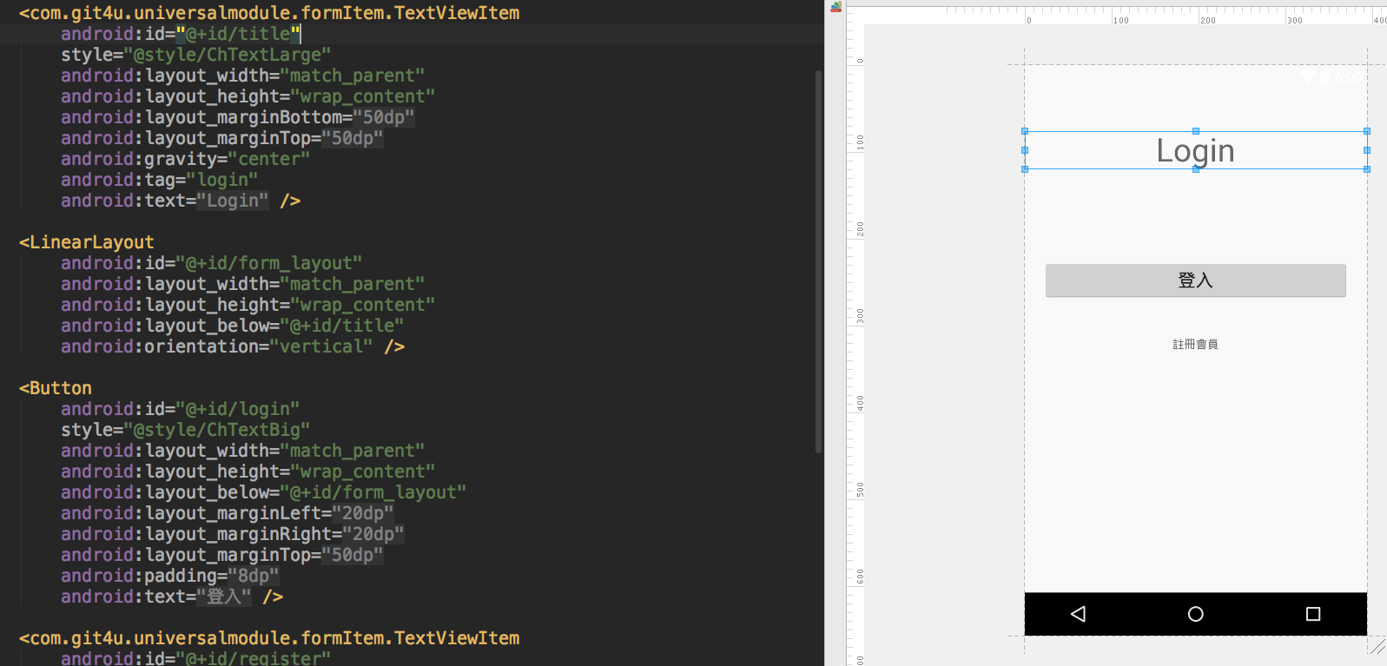
Custom views - Example
Extend textView to Custom textView
Use custom textView element in XML file

Slide 10
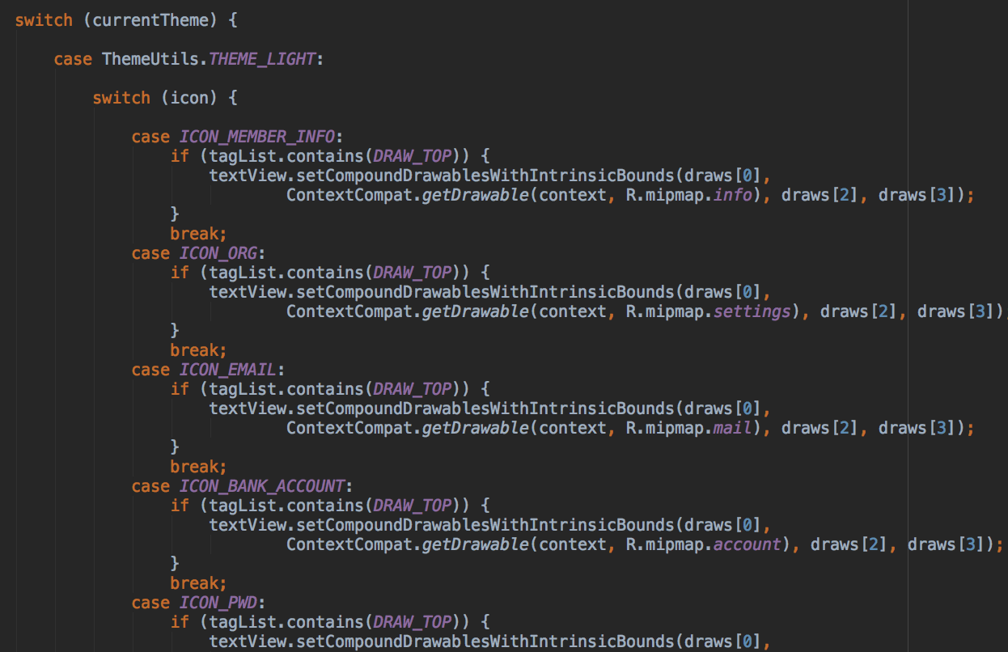
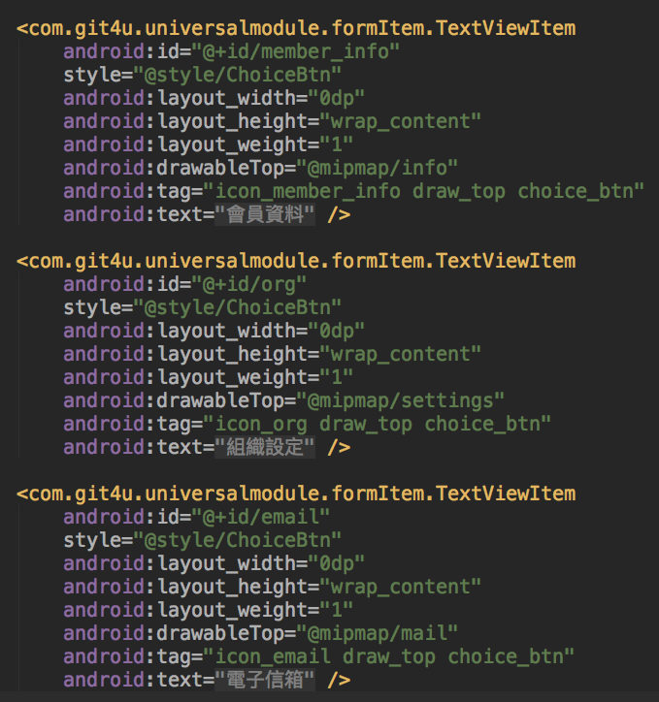
Custom views - tag

