Slide 1
Chapter1
BreakSong

Slide 2
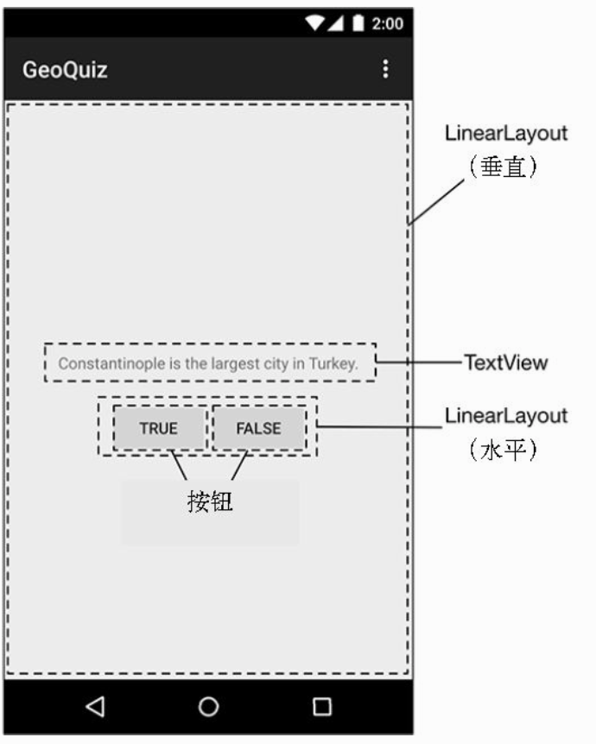
XML

Slide 3
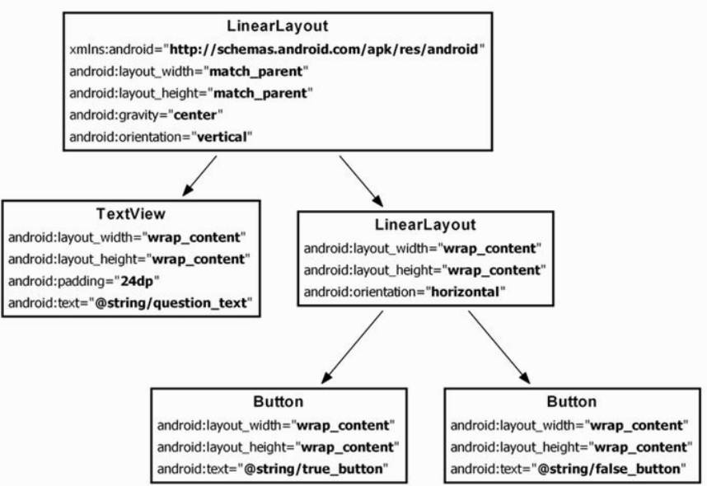
XML

Slide 4
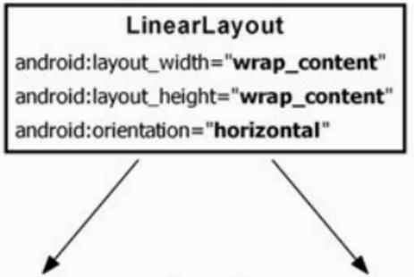
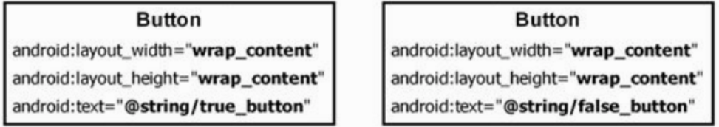
XML attribute
android:layout_width=”wrap_content” / “0dp”
android:layout_height=”match_partent” / “0dp”
android:orientation=”horizontal” (“vertical”)
android:layout_weight=”1”
android:layout_weight=”3”
android:gravity="center"
android:layout_gravity="center"
android:id="@+id/false_button"

Slide 5
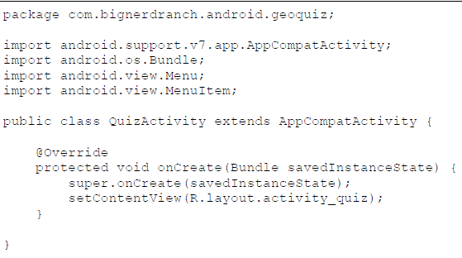
Activity
setContentView(R.layout.activity_quiz);

Slide 6
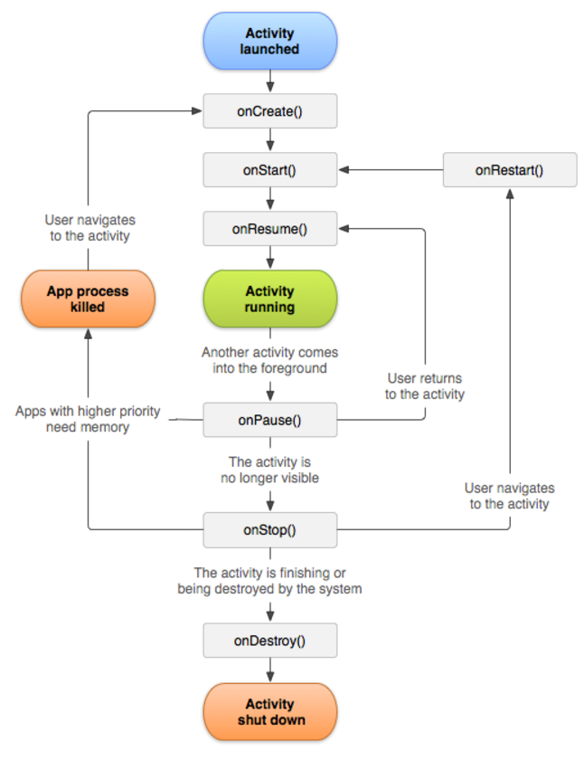
Activity
onCreate()用來做程式的初使化動作(inital view)
onDestory()通常都拿來把onCreate()時的資料做釋放的動作(Back鍵)
onPause()時把需要保存的資料保存 (Home鍵, 其他Activity出現)
onResume()把保存的資料拿回來使用.
(當OnPause的Activity再次被開啟)
Notes:
onPause when an activity is going into the background, but has not (yet) been killed.

Slide 7
View Initial (With ButterKnife)
private Button mTrueButton;
private Button mFalseButton;
mTrueButton = (Button) findViewById(R.id.true_button);
mFalseButton = (Button) findViewById(R.id.false_button);
mTrueButton.setOnClickListener(new Button.OnClickListener(){
@Override
publicvoid onClick(View v) {
// TODO Auto-generated method stub
textView01.setText("Button Click");
}
});
)
-------------------------------------------------------------------------------------------------------------------------
@Bind(R.id.true_button) Button mTrueButton
@Bind(R.id.false_button) Button mFalseButton
@OnClick(R.id.true_button)
void send(){
//do something...
}

Slide 8
View Programming (Define PasswordDialog in A file)
public static void showInputPasswordDialog(Context context, String title, String hint, int resourceId, DialogInterface.OnClickListener clickListener) {
//avoid when the activity calling the dialog was finishing for some reason or another when it tried to show a dialog
if (!((Activity) context).isFinishing()) {
final EditText input = new EditText(context);
input.setHint(hint);
input.setId(resourceId);
input.setTransformationMethod(PasswordTransformationMethod.getInstance());
LinearLayout.LayoutParams layoutParams = new LinearLayout.LayoutParams(LinearLayout.LayoutParams.MATCH_PARENT,
LinearLayout.LayoutParams.MATCH_PARENT);
input.setLayoutParams(layoutParams);
AlertDialog dialog = new AlertDialog.Builder(context)
.setTitle(title)
.setPositiveButton(R.string.g_ok, clickListener)
.setView(input)
.create();
dialog.show();
}
}

Slide 9
View Programming (Use PasswordDialog in B file)
DialogInterface.OnClickListener clickListener = new DialogInterface.OnClickListener() {
@Override
public void onClick(DialogInterface dialogInterface, int i) {
progressDialog.show();
Dialog dialog = Dialog.class.cast(dialogInterface);
EditText editText = (EditText) dialog.findViewById(R.id.input_2nd_password_dialog);
String two_level_pwd = editText.getText().toString();
new Verify2ndLevelPasswordTask(two_level_pwd, verify2ndLevelPasswordTaskListener).execute();
}
};
Utility.showInputPasswordDialog(this, getString(R.string.login_2nd_pwd), getString(R.string.login_2nd_pwd), R.id.input_2nd_password_dialog, clickListener);

Slide 10
Q & A

