Slide 1
Toilet paper and other things …
John Webster 9/24/2020
www.tpapercrisis.com
https://github.com/johnlobster/tpcrisis

Slide 2
Website overview
React
  Front end only
  React-router to create Single Page App
  Header, footer
  Bad jokes, other content
  Create-react-app
  Github
  Netlify

Slide 3

Things I hate about web programming
Performant
  Not in dictionary
  Longer to type than “Fast” (wastes energy in storage)
  Is my car more performant than my bicycle ?
  Who cares (who is my customer) ?
  How performant am I today ?
  Is the other guy more performant than me ?

Slide 4
Performance metrics
Measuring performance
  Time to first render
  Time to first meaningful render
  Time to first user interaction
  Time to switch from page to page
  Time to respond to user input
  Infinite scrolling
  User based performance metrics
    User acquisition, retention

Slide 5
Time to first render
Sequence
Type in www.tpapercris.com → dns lookup → web server
Fetch index.html
Fetch <link> and <script> (Bootstrap etc)
Fetch React bundle
Fetch fonts, images

Slide 6
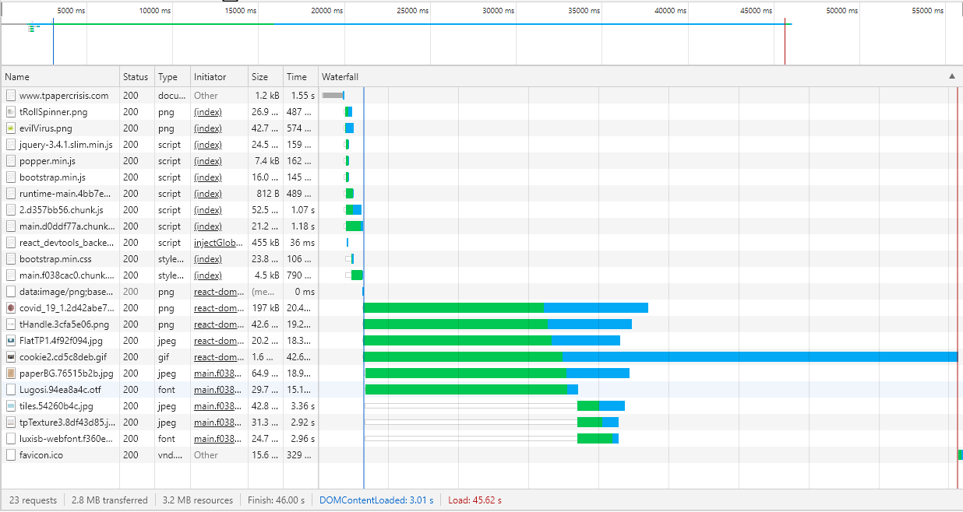
Google inspector – Oh my !

Slide 8
Google inspector – Oh my !

