Slide 1
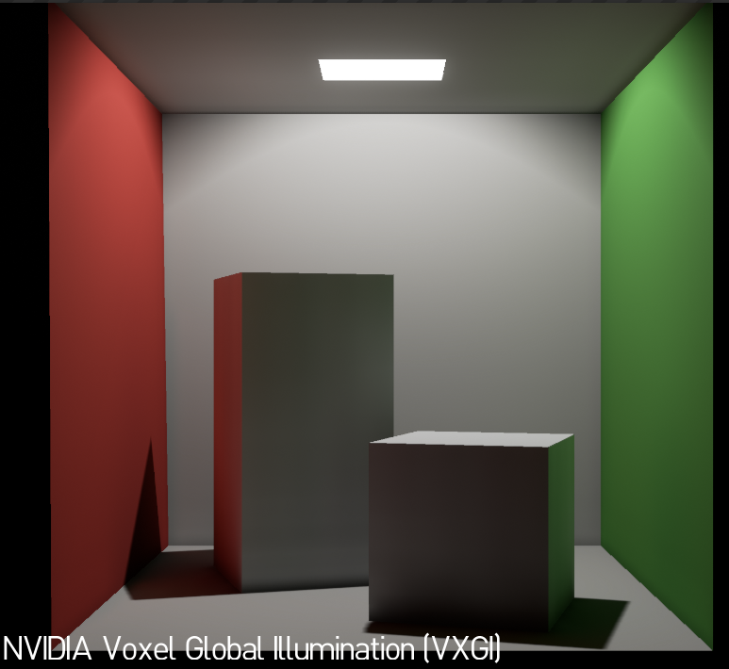
VXGI in UE4
Beta version now available on NvPhysX Github to UE4 licensees
Revoxelizes the whole scene on every frame (for simplicity)
Can cast multi-bounce GI from emissive materials & multiple lights (shadow mapped or not)
With the default parameters, should work and look the same on all DX11 GPUs
Example scenes (Cornell Box and SciFiHallway) are provided

Slide 2
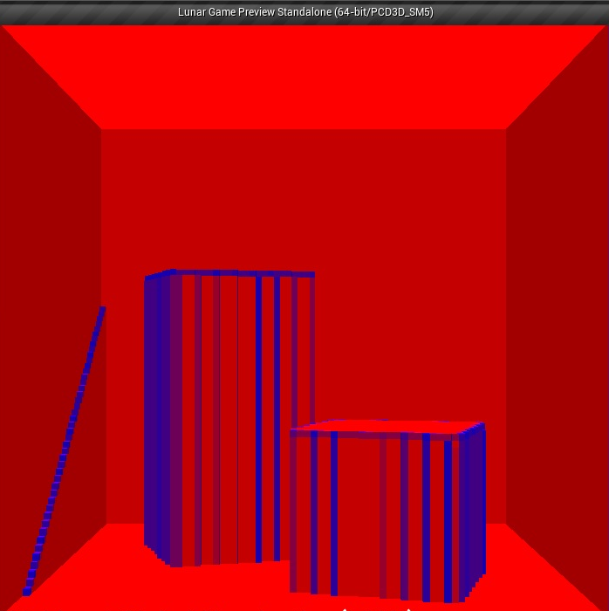
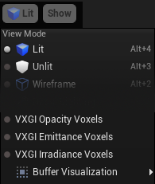
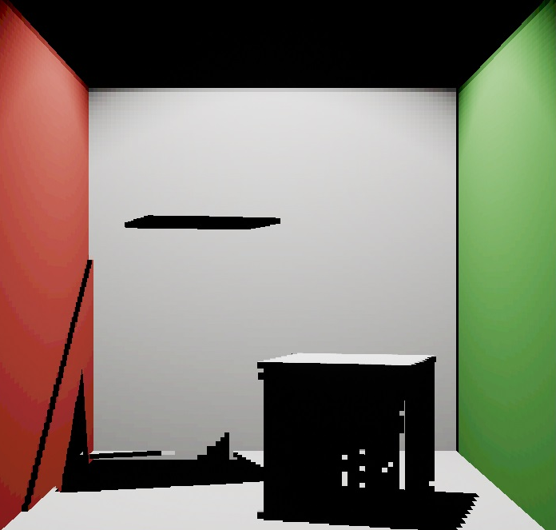
VXGI BRING UP
How to enable it
Check “VXGI Diffuse / Enable Diffuse Tracing” in the PostProcessVolume
Check “VXGI Indirect Lighting” on real lights and make them Movable
Set console variable “r.VXGI.DiffuseTracingEnable 1” (default)
Check “Used With VXGI Voxelization” on surface materials (default)
Use “VXGI Opacity Voxels” view mode to see if all objects are represented as occluders
Use “VXGI Emittance Voxels” view mode to see if directly lit surfaces and emissive objects are represented as emitters

Slide 3
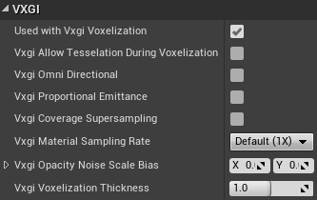
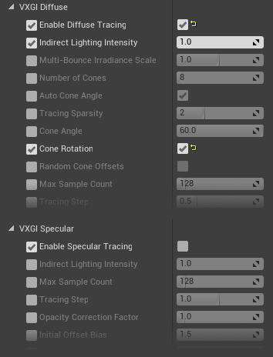
VXGI Parameters
Main Console Variables
r.VXGI.MapSize
r.VXGI.Opacity6D
r.VXGI.Emittance6D
r.VXGI.NvidiaExtensionsEnable
r.VXGI.StoreEmittanceInHdrFormat
r.VXGI.EmittanceStorageScale
r.VXGI.EmittanceInterpolationEnable
r.VXGI.HighQualityEmittanceDownsamplingEnable
r.VXGI.DiffuseTracingEnable
r.VXGI.SpecularTracingEnable
r.VXGI.EmissiveMaterialsEnable
r.VXGI.DiffuseMaterialsEnable
r.VXGI.Range
r.VXGI.DebugClipmapLevel
r.VXGI.AmbientOcclusionMode
r.VXGI.MultiBounceEnable
Material Parameters
Cone Tracing Parameters

Slide 4
VXGI Reflections
How to enable VXGI Reflections
Set console variable “r.VXGI.SpecularTracingEnable 1”
Check “VXGI Specular / Enable Specular Tracing” in the PostProcessVolume
When enabled, VXGI Specular Tracing
Disables SSR
Replaces SSR & light probes with the VXGI Specular Tracing result
Can be combined with SSR if “r.VXGI.CombineSpecularWithSSR 1” is set
Limitation
VXGI reflections are meant to render glossy reflections (roughness >= 0.2 or so)
VXGI cannot render non-glossy reflections well (e.g. perfect mirrors)

Slide 5
Performance knobs
You can type the “ProfileGPU” command to get a breakdown of the GPU time
Output of “stat unit” command also includes VXGI WS (World-Space) and VXGI SS (Screen-Space) GPU times
To improve cone tracing performance, edit the PostProcessVolume settings:
Disable specular tracing
Set “Diffuse Tracing / Number of Cones” to 4
Set “Diffuse Tracing / Tracing Sparsity” to 4 (quarter-resolution tracing)
Enable “Diffuse Tracing / Use Temporal Filtering” (to remove flickering artifacts)
To improve voxelization performance, set these console variables:
Set “r.VXGI.MapSize 64” (to improve both voxelization and tracing performance)
Set “r.VXGI.MultiBounceEnable 0” (to improve voxelization performance)
Set “r.VXGI.HighQualityEmittanceDownsamplingEnable 0” (to improve voxelization performance)

Slide 6
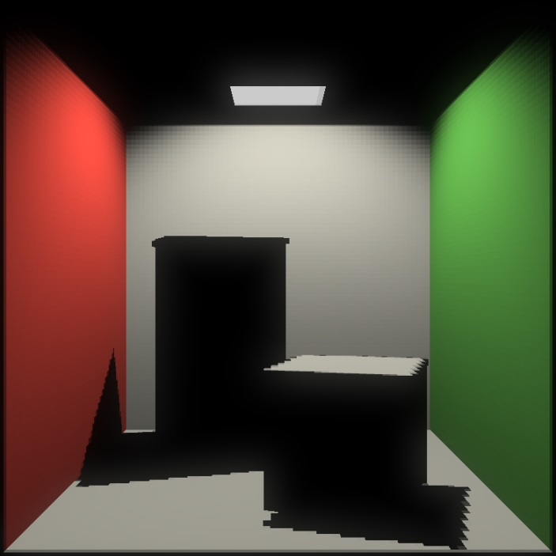
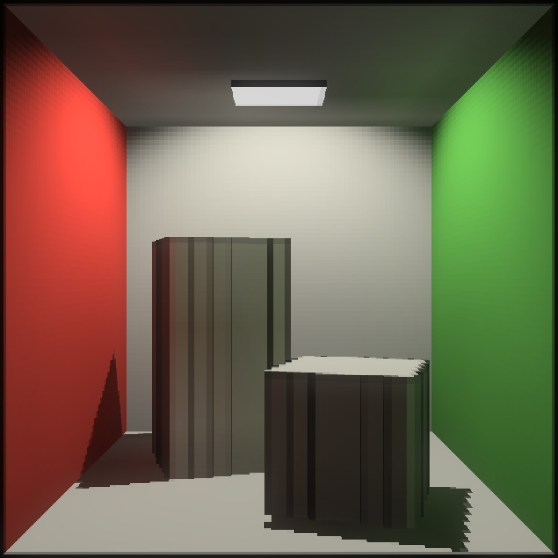
Multi-bounce GI
When multi-bounce support is enabled, VXGI computes a 3D indirect irradiance map after voxelization
Uses the irradiance map during voxelization on the next frame
Adds one more bounce on every frame
Makes the whole scene appear in specular reflections
How to enable it:
Set console varuable “r.VXGI.MultiBounceEnable 1”
Tune “VXGI Diffuse / Multi-Bounce Irradiance Scale” in PostProcessVolume until it looks right
Irradiance may blow up if this value is too high
Use “VXGI Irradiance Voxels” view mode to see the indirect irradiance map
Pictures on the right: visualization of emittance voxels
Single Bounce
Multi-Bounce

Slide 7
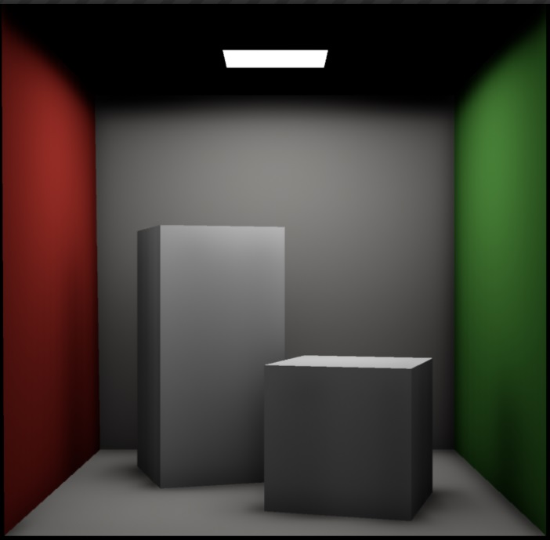
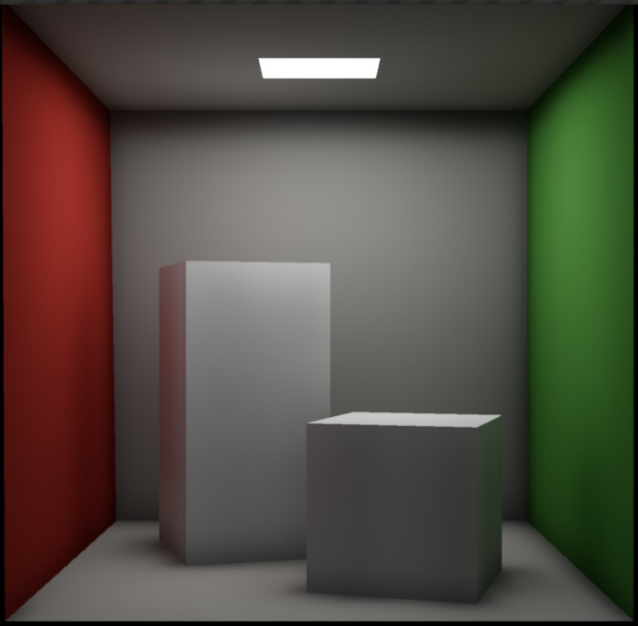
Area Lights
VXGI is good at computing lighting (including soft shadows) from an arbitrary number of area lights of arbitrary shapes.
Using actual emissive surfaces is often better than faking them with traditional local lights.
For both performance and quality reasons, we recommend to not use any fill lights when lighting scenes with VXGI.
With multi-bounce support, the entire scene can be lit by area lights only.
Pictures on the right: Cornell Box lit by one emissive object
Single Bounce
Multi-Bounce

