Slide 1
NIKE DIGITAL CAMPAIGN
By,
JOHN LOTOME

Slide 2
INTRODUCTION
Nike Inc is planning a new digital campaign in Africa, and wants to understand who are the social media influencers are in Africa and in which area fall into (e.g. politics, fashion, art, etc.). This is key to Nike as they don’t want to be associated with the wrong influencers (ethnic and religious polarization figures for example).
Analysis is done based on data scrapped from twitter

Slide 3
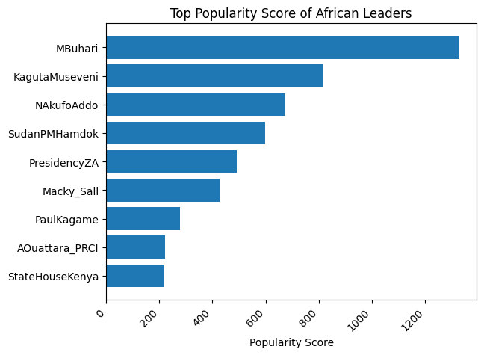
Top African leaders’ Popularity Scores

Slide 4
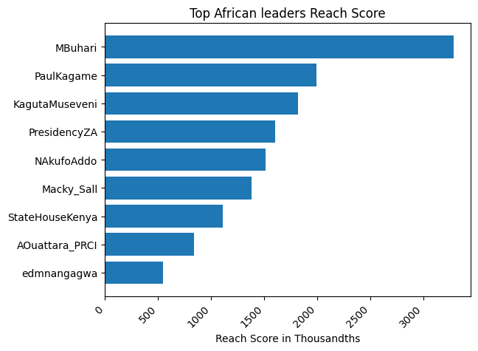
Top African leaders’ Reach Score

Slide 5
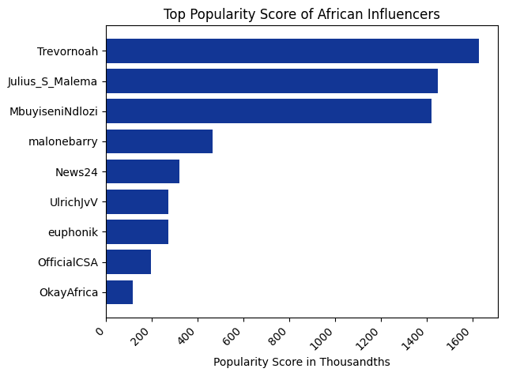
Top African Personalities Popularity Score

Slide 6
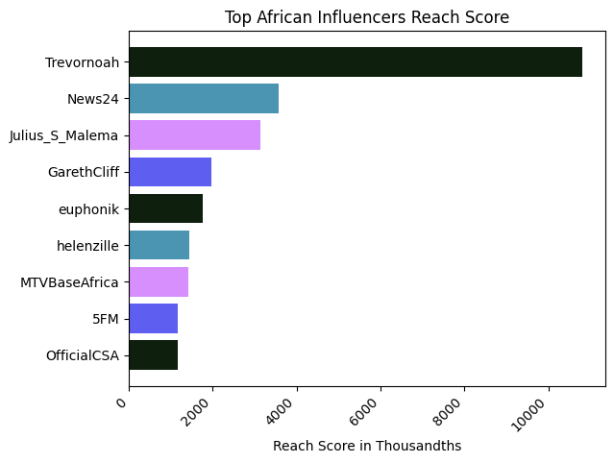
Top African Personalities Reach Score

Slide 7
Limitations
It was hard to gather mentions which was needed for the analysis.

Slide 8
Recommendations
• Nike Inc should consider partnering with the following for their marketing Campaigns
a) Trevor Noah
b) Julius S Malema
• Nike Inc should use #Covid19 while marketing to reach many audience

Slide 9
THANK YOU

