Slide 1
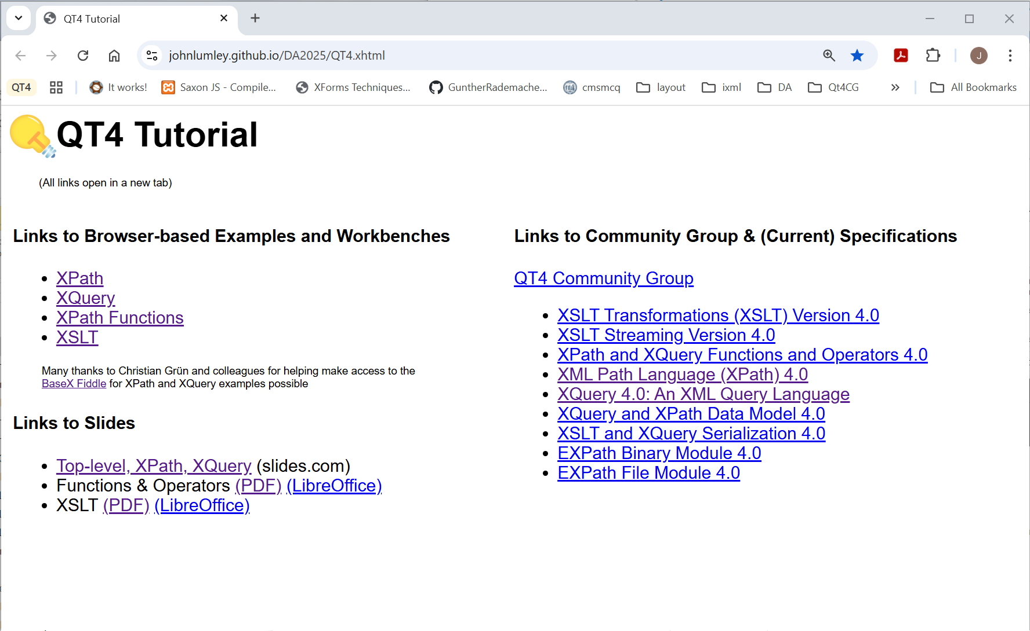
Tutorial Links
https://johnlumley.github.io/DA2025/QT4.xhtml

Slide 2
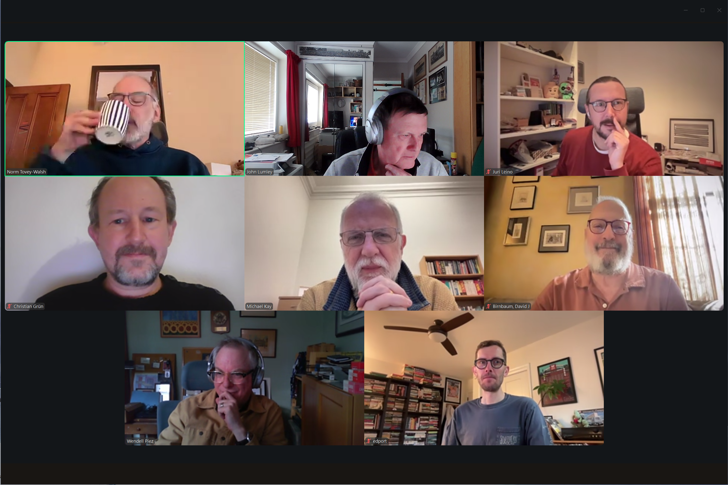
QT4CG team
+ several other valuable members

Slide 3
Navigating the Tree
<A>
array{}
ancestor
ancestor
<B>
<C>
<D>
<B>
map{}
<D>
preceding
preceding
<E>
<F>
first-names
last-name
match= A//F
match= ???/
jnode('last-name')
<G>
array{}

Slide 4
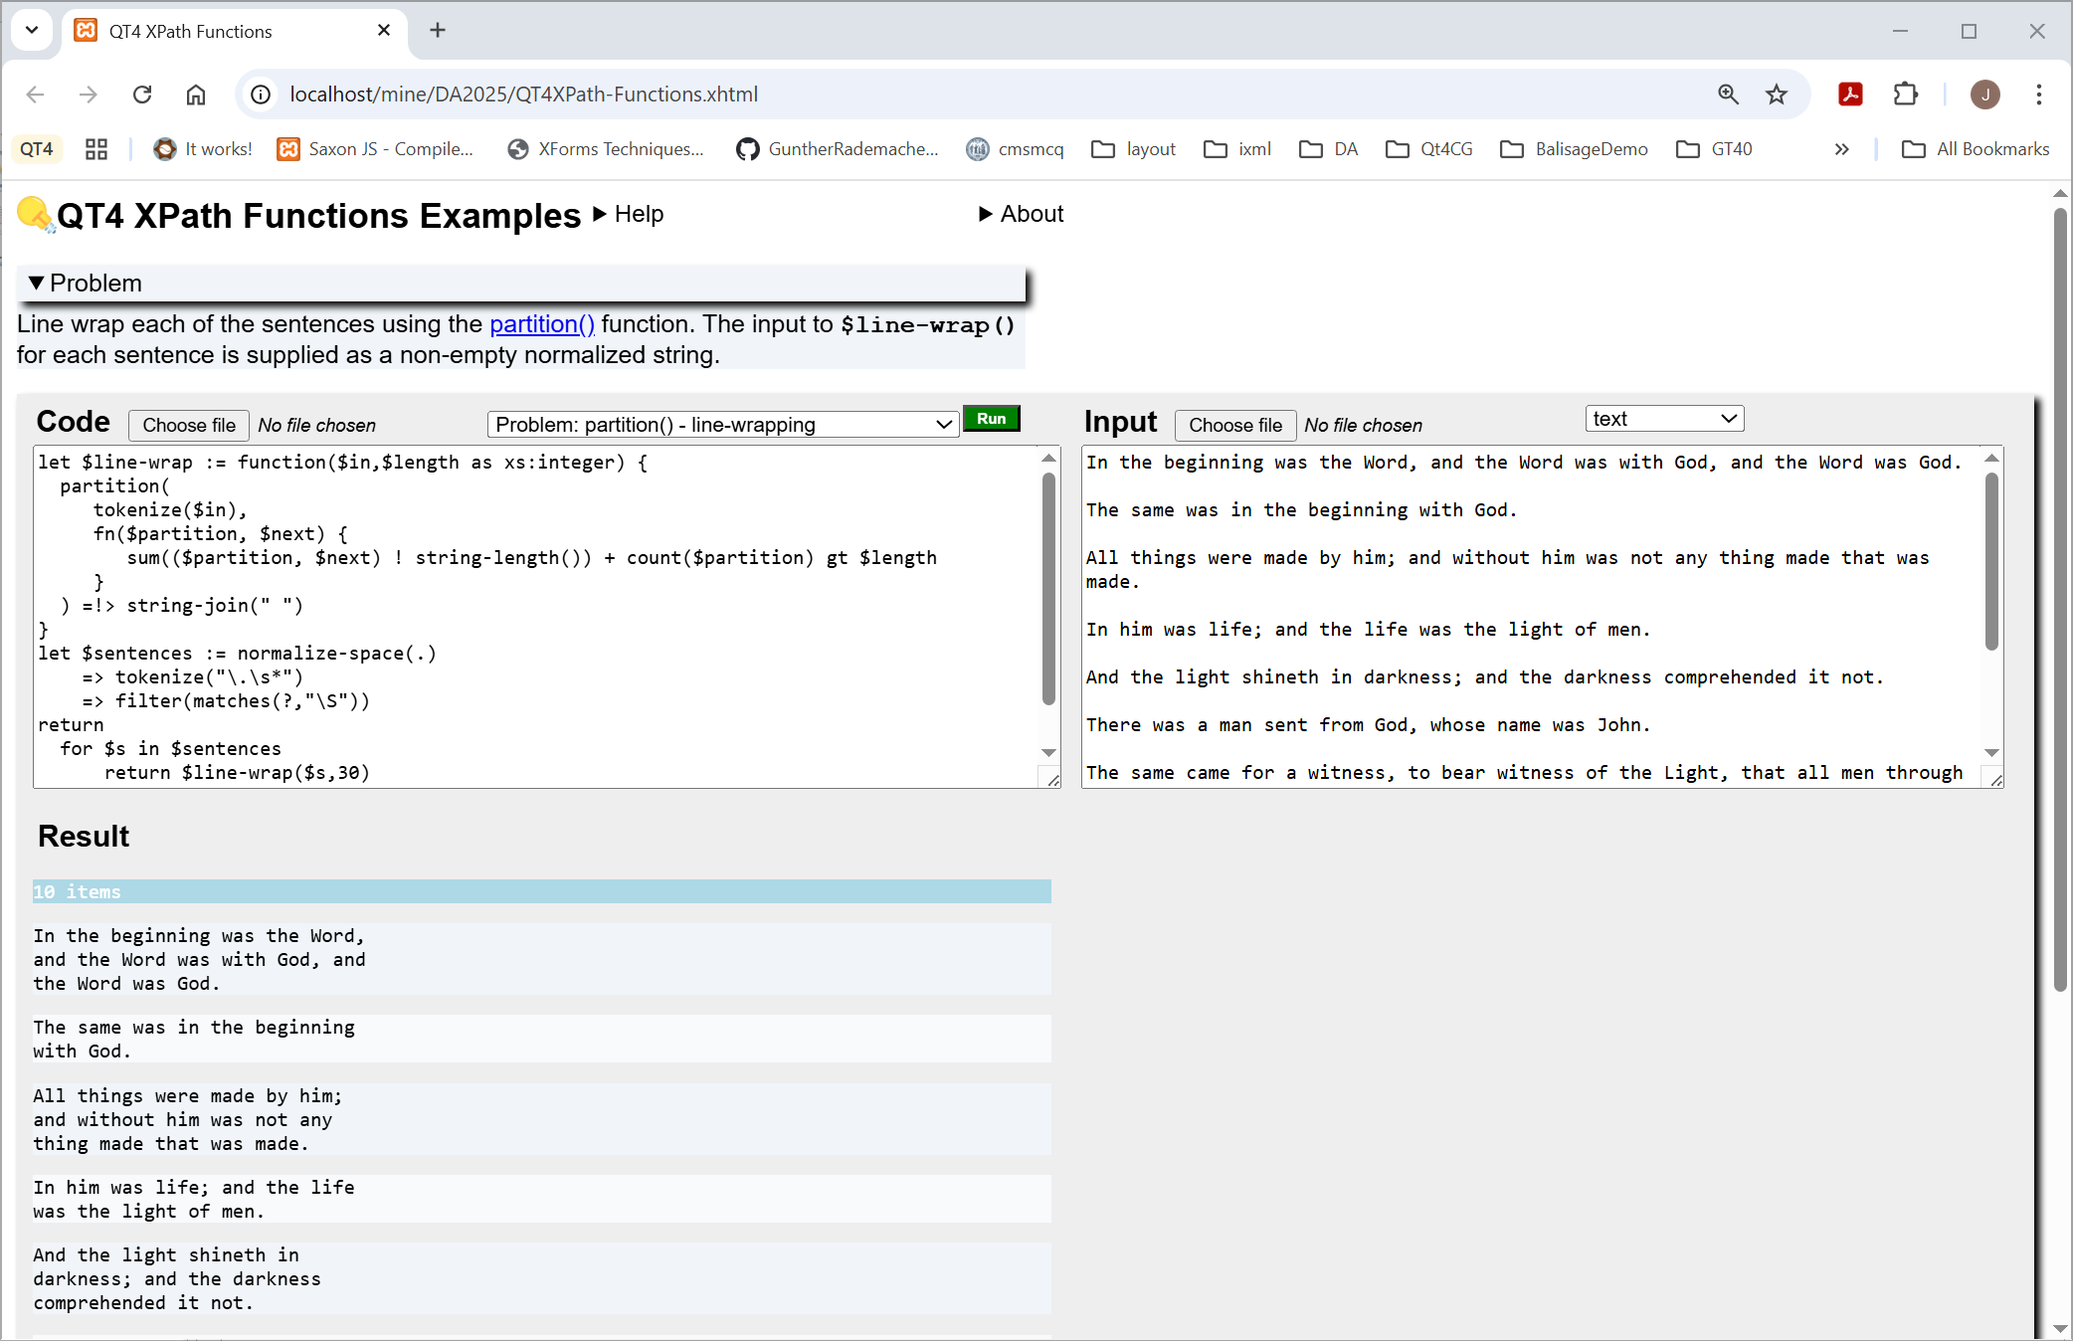
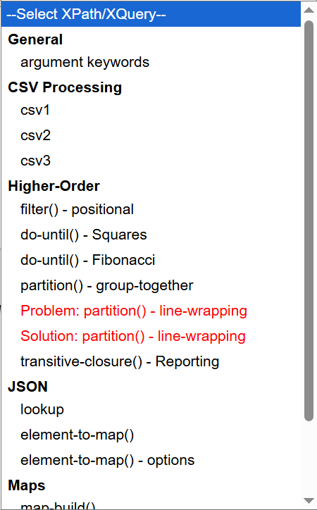
XPath/XQuery workbench
Problem statement & hints
CODE & INPUT can be edited and loaded by:
Example drop-down
Local file chooser
Drag-and-drop
(not Firefox)
CODE
INPUT
Run uses
BaseX Fiddle
to process the expression
(Many thanks!)
RESULT(s)

Slide 5
XPath, XSLT and XQuery 4 –
What’s in it for me?
Template

