Slide 1

XSLT 4.0

Slide 2
Main Features
Syntax additions to make code 'terser'
Enhancements to the type system to allow more expressive constraints, especially for maps and atomic values.
Type-based pattern matching
Additional functionality for processing arrays
Streaming split from the main specification

Slide 3
Development/documentation aid
<xsl:stylesheet xmlns:xsl="http://www.w3.org/1999/XSL/Transform"
main-module="toplevel-uri.xsl" ...>
<xsl:note role="description">
<p>This is a note <b>purely</b> for purposes outside XSLT. <br/>
Think of it as a comment that can contain structured stuff.</p>
</xsl:note>
<xsl:function name="t:temp">
<xsl:note class=”simple”>It can appear anywhere as a child element
and can have any attributes …
</xsl:note>
<xsl:param name="a">
<xsl:note continuation-of="previous::xsl:note[1]">
… and is totally ignored by XSLT for any
syntactic or semantic purposes.</xsl:note>
</xsl:param>
…
</xsl:function>
</xsl:stylesheet>

Slide 4

Syntax additions – increasing XSLT code density
XSLT 4.0
<xsl:choose>
<xsl:when test="$n lt $low">
<xsl:sequence select="../below"/>
</xsl:when>
<xsl:when test="$n gt $high">
<xsl:sequence select="../above"/>
</xsl:when>
<xsl:otherwise>
<xsl:sequence select="../within"/>
</xsl:otherwise>
</xsl:choose>
XSLT 3.0 code
Terser XSLT 4.0 equivalent
<xsl:choose>
<xsl:when test="$n lt $low" select="../below"/>
<xsl:when test="$n gt $high" select="../above"/>
<xsl:otherwise select="../within"/>
</xsl:choose>
These slide examples will be simple, possibly nonsensical or easier in direct XPath, but illustrative

Slide 5
Selection i
@select vs xsl:sequence[@select]
XSLT 4.0
<xsl:choose>
<xsl:when test="$n lt $low">
<xsl:sequence select="../below"/>
</xsl:when>
<xsl:when test="$n gt $high">
<xsl:sequence select="../above"/>
</xsl:when>
<xsl:otherwise>
<xsl:sequence select="../within"/>
</xsl:otherwise>
</xsl:choose>
Similarly for:
xsl:map |
xsl:result-document |
xsl:matching-substring | xsl:non-matching-substring
<xsl:choose>
<xsl:when test="$n lt $low" select="../below"/>
<xsl:when test="$n gt $high" select="../above"/>
<xsl:otherwise select="../within"/>
</xsl:choose>

Slide 6
Selection ii preserving formatted XPath expressions
<xsl:function name="f:book-to-json" as="map(*)">
<xsl:param name="book" as="element(book)">
<xsl:sequence select=”
{ ‘title’ : string($book/title),
‘author’ : array { $book/author ! string() },
‘date’ : let $d := $book/publication return
if(current-date() lt xs:date($d))
then $d else ‘Don&apos;t release’
}”/>
</xsl:function>
<xsl:function name="f:book-to-json" as="map(*)">
<xsl:param name="book" as="element(book)">
<xsl:sequence select=”{ ‘title’ : string($book/title),
‘author’ : array { $book/author ! string() }, ‘date’ : let
$d := $book/publication return if(current-date() lt
xs:date($d)) then $d else ‘Don&apos;t release’}”/>
</xsl:function>
Attribute value normalization

Slide 7
Selection iii preserving formatted XPath expressions
<xsl:function name="f:book-to-json" as="map(*)">
<xsl:param name="book" as="element(book)">
<xsl:select>
{ ‘title’ : string($book/title),
‘author’ : array { $book/author ! string() },
‘date’ : let $d := $book/publication return
if(current-date() lt xs:date($d))
then $d else “Don’t release”
}
</xsl:select>
</xsl:function>

Slide 8
xsl:if @then @else
XSLT 4.0
<xsl:choose>
<xsl:when test="$n ge 0">
<xsl:sequence select="1"/>
</xsl:when>
<xsl:otherwise>
<xsl:sequence select="-1"/>
</xsl:otherwise>
</xsl:choose>
<xsl:choose>
<xsl:when test="$n ge $low and $n le $high">
<xsl:apply-templates/>
</xsl:when>
<xsl:otherwise>
<xsl:sequence select="
error((),'Outside limits')"/>
</xsl:otherwise>
</xsl:choose>
<xsl:if test="$n ge 0"
then="1" else "-1"/>
<xsl:if test="$n ge $low and $n le $high"
else="error((),'Outside limits')">
<xsl:apply-templates/>
</xsl:if>

Slide 9
Switch
<xsl:variable name="n" select="a"/>
<xsl:choose>
<xsl:when test="$n = (1, 2, 3, 4)">
<xsl:sequence select="../small"/>
</xsl:when>
<xsl:when test="$n = (5 to 20)">
<xsl:sequence select="../medium"/>
</xsl:when>
<xsl:otherwise>
<xsl:sequence select="../large"/>
</xsl:otherwise>
</xsl:choose>
<xsl:switch select="$n">
<xsl:when test="1, 2, 3, 4" select="../small"/>
<xsl:when test="5 to 20" select="../medium"/>
<xsl:otherwise select="../large"/>
</xsl:switch>

Slide 10
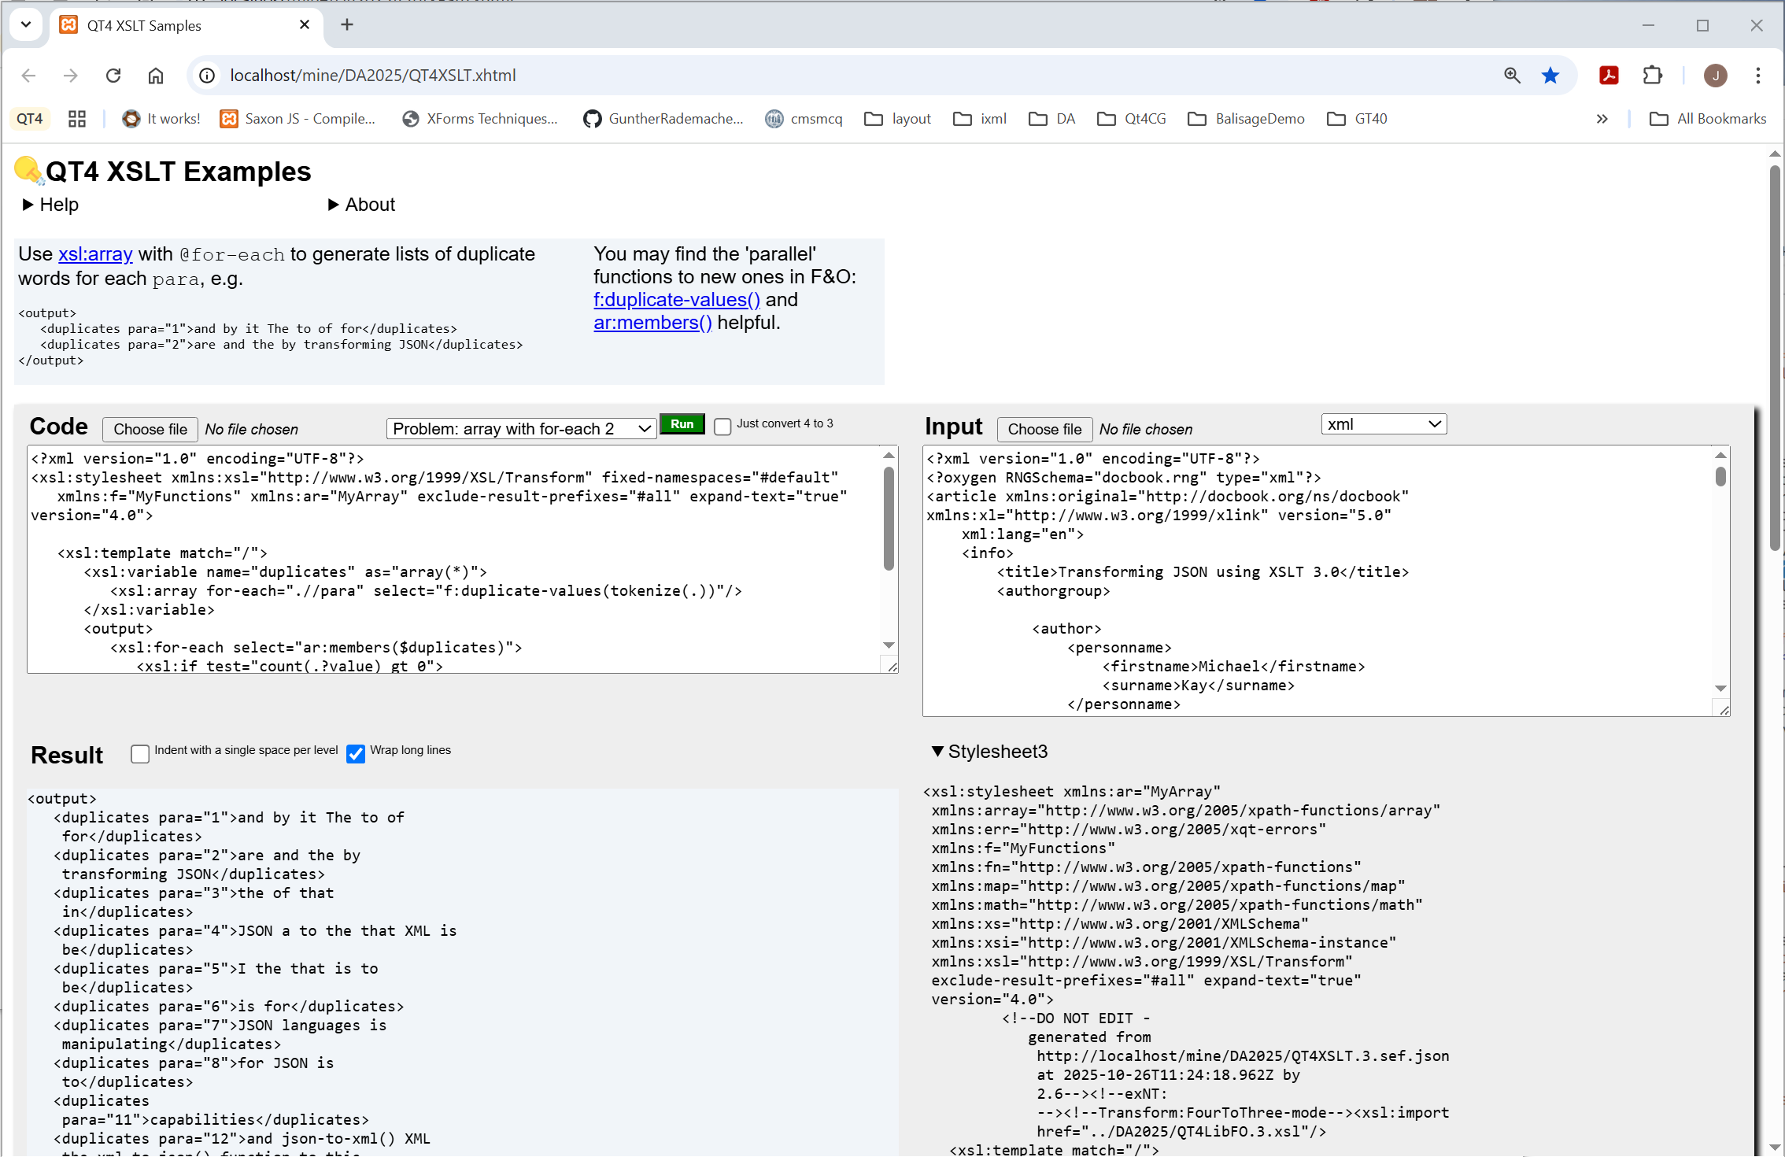
XSLT workbench – i
XSLT 4.0
SaxonJS only compiles/runs XSLT 3 and XPath 3.1
Solution:
Convert XSLT 4 to ~equivalent XSLT 3 for a number of new constructs, and run via fn:transform()
XSLT 4 CODE
INPUT
Only XSLT syntax is converted
XPath expressions are not converted – XPath 4.0 syntax additions and new/modified functions not supported
Some ~equivalent functions are provided in f: ar: and ma: namespaces
XSLT 3 CODE
RESULT

Slide 11
XSLT workbench – ii
Syntax limitations
map{'a':1,'b':2}
map keyword required in 3, optional in 4
{'a':1,'b':2}
function($x) {$x}
inline function keyword must be function in 3, can be fn in 4
fn($x) {$x}
if(a) then b
else ()
if/then/else must be complete in 3,
can use {exp} in 4
if(a) {b}

Slide 12
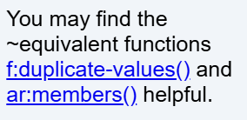
XSLT workbench – iii
~Equivalent functions
Sequence position not supported in XPath 3.1
fn:for-each($input as item()*,
$action as fn(item(), xs:integer) as item()*
) as item()*
<!--QT4FOLib – imported into the XSLT3 stylesheet-->
<xsl:function name="f:for-each" as="item()*">
<xsl:param name="input" as="item()*"/>
<xsl:param name="fn" as="function(*)"/>
<xsl:sequence select="for-each-pair(
$input,
1 to count($input),
$fn)"/>
</xsl:function>
<xsl:sequence select="f:for-each(
('a','b','c'),
function($x,$pos) {$x || $pos}
)"/>
'a1','b2','c3'
Hints will be provided when such functions could be helpful; namespace prefixes are already bound in the stylesheet

Slide 13
Enclosing Mode
XSLT 4.0
<xsl:mode name="M1" on-no-match="shallow-copy"/>
<xsl:template mode="M1" as="element()*" match="p"/>
Lots of other stuff which makes finding all relevant matches difficult
<xsl:template mode="M1" as="element()*" match="/">
<xsl:apply-templates mode="#current"/>
</xsl:template>
Example
Mode
enclosing modes
<xsl:mode name="M1" as="element()*"
on-no-match="shallow-copy">
<xsl:template match="p"/>
...
<xsl:template match="/">
<xsl:apply-templates/>
</xsl:template>
</xsl:mode>
<xsl:template match="*" mode="M1"/>
mode=M1
for matching
& default mode
for application
templates in this mode must not appear elsewhere in the package
<xsl:template match="*" mode="#all"/>
only templates inside the mode are applicable – even #all doesn't apply

Slide 14
Optional function parameters - i
XSLT 4.0
<xsl:function name="f:inRange">
<xsl:param name="n"/>
<xsl:sequence select="f:inRange($n,0)"/>
</xsl:function>
<xsl:function name="f:inRange">
<xsl:param name="n"/>
<xsl:param name="low"/>
<xsl:variable name="high">
<xsl:call-template name="findNumberLimit"/>
</xsl:variable>
<xsl:sequence select="f:inRange($n,$low,$high)"/>
</xsl:function>
<xsl:function name="f:inRange">
<xsl:param name="n"/>
<xsl:param name="low"/>
<xsl:param name="high"/>
<!-- Stuff -->
</xsl:function>

Slide 15
Optional function parameters - ii
XSLT 4.0
<xsl:function name="f:inRange">
<xsl:param name="n" as="element()"/>
<xsl:param name="low" required="no" select="0"/>
<xsl:param name="high" required="no">
<xsl:call-template name="findNumberLimit"/>
</xsl:param>
<!-- Stuff -->
</xsl:function>

Slide 16
Named Item Types
<xsl:param name="upscale" as="map(xs:string,function(xs:double) as xs:double)"/>
<xsl:param name="downscale" as="map(xs:string,function(xs:double) as xs:double)"/>
<xsl:variable name="converters" as="map(xs:string,function(xs:double) as xs:double)"
select="map{
'double': function ($x) {$x + $x},
'quadruple': function ($x) {4 * $x}
}""/>
<xsl:item-type name="f:converters"
as="map(xs:string,function(xs:double) as xs:double)"/>
<xsl:param name="upscale" as="f:converters"/>
<xsl:param name="downscale" as="f:converters"/>
<xsl:variable name="converters" as="f:converters" select="
map {
'double': function ($x) {$x + $x},
'quadruple': function ($x) {4 * $x}
}"/>

Slide 17
Record Types - i
<xsl:record-type name="f:complex" constructor=”true”>
<xsl:field name="r" as="xs:double"/>
<xsl:field name="i" as="xs:double" required="no" default="0"/>
</xsl:record-type>
Constructor function
<xsl:variable name="i" as="f:complex" select="f:complex(0, 1)"/>
<xsl:variable name="oneReal" as="f:complex" select="f:complex(1)"/>
$oneReal,$i
{'r': 0,'i': 1},{'r': 1,'i': 0}

Slide 18
Record Types - ii
<xsl:record-type name="f:complex" constructor=”true”>
<xsl:field name="r" as="xs:double"/>
<xsl:field name="i" as="xs:double" required="no" default="0"/>
</xsl:record-type>
Constructor instruction
Expression evaluated in current context
<xsl:record r=”$end?x - $start?x” i=”$end?y - $start?y”/>
xs:NCName of key
{'r': 15, 'i': 12}
<xsl:record xsl:as=”f:complex” r=”$end?x - $start?x” i=”$end?y - $start?y”
xsl:use-when=”$use-records”/>
This is an exception – standard attributes must be in XSLT namespace

Slide 19
Type-based pattern matching
<xsl:template match="
.[. instance of array(xs:date)] |
.[. instance of map(xs:string,*)]”>
record(first, last, *)[?location = 'UK']
matches a map with keys including "first" and "last", and an entry {"location": "UK"}
<xsl:template match="
type(array(xs:date)) |
type(map(xs:string,*))”>
array(record(first, last, *))[array:size(.) gt 0]
matches a non-empty array where every entry is a map with keys including "first" and "last"
<xsl:template match="
array(xs:date) |
map(xs:string,*)”>
jnode(books, array(record(Author, Title, *)))
matches any JNode of a map entry whose key is "books" and whose content is an array of records, each record having entries keyed "Author" and "Title" (with other entries also allowed)

Slide 20
Extension Instructions to call templates
<xsl:template name="f:report">
<xsl:param name="code" as="xs:integer" required=”yes”/>
<xsl:param name="message" as="xs:string?"/>
<report code="{$code}">{($message,’Emergency’)[1]}</report>
</xsl:template>
<xsl:call-template name="f:report">
<xsl:with-param name="code" select="123"/>
<xsl:with-param name="message" select="'All normal'"/>
</xsl:call-template>
… extension-element-prefixes=”f”…
<xsl:template name="f:report"> … </xsl:template/>
<f:report code="123" message="All normal"/>
<f:report code="999"/>
Example
Callable
extension call

Slide 21
Fixed namespaces
<xsl:stylesheet
xmlns:xsl="http://www.w3.org/1999/XSL/Transform"
xmlns:array="http://www.w3.org/2005/xpath-functions/array"
xmlns:err="http://www.w3.org/2005/xqt-errors"
xmlns:fn="http://www.w3.org/2005/xpath-functions"
xmlns:map="http://www.w3.org/2005/xpath-functions/map"
xmlns:math="http://www.w3.org/2005/xpath-functions/math"
xmlns:xs="http://www.w3.org/2001/XMLSchema"
xmlns:xsi="http://www.w3.org/2001/XMLSchema-instance"
version="3.0">
<!-- Stuff -->
</xsl:stylesheet>
<xsl:stylesheet
xmlns:xsl="http://www.w3.org/1999/XSL/Transform"
fixed-namespaces="#default"
version="4.0"
<!-- Stuff -->
</xsl:stylesheet>

Slide 22
Separators
<xsl:apply-templates select="AUTHOR">
<xsl:sort select="LAST-NAME"/>
<xsl:sort select="FIRST-NAME"/>
</xsl:apply-templates>
<xsl:template match="AUTHOR">
<!-- Stuff -->
<xsl:if test="position() lt last()">
<xsl:text>, </xsl:text>
</xsl:if>
</xsl:for-each>
<xsl:for-each select="AUTHOR">
<xsl:sort select="LAST-NAME"/>
<xsl:sort select="FIRST-NAME"/>
<xsl:apply-templates select="."/>
<xsl:if test="position() lt last()">
<xsl:text>, </xsl:text>
</xsl:if>
</xsl:for-each>
Michael Kay, John Lumley
<xsl:apply-templates select="AUTHOR" separator=", ">
<xsl:sort select="LAST-NAME"/>
<xsl:sort select="FIRST-NAME"/>
</xsl:apply-templates>
Similarly for:
xsl:for-each

Slide 23
Grouping – split-when
Next item
Group so far
<xsl:for-each-group select="1 to 4, 5, 7 to 9, 10 to 12, 14, 15, 20 to 22"
split-when="$next ne ($group[last()] + 1)">
<a g="{current-group()}"/>
</xsl:for-each-group>
<b g="1 2 3 4 5"/>
<b g="7 8 9 10 11 12"/>
<b g="14 15"/>
<b g="20 21 22"/>
Example
Grouping
split-when: line-wrap

Slide 24
xsl:array @for-each
<xsl:variable name="powers" select="
let $parts := (1 to 4)!
map{'value':(., . * .,. * . * .)}
return
array:for-each(array{$parts},
function($a){$a?value})"/>
[ (1,1,1),
(2,4,8),
(3,9,27),
(4,16,64) ]
<xsl:variable name="powers" as="array(*)">
<xsl:array for-each="1 to 4" select="., . * .,. * . * ."/>
</xsl:variable>
<powers>{array:for-each($powers,string-join(?,'-'))}</powers>
Example
Array
array/@for-each
duplicate words
<powers>1-1-1 2-4-8 3-9-27 4-16-64</powers>
Caution – proposed but not yet fully discussed/agreed

Slide 25
xsl:item-type
For-each and apply-templates separator
mode/@as
Extension instructions
map/@duplicates cf map:build()
Xsl:for-each-group/@split-when
Named record types
Xsl:record
@select on xsl:map|result-document|when|otherwise|(non-)matching-substring
Xsl:select
Self-referential Global variables of function() type
Parameters passed automatically to apply-imports and next-match
Optional parameters to xsl:function
Xsl:switch
Xsl:note stylesheet/@main-module
stylesheet/@fixed-namespaces
Type-based patterns
Xsl:array
Enclosing mode
Shallow-copy-all for map/array trees
Ordered maps (XPath)

Slide 26
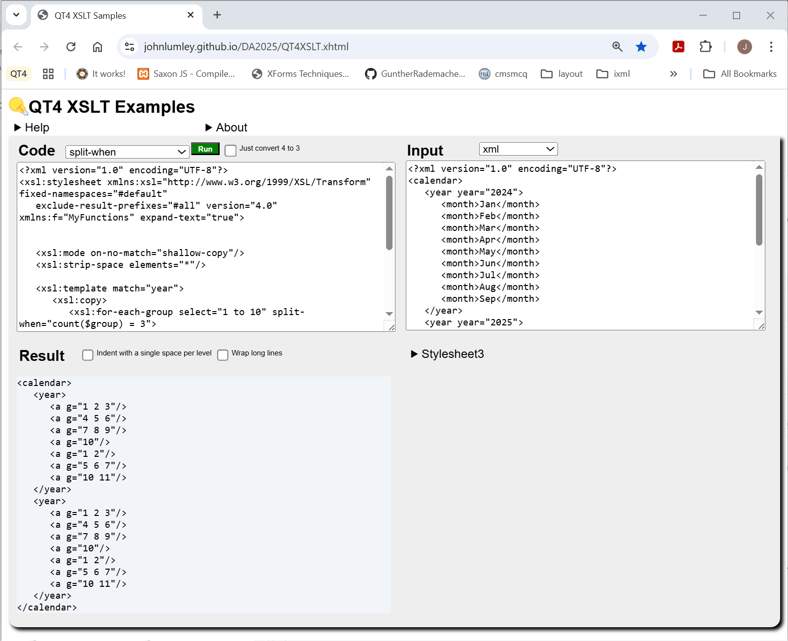
Syntax additions
XSLT 4.0
Many of the XSLT syntax additions can be source-converted to XSLT3
A browser-based workbench does this and executes

