Slide 1

Functions & Operators 4.0

Slide 2
Overview
EXPath File and Binary modules adopted and refined
~90 new functions
~60 functions extended
Options maps where appropriate
Argument names are now significant (keyword calls)
Consistency improved

Slide 3
Optional arguments
Multiple-arity functions now defined with optional arguments:
fn:deep-equal($parameter1 as item()*,
$parameter2 as item()*) as xs:boolean
fn:deep-equal($parameter1 as item()*,
$parameter2 as item()*,
$collation as xs:string) as xs:boolean
fn:deep-equal(
$input1 as item()*,
$input2 as item()*,
$options as (xs:string | map(*))? := {}
) as xs:boolean

Slide 4
Sequence position arguments in Higher-Order Functions
Many of the higher-order functions now have an optional sequence position:
fn:filter($input as item()*,
$predicate as fn(item(), xs:integer) as xs:boolean?
) as item()*
Sequence position
('a','z') =!> string-to-codepoints()
=> fn($t) { $t[1] to $t[2] }() =!> codepoints-to-string()
=> filter(fn($item,$pos) {$pos mod 2 eq 0})
'b','d','f'… 'x','z'

Slide 5
Keyword arguments in static function calls
fn:sort( $input as item()*,
$collation as xs:string? := fn:default-collation(),
$key as fn(item()) as xs:anyAtomicType* := fn:data#1
) as item()*
Argument names now significant:
Arguments by position
Arguments by keyword (following)
sort(//employee, key := fn($e) { xs:decimal($e/salary) })
fn:sort(//employee,fn:default-collation(),
fn($e) { xs:decimal($e/salary) })

Slide 6
Options as a record argument
Mostly on functions processing maps, arrays and resources:
fn:csv-to-arrays(
$value as xs:string?,
$options as map(*)? := {}
) as array(xs:string)*
record(
field-delimiter? as xs:string,
row-delimiter? as xs:string,
quote-character? as xs:string,
trim-whitespace? as xs:boolean
)

Slide 7
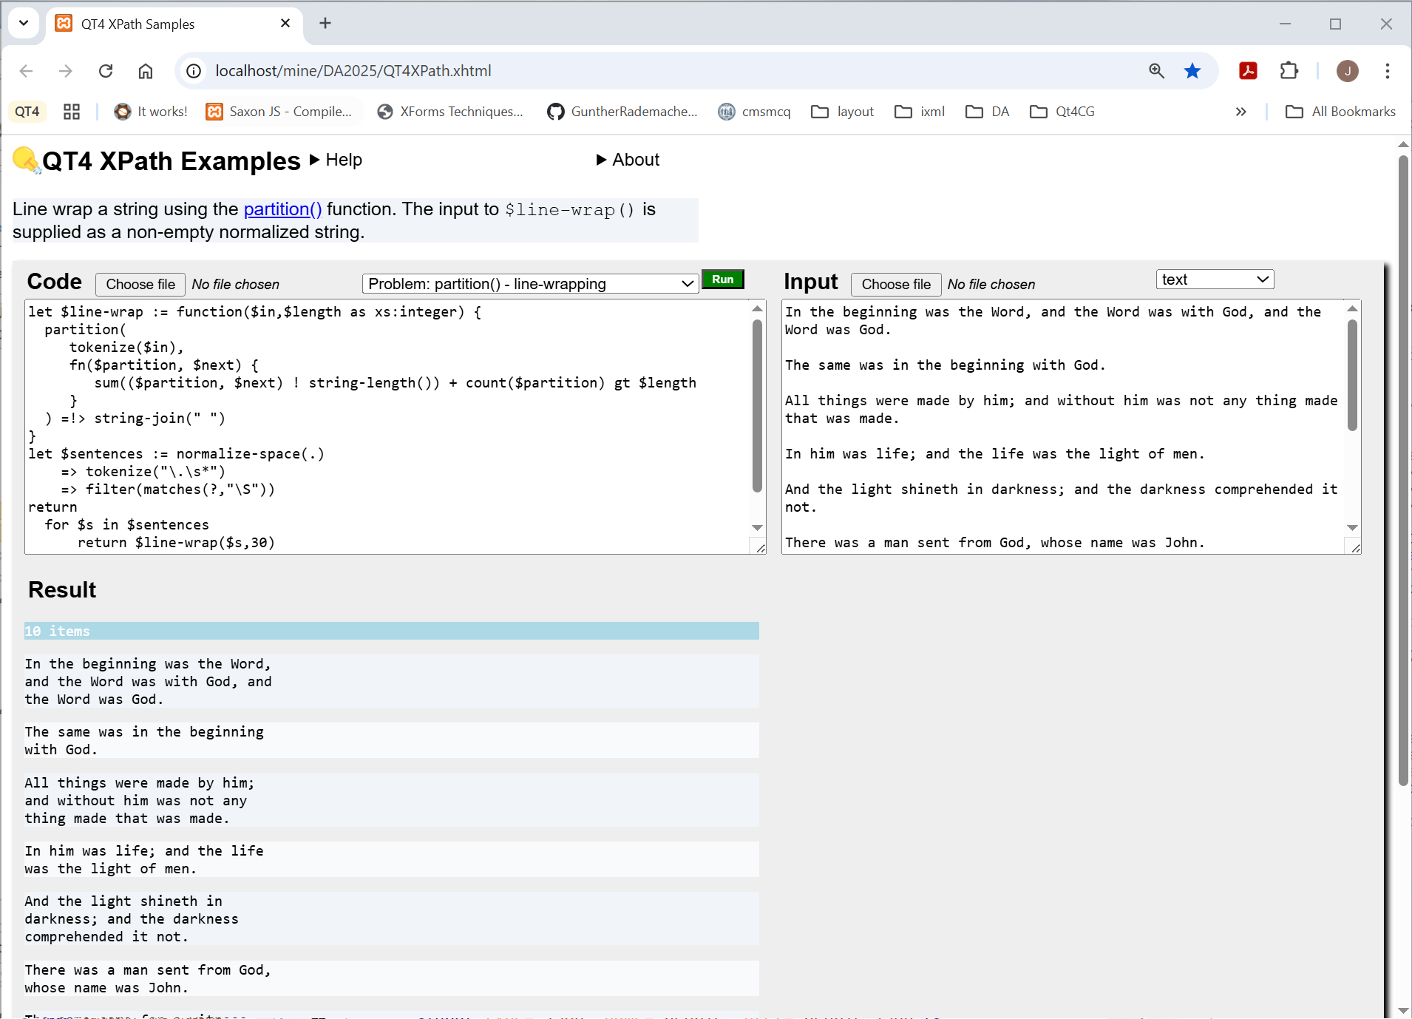
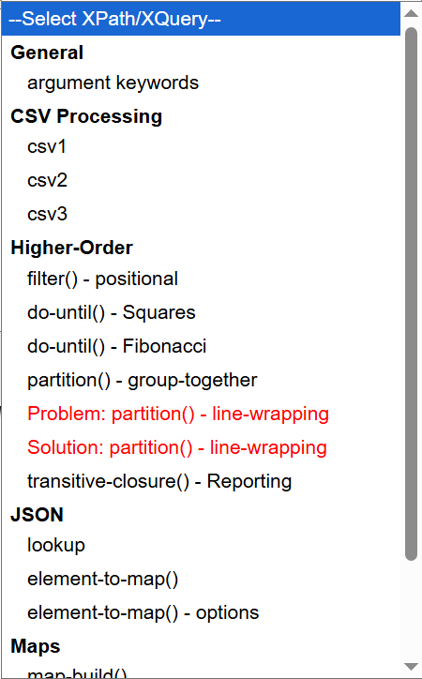
XPath workbench
Problem statement & hints
CODE & INPUT can be edited and loaded by:
Example drop-down
Local file chooser
Drag-and-drop
(not Firefox)
CODE
INPUT
Run uses
BaseX Fiddle
to process the expression
(Many thanks!)
RESULT(s)

Slide 8
General Functions on Sequences
fn:foot() | The last of a sequence | cf fn:head()
fn:trunk() | All but the last | cf fn:tail()
fn:identity() | Passes argument unchanged
fn:void() | Consumes the argument
fn:items-at() | Items from selected positions | Can be any order and have duplicates
fn:replicate() | Multiple copies of a sequence | (1 to $count) ! $input
fn:sequence-join() | Insert separator between adjacent items
fn:slice() | Subsequence with ‘step/stride’ | Can be in reverse cf Javascript/Python

Slide 9
Comparison Functions
fn:atomic-equal() | (Coerced) type/value equality | ≡ comparing map keys
fn:contains-subsequence() | One sequence contains a given contiguous subsequence | Used-suppliable comparison function
fn:duplicate-values() | Values that appear more than once
fn:ends-with-subsequence() | One sequence finishes with a given contiguous subsequence | Used-suppliable comparison function
fn:starts-with-subsequence() | One sequence starts with a given contiguous subsequence | Used-suppliable comparison function
fn:all-equal() | All items have equal atomic value | Used-suppliable collation
fn:all-different() | No two items have equal atomic value | Used-suppliable collation

Slide 10
Basic Higher-Order Functions i
fn:do-until()| fn:while-do() | Processes a value repeatedly while a condition is (false | true) | Action & predicate functions, with $position
fn:every()| fn:some() | (Every | at least one) item satisfies a predicate | Predicate function with $position
fn:highest()| fn:lowest() | Items which have the (highest | lowest) sort key | Collation & key function
fn:sort-by() | Sort using several sort-key functions | Collations & sort-key value functions
fn:sort-with() | Sort using comparator functions | List of -ve|0|+ve comparison functions

Slide 11
Example – fn:do-until()
Starting value
Current result
fn:do-until(
$input as item()*,
$action as fn(item()*, xs:integer) as item()*,
$predicate as fn(item()*, xs:integer) as xs:boolean?
) as item()*
Stop when
Sequence position
Example
Higher-Order
do-until()

Slide 12
Basic Higher-Order Functions ii
fn:index-where() | Positions in input of items that match predicate | Predicate function with $position
fn:subsequence-where() | Contiguous subsequence – start and end points determined by predicates | Start & end predicate functions with $position
fn:take-while() | Items prior to the first failing predicate match | Predicate function with $position
fn:partition() | Partition into arrays splitting when a condition is true. cf xsl:for-each-group[@split-when] | Split function($so-far, $item, $position).
fn:scan-left()| fn:scan-right() | Array of successive partial results of fn:fold-left()|fn:fold-right()

Slide 13
Example – fn:partition()
Next item
fn:partition(
$input as item()*,
$split-when as fn(item()*, item(), xs:integer) as xs:boolean?
) as array(item()*)*
Partition so far
Sequence position
Example
Higher-Order
partition()
line wrapping

Slide 14
Basic Higher-Order Functions iii
fn:transitive-closure() | All GNodes reachable by repeated function application | Can be used on nested maps/arrays
fn:partial-apply() | Partial binding of function arguments | More flexible than f:is-larger(?,0)
fn:op() | Generates a function to apply a binary operator to two arguments
Example
Higher-Order
transitive-closure()
checking ixml

Slide 15
Numeric/Math Functions
fn:divide-decimals() | Divide xs:decimals to defined precision returning quotient and remainder.
fn:isNaN() | true if xs:float or xs:double NaN value
fn:parse-integer() | String to integer with radix 2 to 36
math:e()| math:cosh() | math:sinh() |math:tanh()

Slide 16
String Functions
fn:collation() | Constructs a collation URI with properties. | For Unicode Collation Algorithm
fn:collation-available() | Checks whether a collation URI with properties is recognized by the implementation
fn:char() | A string containing a single character or glyph
fn:characters() | Split into a sequence of single-character strings | string-to-codepoints($value) ! codepoints-to-string(.)
fn:graphemes() | Produces grapheme clusters
fn:hash() | Hash, checksum or CRC function applied to string or binary input

Slide 17
URI & QName Functions
fn:decode-from-uri() | Decodes URI-escaped characters in a string
fn:parse-uri() | Parses a URI to a map of its parts
fn:build-uri() | Constructs a URI string from its parts
fn:parse-QName() | EQName → xs:QName | prefix:local or Q{URI}local
fn:expanded-QName() | xs:QName → EQName | Q{URI}local

Slide 18
Date/Time Functions
fn:seconds() | A duration defined in seconds
fn:unix-dateTime() | Conventional timezone offset for a given place and time
fn:civil-timezone() | A string containing a single character or glyph

Slide 19
Node Functions
fn:in-scope-namespaces() | A map of prefix → namespace URI in-scope for an element node | fn:namespace-uri-for-prefix() and fn:in-scope-prefixes() redefined in terms of this
fn:siblings() | Siblings of a GNode in document order | Works with map/array entries
fn:distinct-ordered-nodes() | Removes duplicate GNodes and sorts the input into document order

Slide 20
Map Functions
map:build() | Build a map from a sequence of items | Key and value generating functions with $position
map:empty() | true if a map has no entries
map:entries() | Returns all the key-value pairs of a map as a sequence of single-entry maps
map:filter() | Selects entries from a map, returning a new map | Predicate function($key, $value)
map:items() | All the values of a map, as a sequence in order
map:keys-where() | Selects keys from a map | Predicate function($key, $value)

Slide 21
Example – map:build()
Sequence position
map:build(
$input as item()*,
$key as (fn($item as item(), $position as xs:integer)
as xs:anyAtomicType*)? := fn:identity#1,
$value as (fn($item as item(), $position as xs:integer)
as item()*)? := fn:identity#1,
$options as map(*)? := {}
) as map(*)
Example
Maps
map-build()
frequency analysis

Slide 22
Element → Map (for JSON)
fn:element-to-map() | Converts an element node into a map that is suitable for JSON serialization | Can use a pre-analysed plan
fn:element-to-map-plan() | Analyzes sample data to generate a conversion plan, organised by element and attribute name | Suitable for use by fn:element-to-map() Anticipated running on a sample set to then apply to a larger corpus
Example
JSON
element-to-map()-*

Slide 23
Array Functions - i
array:build() | Build an array from a sequence of items | Value generating function with $position
array:empty() | true if an array has no entries
array:foot() | The last member of an array | cf fn:foot()
array:trunk() | Remove the last member of an array | cf fn:trunk()
array:slice() | An array containing members of an input array selected by position | $start, $end and $step. cf fn:slice()
array:index-of() | Returns positions of members equal to a target | Comparison using fn:deep-equal() with collation
array:index-where() | Returns positions of members which match a predicate | Predicate function($value,$position)

Slide 24
Array Functions - ii
array:items() | All the values of an array, as a concatenated sequence
array:members() | The contents of an array, as a sequence of value records | {‘value’: $sequence}*
array:of-members() | Constructs an array from the contents of a sequence of value records | {‘value’: $sequence}*
array:sort-by() | Sort using several sort-key functions | Collations & sort-key value functions cf fn:sort-by()
array:split() | The contents of an array, as a sequence of single entry arrays

Slide 25
JNode Functions
fn:jtree() | Delivers a root JNode wrapping a map or array, enabling the use of lookup expressions to navigate a JTree rooted at that map or array
fn:jnode-selector() | The selector property of a JNode | xs:integer ≥ 1 for an array JNode, xs:anyAtomicType for a map JNode
fn:jnode-content() | The content property of a JNode | Most coercion rules handle this automatically
fn:jnode-position() | The position property of a JNode | 1 except for map/array multiple sequence values (never in JSON structures)

Slide 26
External Resources - i
fn:unparsed-binary() | Reads an external resource (e.g. a file) and returns its contents in binary | cf file:read-binary()
fn:xsd-validator() | Generates a function suitable for validating a document or element
fn:parse-html() | Parses input as HTML returning a document node
fn:html-doc() | Reads an external resource containing HTML and parses it

Slide 27
External Resources - ii
fn:csv-to-arrays() | Parses CSV data supplied as a string, returning the results as a sequence of arrays of strings
fn:parse-csv() | Parses CSV data, returning a record containing information about the names in the header, as well as the data itself
fn:csv-doc() | Reads an external resource containing CSV and parses it
fn:csv-to-xml() | Parses CSV data supplied as a string, returning the results as an XML document
fn:invisible-xml() | Creates an Invisible XML parser for a grammar

