Slide 1
XSLT 4.0

Slide 2
Extra Features
Enhancements to the type system to allow more expressive constraints, especially for maps and atomic values.
Additional functionality for processing arrays.
Exploitation of the power afforded by first-class function items

Slide 3
xsl:item-type
For-each and apply-templates separator
mode/@as
Extension instructions
map/@duplicates cf map:build()
Xsl:for-each-group/@split-when
Named record types
Xsl:record
@select on xsl:map|result-document|when|otherwise|(non-)matching-substring
Xsl:select
Self-referential Global variables of function() type
Parameters passed automatically to apply-imports and next-match
Optional parameters to xsl:function
Xsl:switch
Xsl:note stylesheet/@main-module
stylesheet/@fixed-namespaces
Type-based patterns
Xsl:array
Enclosing mode
Shallow-copy-all for map/array trees
Ordered maps (XPath)

Slide 4

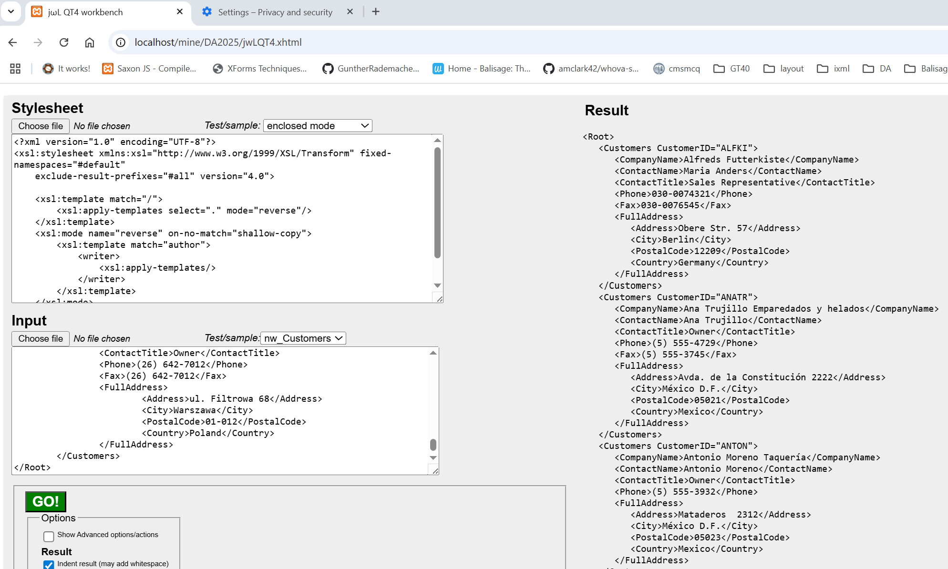
Syntax additions
XSLT 4.0
Many of the XSLT syntax additions can be source-converted to XSLT3
A browser-based workbench can show these and execute

Slide 5
Syntax additions – increasing XSLT code density
XSLT 4.0
<xsl:choose>
<xsl:when test="$n lt $low">
<xsl:sequence select="../below"/>
</xsl:when>
<xsl:when test="$n gt $high">
<xsl:sequence select="../above"/>
</xsl:when>
<xsl:otherwise>
<xsl:sequence select="../within"/>
</xsl:otherwise>
</xsl:choose>
XSLT 3.0 code
Terser XSLT 4.0 equivalent
<xsl:choose>
<xsl:when test="$n lt $low" select="../below"/>
<xsl:when test="$n gt $high" select="../above"/>
<xsl:otherwise select="../within"/>
</xsl:choose>

Slide 6
Selection –
@select vs xsl:sequence[@select]
XSLT 4.0
<xsl:choose>
<xsl:when test="$n lt $low">
<xsl:sequence select="../below"/>
</xsl:when>
<xsl:when test="$n gt $high">
<xsl:sequence select="../above"/>
</xsl:when>
<xsl:otherwise>
<xsl:sequence select="../within"/>
</xsl:otherwise>
</xsl:choose>
Similarly for:
xsl:map |
xsl:result-document |
xsl:matching-substring | xsl:non-matching-substring
<xsl:choose>
<xsl:when test="$n lt $low" select="../below"/>
<xsl:when test="$n gt $high" select="../above"/>
<xsl:otherwise select="../within"/>
</xsl:choose>

Slide 7
Selection – preserving formatted XPath expressions
<xsl:function name="f:book-to-json" as="map(*)">
<xsl:param name="book" as="element(book)">
<xsl:select>
{ "title" : string($book/title),
"isbn" : string($book/isbn),
"price" : number($book/@price),
"author" : array { $book/author ! string() },
"date" : current-date()"
}
</xsl:select>
</xsl:function>

Slide 8
If @then @else
XSLT 4.0
<xsl:choose>
<xsl:when test="$n ge $low and $n le $high">
<xsl:sequence select="../within"/>
</xsl:when>
<xsl:otherwise>
<xsl:sequence select="../without"/>
</xsl:otherwise>
</xsl:choose>
<xsl:if test="$n ge $low and $n le $high"
then="../within" else="../without"/>

Slide 9
Enclosing Mode
XSLT 4.0
<xsl:mode name="removePara" on-no-match="shallow-copy"/>
<xsl:template mode="removePara" as="element()*" match="/">
<xsl:apply-templates mode="#current"/>
</xsl:template>
Lots of other stuff which makes finding all relevant matches difficult
<xsl:template mode="removePara" as="element()*" match="p"/>
<xsl:mode name="removePara" on-no-match="shallow-copy" as="element()*">
<xsl:template match="/">
<xsl:apply-templates/>
</xsl:template>
<xsl:template match="p"/>
</xsl:mode>

Slide 10
Optional function parameters
XSLT 4.0
<xsl:function name="f:inRange">
<xsl:param name="n"/>
<xsl:sequence select="f:inRange($n,0)"/>
</xsl:function>
<xsl:function name="f:inRange">
<xsl:param name="n"/>
<xsl:param name="low"/>
<xsl:variable name="high">
<xsl:call-template name="findLimit"/>
</xsl:variable>
<xsl:sequence select="f:inRange($n,$low,$high)"/>
</xsl:function>
<xsl:function name="f:inRange">
<xsl:param name="n"/>
<xsl:param name="low"/>
<xsl:param name="high"/>
<!-- Stuff -->
</xsl:function>
<xsl:function name="f:inRange">
<xsl:param name="n" as="element()"/>
<xsl:param name="low" required="no" select="0"/>
<xsl:param name="high" required="no">
<xsl:call-template name="findLimit"/>
</xsl:param>
<!-- Stuff -->
</xsl:function>

Slide 11
Named Item Types
<xsl:param name="upscale" as="map(xs:string,function(xs:double) as xs:double)"/>
<xsl:param name="downscale" as="map(xs:string,function(xs:double) as xs:double)"/>
<xsl:variable name="converters" as="map(xs:string,function(xs:double) as xs:double)"
select="map{
'double': function ($x) {$x + $x},
'quadruple': function ($x) {4 * $x}
}""/>
<xsl:item-type name="f:converters"
as="map(xs:string,function(xs:double) as xs:double)"/>
<xsl:param name="upscale" as="f:converters"/>
<xsl:param name="downscale" as="f:converters"/>
<xsl:variable name="converters" as="f:converters" select="
map {
'double': function ($x) {$x + $x},
'quadruple': function ($x) {4 * $x}
}"/>

Slide 12
Record Types, Constructors
<xsl:record-type name="f:complex" constructor=”true”>
<xsl:field name="r" as="xs:double"/>
<xsl:field name="i" as="xs:double" required="no" default="0"/>
</xsl:record-type>
<xsl:variable name="i" as="f:complex" select="f:complex(0, 1)"/>
<xsl:record xsl:as=”f:complex” r=”15” i=”12” xsl:use-when=”$use-records”/>

Slide 13
Extension Instructions to call templates
<xsl:template name="f:report">
<xsl:param name="code" as="xs:integer" required=”yes”/>
<xsl:param name="message" as="xs:string?"/>
<report code="{$code}">{($message,’Emergency’)[1]}</report>
</xsl:template>
<xsl:call-template name="f:report">
<xsl:with-param name="code" select="123"/>
<xsl:with-param name="message" select="'All normal'"/>
</xsl:call-template>
…
… extension-element-prefixes=”f”…
<xsl:template name="f:report"> … </xsl:template/>
<f:report code="123" message="All normal"/>
<f:report code="999"/>

Slide 14
Fixed namespaces
<xsl:stylesheet
xmlns:xsl="http://www.w3.org/1999/XSL/Transform"
xmlns:array="http://www.w3.org/2005/xpath-functions/array"
xmlns:err="http://www.w3.org/2005/xqt-errors"
xmlns:fn="http://www.w3.org/2005/xpath-functions"
xmlns:map="http://www.w3.org/2005/xpath-functions/map"
xmlns:math="http://www.w3.org/2005/xpath-functions/math"
xmlns:xs="http://www.w3.org/2001/XMLSchema"
xmlns:xsi="http://www.w3.org/2001/XMLSchema-instance"
version="3.0">
<!-- Stuff -->
</xsl:stylesheet>
<xsl:stylesheet
xmlns:xsl="http://www.w3.org/1999/XSL/Transform"
fixed-namespaces="#default"
version="4.0"
<!-- Stuff -->
</xsl:stylesheet>

Slide 15
Separators
<xsl:apply-templates select="AUTHOR">
<xsl:sort select="LAST-NAME"/>
<xsl:sort select="FIRST-NAME"/>
</xsl:apply-templates>
<xsl:template match="AUTHOR">
<!-- Stuff -->
<xsl:if test="position() lt last()">
<xsl:text>, </xsl:text>
</xsl:if>
</xsl:for-each>
<xsl:for-each select="AUTHOR">
<xsl:sort select="LAST-NAME"/>
<xsl:sort select="FIRST-NAME"/>
<xsl:apply-templates select="."/>
<xsl:if test="position() lt last()">
<xsl:text>, </xsl:text>
</xsl:if>
</xsl:for-each>
<xsl:apply-templates select="AUTHOR" separator=", ">
<xsl:sort select="LAST-NAME"/>
<xsl:sort select="FIRST-NAME"/>
</xsl:apply-templates>
Similarly for:
xsl:for-each

Slide 16
Switch
<xsl:variable name="n" select="a" as="item()"/>
<xsl:choose>
<xsl:when test="$n = (1, 2, 3, 4)">
<xsl:sequence select="../small"/>
</xsl:when>
<xsl:when test="$n = (5 to 20)">
<xsl:sequence select="../medium"/>
</xsl:when>
<xsl:otherwise>
<xsl:sequence select="../large"/>
</xsl:otherwise>
</xsl:choose>
<xsl:switch select="$n">
<xsl:when test="1, 2, 3, 4" select="../small"/>
<xsl:when test="5 to 20" select="../medium"/>
<xsl:otherwise select="../large"/>
</xsl:switch>

Slide 17
Arrays FIX!!!!!
<xsl:variable name="n" select="a" as="item()"/>
<xsl:choose>
<xsl:when test="$n = (1, 2, 3, 4)">
<xsl:sequence select="../small"/>
</xsl:when>
<xsl:when test="$n = (5 to 20)">
<xsl:sequence select="../medium"/>
</xsl:when>
<xsl:otherwise>
<xsl:sequence select="../large"/>
</xsl:otherwise>
</xsl:choose>
<xsl:switch select="$n">
<xsl:when test="1, 2, 3, 4" select="../small"/>
<xsl:when test="5 to 20" select="../medium"/>
<xsl:otherwise select="../large"/>
</xsl:switch>

Slide 18
Development/documentation aid
<xsl:stylesheet xmlns:xsl="http://www.w3.org/1999/XSL/Transform"
main-module="toplevel-uri.xsl" ...>
<xsl:note role="description">
<p>This is a note <b>purely</b> for purposes outside XSLT. <br/>
Think of it as a comment that can contain structured stuff.</p>
</xsl:note>
<xsl:function name="t:temp">
<xsl:note class=”simple”>It can appear anywhere as a child element
and can have any attributes …
</xsl:note>
<xsl:param name="a">
<xsl:note continuation-of="previous::xsl:note[1]">
… and is totally ignored by XSLT for any
syntactic or semantic purposes.</xsl:note>
</xsl:param>
…
</xsl:function>
</xsl:stylesheet>

