Slide 1

XPath, XSLT and XQuery 4 –
What’s in it for me?
Juri Leino, John Lumley
QT4 Community Group
qt4cg.org

Slide 2
Agenda
Overview of QT4CG activities
Summaries of XPath, XSLT & XQuery 4
Detailed – ~ 60 mins each
  XPath – with execution in BaseX (or BXFiddle?)
  XSLT – some execution in browser workbench
  XQuery – with execution in BaseX

Slide 3
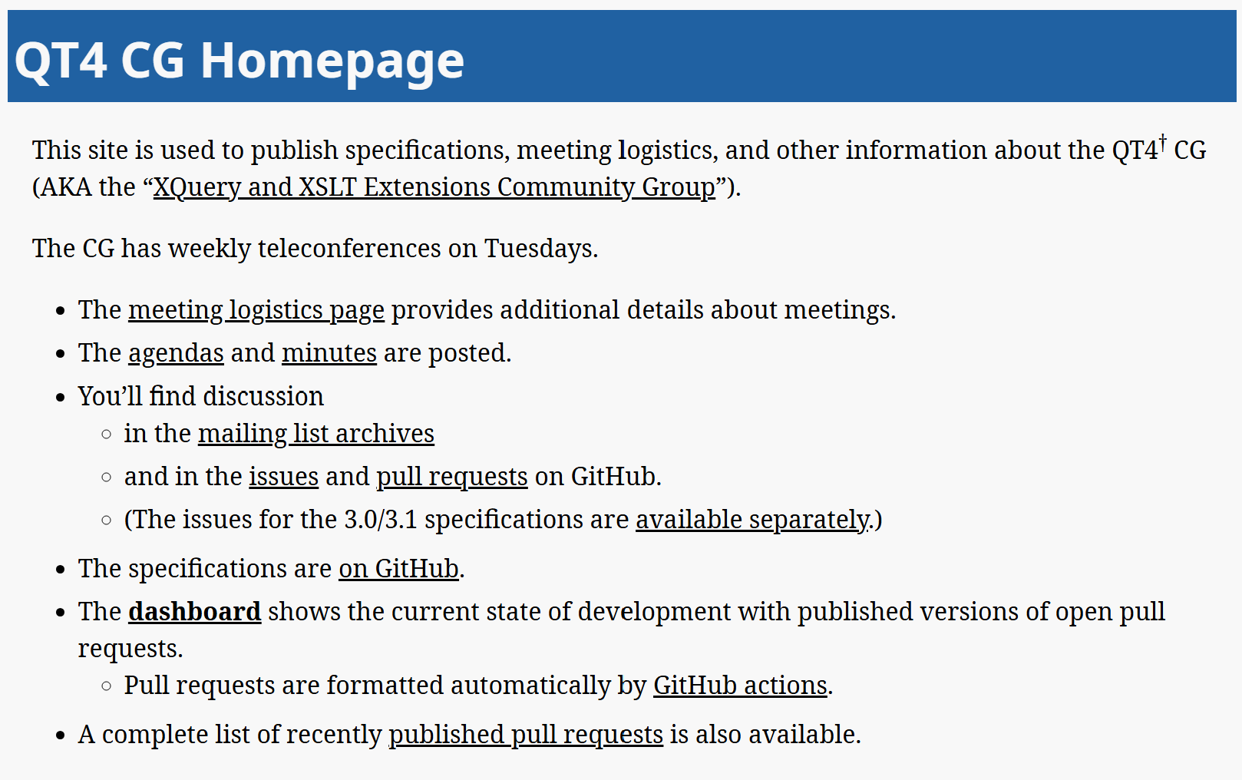
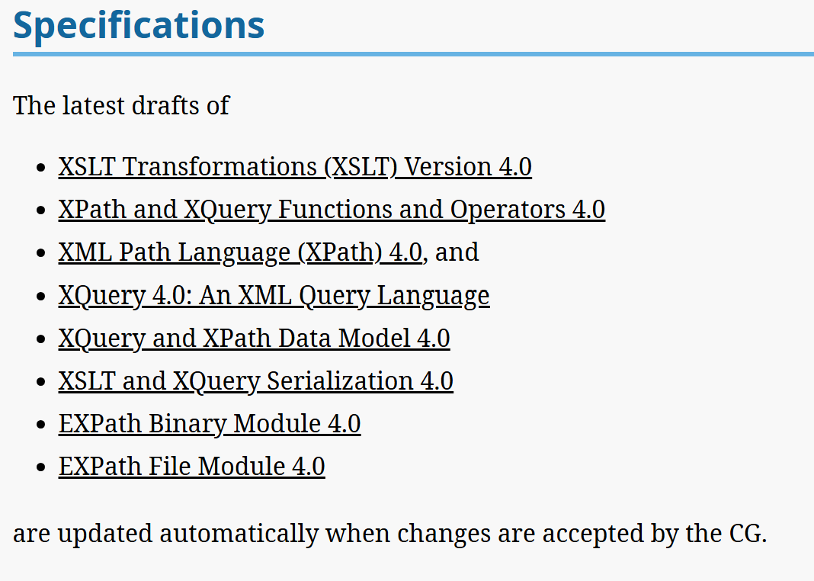
Started 6th September 2022
133 weekly (Zoom) meetings thus far
~12 active members; email; GitHub
>2000 issues/pull requests
~ 1 year to expected spec. completion
QT4 Community Group
qt4cg.org
A Community Group under W3C

Slide 4
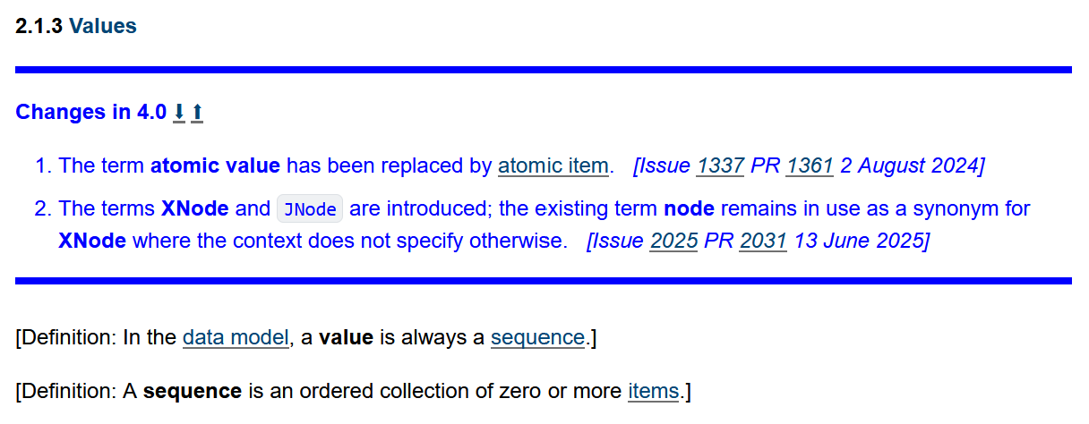
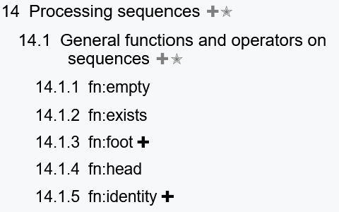
The specifications have extensive identification of changes
Change summaries on (sub)sections
Sections with significant changes in the TOC
Previous/Next
Links to Issue/PR discussions
New functions
BUT – the specifications are altering!

Slide 5
QT4 – moving from 3.1 to 4.0
Improved features to process (nested) maps and arrays as easily as node trees
  Full processing of (deep) JSON as a target
Syntax and function additions to improve ease of use
Minimal backwards incompatibility

Slide 6
XPath 4.0 – overview
Better support for nested maps/arrays
  JNode – an array/map entry with ‘axis-relationships’
  Deep lookup operators
  Maps are now ordered
Structured Record (map) types
Improved ‘pipelines’ => -> =!>

Slide 7
XSLT 4.0 – overview
Syntactic additions to make stylesheets cleaner
  Enclosing modes
  Declared item/record types
  Regularized @select | xsl:sequence/@select
Better support for maps/arrays
  Template matching
Potential freezing of streaming support

Slide 8
XQuery 4.0 – overview
For Juri

Slide 9
F&O 4.0 – overview
EXPath File and Binary modules
adopted and refined
~90 new functions
~60 functions extended
Options maps where appropriate
Consistency

