Slide 1
Functional programming, in the data structures course, in Java
John MacCormick
Dickinson College
Notes:
Hi everyone, my colleagues and I at Dickinson College would like to propose to you a new way of teaching functional programming in your computer science curriculum.

Slide 2
Idea: embed functional programming in core courses, so that all students see it
Problem with existing curriculums: about 40% of students never see functional programming (FP)
Solution: Incorporate functional programming into required core courses (functional embedding)
Specific example in this talk: insert a week of functional programming into the data structures course (in Java)
Notes:
The central idea is to embed functional programming in core courses, so that all students will see it.

Slide 3
Functional programming is important
Evidence:
3/84 competencies in 2020 ACM/IEEE curriculum guidelines require functional programming (FP)
This is equivalent to a few weeks of class time
[also: our external reviewers recommended more FP coverage]

Slide 4
CS curriculums employ five different approaches to teaching FP
functional-first: CS1 taught in a functional language
functional-required: FP taught in required programming languages (PL) course
functional-elective: FP taught in elective PL course
functional-minimal: FP coverage is negligible or incidental
functional-embedded: FP is incorporated into one or more required core courses
new approach proposed in this talk

Slide 5
Many students never learn functional programming
Analysis of CS curriculums of the institutions represented in the four most recent CCSC conference proceedings:
Approach to FP | frequency | percentage
functional-first | 0 | 0%
functional-required | 12 | 41%
functional-elective | 11 | 38%
functional-minimal | 6 | 21%
functional-embedded | 0 | 0%
About 40% don’t learn any FP
actually 20-60%, depending on how many take a PL elective
new approach proposed in this talk

Slide 6
Idea: embed functional programming in core courses, so that all students see it
Problem with existing curriculums: about 40% of students never see functional programming (FP)
Solution: Incorporate functional programming into required core courses (functional embedding)
Specific example in this talk: insert a week of functional programming into the data structures course (in Java)

Slide 7
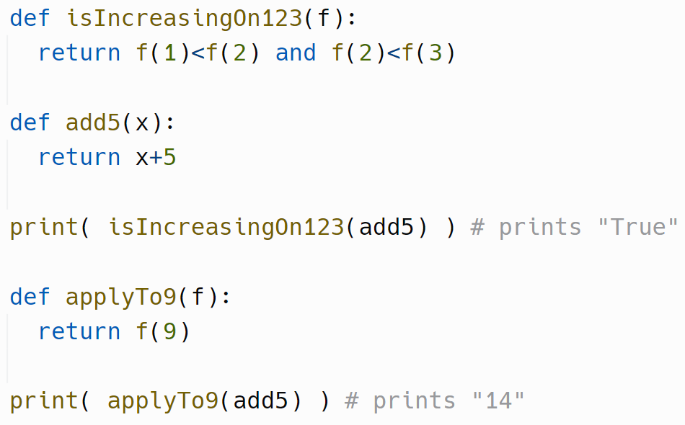




FP is ugly in Java, so we introduce it in Python first
This works fine even for students who have never seen Python
The syntax is extremely intuitive
Lambda expressions are also easy to understand in this context

Slide 8
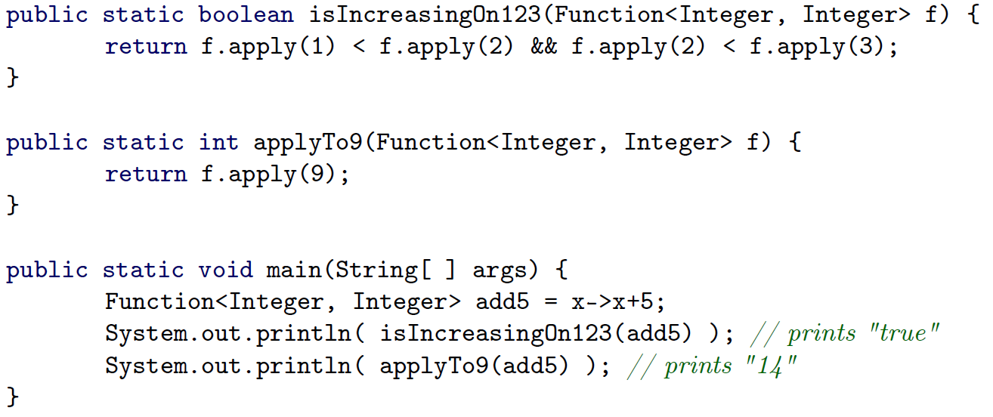

The equivalent, ugly Java version is now easy to understand
Python
Use a lambda expression here.
Do not explain functional interfaces.
Java

Slide 9
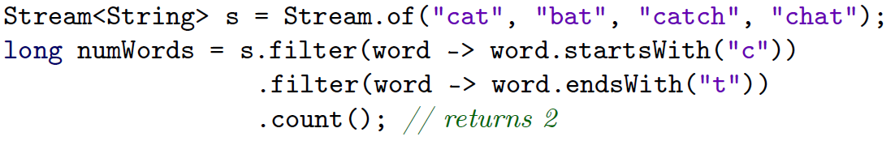

Java’s Stream API provides meaningful, accessible applications of FP
Examples include:
Elementary filtering and counting
Parallel processing
.parallel()

Slide 10





Java’s Stream API provides meaningful, accessible applications of FP
Examples include:
Elementary filtering and counting
Parallel processing
Map-reduce
IntStream nVals = ...
double strangeProduct = nVals
.mapToDouble(n -> n + Math.sqrt(n))
.reduce(1.0, (prod, val) -> prod * val);

Slide 11
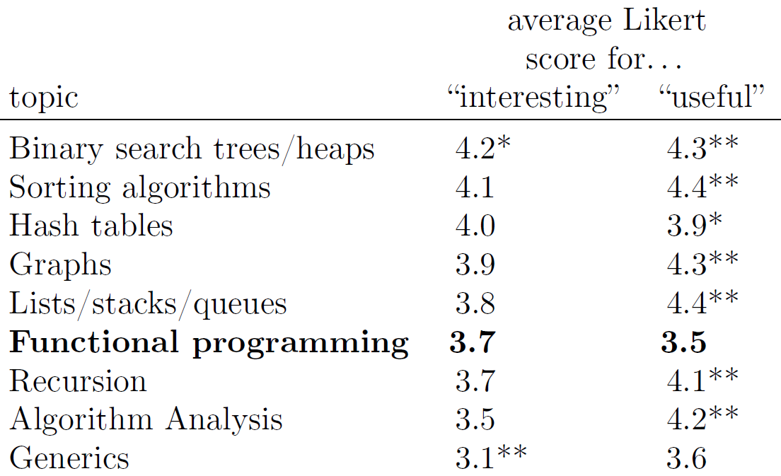
Students mastered the FP basics, but perceptions were mixed
Students performed well on FP exam questions, including map-reduce (see paper)
Students perceived the FP content as interesting but not particularly useful:

Slide 12
Idea: embed functional programming in core courses, so that all students see it
Problem with existing curriculums: about 40% of students never see functional programming (FP)
Solution: Incorporate functional programming into required core courses (functional embedding)
Specific example in this talk: insert a week of functional programming into the data structures course (in Java)

Slide 13
Future work
Emphasize other FP ideas, not just lambda expressions (e.g. immutability and its advantages)
Embed FP into other courses such as algorithms, networking, operating systems, theory of computation, software engineering
Thank you to the anonymous reviewers—they helped clarify our thinking

