Slide 1
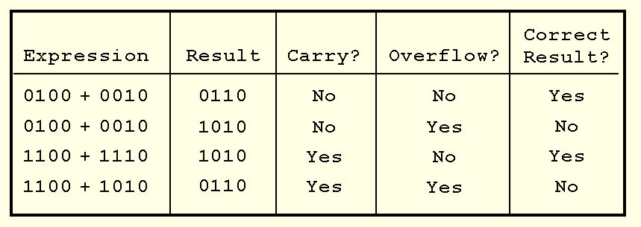
2.4 Signed Integer Representation

