Slide 1
Puzzles from Null & Lobur Chapter 3 powerpoint slides

Slide 2
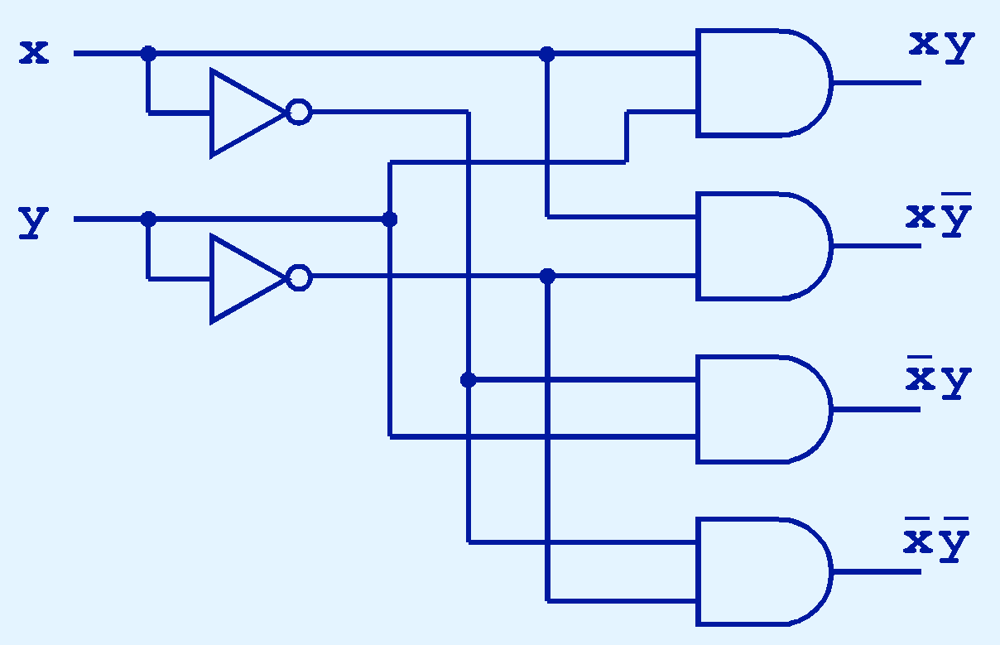
(1) 2-to-4 decoder
If x = 0 and y = 1, which output line is enabled?

Slide 3
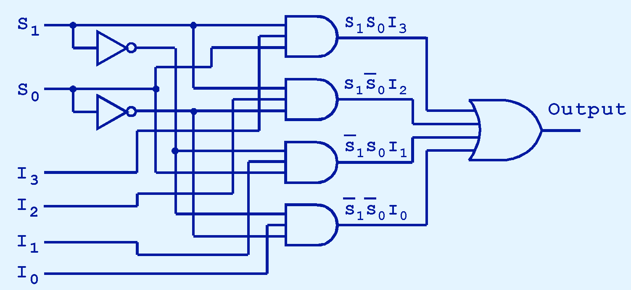
(2) 4-to-1 multiplexer
If S₀ = 1 and S₁ = 0, which input is transferred to the output?

Slide 4
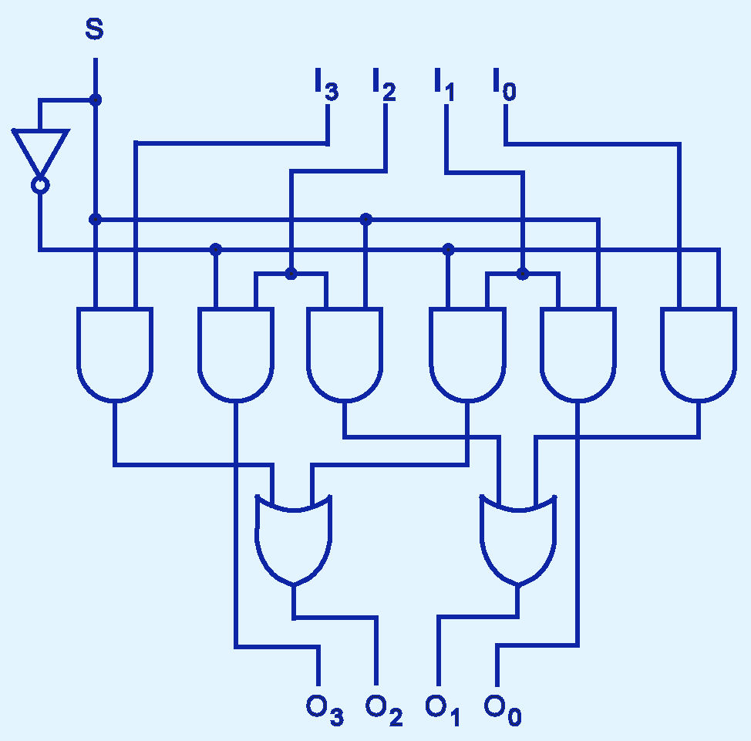
(3) bit shifter
If S = 0, in which direction do the input bits shift?

