Slide 1
Typogenetics
from Hofstadter’s GEB

Slide 2
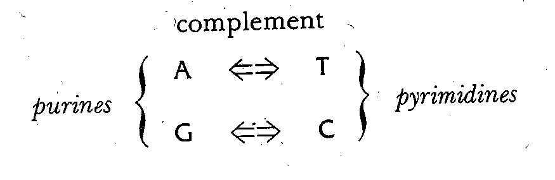
Complementary base pairs

Slide 3
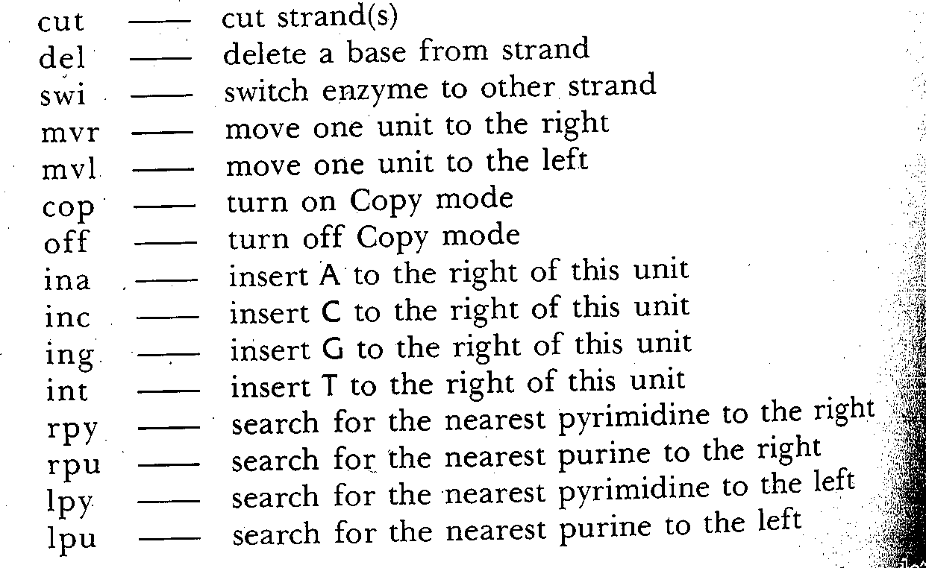
Amino acids

Slide 4
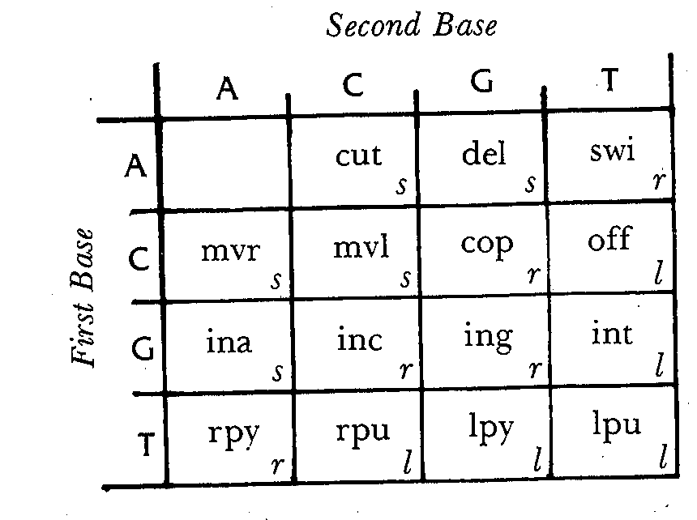
Typogenetic code

Slide 5
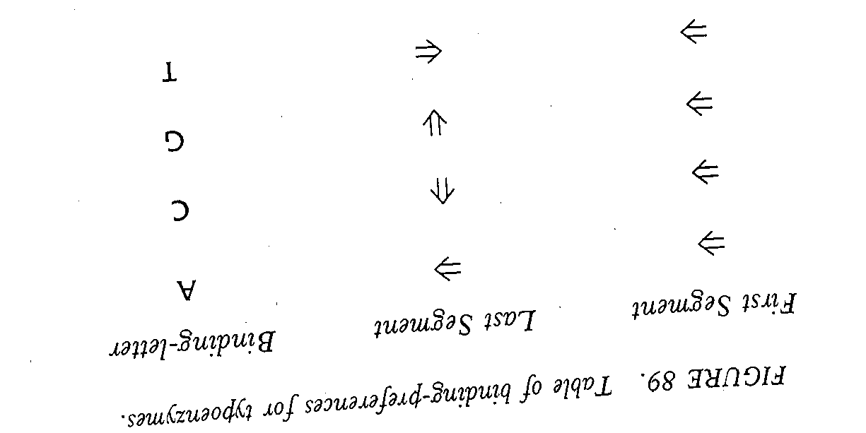
Enzyme binding preferences

