Slide 1
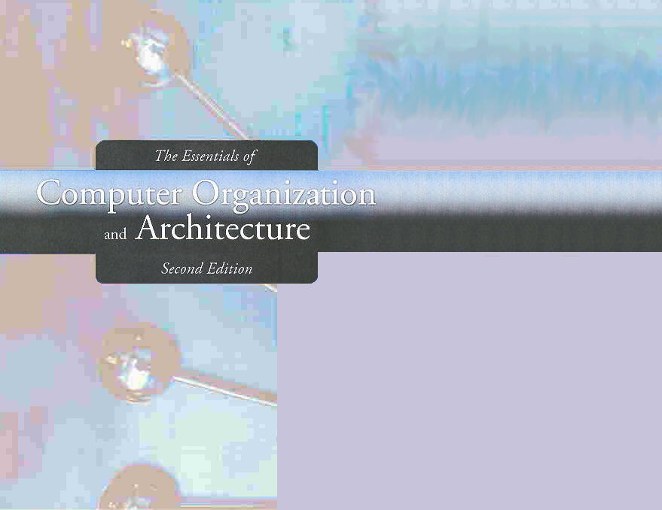
Chapter 7
Input/Output and Storage Systems

Slide 2

Chapter 7 Objectives
Understand how I/O systems work, including I/O methods and architectures.
Become familiar with storage media, and the differences in their respective formats.
Understand how RAID improves disk performance and reliability, and which RAID systems are most useful today.
Be familiar with emerging data storage technologies and the barriers that remain to be overcome.

Slide 3
7.1 Introduction
Data storage and retrieval is one of the primary functions of computer systems.
  One could easily make the argument that computers are more useful to us as data storage and retrieval devices than they are as computational machines.
All computers have I/O devices connected to them, and to achieve good performance I/O should be kept to a minimum!
In studying I/O, we seek to understand the different types of I/O devices as well as how they work.

Slide 4
7.2 I/O and Performance
Sluggish I/O throughput can have a ripple effect, dragging down overall system performance.
  This is especially true when virtual memory is involved.
The fastest processor in the world is of little use if it spends most of its time waiting for data.
If we really understand what’s happening in a computer system we can make the best possible use of its resources.

Slide 5
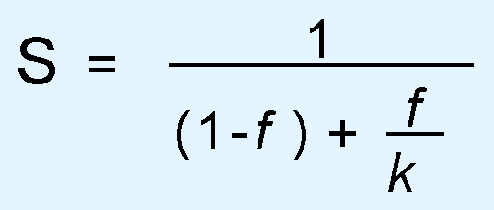
7.3 Amdahl’s Law
The overall performance of a system is a result of the interaction of all of its components.
System performance is most effectively improved when the performance of the most heavily used components is improved.
This idea is quantified by Amdahl’s Law:
  where S is the overall speedup;
  f is the fraction of work performed by a faster component; and
  k is the speedup of the faster component.

Slide 6
7.3 Amdahl’s Law
Amdahl’s Law gives us a handy way to estimate the performance improvement we can expect when we upgrade a system component.
On a large system, suppose we can upgrade a CPU to make it 50% faster for $10,000 or upgrade its disk drives for $7,000 to make them 250% faster.
Processes spend 70% of their time running in the CPU and 30% of their time waiting for disk service.
An upgrade of which component would offer the greater benefit for the lesser cost?

Slide 7
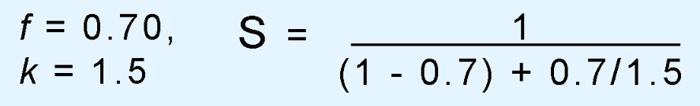
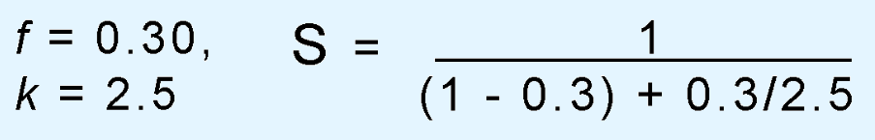
7.3 Amdahl’s Law
The processor option offers a 130% speedup:
And the disk drive option gives a 122% speedup:
Each 1% of improvement for the processor costs $333, and for the disk a 1% improvement costs $318.
Should price/performance be your only concern?

Slide 8
7.4 I/O Architectures
We define input/output as a subsystem of components that moves coded data between external devices and a host system.
I/O subsystems include:
  Blocks of main memory that are devoted to I/O functions.
  Buses that move data into and out of the system.
  Control modules in the host and in peripheral devices
  Interfaces to external components such as keyboards and disks.
  Cabling or communications links between the host system and its peripherals.

Slide 9
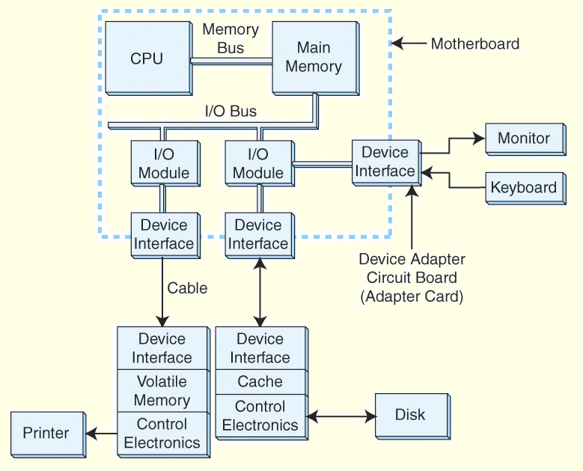
7.4 I/O Architectures
This is a
model I/O
configuration.

Slide 10
7.4 I/O Architectures
I/O can be controlled in four general ways.
Programmed I/O reserves a register for each I/O device. Each register is continually polled to detect data arrival.
Interrupt-Driven I/O allows the CPU to do other things until I/O is requested.
Direct Memory Access (DMA) offloads I/O processing to a special-purpose chip that takes care of the details.
Channel I/O uses dedicated I/O processors.

Slide 11
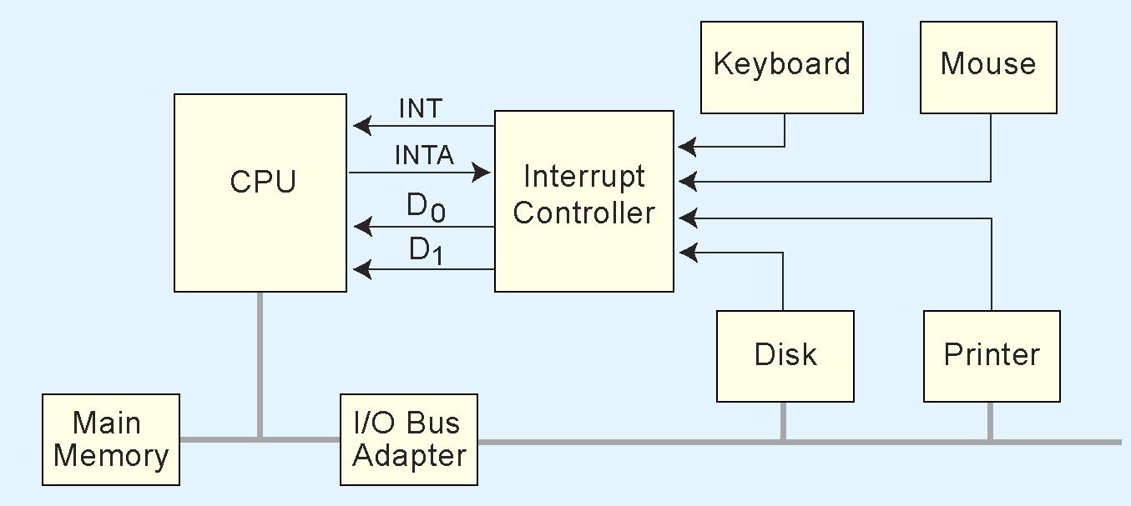
7.4 I/O Architectures
  This is an idealized I/O subsystem that uses interrupts.
  Each device connects its interrupt line to the interrupt controller.
The controller signals the CPU when any of the interrupt lines are asserted.

Slide 12
7.4 I/O Architectures
Recall from Chapter 4 that in a system that uses interrupts, the status of the interrupt signal is checked at the top of the fetch-decode-execute cycle.
The particular code that is executed whenever an interrupt occurs is determined by a set of addresses called interrupt vectors that are stored in low memory.
The system state is saved before the interrupt service routine is executed and is restored afterward.

Slide 13
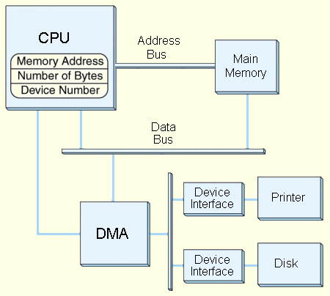
7.4 I/O Architectures
  This is a DMA configuration.
  Notice that the DMA and the CPU share the bus.
  The DMA runs at a higher priority and steals memory cycles from the CPU.

Slide 14
7.4 I/O Architectures
Very large systems employ channel I/O.
Channel I/O consists of one or more I/O processors (IOPs) that control various channel paths.
Slower devices such as terminals and printers are combined (multiplexed) into a single faster channel.
On IBM mainframes, multiplexed channels are called multiplexor channels, the faster ones are called selector channels.

Slide 15
7.4 I/O Architectures
Channel I/O is distinguished from DMA by the intelligence of the IOPs.
The IOP negotiates protocols, issues device commands, translates storage coding to memory coding, and can transfer entire files or groups of files independent of the host CPU.
The host has only to create the program instructions for the I/O operation and tell the IOP where to find them.

Slide 16
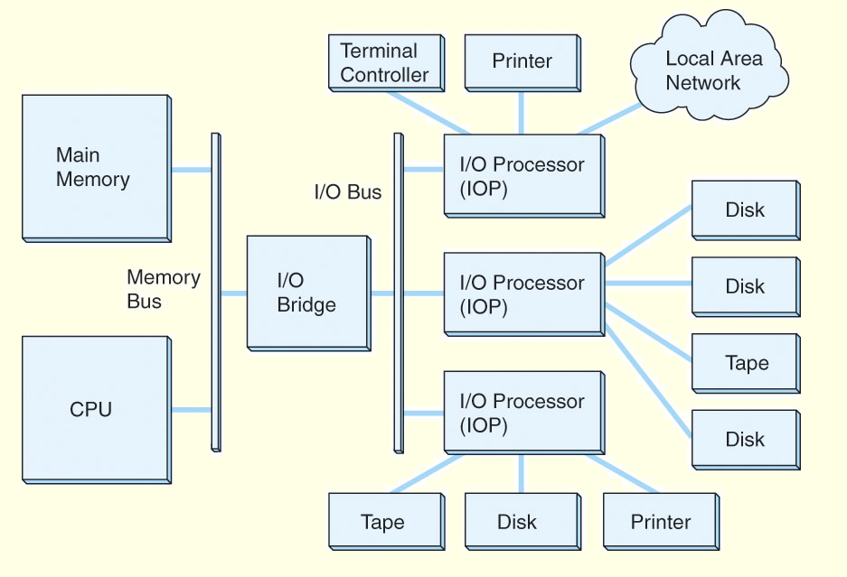
7.4 I/O Architectures
This is a channel I/O configuration.

Slide 17
7.4 I/O Architectures
Character I/O devices process one byte (or character) at a time.
  Examples include modems, keyboards, and mice.
  Keyboards are usually connected through an interrupt-driven I/O system.
Block I/O devices handle bytes in groups.
  Most mass storage devices (disk and tape) are block I/O devices.
  Block I/O systems are most efficiently connected through DMA or channel I/O.

Slide 18
7.4 I/O Architectures
I/O buses, unlike memory buses, operate asynchronously. Requests for bus access must be arbitrated among the devices involved.
Bus control lines activate the devices when they are needed, raise signals when errors have occurred, and reset devices when necessary.
The number of data lines is the width of the bus.
A bus clock coordinates activities and provides bit cell boundaries.

Slide 19
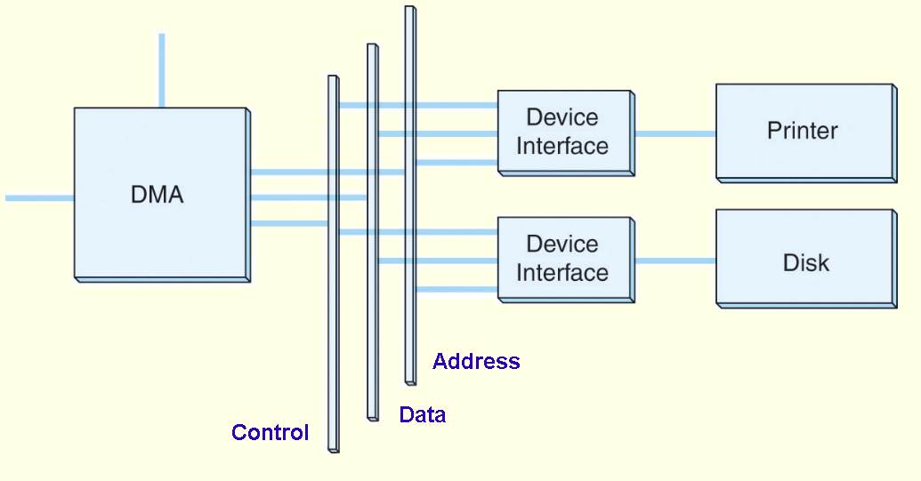
7.4 I/O Architectures
This is a generic DMA configuration showing how the DMA circuit connects to a data bus.

Slide 20
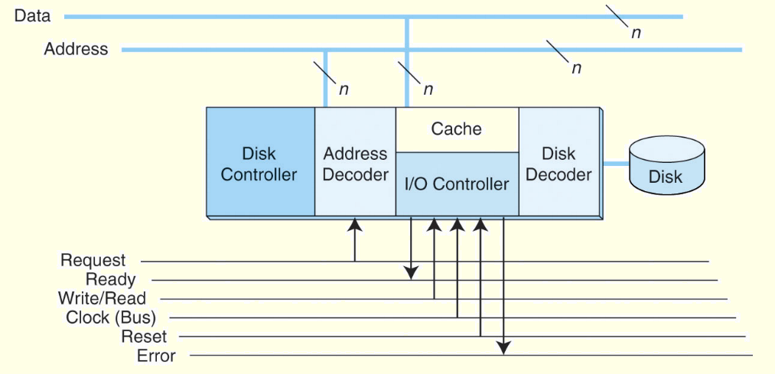
7.4 I/O Architectures
This is how a bus connects to a disk drive.

Slide 21
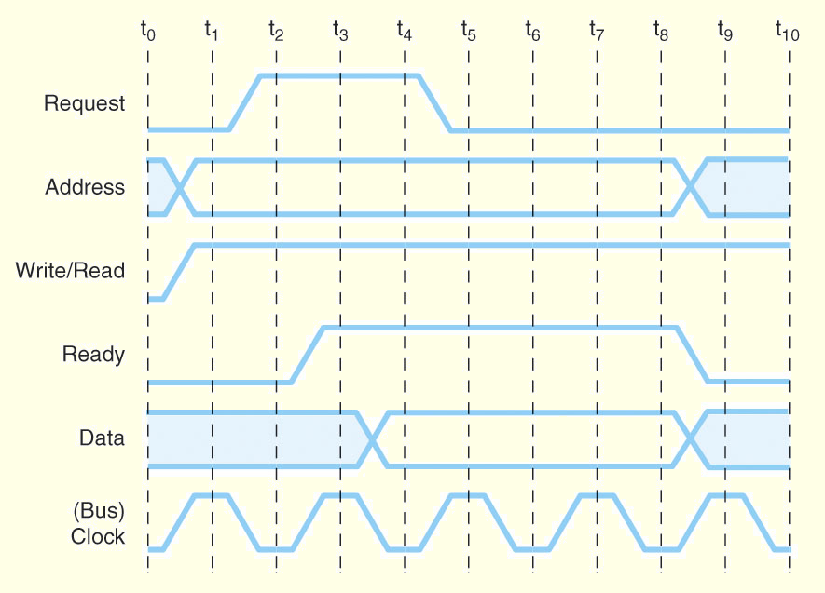
7.4 I/O Architectures
Timing diagrams, such as this one, define bus operation in detail.

Slide 22
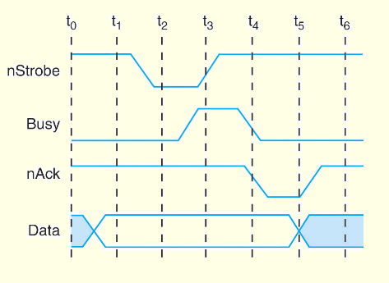
7.5 Data Transmission Modes
Bytes can be conveyed from one point to another by sending their encoding signals simultaneously using parallel data transmission or by sending them one bit at a time in serial data transmission.
Parallel data transmission for a printer resembles the signal protocol of a memory bus:

Slide 23
7.5 Data Transmission Modes
In parallel data transmission, the interface requires one conductor for each bit.
Parallel cables are fatter than serial cables.
Compared with parallel data interfaces, serial communications interfaces:
  Require fewer conductors.
  Are less susceptible to attenuation.
  Can transmit data farther and faster.
Serial communications interfaces are suitable for time-sensitive (isochronous) data such as voice and video.

Slide 24
7.6 Magnetic Disk Technology
Magnetic disks offer large amounts of durable storage that can be accessed quickly.
Disk drives are called random (or direct) access storage devices, because blocks of data can be accessed according to their location on the disk.
  This term was coined when all other durable storage (e.g., tape) was sequential.
Magnetic disk organization is shown on the following slide.

Slide 25
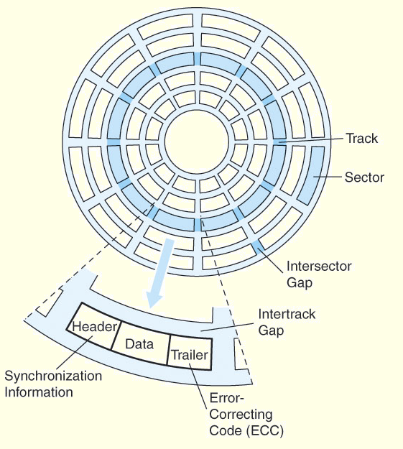
7.6 Magnetic Disk Technology
Disk tracks are numbered from the outside edge, starting with zero.

Slide 26
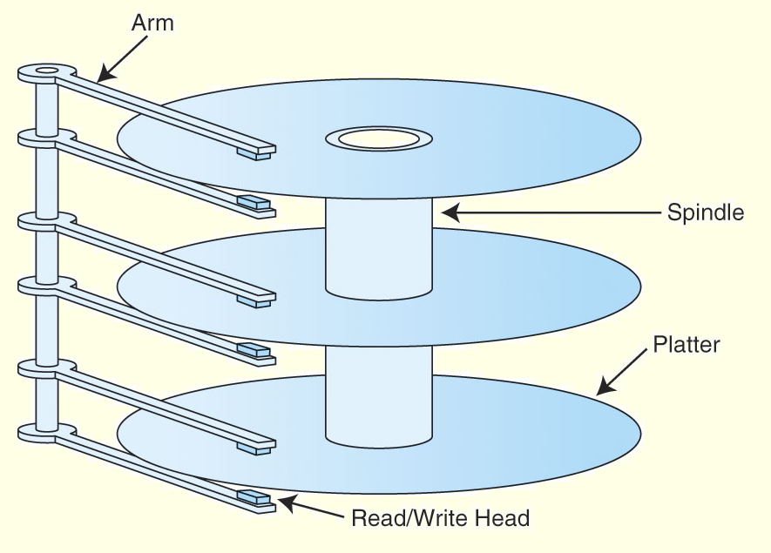
7.6 Magnetic Disk Technology
Hard disk platters are mounted on spindles.
Read/write heads are mounted on a comb that swings radially to read the disk.

Slide 27
7.6 Magnetic Disk Technology
The rotating disk forms a logical cylinder beneath the read/write heads.
Data blocks are addressed by their cylinder, surface, and sector.

Slide 28
7.6 Magnetic Disk Technology
There are a number of electromechanical properties of hard disk drives that determine how fast its data can be accessed.
Seek time is the time that it takes for a disk arm to move into position over the desired cylinder.
Rotational delay is the time that it takes for the desired sector to move into position beneath the read/write head.
Seek time + rotational delay = access time.

Slide 29
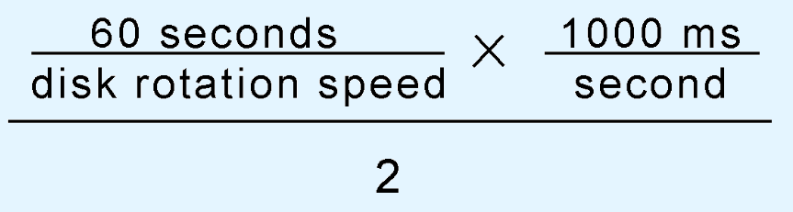
7.6 Magnetic Disk Technology
Transfer rate gives us the rate at which data can be read from the disk.
Average latency is a function of the rotational speed:
Mean Time To Failure (MTTF) is a statistically-determined value often calculated experimentally.
  It usually doesn’t tell us much about the actual expected life of the disk. Design life is usually more realistic.
Figure 7.11 in the text shows a sample disk specification.

Slide 30
7.6 Magnetic Disk Technology
Floppy (flexible) disks are organized in the same way as hard disks, with concentric tracks that are divided into sectors.
Physical and logical limitations restrict floppies to much lower densities than hard disks.
A major logical limitation of the DOS/Windows floppy diskette is the organization of its file allocation table (FAT).
  The FAT gives the status of each sector on the disk: Free, in use, damaged, reserved, etc.

Slide 31
7.6 Magnetic Disk Technology
On a standard 1.44MB floppy, the FAT is limited to nine 512-byte sectors.
  There are two copies of the FAT.
There are 18 sectors per track and 80 tracks on each surface of a floppy, for a total of 2880 sectors on the disk. So each FAT entry needs at least 12 bits (2¹¹= 2048 < 2880 < 2¹² = 4096).
  Thus, FAT entries for disks smaller than 10MB are 12 bits, and the organization is called FAT12.
  FAT 16 is employed for disks larger than 10MB.

Slide 32
7.6 Magnetic Disk Technology
The disk directory associates logical file names with physical disk locations.
Directories contain a file name and the file’s first FAT entry.
If the file spans more than one sector (or cluster), the FAT contains a pointer to the next cluster (and FAT entry) for the file.
The FAT is read like a linked list until the <EOF> entry is found.

Slide 33
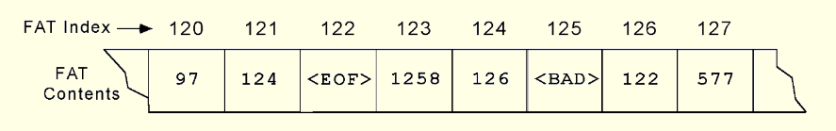
7.6 Magnetic Disk Technology
A directory entry says that a file we want to read starts at sector 121 in the FAT fragment shown below.
  Sectors 121, 124, 126, and 122 are read. After each sector is read, its FAT entry is to find the next sector occupied by the file.
  At the FAT entry for sector 122, we find the end-of-file marker <EOF>.
How many disk accesses are required to read this file?

Slide 34
7.7 Optical Disks
Optical disks provide large storage capacities very inexpensively.
They come in a number of varieties including CD-ROM, DVD, and WORM.
Many large computer installations produce document output on optical disk rather than on paper. This idea is called COLD-- Computer Output Laser Disk.
It is estimated that optical disks can endure for a hundred years. Other media are good for only a decade-- at best.

Slide 35
7.7 Optical Disks
CD-ROMs were designed by the music industry in the 1980s, and later adapted to data.
This history is reflected by the fact that data is recorded in a single spiral track, starting from the center of the disk and spanning outward.
Binary ones and zeros are delineated by bumps in the polycarbonate disk substrate. The transitions between pits and lands define binary ones.
If you could unravel a full CD-ROM track, it would be nearly five miles long!

Slide 36
7.7 Optical Disks
The logical data format for a CD-ROM is much more complex than that of a magnetic disk. (See the text for details.)
Different formats are provided for data and music.
Two levels of error correction are provided for the data format.
Because of this, a CD holds at most 650MB of data, but can contain as much as 742MB of music.

Slide 37
7.7 Optical Disks
DVDs can be thought of as quad-density CDs.
  Varieties include single sided, single layer, single sided double layer, double sided double layer, and double sided double layer.
Where a CD-ROM can hold at most 650MB of data, DVDs can hold as much as 17GB.
One of the reasons for this is that DVD employs a laser that has a shorter wavelength than the CD’s laser.
This allows pits and land to be closer together and the spiral track to be wound tighter.

Slide 38
7.7 Optical Disks
A shorter wavelength light can read and write bytes in greater densities than can be done by a longer wavelength laser.
This is one reason that DVD’s density is greater than that of CD.
The manufacture of blue-violet lasers can now be done economically, bringing about the next generation of laser disks.
Two incompatible formats, HD-CD and Blu-Ray, are competing for market dominance.

Slide 39
7.7 Optical Disks
Blu-Ray was developed by a consortium of nine companies that includes Sony, Samsung, and Pioneer.
  Maximum capacity of a single layer Blu-Ray disk is 25GB.
HD-DVD was developed under the auspices of the DVD Forum with NEC and Toshiba leading the effort.
  Maximum capacity of a single layer HD-DVD is 15GB.
The big difference between the two is that HD-DVD is backward compatible with red laser DVDs, and Blu-Ray is not.

Slide 40
7.7 Optical Disks
Blue-violet laser disks have also been designed for use in the data center.
The intention is to provide a means for long term data storage and retrieval.
Two types are now dominant:
  Sony’s Professional Disk for Data (PDD) that can store 23GB on one disk and
  Plasmon’s Ultra Density Optical (UDO) that can hold up to 30GB.
It is too soon to tell which of these technologies will emerge as the winner.

Slide 41
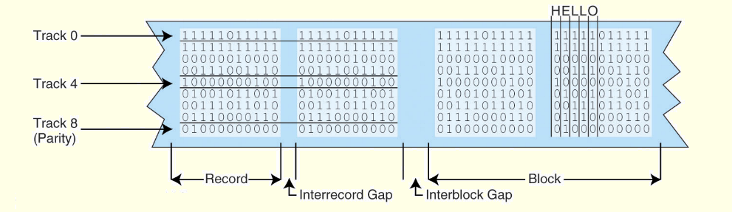
7.8 Magnetic Tape
First-generation magnetic tape was not much more than wide analog recording tape, having capacities under 11MB.
Data was usually written in nine vertical tracks:

Slide 42
7.8 Magnetic Tape
Today’s tapes are digital, and provide multiple gigabytes of data storage.
Two dominant recording methods are serpentine and helical scan, which are distinguished by how the read-write head passes over the recording medium.
Serpentine recording is used in digital linear tape (DLT) and Quarter inch cartridge (QIC) tape systems.
Digital audio tape (DAT) systems employ helical scan recording.
These two recording methods are shown on the next slide.

Slide 43
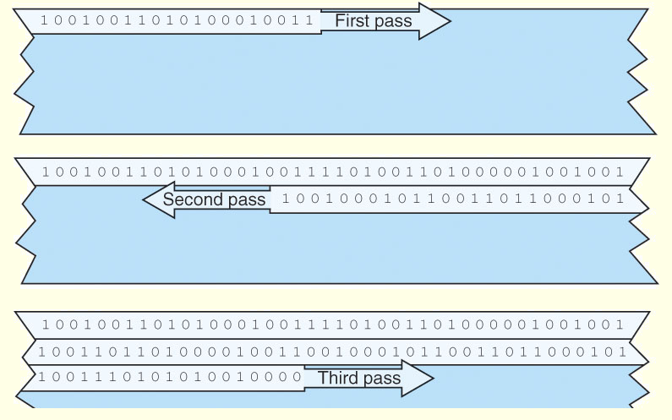
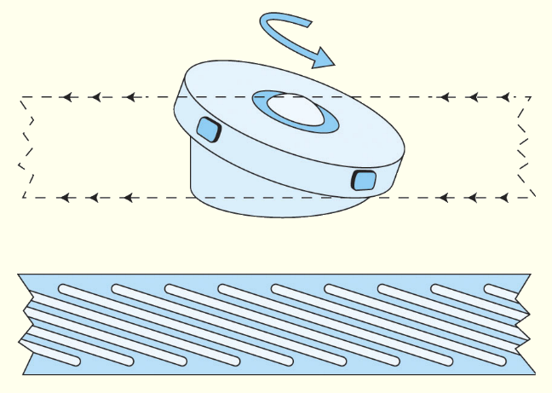
7.8 Magnetic Tape
← Serpentine
Helical Scan →

Slide 44
7.8 Magnetic Tape
Numerous incompatible tape formats emerged over the years.
  Sometimes even different models of the same manufacturer’s tape drives were incompatible!
Finally, in 1997, HP, IBM, and Seagate collaboratively invented a best-of-breed tape standard.
They called this new tape format Linear Tape Open (LTO) because the specification is openly available.

Slide 45
7.8 Magnetic Tape
LTO, as the name implies, is a linear digital tape format.
The specification allowed for the refinement of the technology through four “generations.”
Generation 3 was released in 2004.
  Without compression, the tapes support a transfer rate of 80MB per second and each tape can hold up to 400GB.
LTO supports several levels of error correction, providing superb reliability.
  Tape has a reputation for being an error-prone medium.

Slide 46
7.9 RAID
RAID, an acronym for Redundant Array of Independent Disks was invented to address problems of disk reliability, cost, and performance.
In RAID, data is stored across many disks, with extra disks added to the array to provide error correction (redundancy).
The inventors of RAID, David Patterson, Garth Gibson, and Randy Katz, provided a RAID taxonomy that has persisted for a quarter of a century, despite many efforts to redefine it.

Slide 47
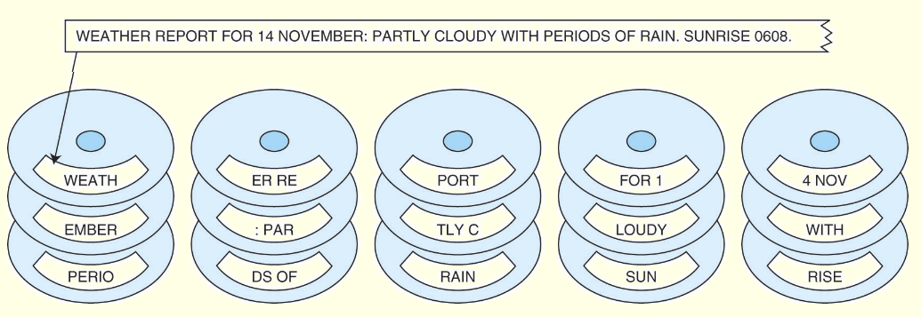
7.9 RAID
RAID Level 0, also known as drive spanning, provides improved performance, but no redundancy.
  Data is written in blocks across the entire array
  The disadvantage of RAID 0 is in its low reliability.

Slide 48
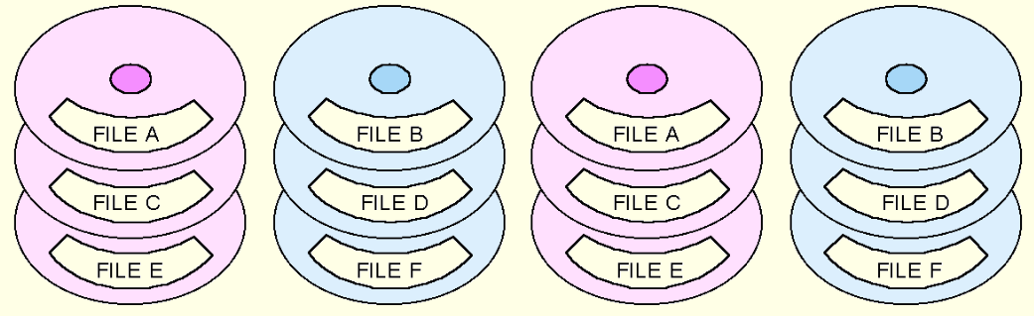
7.9 RAID
RAID Level 1, also known as disk mirroring, provides 100% redundancy, and good performance.
  Two matched sets of disks contain the same data.
  The disadvantage of RAID 1 is cost.

Slide 49
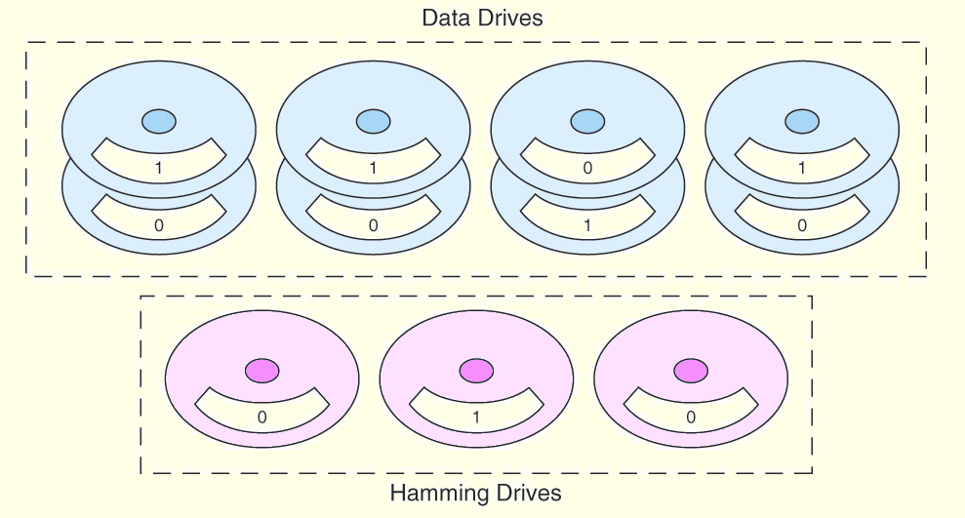
7.9 RAID
A RAID Level 2 configuration consists of a set of data drives, and a set of Hamming code drives.
  Hamming code drives provide error correction for the data drives.
  RAID 2 performance is poor and the cost is relatively high.

Slide 50
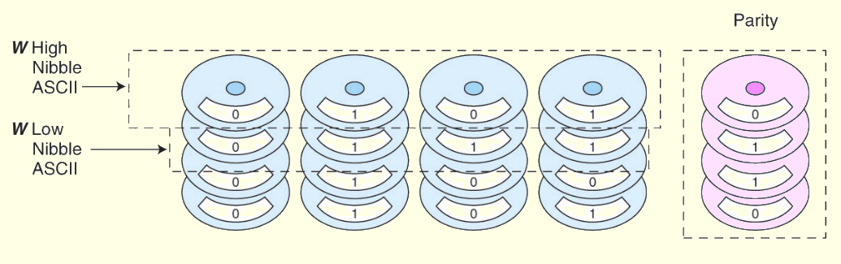
7.9 RAID
RAID Level 3 stripes bits across a set of data drives and provides a separate disk for parity.
  Parity is the XOR of the data bits.
  RAID 3 is not suitable for commercial applications, but is good for personal systems.

Slide 51
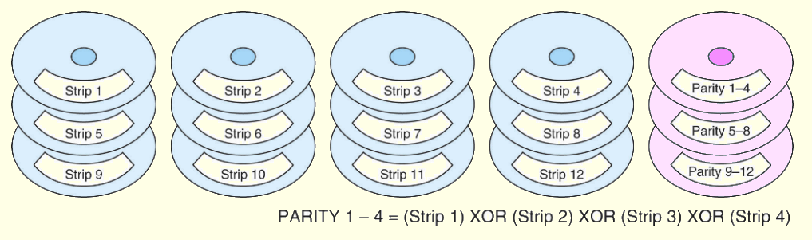
7.9 RAID
RAID Level 4 is like adding parity disks to RAID 0.
  Data is written in blocks across the data disks, and a parity block is written to the redundant drive.
  RAID 4 would be feasible if all record blocks were the same size.

Slide 52
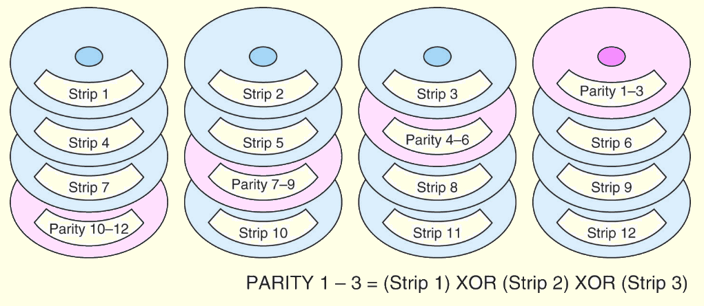
7.9 RAID
RAID Level 5 is RAID 4 with distributed parity.
  With distributed parity, some accesses can be serviced concurrently, giving good performance and high reliability.
  RAID 5 is used in many commercial systems.

Slide 53
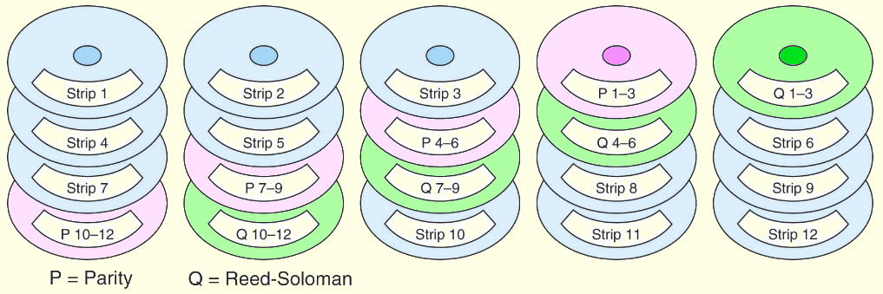
7.9 RAID
RAID Level 6 carries two levels of error protection over striped data: Reed-Soloman and parity.
  It can tolerate the loss of two disks.
  RAID 6 is write-intensive, but highly fault-tolerant.

Slide 54
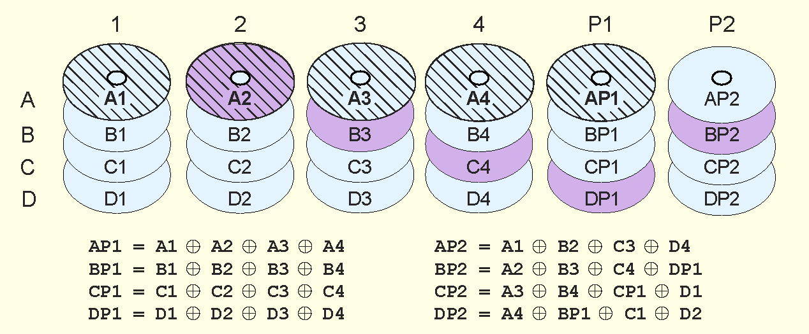
7.9 RAID
Double parity RAID (RAID DP) employs pairs of over- lapping parity blocks that provide linearly independent parity functions.

Slide 55
7.9 RAID
Like RAID 6, RAID DP can tolerate the loss of two disks.
The use of simple parity functions provides RAID DP with better performance than RAID 6.
Of course, because two parity functions are involved, RAID DP’s performance is somewhat degraded from that of RAID 5.
  RAID DP is also known as EVENODD, diagonal parity RAID, RAID 5DP, advanced data guarding RAID (RAID ADG) and-- erroneously-- RAID 6.

Slide 56
7.9 RAID
Large systems consisting of many drive arrays may employ various RAID levels, depending on the criticality of the data on the drives.
  A disk array that provides program workspace (say for file sorting) does not require high fault tolerance.
Critical, high-throughput files can benefit from combining RAID 0 with RAID 1, called RAID 10.
Keep in mind that a higher RAID level does not necessarily mean a “better” RAID level. It all depends upon the needs of the applications that use the disks.

Slide 57
7.10 The Future of Data Storage
Advances in technology have defied all efforts to define the ultimate upper limit for magnetic disk storage.
  In the 1970s, the upper limit was thought to be around 2Mb/in².
  Today’s disks commonly support 20Gb/in².
Improvements have occurred in several different technologies including:
  Materials science
  Magneto-optical recording heads.
  Error correcting codes.

Slide 58
7.10 The Future of Data Storage
As data densities increase, bit cells consist of proportionately fewer magnetic grains.
There is a point at which there are too few grains to hold a value, and a 1 might spontaneously change to a 0, or vice versa.
This point is called the superparamagnetic limit.
  In 2006, the superparamagnetic limit is thought to lie between 150Gb/in² and 200Gb/in² .
Even if this limit is wrong by a few orders of magnitude, the greatest gains in magnetic storage have probably already been realized.

Slide 59
7.10 The Future of Data Storage
Future exponential gains in data storage most likely will occur through the use of totally new technologies.
Research into finding suitable replacements for magnetic disks is taking place on several fronts.
Some of the more interesting technologies include:
  Biological materials
  Holographic systems and
  Micro-electro-mechanical devices.

Slide 60
7.10 The Future of Data Storage
Present day biological data storage systems combine organic compounds such as proteins or oils with inorganic (magentizable) substances.
Early prototypes have encouraged the expectation that densities of 1Tb/in² are attainable.
Of course, the ultimate biological data storage medium is DNA.
  Trillions of messages can be stored in a tiny strand of DNA.
Practical DNA-based data storage is most likely decades away.

Slide 61
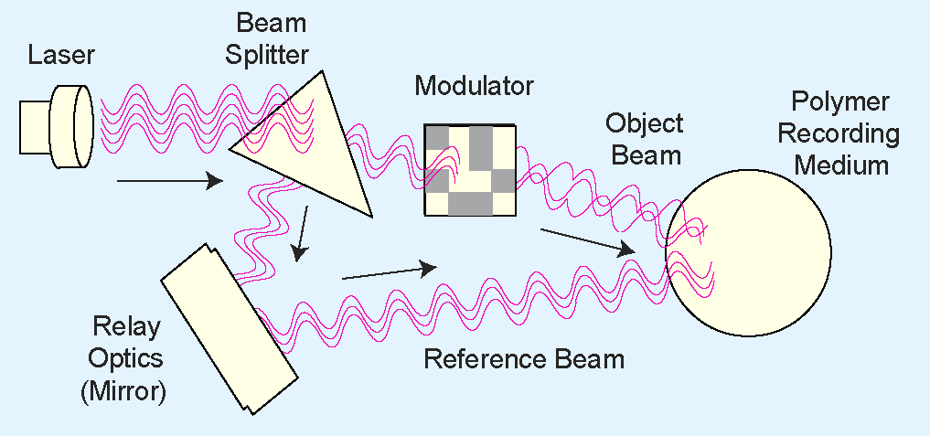
7.10 The Future of Data Storage
Holographic storage uses a pair of laser beams to etch a three-dimensional hologram onto a polymer medium.

Slide 62
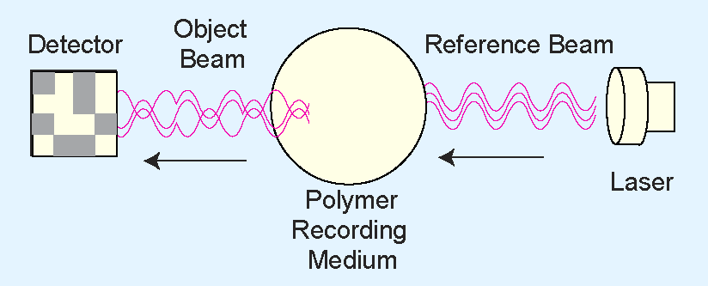
7.10 The Future of Data Storage
Data is retrieved by passing the reference beam through the hologram, thereby reproducing the original coded object beam.

Slide 63
7.10 The Future of Data Storage
Because holograms are three-dimensional, tremendous data densities are possible.
Experimental systems have achieved over 30Gb/in², with transfer rates of around 1GBps.
In addition, holographic storage is content addressable.
  This means that there is no need for a file directory on the disk. Accordingly, access time is reduced.
The major challenge is in finding an inexpensive, stable, rewriteable holographic medium.

Slide 64
7.10 The Future of Data Storage
Micro-electro-mechanical storage (MEMS) devices offer another promising approach to mass storage.
IBM’s Millipede is one such device.
Prototypes have achieved densities of 100Gb/in² with 1Tb/in² expected as the technology is refined.
A photomicrograph of Millipede is shown on the next slide.

Slide 65
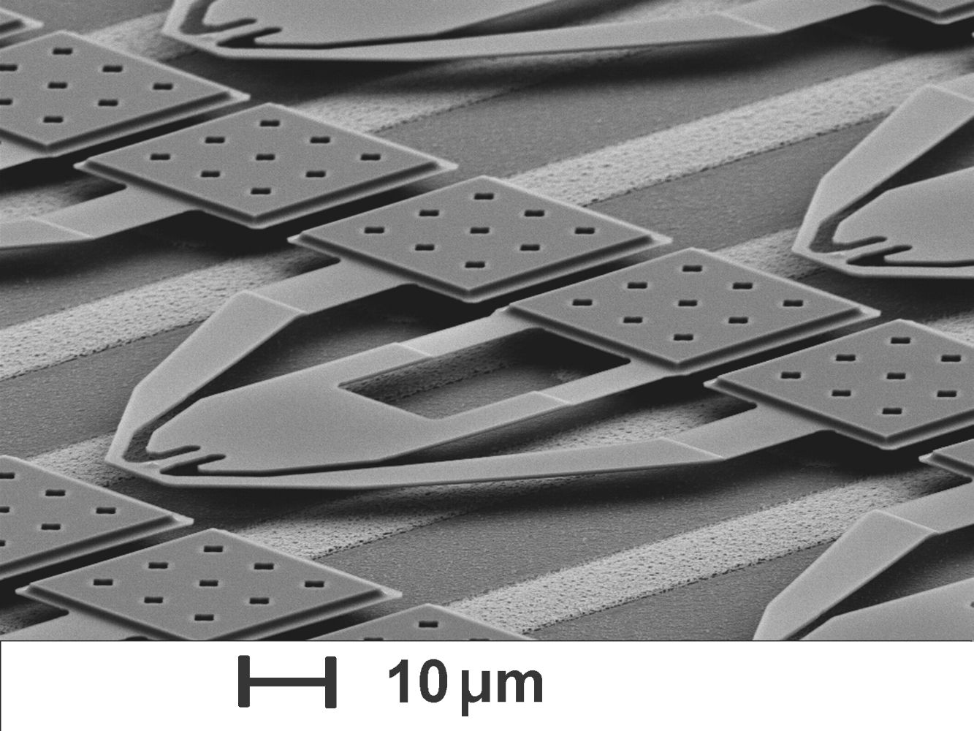
7.10 The Future of Data Storage
Millipede consists of thousands of cantilevers that record a binary 1 by pressing a heated tip into a polymer substrate.
The tip reads a binary 1 when it dips into the imprint in the polymer
Photomicrograph courtesy of the IBM Corporation.
© 2005 IBM Corporation

Slide 66
Chapter 7 Conclusion
I/O systems are critical to the overall performance of a computer system.
Amdahl’s Law quantifies this assertion.
I/O systems consist of memory blocks, cabling, control circuitry, interfaces, and media.
I/O control methods include programmed I/O, interrupt-based I/O, DMA, and channel I/O.
Buses require control lines, a clock, and data lines. Timing diagrams specify operational details.

Slide 67
Chapter 7 Conclusion
Magnetic disk is the principal form of durable storage.
Disk performance metrics include seek time, rotational delay, and reliability estimates.
Optical disks provide long-term storage for large amounts of data, although access is slow.
Magnetic tape is also an archival medium. Recording methods are track-based, serpentine, and helical scan.

Slide 68
Chapter 7 Conclusion
RAID gives disk systems improved performance and reliability. RAID 3 and RAID 5 are the most common.
RAID 6 and RAID DP protect against dual disk failure, but RAID DP offers better performance.
Any one of several new technologies including biological, holographic, or mechanical may someday replace magnetic disks.
The hardest part of data storage may be end up be in locating the data after it’s stored.

Slide 69
End of Chapter 7

