Slide 1
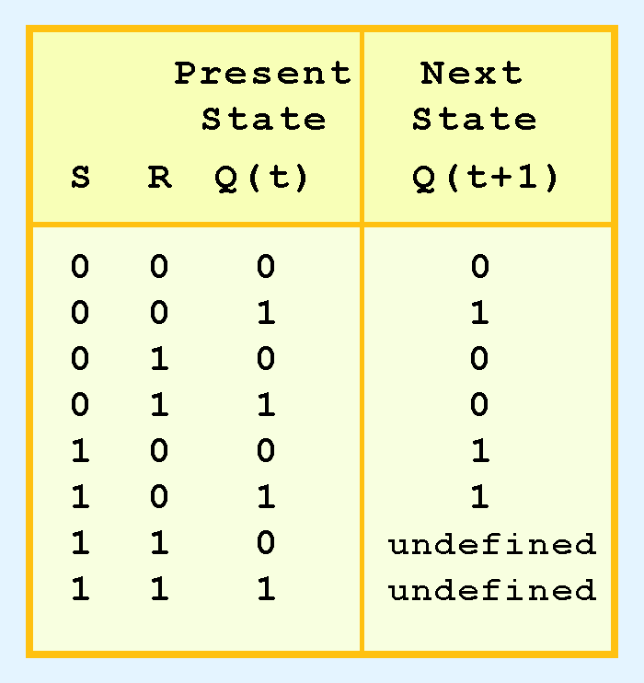
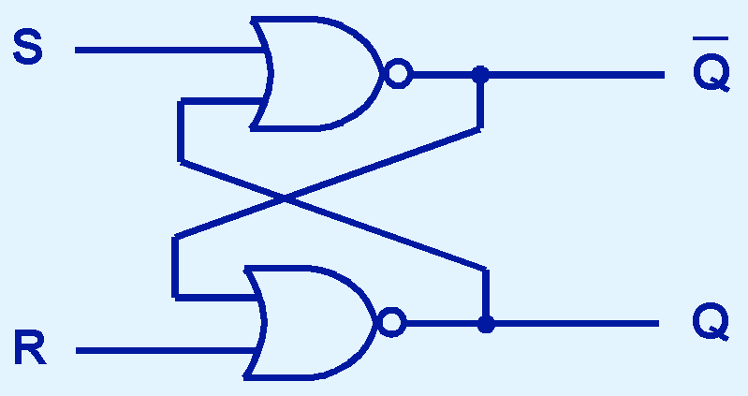
Puzzles for sequential circuits from Null & Lobur Chapter 3 powerpoint slides
(1) SR flip-flop

Slide 2
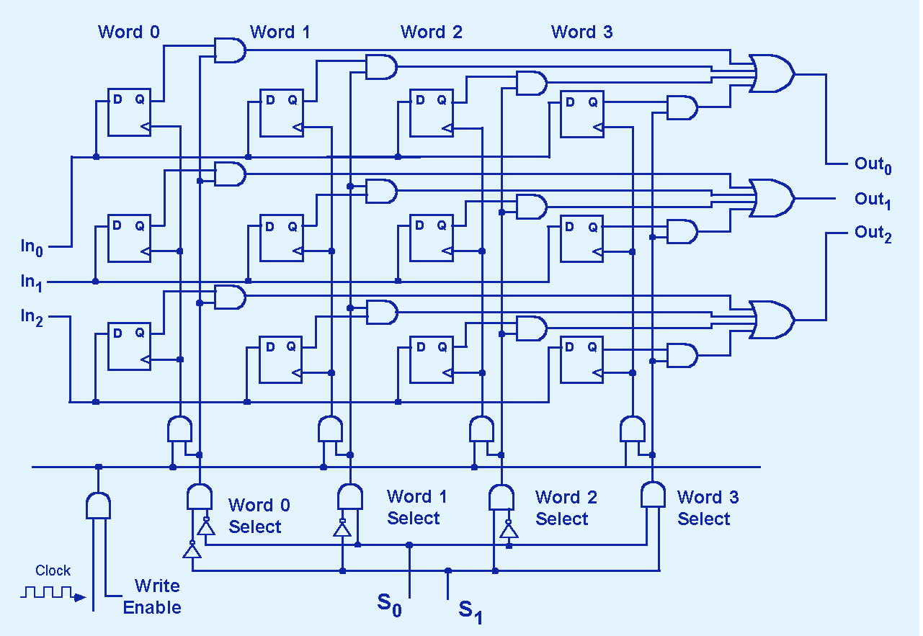
(2) 4-word memory with 3-bit words
What are outputs for given states?

Slide 3
(3) 4-word memory with 3-bit words, again
What are outputs for given states?

Slide 4
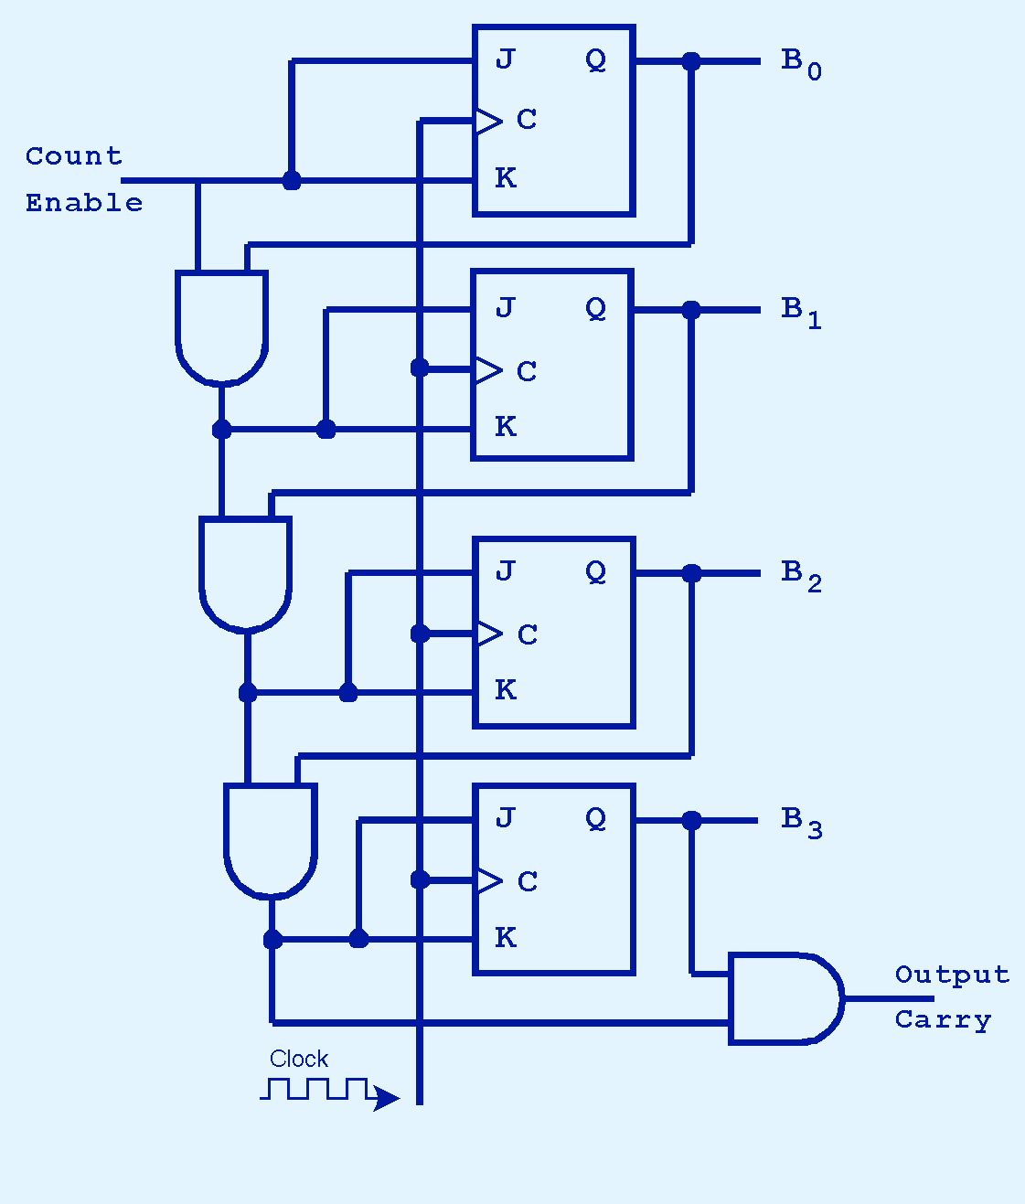
(4) 4-bit counter
Compute output for 8 clock cycles starting from given states

