Slide 1
An informal description of artificial neural networks
John MacCormick

Slide 2
Decision tree for “Should I take an umbrella?”

Slide 3
Schematic representation of a biological neuron

Slide 4
Neural network for “Should I take an umbrella?”

Slide 5
Objective: detect sunglasses
Source for sunglasses data and code: Tom Mitchell, Machine Learning, McGraw-Hill (1998).

Slide 6
We use an artificial neural network with a single hidden layer

Slide 7
Our artificial neurons compute a weighted sum followed by a non-linear threshold (actually a sigmoid)

Slide 8
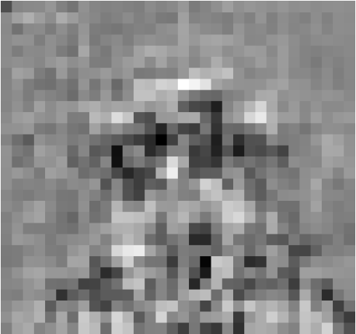
The weights of the inputs to each neuron are tuned to produce good results on the training set

Slide 9
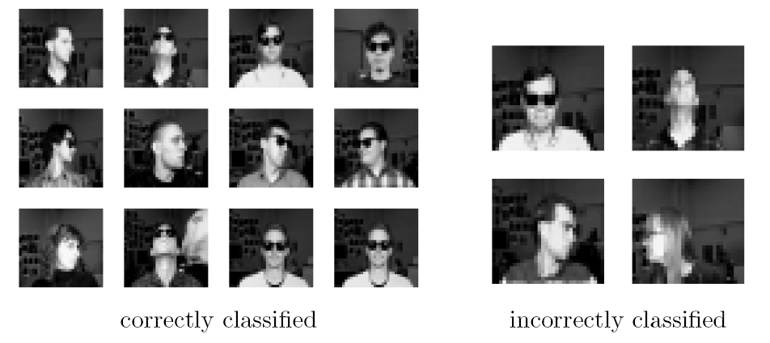
This experiment produced an 85% success rate for determining the presence of sunglasses

