Slide 1
Brief notes and exercises on non-classical search
These notes are not intended to make sense on their own. Please read them in conjunction with the textbook.

Slide 2
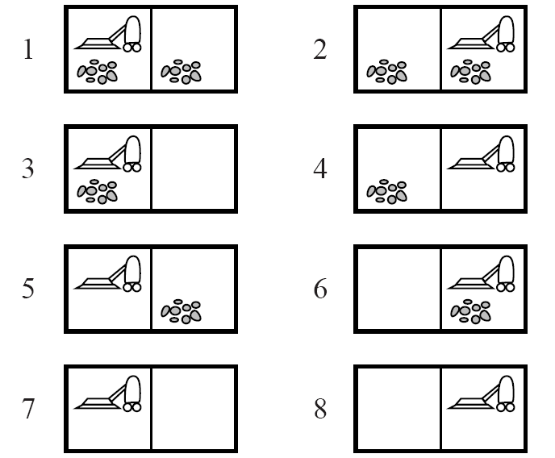
The eight possible states in the vacuum world

Slide 3
Types of non-classical search
Partial observations
Examples:
No sensors whatsoever (“sensorless”)
Local-only sensor (tells us our location and dirtiness of current location)
Nondeterministic
Examples:
Erratic vacuum world
Suck on a dirty square might clean adjacent one too
Suck on a clean square might deposit dirt there
Slippery vacuum world
Right or Left can fail
Nondeterministic and Partial observations
Examples:
Erratic, sensorless vacuum world
Slippery vacuum world with local-only sensor

Slide 4
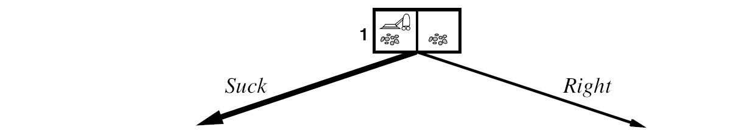
Exercise: assume we are in the slippery world. Complete the and-or tree below and indicate a strategy for reaching a goal state.
Hint: this need not technically be a tree. You can have edges that loop back to previous states.

Slide 5
Exercises for understanding belief states
Exercise A:
Draw the complete state-space graph for the belief states in a deterministic, sensorless vacuum world
Describe a strategy for reaching a goal state
Exercise B:
Draw the complete state-space graph for the belief states in a deterministic vacuum world with a local-only sensor. Assume initially we detect that the location is the left square, and it is dirty.
Describe a strategy for reaching a goal state.
Exercise C:
Draw part of the state-space graph for the belief states in a slippery vacuum world with a local-only sensor. Assume initially we detect that the location is the left square, and it is dirty.
Describe a strategy for reaching a goal state.

