Slide 1
#ScholarStrike

Slide 2
Social justice in computer science
#ScholarStrike has a particular focus on racialized violence. Here we examine some related social justice issues in the world of computer science.

Slide 3
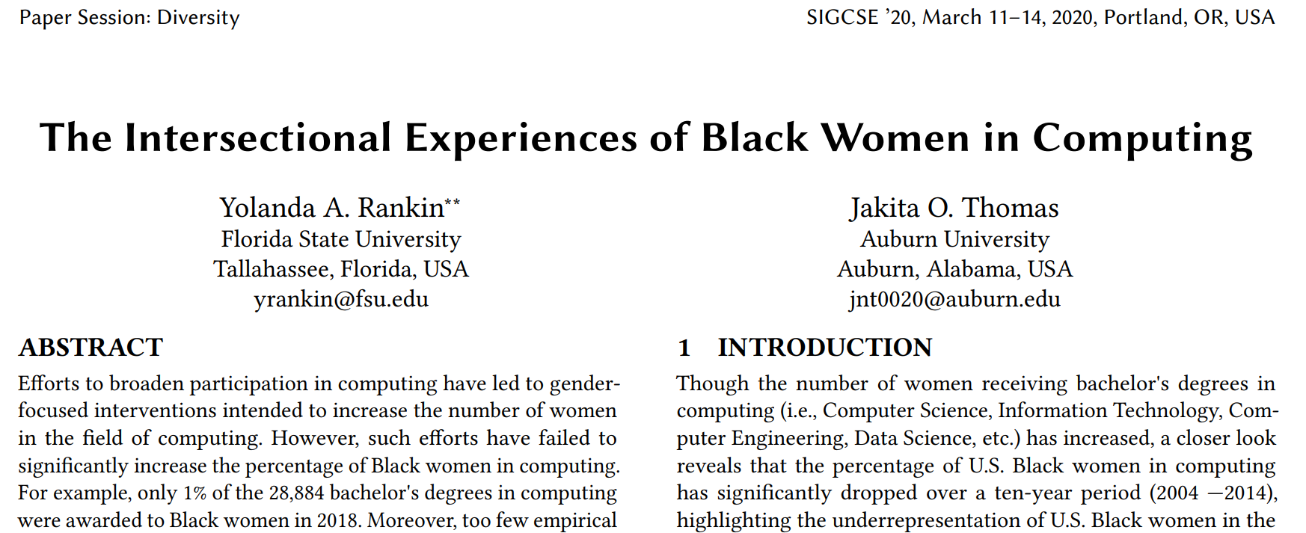
CS education research investigates ongoing problems with racial and gender equity
See the latest program for the top computer science education conference:
https://sigcse2020.sigcse.org/online/papers.html
Note sessions on diversity, mentoring, computing for social good

Slide 4
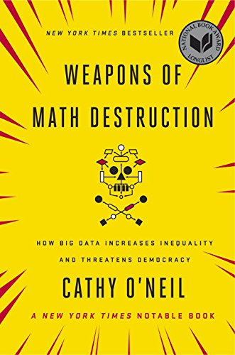
Machine learning research investigates implicit bias in algorithms
Black in AI
https://blackinai.github.io/
BAI 2019
Rediet Abebe
Timnit Gebru

