Slide 1
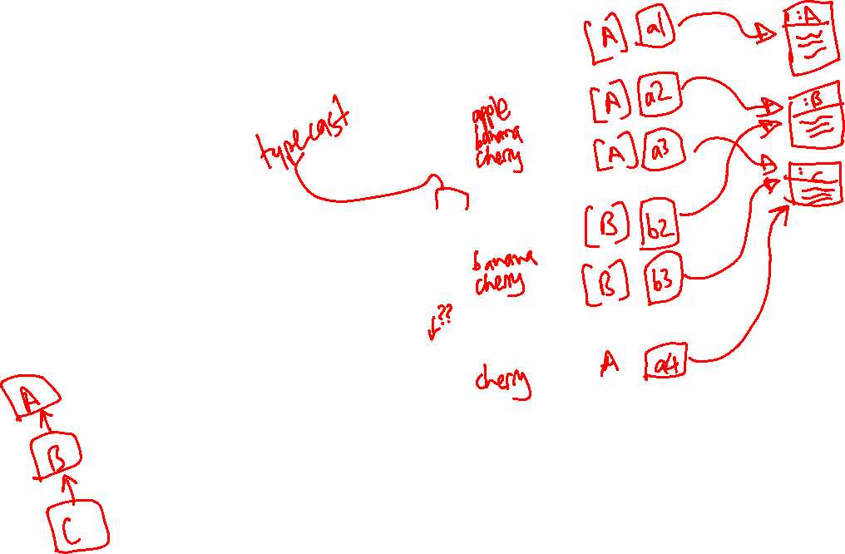
public class A {
public void print() {
System.out.println("apple");
}
}
A a1 = new A();
A a2 = new B();
A a3 = new C();
a1.print();
a2.print();
a3.print();
public class B extends A {
public void print() {
System.out.println("banana");
}
}
B b2 = (B) a2;
B b3 = (B) a3;
b2.print();
b3.print();
public class C extends B {
public void print() {
System.out.println("cherry");
}
}
A a4 = b3;
a4.print();

