Slide 1
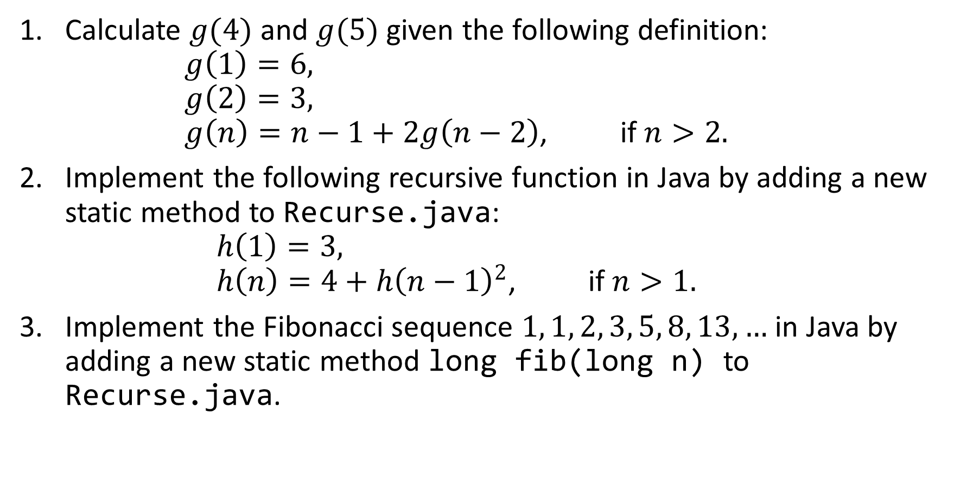
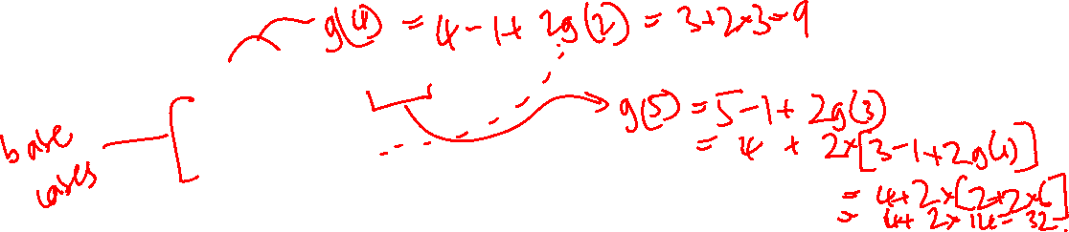
Calculate $g(4)$ and $g(5)$ given the following definition: $g\left(1\right)=6,$ $g\left(2\right)=3,$ $g\left(n\right)=n−1+2g\left(n−2\right)\text{, }\text{if} n>2.$
Implement the following recursive function in Java by adding a new static method to Recurse.java: $h\left(1\right)=3,$ $h\left(n\right)=4+{h\left(n−1\right)}^{2}\text{, }\text{if} n>1.$
Implement the Fibonacci sequence $1, 1, 2, 3, 5, 8, 13,…$ in Java by adding a new static method long fib(long n) to Recurse.java.

