Slide 1

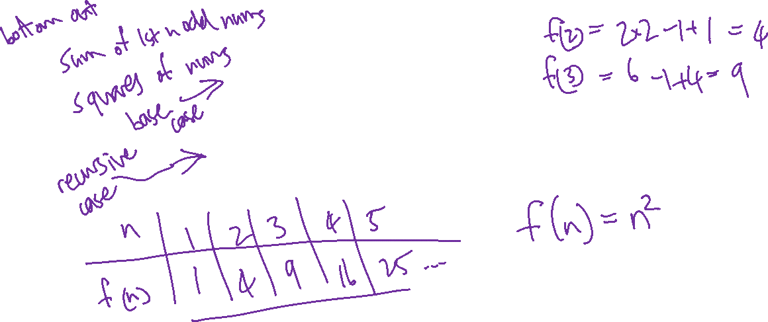


Review: what well-known mathematical function is defined by this recursive definition:

Slide 2
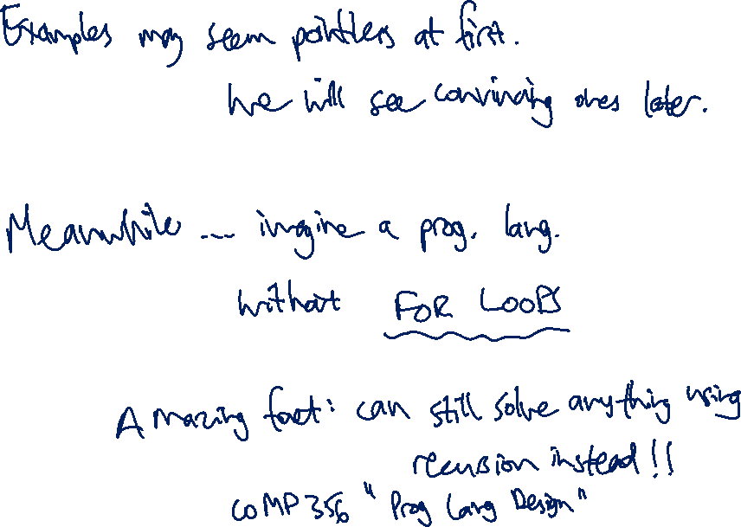

Slide 3

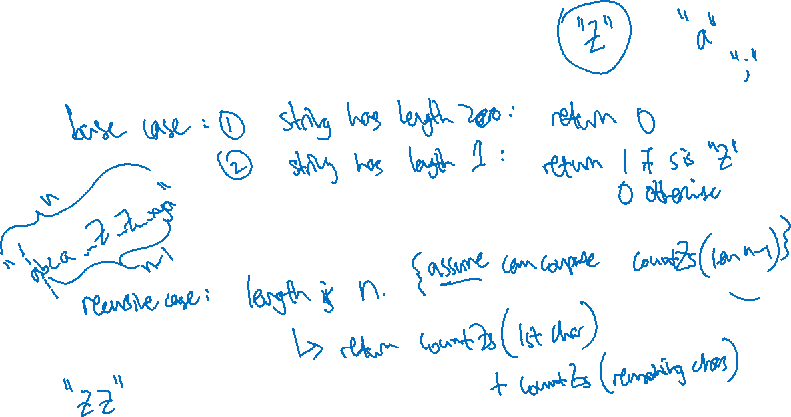

Slide 4
