Slide 1
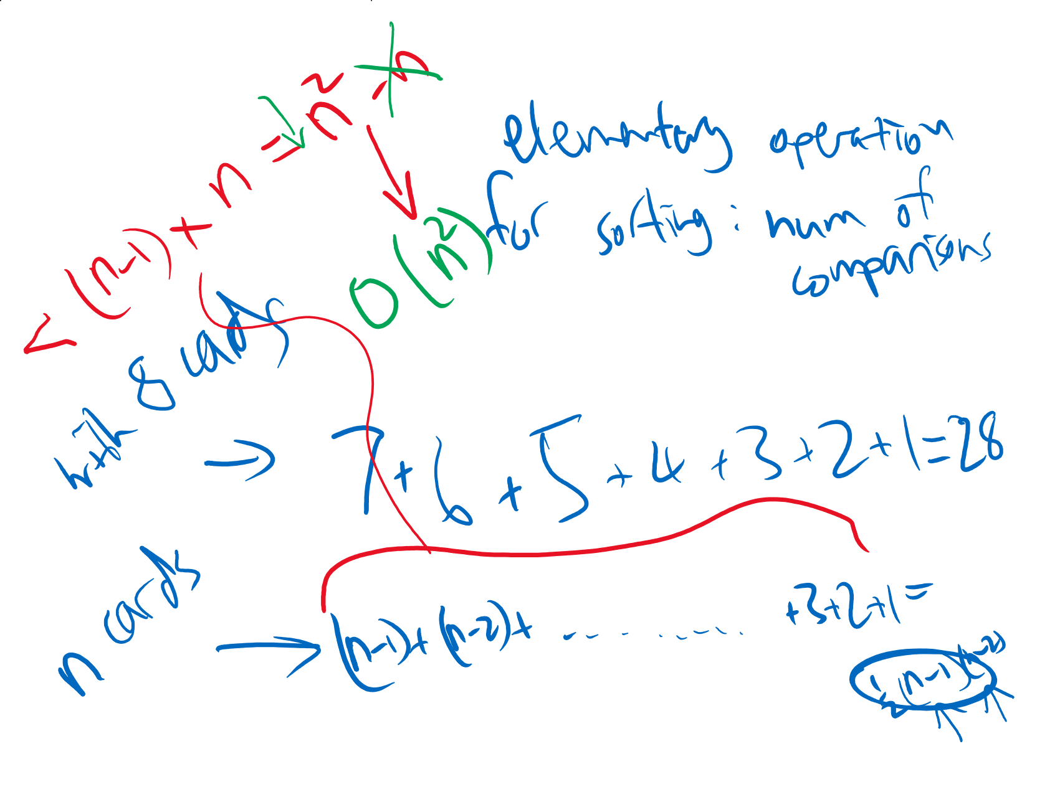
Asymptotic analysis of selection sort

Slide 2
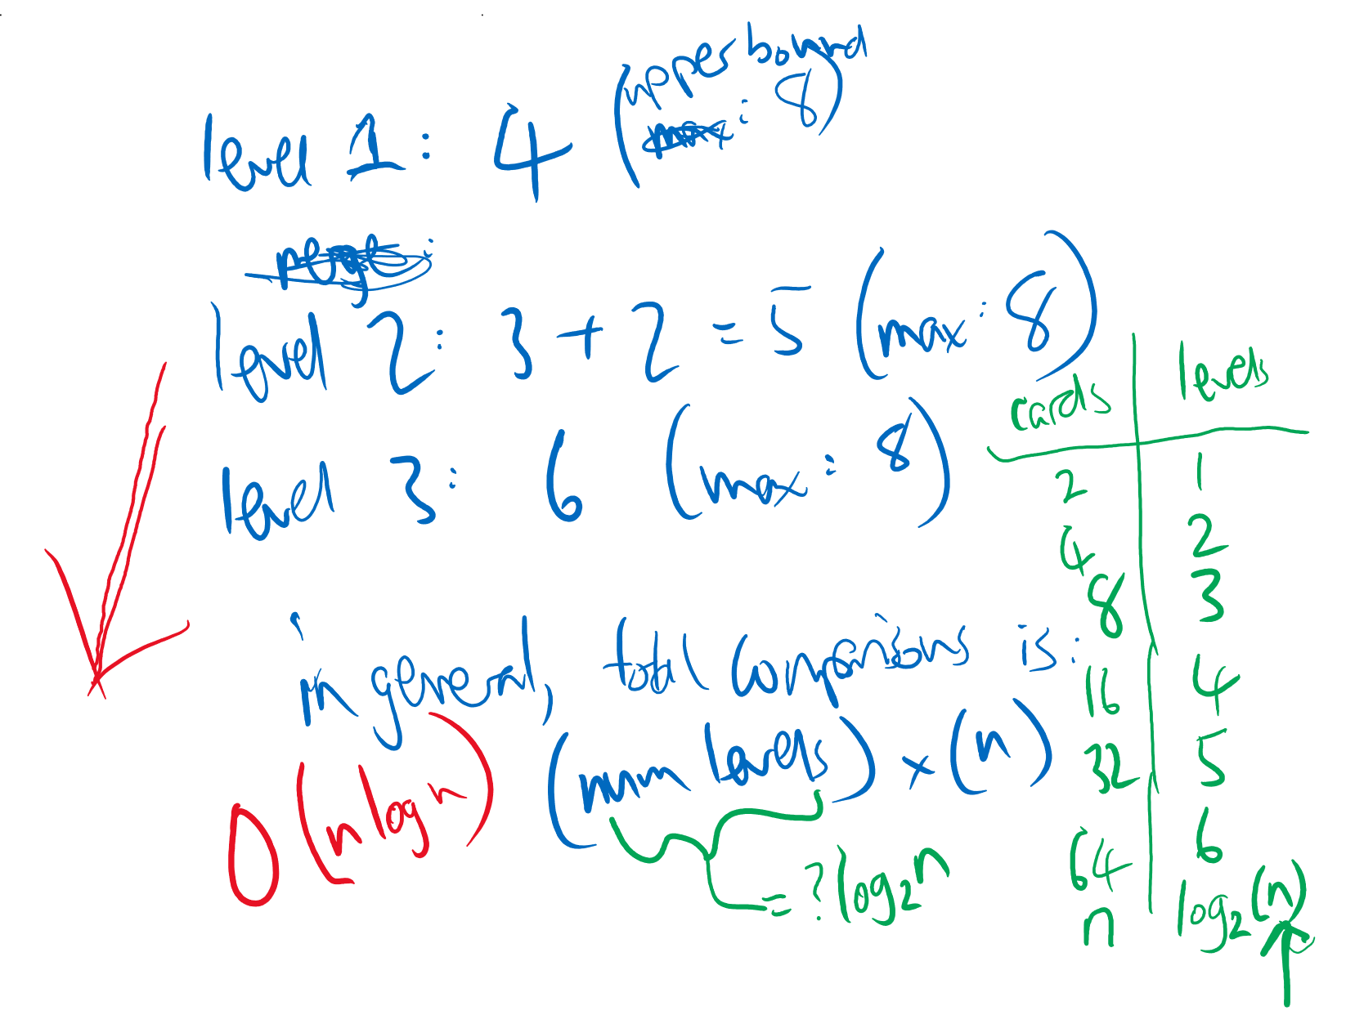
Asymptotic analysis of merge sort

