Slide 1
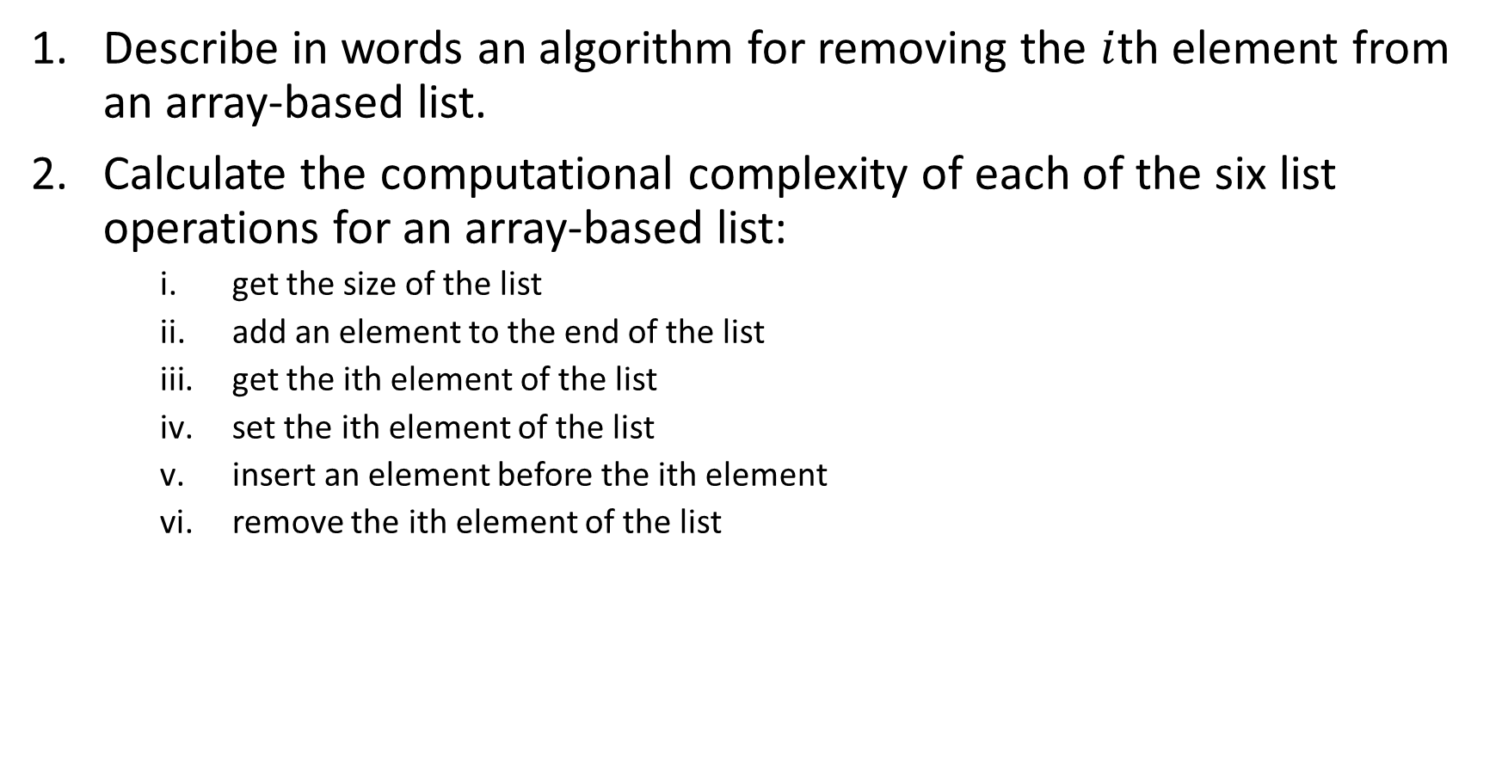
Describe in words an algorithm for removing the $i$th element from an array-based list.
Calculate the computational complexity of each of the six list operations for an array-based list:
get the size of the list
add an element to the end of the list
get the ith element of the list
set the ith element of the list
insert an element before the ith element
remove the ith element of the list

