Slide 1
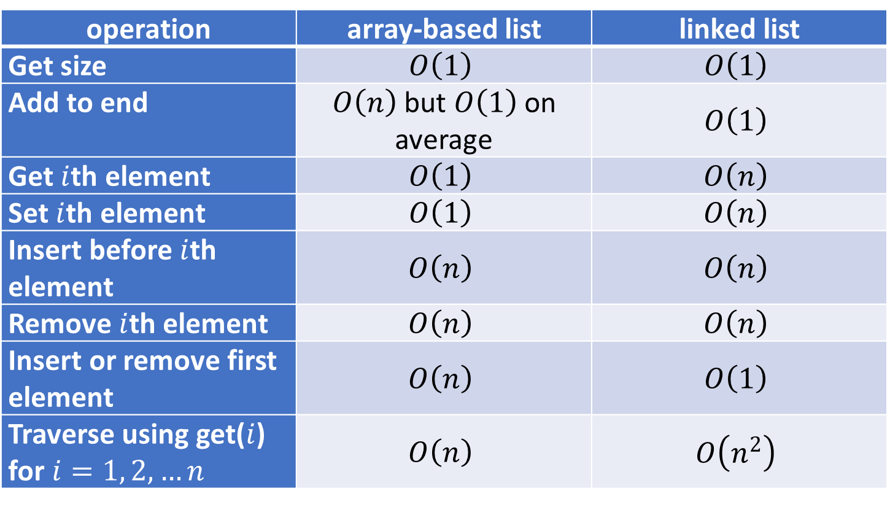

operation | array-based list | linked list
Get size | $$O\left(1\right)$$ | $$O\left(1\right)$$
Add to end | $O\left(n\right)$ but $O\left(1\right)$ on average | $$O\left(1\right)$$
Get $i$th element | $$O\left(1\right)$$ | $$O\left(n\right)$$
Set $i$th element | $$O\left(1\right)$$ | $$O\left(n\right)$$
Insert before $i$th element | $$O\left(n\right)$$ | $$O\left(n\right)$$
Remove $i$th element | $$O\left(n\right)$$ | $$O\left(n\right)$$
Insert or remove first element | $$O\left(n\right)$$ | $$O\left(1\right)$$
Traverse using get($i$) for $i=1, 2, …n$ | $$O\left(n\right)$$ | $$O\left(n^{2}\right)$$

Slide 2
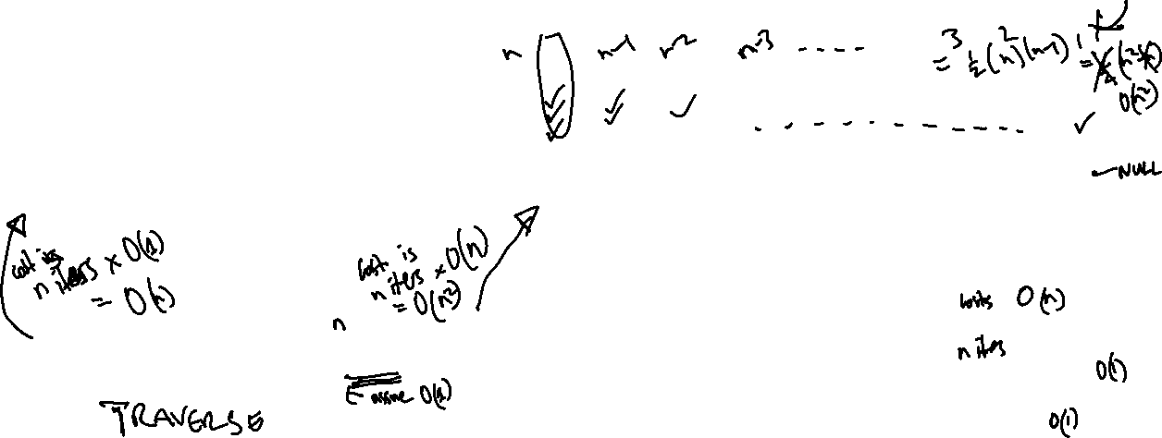
List traversal can be expensive if it's not done right
for (int i = 0; i < list.size(); i++) {
Object object = list.get(i);
doSomething(object);
}
LinkedNode current = head;
while (current != null) {
doSomething(current.getElement());
current = current.getNext();
}

