Slide 1
Computer Science
What is Computer Science?
  Algorithm Design and Analysis
  Organization and Architecture
  Artificial Intelligence
  Databases
  Operating Systems
  Programming Languages
  Theory of Computation
  Networking
Notes:
All of what I’m going to talk about is also contained in the links on the web page for today. So you can find it all there later too. So no need to write everything down.
Instead pay attention, think about what we are doing, ask questions. Go back later and review the details.
Algorithm Design and Analysis = finding better ways to solve problems (less time / less storage)
Organization and Architecture = design faster / smaller / more powerful machines.
Artificial Intelligence = develop techniques by which machines exhibit ability to reason. E.g. (face, speech, handwriting) recognition, game playing (chess), medical diagnosis
Database = efficient storage and retrieval of massive amounts of information
Operating Systems = Making computers easier to use and easier to develop software for.
Programming Languages = (design, implementation, analysis) of languages for programming computers.
Theory of Computation = what problems computers can and can’t solve.
Networking = communication between computers. E.g. Internet, web, IM, email etc.
If you continue in CS you’ll see courses on all of these things and probably some more.
This class starts out with a little organization and architecture; To give you an idea of how computers work on the inside.
We’ll spend most of our time learning the basics of programming
That is writing down sequences of instructions for the computer in a language that it understands.
In learning to program this semester we’ll use some examples that come from some of these areas:
Artificial Intelligence: We’ll create a blackjack player, strategies for trading stocks, a virtual pet, simulate evolution.
Programming Languages: We’ll write a program that interprets a simple programming language that controls a simulated robot.
Databases: We’ll develop part of a digital music library and MP3 player.

Slide 2
History of Computing
When was the first computing device invented?
  Depends what is meant by “Computing Device”
    Abacus (2400 BC)
    Napier’s Bones (1615)
    Slide Rule (1630)
  Automatic Computers
Notes:
But let’s go back and start from the beginning.
Abacus - addition and subtraction
Napier’s Bones - mechanical method for doing multiplication and division.
Slide Rule - addition/subtraction/multiplication/division/logarithms

Slide 3
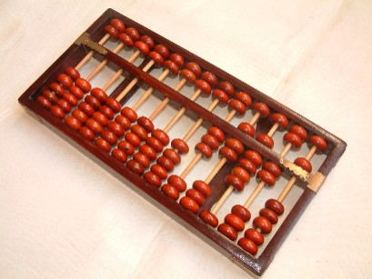
Abacus

Slide 4
History of Computing
The history of computing is usually divided into generations:
  Mechanical Era / Generation 0 (1623-1945)
  First Generation (1937-1953)
  Second Generation (1954-1962)
  Third Generation (1963-1972)
  Fourth Generation (1972-1984)
  Fifth Generation (1984-1990)
  Sixth Generation (1990-????)
Notes:
Dates are not really important…. Look at 5 websites and you’ll find 5 different sets of dates. Even some overlap with gen 0 and gen 1.
Instead each generations is defined by the introduction of a new technology that revolutionized how computers were build and lead to revolutionary changes in the performance of computers.
As we go through each generation we’ll consider two features of the machines:
We’ll look at the technology used to construct the machines and how it affected the computer.
We’ll also look at how computers in each generation were programmed.
In addition we’ll see some representative machines from each generation and meet some of the influential people.

Slide 5
Mechanical Era (1623-1945)
Analog Machines
Digital Machines
Notes:
Two distinct types of machines in this era… sometimes called genration 0.

Slide 6
Mechanical Era (1623-1945)
Analog machines
  Shafts and Gears
    Pascaline (1642)
    Analytical Engine (1842)
      First programmable machine
  Shafts and gears lead to accumulation of error.
Notes:
Difficulty of positioning shafts and gears precisely leads to the accumulation of error.
If the first gear is off by a little bit then the next one will be off by a little more and so on and so forth.
Eventually, if enough gears are needed to perform a long calculation then the end result will contain so much errs as not to be useful.
Similar to the old “telephone” game…

Slide 7
Mechanical Era (1623-1945)
Digital Machines
  Electromechanical Relays
    Computing based on switches turning on and off.
      Eliminates accumulation of error.
      Basis for all modern computing.
    Harvard Mark I (1944)
  Programming:
    Punch Cards and Paper Tapes
Notes:
On and off is a lot less error prone than positioning a gear to a specific location
With digital machines error doesn’t build up that way (on is on, off is off)
Making it much easier to build long chains of computation.

Slide 8
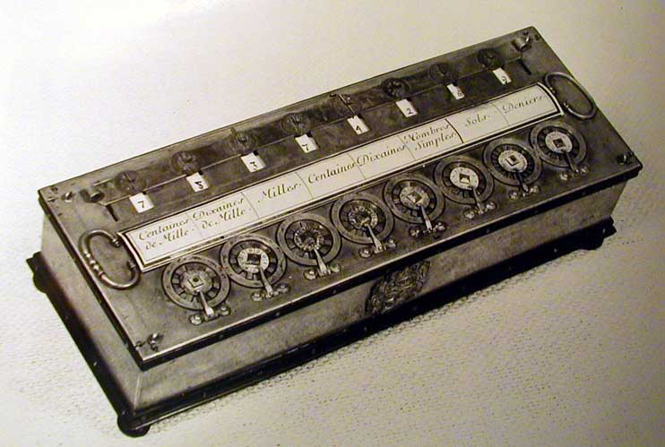
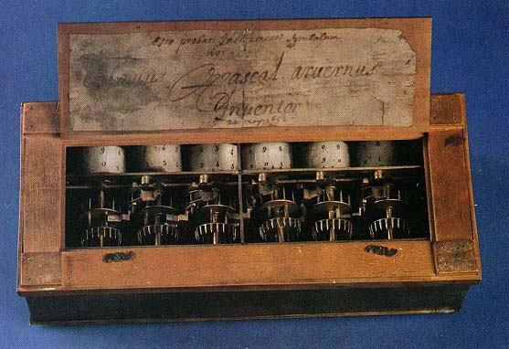
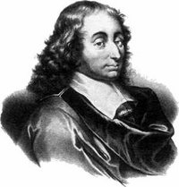
Pascaline
Blaise
Pascal
Notes:
Invented by Blaise Pascal
For his father to use for tax calculations.
Not programmable in modern sense of the word:
Programmed by physically turning dials which turned gears inside.
“Program instructions” were “in the user’s head”
Every time the program was run, the user had to execute the instructions.
Pascal:
pascal programming language
pascal’s triangle
pascal’s wager

Slide 9
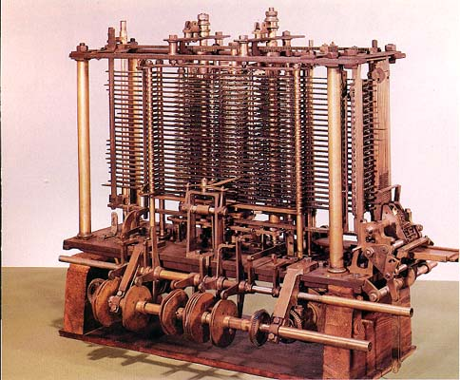
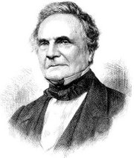
Analytical Engine (1842)
Charles
Babbage
Notes:
Similar idea to the pascaline in that it used Gears and spindles
Much larger, more sophisticated and more general purpose.
First programmable machine: Program instructions were stored on copper plates
Resubmit copper plate every time to run the program again (Automatic computation)
Steam driven
Never fully constructed at the time (machining was not precise enough)
A predecessor, the Difference Engine was built and could solve differential equations
Created by Charles Babbage - also purported to be a bookie.

Slide 10
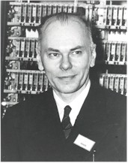
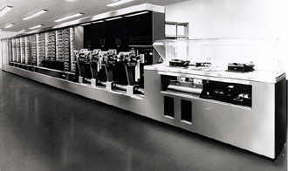
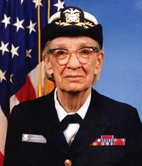

Harvard Mark I
Howard
Aiken
Grace
Hopper

Slide 11
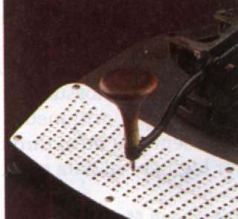
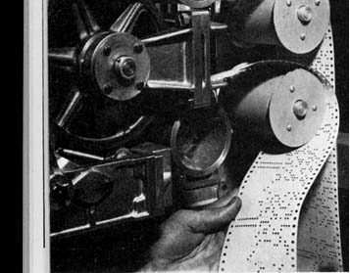
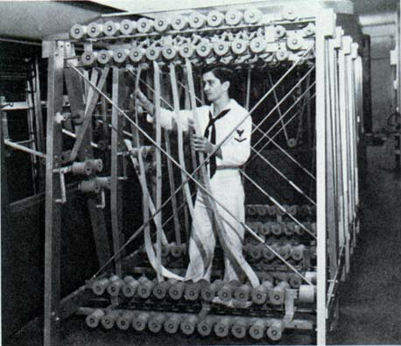
Punch Cards and Paper Tape
Notes:
Machines programmed by punching holes at appropriate places and in appropriate patterns on cards or tape.
Run the tape through the machine to run the program.
To run the program again, run the tape through the machine again.

Slide 12
First Generation (1937-1953)
Vacuum Tubes
  Exactly the same functionality as a relay
    Fully electronic
      No moving parts
      Faster than relays
    EDVAC (1948)
      Stored Program

Slide 13
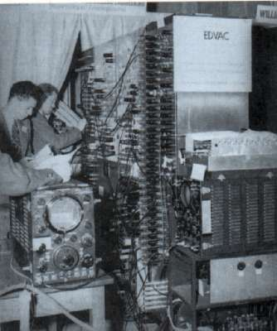
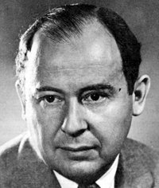
EDVAC
John
von Neumann
Notes:
Stored Program = both program instructions and data were stored in the computer’s memory.
Program loaded in from paper tape or punched cards
But once loaded could be run over and over again.
First time!
Reported that when these machines were fired up they consumed so much power that the lights would dim in the part of the city where they were located.

Slide 14
Second Generation (1954-1962)
Discrete transistors
  Same functionality as a vacuum tube
    Smaller, faster, cheaper, more reliable
  First commercial computers
    IBM (1954)
  High Level Programming Languages
    Fortran (1955) / Cobol (1959)
Notes:
Example of HLL code…

Slide 15
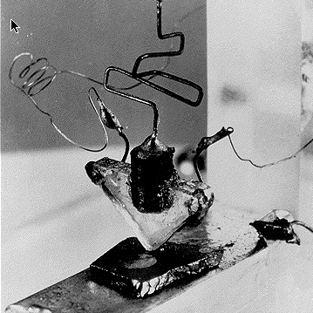
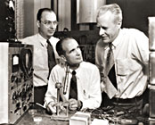
First Transistor (1947)
John Bardeen
Walter Brattain
William Shockley
Notes:
Nobel prize in 1956.

Slide 16
More Generations
Third Generation (1963-1972)
  Integrated Circuits (10-1000 transistors / chip)
Fourth Generation (1972-1984)
  Very Large Scale Integration
  (VLSI = 1k to 100k transistors / chip)
  Personal Computing
Fifth Generation (1984-1990)
  Improved VLSI (100k to 1M transistors / chip)
  Parallel processing / Networking
Sixth Generation (1990-????)
  Ultra LSI (10M to 100M transistors / chip)
  Multiprocessors / Internet
Notes:
More and more transistors packed into smaller and smaller spaces.

Slide 17
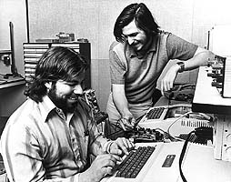
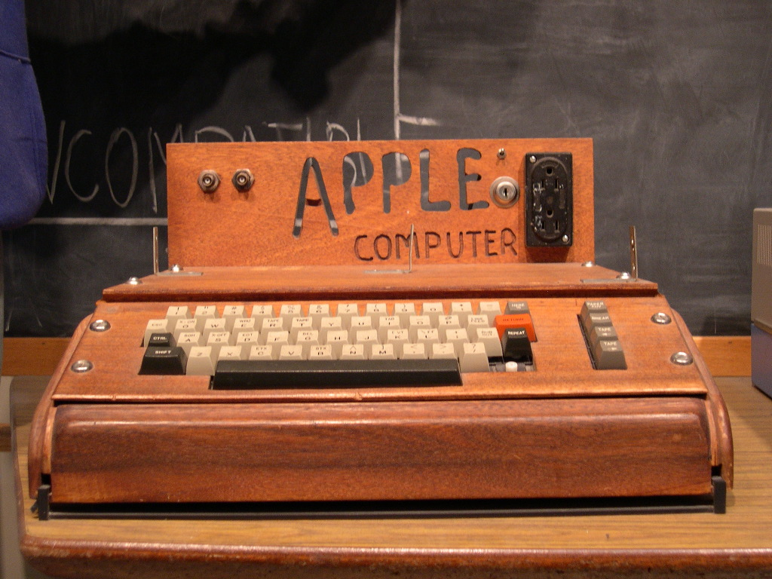
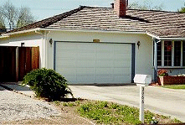
Apple I Computer (1976)
Steve Jobs
Steve Wozniak
Notes:
Also IBM PC 1981.

Slide 18
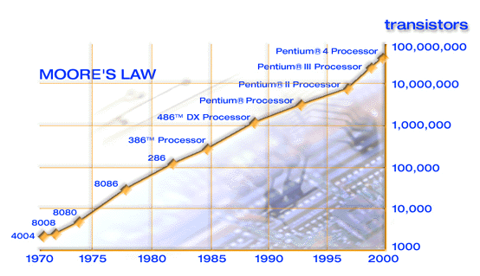

Moore’s Law
“the density of silicon chips doubles every 18 months.”
  Intel Founder, Gordon Moore (1965)
Notes:
2005 Pentium D - 230 million transistors
90nm features = 10 million of them lined up side by side would be about 1 meter long.
Corollary: The power of computers doubles every 18 months.
Corollary: The computer I want always costs the same amount

Slide 19
Programming Languages
Fortran – 1956
COBOL – 1960
Lisp -1960
Basic – 1966
C – 1973
C++ - 1981
Java – 1995
And hundreds more

Slide 20
Internet
Started by ARPA (DOD) – 1969
WWW – 1993
E-commerce – 1996
Over a billion users - 2010

