Slide 1
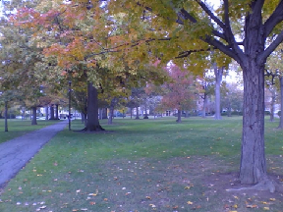
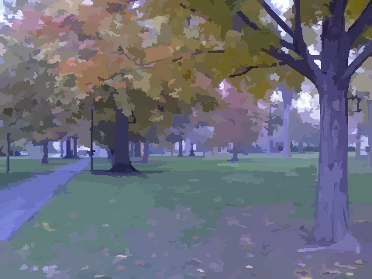


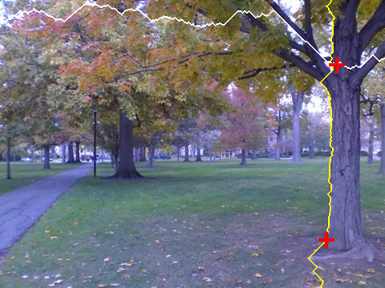
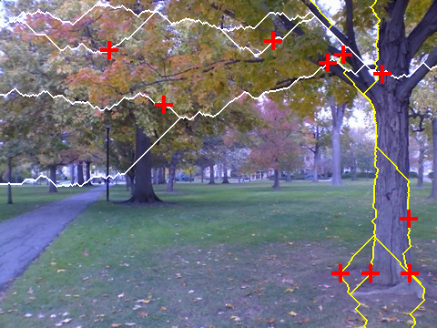
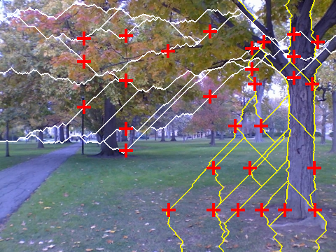
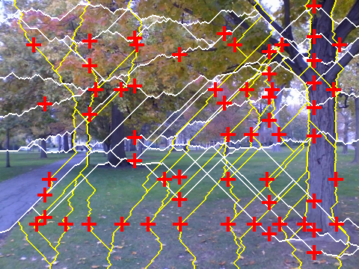
Fast Superpixels for Video Analysis
Fabio Drucker and John MacCormick (Dickinson College, Pennsylvania)
1. Background
• Instead of analyzing video using tens of thousands of pixels in each frame, would like to restrict analysis to about 1000 superpixels in each frame:
• Popular existing superpixel algorithms use 2D, region-based approaches that are too slow for real-time video analysis
• In fact, superpixels can be computed using 1D dynamic programming approaches that are much faster
– Seam carving (Avidan & Shamir 2007), superpixel lattices (Moore et. al 2008), and PathFinder (this poster) are all examples of the 1D dynamic programming approach
2. Main result
3. PathFinder: example of a 1D approach to superpixels
4. Results:
• Compare with the fastest known 2D approach: “Efficient Graph-Based Image Segmentation” (EGBIS), Felzenszwalb & Huttenlocher 2004.
• Assess accuracy using “mean accuracy” of Moore et. al 2008, which compares with human segmentations
• PathFinder is about 3% less accurate:
• PathFinder is 30-40 times faster:
Compute edge strengths from a cheap Sobel-like operator
Build approximately-vertical paths that follow strong edges. While more paths are needed:
2.1 Choose a seed point at a strong edge, not near an existing path
2.2 Grow the approximately vertical path with maximum total edge strength from seed
– very cheap via dynamic programming
– restrict path to deviate from vertical by at most 45°
Repeat step 2 for horizontal paths
The resulting deformed grid defines the boundaries of the superpixels
60,000 pixels
1200 superpixels
our 1D approach is:
PathFinder
EGBIS
3% less accurate
30-40 times faster
1 path
5 paths
. . . than fastest known 2D approach
Therefore, 1D superpixel approaches should be attractive for video analysis
15 paths
30 paths

