Slide 1
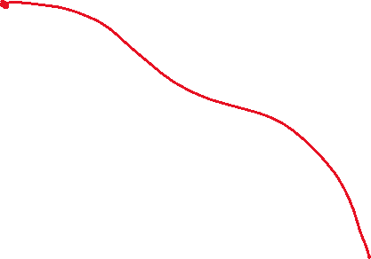


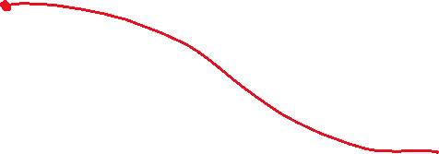
Object diagram
exampleStudent : Student
name: "Kazuo Ishiguro"
hubBox: 4474
homeAddress:
localAddress:
course1:
course2:
⋮
: Address
houseNumber: 552
streetName: "Pacific St"
⋮
: Address
houseNumber: 67
streetName: "Louther St"
⋮
: Course
name: "Introduction to Sculpture"
department: "ART"
⋮
: Course
name: "Galois Theory"
department: "MATH"
⋮

Slide 2




Class diagram
Student
Address
Course

