Slide 1
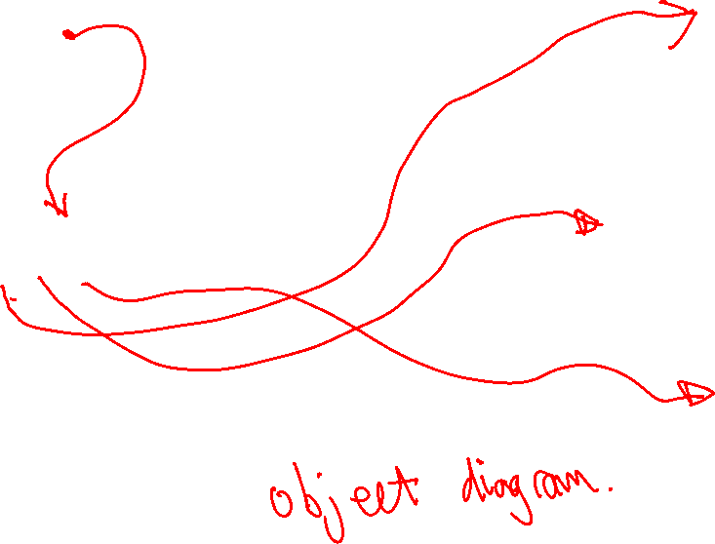
:VideoStore
storeName: "COMP132 Movies"
dvdList:
:DVD
title: "Fantastic Mr. Fox"
mpaaRating: "PG"
rentalLength: 7
nightsRented: 0
:DVD
title: "Isle of Dogs"
mpaaRating: "PG-13"
rentalLength: 7
nightsRented: 0
:ArrayList<DVD>
[0] [1] [2] [3] [4] ….
:DVD
title: "Avengers: Infinity War"
mpaaRating: "PG-13"
rentalLength: 2
nightsRented: 0

Slide 2
:VideoStore
storeName: "COMP132 Movies"
dvdList:
:DVD
title: "Fantastic Mr. Fox"
mpaaRating: "PG"
rentalLength: 7
nightsRented: 0
:DVD
title: "Isle of Dogs"
mpaaRating: "PG-13"
rentalLength: 7
nightsRented: 0
:ArrayList<DVD>
[0] [1] [2] [3] [4] ….
:DVD
title: "Avengers: Infinity War"
mpaaRating: "PG-13"
rentalLength: 2
nightsRented: 0

Slide 3
:VideoStore
storeName: "COMP132 Movies"
dvdList:
:DVD
title: "Fantastic Mr. Fox"
mpaaRating: "PG"
rentalLength: 7
nightsRented: 0
:DVD
title: "Isle of Dogs"
mpaaRating: "PG-13"
rentalLength: 7
nightsRented: 0
:ArrayList<DVD>
[0] [1] [2] [3] [4] ….
:DVD
title: "Avengers: Infinity War"
mpaaRating: "PG-13"
rentalLength: 2
nightsRented: 0

Slide 4
:VideoStore
storeName: "COMP132 Movies"
dvdList:
:DVD
title: "Fantastic Mr. Fox"
mpaaRating: "PG"
rentalLength: 7
nightsRented: 0
:DVD
title: "Isle of Dogs"
mpaaRating: "PG-13"
rentalLength: 7
nightsRented: 0
:ArrayList<DVD>
[0] [1] [2] [3] [4] ….
:DVD
title: "Avengers: Infinity War"
mpaaRating: "PG-13"
rentalLength: 2
nightsRented: 0

