Slide 1
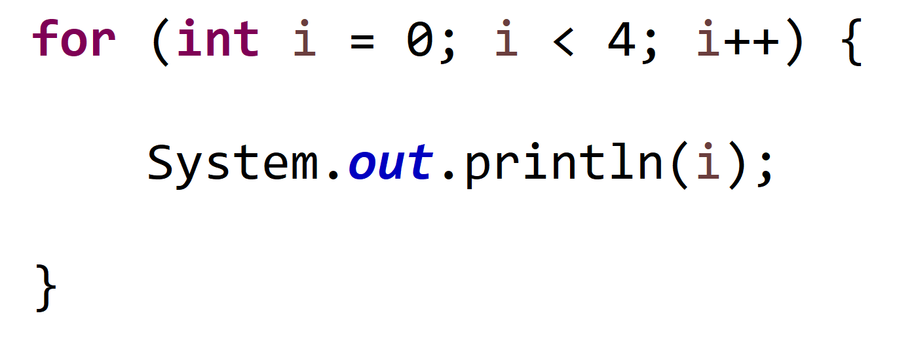


















loop initializer
loop condition
loop update
main loop
loop termination

Slide 2
loop initializer
loop condition
loop update

Slide 3
loop initializer
loop condition
loop update

