Slide 1
Change the Face of Computer Science
#BlackVoicesForCS
John MacCormick, Dickinson College
February 2021

Slide 2
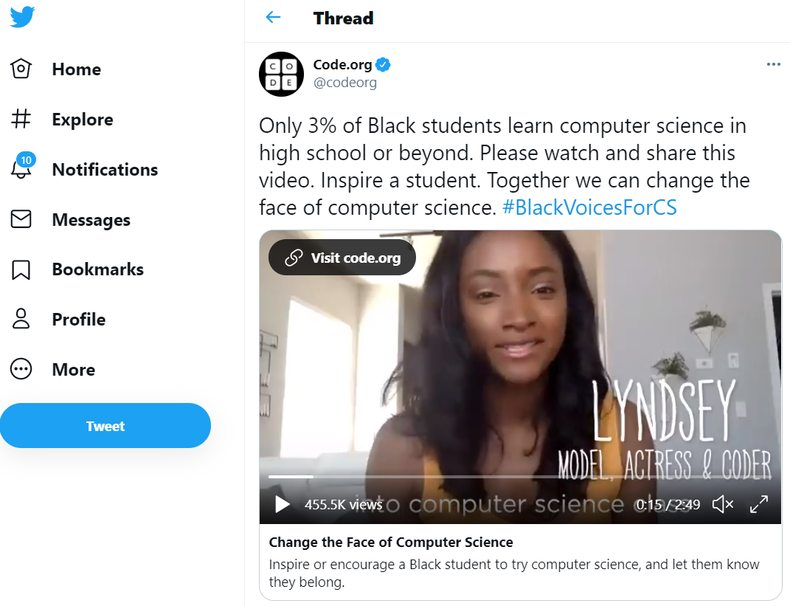
Change the Face of Computer Science
https://www.youtube.com/watch?v=uhcA6K8rWp0

Slide 3
Social justice in computer science

Slide 4
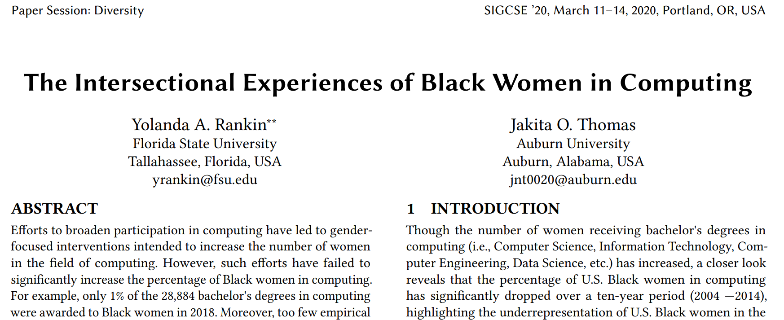
CS education research investigates ongoing problems with racial and gender equity
See the latest program for the top computer science education conference:
https://sigcse2020.sigcse.org/online/papers.html
Note sessions on diversity, mentoring, computing for social good

Slide 5

Machine learning research investigates implicit bias in algorithms
Black in AI
https://blackinai.github.io/
BAI 2019
Rediet Abebe
Timnit Gebru

