Slide 1
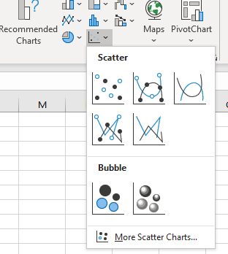


Instructions for timing an algorithm and graphing the results
Run the Java program that prints out your results, e.g. SelectionSort.java
Copy and paste the output into an Excel spreadsheet
Select the data you just pasted then create a scatterplot by choosing Insert | Charts | Scatter
Right click on one of the data points in the chart, choose Add trendline…
Try the various options to see which looks best: exponential, logarithmic, linear, polynomial
For polynomial, try order 2, 3, 4… and choose the lowest order that looks good
If desired, activate checkbox Display Equation on chart.

